Slide 1
VERISIGHT
Screenshot
forensic triage
4 review layers
Pixel • layout
Metadata • rules
How VeriSight checks payment screenshots—and what its results mean
ORIGINAL SCREENSHOT • BASELINE EVALUATION

Slide 2
WHY IT MATTERS
Why screenshot review matters
A screenshot can show payment details, but it is still an image. Reviewers need a repeatable way to inspect it.
01
EASY TO SHARE
02
CAN BE CHANGED
Payment screenshots move through chats and support workflows as convenient visual records.
Edits, crops and re-saving can alter what the image shows or how its pixels look.
03
SIGNALS ARE TECHNICAL
04
ONE REVIEW WORKFLOW
Compression, text alignment, file metadata and QR data each need different checks.
VeriSight combines these checks into a clear summary so reviewers can focus on the relevant cues.
Purpose: speed up the first review step. Confirming settlement still uses the authorized payment provider or account record.

Slide 3
HOW IT WORKS
Four layers of screenshot review
01 PIXEL & IMAGE CUES
ELA compares JPEG compression patterns. Wavelet analysis checks image texture; clone detection finds repeated regions.
02 LAYOUT & TEXT SHAPES
Bounding boxes mark text-like areas. Baseline alignment checks whether text lines sit evenly.
03 FILE DETAILS & RULES
EXIF stores file details. QR data and time/reference formats can be checked; VeriSight does not contact a bank.
04 HEURISTIC SCORE
Weighted cues add points. A threshold maps the score to a review status; it is not a fraud probability.
This demo checks text layout. OCR (Optical Character Recognition) is the method used to read words from screenshot images.

Slide 4
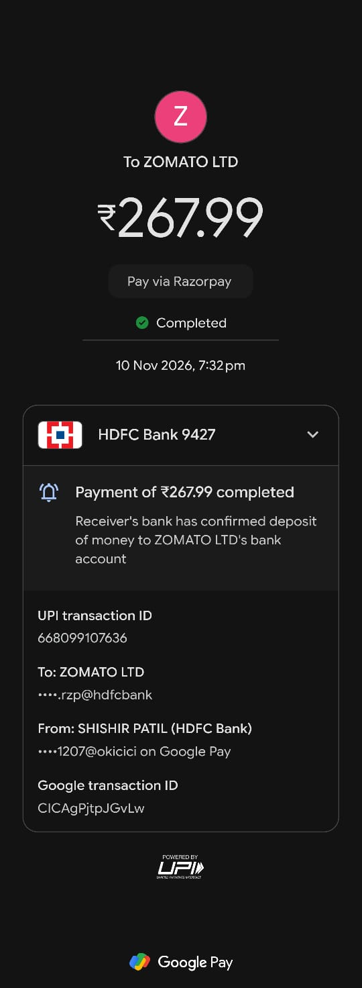
USER-PROVIDED ORIGINAL / UNALTERED PAYMENT CONTENT
Original screenshot — baseline case
REFERENCE IMAGE
The screenshot is a real, user-provided image—not a generated sample.
Test intent: use one original image as the baseline for screenshot analysis.
Displayed status: “Completed.” This is screen content; independent confirmation comes from the payment provider or account record.
Payment details are shown as they appear in the user-provided screenshot.

Slide 5

REAL-SCREENSHOT ROBUSTNESS TEST 1
Test 1 — JPEG re-save
IMAGE-ONLY CHANGE
Saved the same image as JPEG at quality 82.
ANOMALY CHECK
Does normal JPEG recompression change the compression or noise cues?
HOW VERISIGHT CHECKS THIS CASE
Layer 1 checks compression and noise patterns.
Layer 2 checks text edges, spacing, and alignment.
Layer 3 reviews available metadata and format clues.
Layer 4 combines cues using rule-based checks.
These cues support review; they do not prove fraud.
Checks the detector’s stability after a common image re-save.

Slide 6
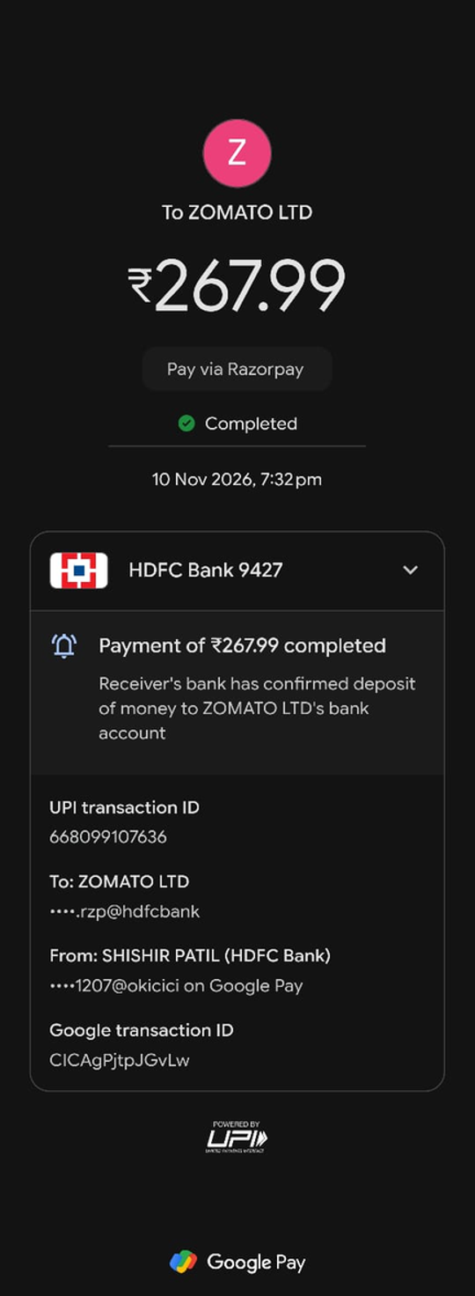
REAL-SCREENSHOT ROBUSTNESS TEST 2
Test 2 — Resize round-trip
IMAGE-ONLY CHANGE
Resized to 80%, then restored to the original dimensions.
ANOMALY CHECK
Does display scaling change text-layout or sharpness cues?
HOW VERISIGHT CHECKS THIS CASE
Layer 1 checks sharpness and noise after resizing.
Layer 2 compares text spacing and alignment.
Layer 3 reviews available metadata and format clues.
Layer 4 combines cues using rule-based checks.
Resizing alone does not prove image tampering.
All visible receipt details remain unchanged.

Slide 7
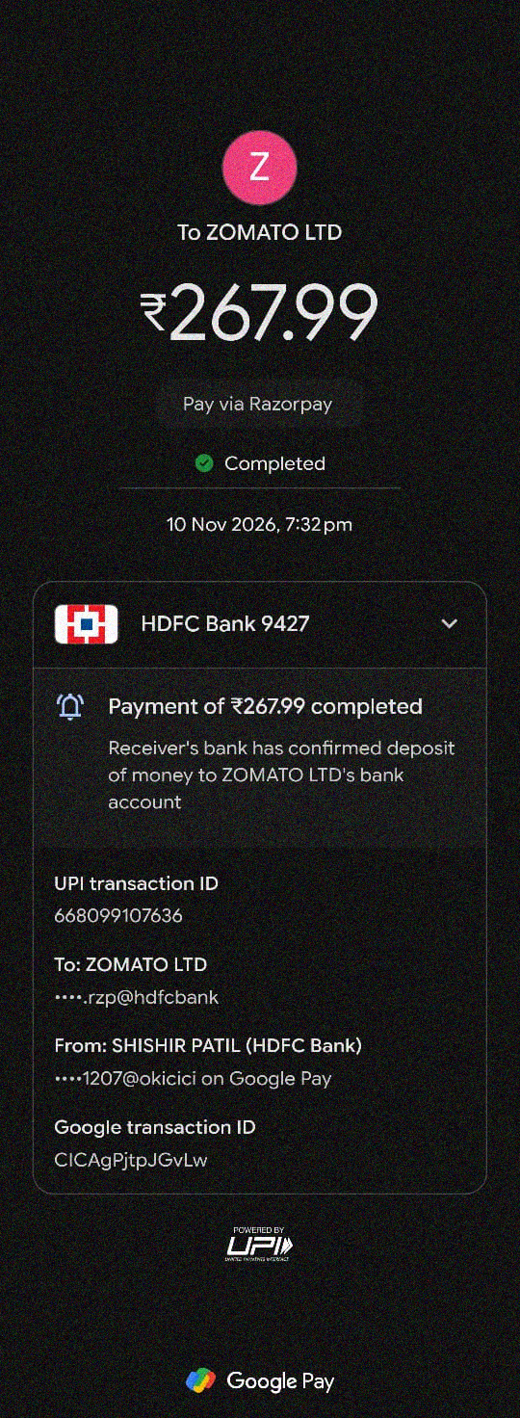
REAL-SCREENSHOT ROBUSTNESS TEST 3
Test 3 — Controlled wavelet noise
IMAGE-ONLY CHANGE
Added controlled high-frequency noise to the original image copy.
ANOMALY CHECK
Does this added texture raise wavelet or ELA cues?
HOW VERISIGHT CHECKS THIS CASE
Layer 1 checks for unusual high-frequency noise.
Layer 2 reviews text edges and alignment.
Layer 3 reviews available metadata and format clues.
Layer 4 combines cues using rule-based checks.
Noise cues alone do not prove fraud.
High-frequency texture measure: 10.68 → 41.96. This simple pixel metric is not VeriSight’s anomaly score.

Slide 8

REAL-SCREENSHOT ROBUSTNESS TEST 4
Test 4 — Format conversion
IMAGE-ONLY CHANGE
Converted the same image through PNG, then saved as JPEG at quality 90.
ANOMALY CHECK
Does a format change affect compression and metadata cues?
HOW VERISIGHT CHECKS THIS CASE
Layer 1 checks compression and noise after conversion.
Layer 2 reviews text edges and alignment.
Layer 3 checks file-format and metadata clues.
Layer 4 combines cues using rule-based checks.
Conversion cues alone do not prove fraud.
This tests image-processing sensitivity, not transaction fraud.

Slide 9
ACCURACY MEASUREMENT
How to read the inaccuracy meter
PROTOTYPE SCORE
ACCURACY / INACCURACY
Summarizes the image and metadata cues found by the current rules, helping reviewers focus their attention.
Compares each system decision with an independently confirmed label for that case.
INACCURACY = WRONG CLASSIFICATIONS ÷ INDEPENDENTLY LABELED CASES × 100%
One screenshot gives us the baseline. A meaningful inaccuracy percentage comes after multiple independently labeled cases.
Current stage: baseline captured; analyzer output and verified case labels are next.

Slide 10
CASE-BY-CASE EVALUATION
What to record for each test case
1. CASE LABEL
2. PROTOTYPE OUTPUT
3. VERIFIED RESULT
4. CASE OUTCOME
Original / expected condition
Review status, heuristic points, flagged cue
Independent ground truth: genuine / altered
Correct flag, false alarm, missed edit, or unclear
Keep the real receipt unchanged. If a test changes payment fields, use a clearly labeled fictional test receipt. This protects the original and gives each case a known label.
A result can be scored only after both the system output and verified expected result are recorded.

Slide 11
INTERPRETATION
VeriSight in a complete review workflow
SCREENSHOT SIGNALS
COMPLEMENTARY CHECKS
• Compare pixel texture and compression
• Measure text-like regions and alignment
• Inspect EXIF, QR payload and format patterns
• Combine findings in a review status
• OCR (text recognition) can read screenshot words
• Payment records can confirm settlement and payee
• A trusted C2PA verifier can check a signature
• Labeled test sets can measure model performance
Together, screenshot analysis, payment records and trusted signature checks give reviewers a broader evidence picture. Labeled tests track performance across apps and devices.

