Slide 1

RNS INSTITUTE OF TECHNOLOGY
BENGALURU - 98
DEPARTMENT OF COMPUTER SCIENCE & ENGINEERING
Presentation on Internship
Depression Prediction using Machine Learning
Arya Adesh
USN: 1RN18CS019
New Age Solutions Technologies
Internal Guide
Dr. H R Shashidhar
Associate Professor, Dept of CSE, RNSIT
External Guide
Mr. Aman Upadhyay
Prof, Company-Nastech
Notes:
1

Slide 2
AGENDA
Abstract
About the Company
Introduction
Literature Survey
Requirements
System Design
Detailed Design
Implementation
Testing
Conclusion and Future Enhancements
References
Q & A
VIII Semester, Department of CSE, RNSIT
2021 - 2022
2

Slide 3
ABSTRACT
Detection of Depression from DASS42
The DASS-42 is a 42 item self-report scale designed to measure the negative emotional states of depression, anxiety and stress. The principal value of the DASS in a clinical setting is to clarify the locus of emotional disturbance, as part of the broader task of clinical assessment.
As the scales of the DASS have been shown to have high internal consistency and to yield meaningful discriminations in a variety of settings, the scales should meet the needs of both researchers and clinicians who wish to measure current state or change in state over time.
VIII Semester, Department of CSE, RNSIT
2021 - 2022
3

Slide 4
About the Company
NASTECH is formed with the purpose of bridging the gap between Academia and Industry.
Nastech is one of the leading Global Certification and Training service providers for technical and management programs for educational institutions.
We collaborate with educational institutes to understand their requirements and form a strategy in consultation with all stakeholders to fulfill those by skilling , reskilling and upskilling the students and faculties on new age skills and technologies.
VIII Semester, Department of CSE, RNSIT
2021 - 2022
4

Slide 5
INTRODUCTION
Depression is one of the main factors that generates disability in populations in modern societies. Having experienced epidemics or natural disasters increases long-term levels of depression in populations and may also increase their future suicide rates Experiencing more upsetting events in life and finding it difficult to cope with them are also predictors of anxiety, stress, and depression.
Covid-19 has caused significant distress around the globe. Apart from the evident physical symptoms in infected cases, it has caused serious damage to public mental health. India, like other countries, implemented a nationwide lockdown to contain and curb the transmission of the virus.
VIII Semester, Department of CSE, RNSIT
2021 - 2022
5

Slide 6
Requirements
HARDWARE REQUIREMENTS:
Processor : Pentium 4 and above
Processor Speed : 2.4 GHz
RAM : 1GB
Storage Space : 40GB
Monitor : 1024x768 or 1280x1024
SOFTWARE REQUIREMENTS:
IDE : Jupyter Notebook/Google Colab
Interpreter : Python 3
VIII Semester, Department of CSE, RNSIT
2021 - 2022
6

Slide 7
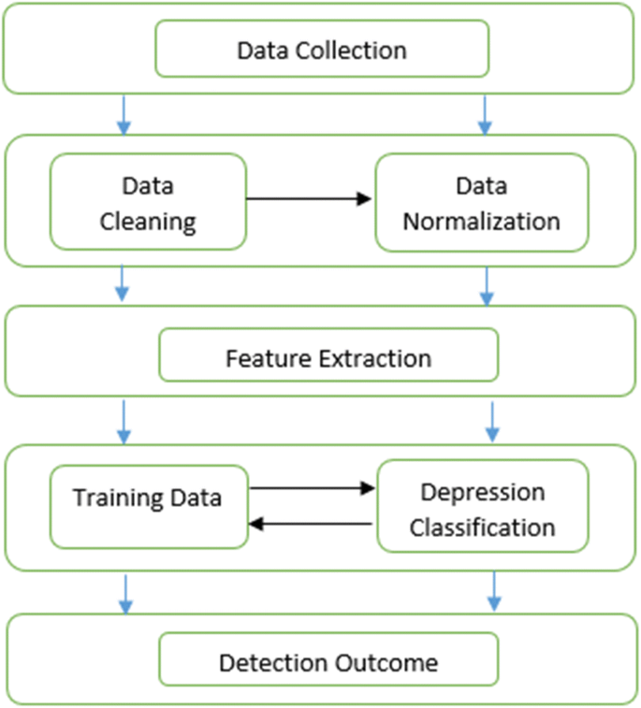
System Design
VIII Semester, Department of CSE, RNSIT
2021 - 2022
7
Notes:
7

Slide 8
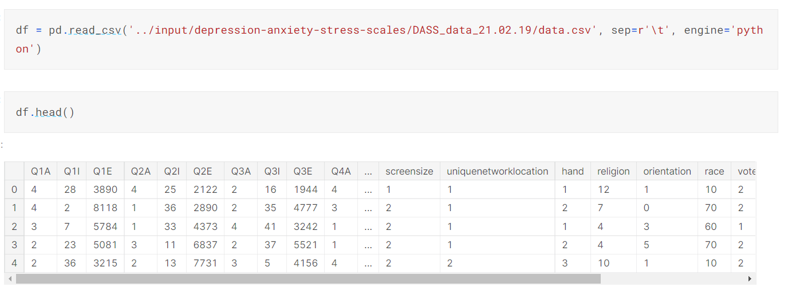
Implementation / Coding
VIII Semester, Department of CSE, RNSIT
2021 - 2022
8
Notes:
8

Slide 9
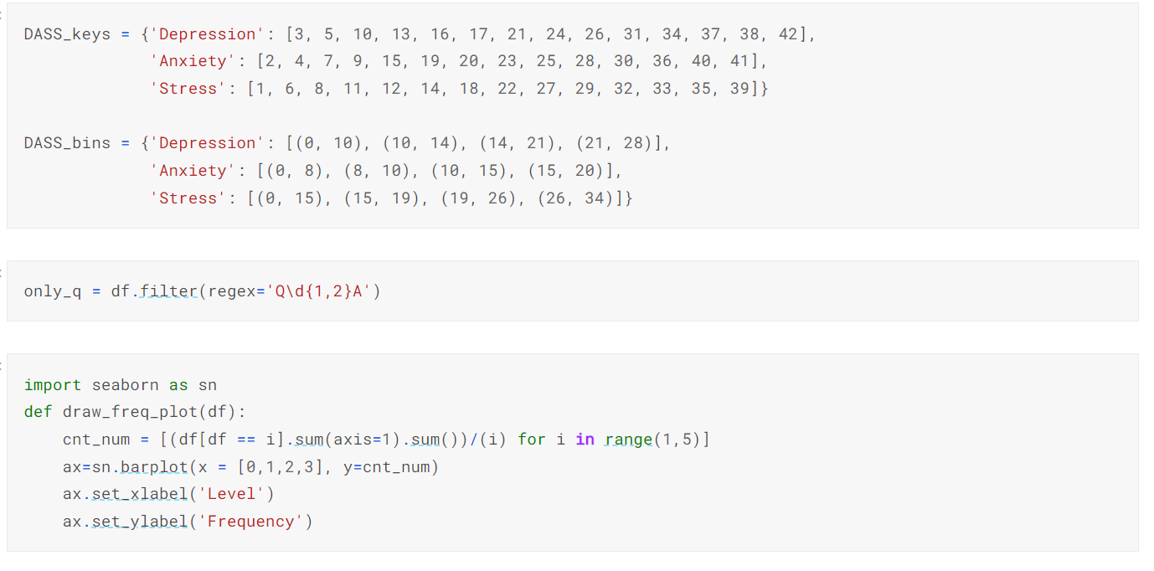
Implementation / Coding
VIII Semester, Department of CSE, RNSIT
2021 - 2022
9
Notes:
9

Slide 10
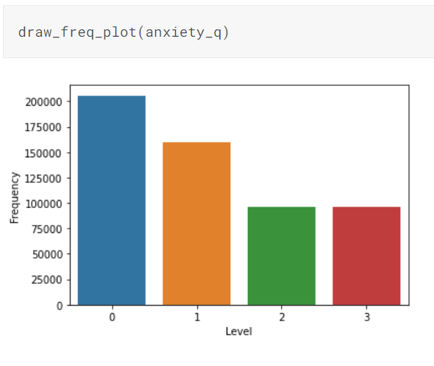
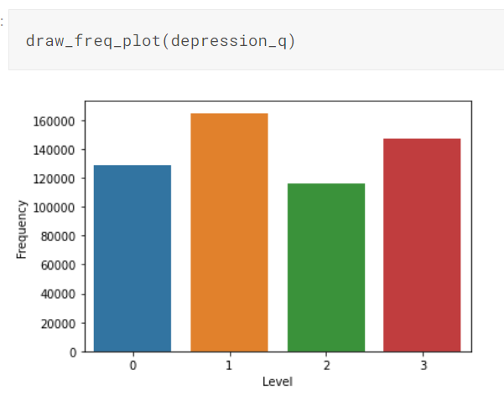
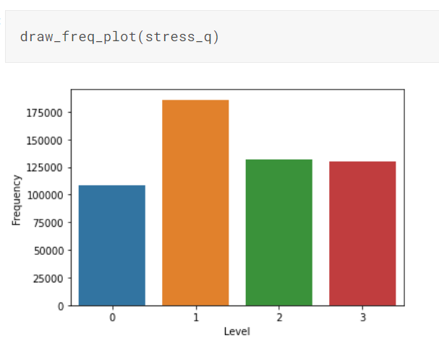
Implementation / Coding
VIII Semester, Department of CSE, RNSIT
2021 - 2022
10
Notes:
10

Slide 11
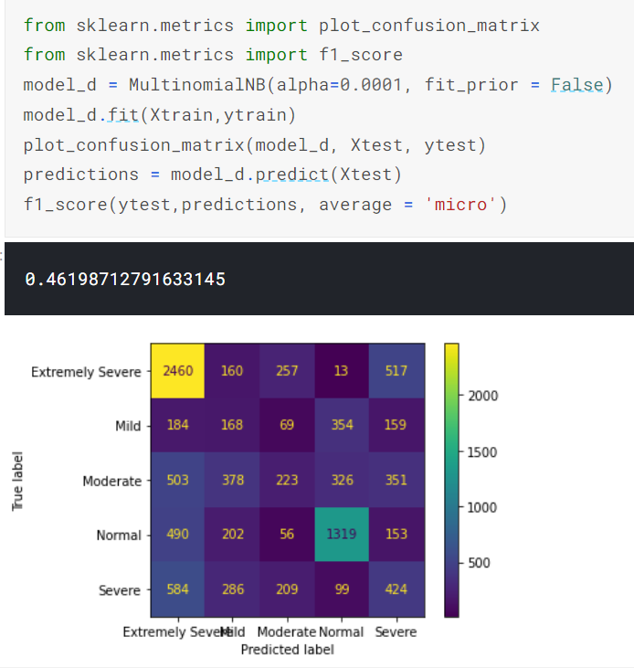
Result
VIII Semester, Department of CSE, RNSIT
2021 - 2022
11
Notes:
11

Slide 12
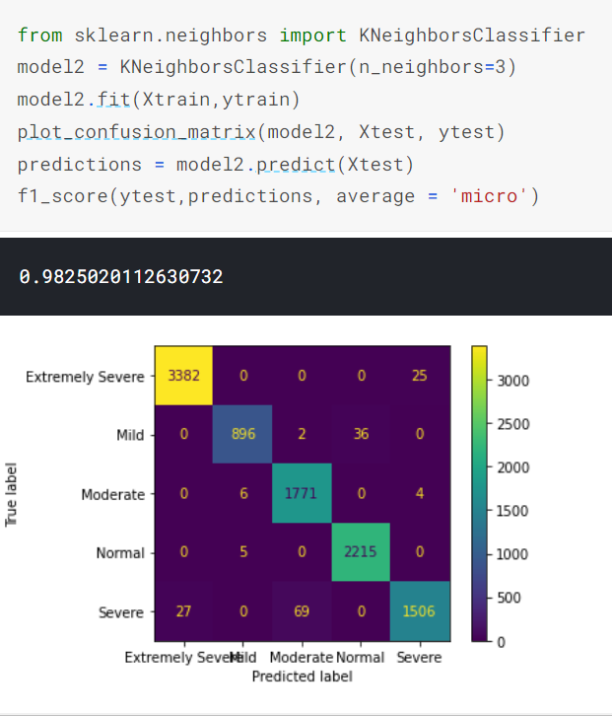
Result
VIII Semester, Department of CSE, RNSIT
2021 - 2022
12
Notes:
12

Slide 13
CONCLUSIONS
Using various machine learning algorithms we were able to classify people into different levels of depression, anxiety and Stress.
The exploratory data analysis provides insights such as distribution of categorical variables, outliers, survey participants origin country, religion, screen size.
In conclusion DASS score prediction helped us get better insight into levels of depression, anxiety and stress and factors responsible for them using machine learning and data analysis.
VIII Semester, Department of CSE, RNSIT
2021 - 2022
13
Notes:
13

Slide 14
Future Enhancements
Create a website with DASS42 questions and predict the depression, anxiety and stress levels.
Accesibilty for blind people as questions can be read out and they can answer using voice commands.
Questions can be translated into different languages and this can help a wide array of people.
VIII Semester, Department of CSE, RNSIT
2021 - 2022
14
Notes:
14

Slide 15
REFERENCES
Links:
1) https://www.kaggle.com/noobiedatascientist/isolation-forest-and-eda/data
2) https://openpsychometrics.org/tests/TMAS/
3) https://www.healthfocuspsychology.com.au/tools/dass-42/
4) https://pdf.sciencedirectassets.com/280203/
Books:
1)Introduction to Machine Learning with Python: A Guide for Data Scientists, by Sarah Guido & Andreas C. Mueller.
2)Hands-on Machine Learning with Scikit-Learn, Keras, and TensorFlow: Concepts.
3)Mathematics for Machine Learning, by Marc Peter Deisenroth.
VIII Semester, Department of CSE, RNSIT
2021 - 2022
15

Slide 16
Question and Answer
VIII Semester, Department of CSE, RNSIT
2021 - 2022
16

Slide 17
THANK YOU
VIII Semester, Department of CSE, RNSIT
2021 - 2022
17

