Slide 1
IBM University Engagement Project Submission
"GrantScout — AI Grant & Funding Finder for Startups"

Slide 2

Project Title – GrantScout: AI Grant & Funding Finder for Startups
Domain of Project – GovTech / Fintech
Student Name | Recent Passport Photo | Email ID | Mobile number [WhatsApp]
Arya Badugu |  | aryabadugu@gmail.com | +91 8169933291

Slide 3
Problem Statement -
Problem Statement #18 : GrantScout — AI Grant & Funding Finder for Indian Startups
The Challenge
Funding opportunities for Indian startups are scattered across dozens of government portals, in different formats, languages and update cycles. Early-stage founders cannot afford grant consultants and lack time to manually track 35+ active national and state schemes.
Specific Pain Points:
• Unstructured data – Grant PDFs have inconsistent layouts; eligibility, deadlines, and required documents are buried in prose.
• Personalization gap – Startups need results filtered by their stage, sector, state, and DPIIT recognition status.
• Draft burden – Writing a tailored grant application is time-consuming and requires domain expertise.
• Legal boundaries – Automated systems must respect public-only sources and never scrape login-protected portals.
The Objective
Build GrantScout, an agentic RAG system that:
• Ingests real government grant documents (PDF / DOCX / TXT) via pdfplumber and python-docx.
• Extracts structured grant metadata (name, body, amount, stage, sector, state, deadline) using IBM Granite via JSON-only prompts with Pydantic validation.
• Matches startups to relevant schemes using hybrid scoring: hard eligibility filters + semantic similarity (ChromaDB) + Granite reasoning.
• Drafts tailored application proposals grounded only in retrieved grant text and the startup's profile.
• Answers grounded Q&A with source citations (document + page).
• Shows every agent step in an Agent Trace tab for full transparency.

Slide 4
Proposed Solution -
Proposed Solution : GrantScout Agentic RAG Pipeline
Architecture Overview
User → Streamlit UI → Agent Pipeline → IBM watsonx.ai (Granite) + ChromaDB + IBM COS
6-Stage Agentic Pipeline:
1) Ingest Agent – Parses PDF/DOCX/TXT using pdfplumber & python-docx, chunks text, embeds with IBM Granite Embedding 278M Multilingual, stores in ChromaDB (local vector store). Originals stored in IBM COS (fallback: local /data/ folder).
2) Extract Agent – For each grant, calls IBM Granite 4H-Small via watsonx.ai SDK with a JSON-only prompt. Outputs a validated Pydantic GrantInfo object: name, issuing body, funding amount, eligible stage, sectors, state restrictions, eligibility criteria, deadline, required documents, application link, source file + page. Missing fields → null (never guessed).
3) Retrieve Agent – Hybrid retrieval: ChromaDB semantic search (top-k chunks) + keyword boost for scheme name / sector / state.
4) Match Agent – Hard eligibility filters (stage, sector, state, DPIIT status) → semantic similarity score → Granite reasoning pass → ranked MatchResult list with: match score, 'why it matches', 'what is missing', days until deadline.
5) Draft Agent – Generates a HITL-gated application draft (problem, solution, impact, budget justification, eligibility mapping) grounded only in retrieved grant text + startup profile. Labeled 'DRAFT – review before submission'. Requires explicit user approval before export.
6) Chat Agent – Grounded Q&A (top_k=2 full chunks). Citations include document name + page. If context is insufficient → 'not found in the provided documents.'

Slide 5
Technology Used
• IBM Granite 4H-Small (ibm/granite-4-0-tiny-preview) – LLM for JSON extraction, match reasoning, proposal drafting, and grounded Q&A. Model ID configurable in config.py.
• IBM Granite Embedding 278M Multilingual (ibm/granite-embedding-278m-multilingual) – Embedding model for semantic indexing and retrieval via ChromaDB.
• IBM watsonx.ai (ibm-watsonx-ai SDK) – Inference runtime. Free Lite tier. Project-scoped via WATSONX_PROJECT_ID.
• IBM Cloud Object Storage (ibm-cos-sdk) – Stores ingested grant documents. Local /data/ fallback if COS not configured.
• ChromaDB – Local vector database for embeddings and semantic search.
• Python 3.11 – Core language with type hints, docstrings, logging throughout.
• Streamlit – Frontend UI: 6 tabs (Upload, Matches, Draft, Chat, Trace, Eval).
• pdfplumber – PDF text extraction (lightweight, no Java dependency).
• python-docx – DOCX parsing.
• Pydantic – Schema validation for GrantInfo, StartupProfile, MatchResult.
• pytest (41/41 tests passing) – All IBM calls mocked with unittest.mock.

Slide 6
Agent Pipeline Components (Python — no LangFlow dependency)
GrantScout uses a clean Python agent pipeline with separate tool functions. Each tool is also wrapped as a watsonx Orchestrate-compatible function (core/orchestrate_tools.py).
1) ingest_documents(file_path, file_type) – Parses PDF/DOCX/TXT, splits into 500-char chunks with 50-char overlap, embeds via Granite Embedding, upserts to ChromaDB. Uploads original to IBM COS.
2) extract_grant_info(text) – Calls Granite via watsonx.ai SDK with a JSON-only system prompt. Returns validated GrantInfo Pydantic object. Retries up to 3x on parse failure. Missing fields set to null — never guessed.
3) retrieve_chunks(query, startup_profile, top_k=5) – Hybrid search: ChromaDB cosine similarity + keyword boost for sector/state/stage.
4) match_grants(startup_profile, retrieved_grants) – Hard filter pass (stage, sector, state, DPIIT) → semantic score → Granite reasoning → MatchResult list with: score, why_matches, what_is_missing, days_until_deadline.
5) draft_proposal(grant, startup_profile) – Generates 6-section application draft grounded in grant text + profile. Labels output 'DRAFT – review before submission'. Requires explicit user approval before DOCX/PDF export.
6) chat_qa(question, conversation_history) – top_k=2 full chunks, directive prompt. Returns answer + citations (document + page). Falls back: 'not found in the provided documents.

Slide 7
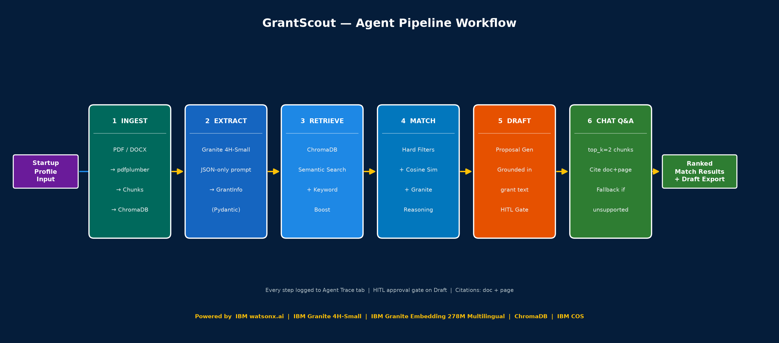
Agent Pipeline Workflow -

Slide 8
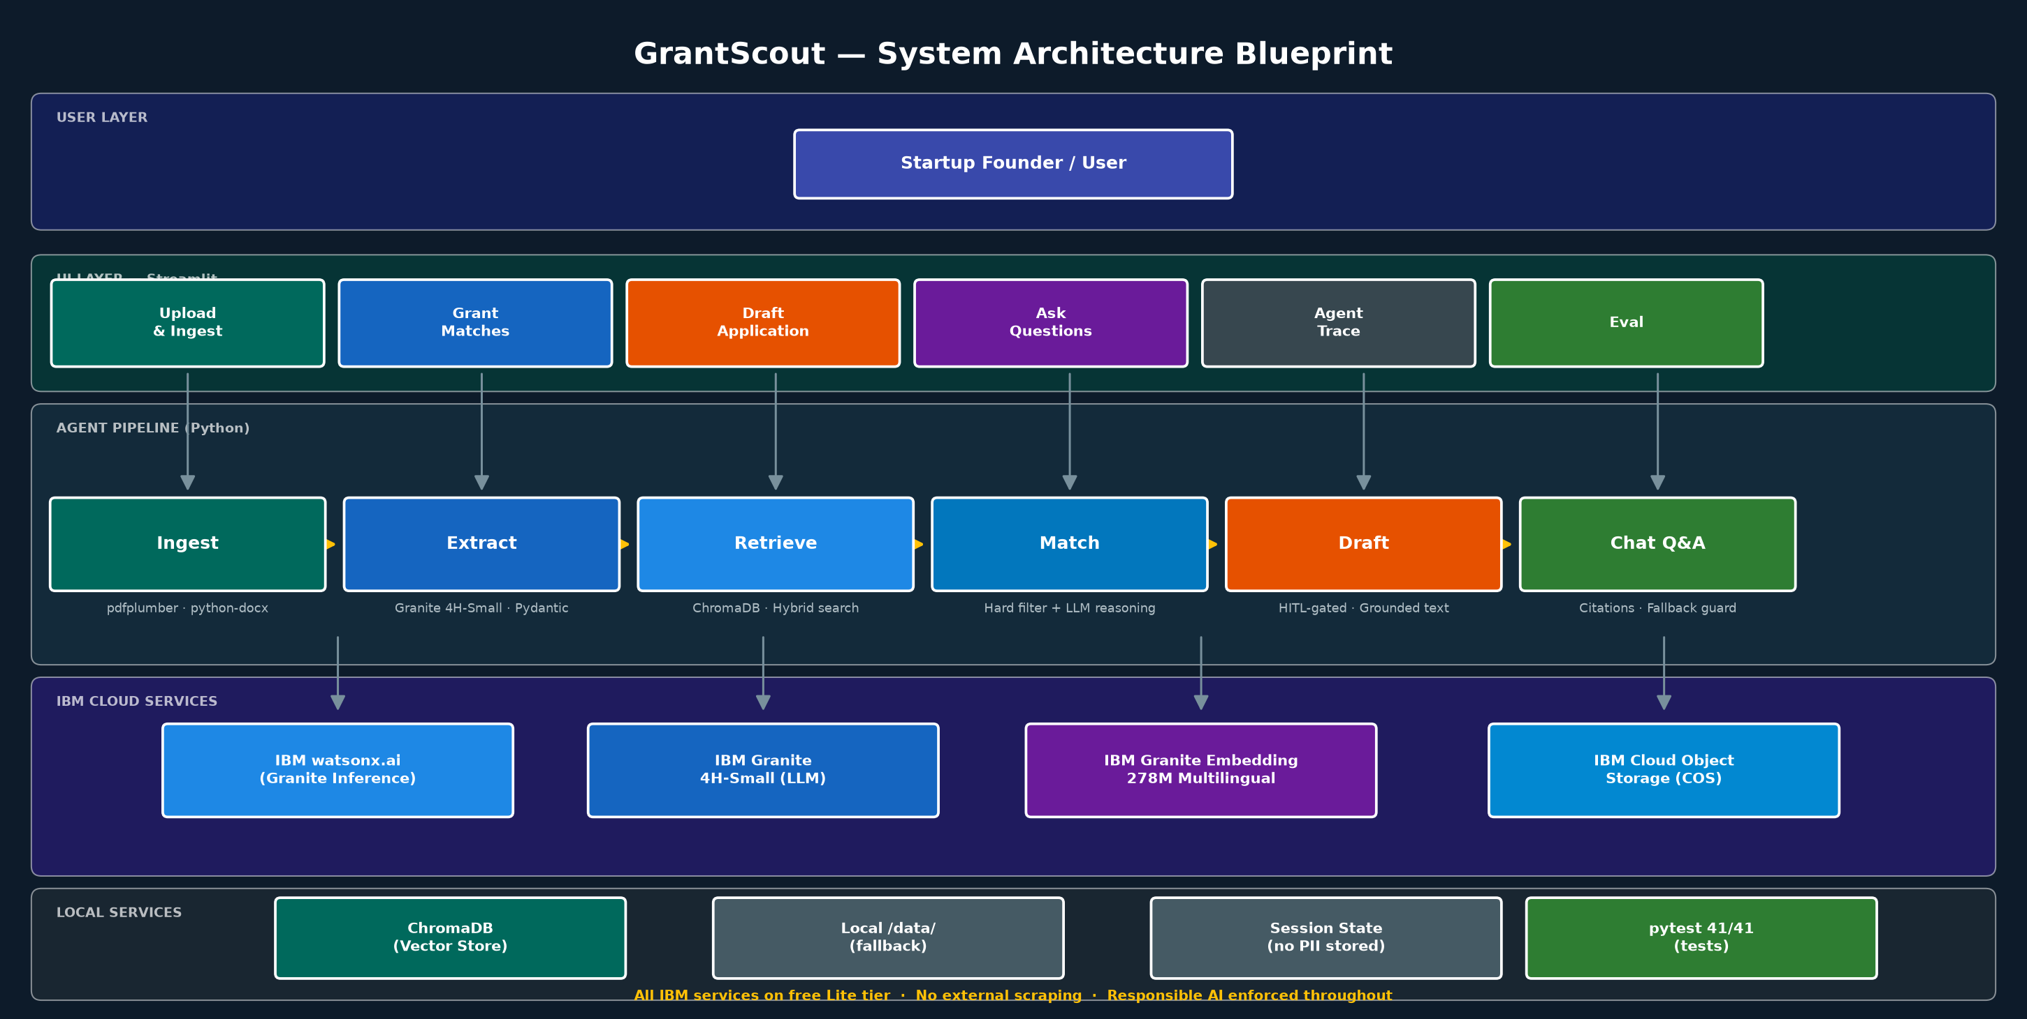
Architecture Blueprint

Slide 9
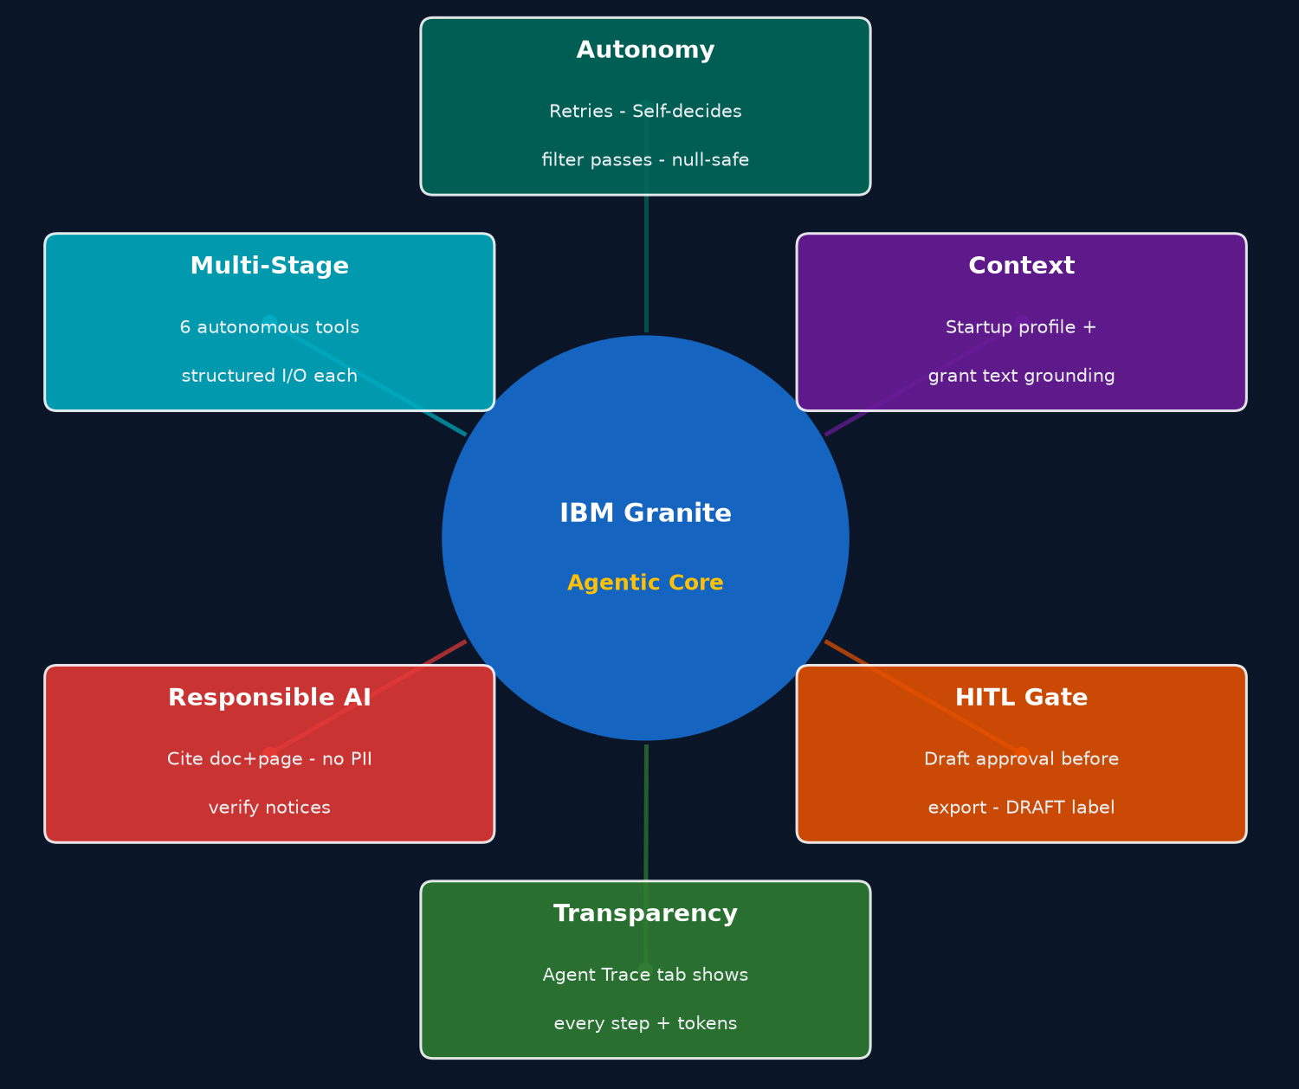
Role of Agentic AI in GrantScout
GrantScout demonstrates genuine agentic behavior: each stage of the pipeline is an autonomous tool function that decides what to do based on its input, calls IBM Granite for reasoning, and passes structured output to the next stage.
Autonomy – The Extract Agent independently retries malformed JSON up to 3 times before marking a field as null. The Match Agent self-decides which grants pass the hard filter before invoking Granite for reasoning.
Context Awareness – The Draft Agent grounds every sentence in retrieved grant text and the startup profile. It refuses to fabricate details not present in the source documents.
Human-in-the-Loop Gate – The Draft Agent requires explicit user approval before any export. Drafts are labeled 'DRAFT – review before submission' and carry a verify notice on all deadlines and amounts.
Transparency – The Agent Trace tab shows every pipeline step (retrieve → extract → filter → score → draft) with timestamps, inputs, outputs, and token counts — making the agentic reasoning fully observable by judges.
Responsible AI – Citations on every claim (document + page), no PII stored beyond session, clear-data button, public documents only, ethics note in sidebar.

Slide 10
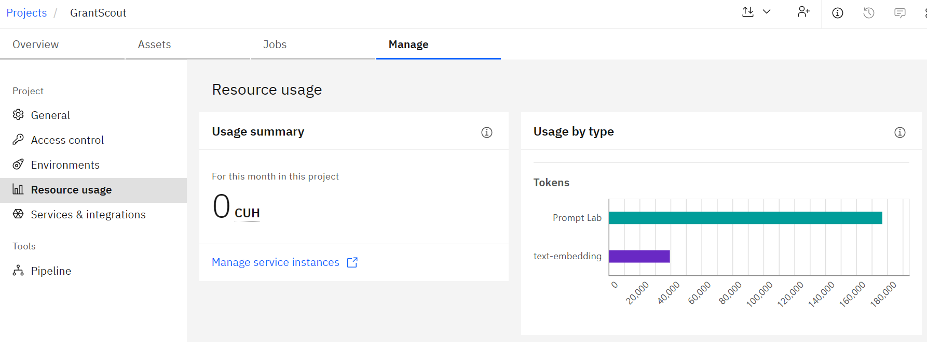
Token Usage
Approx. 2,000–4,000 tokens per grant extraction; ~1,500 tokens per Q&A; ~3,500 tokens per proposal draft. All via IBM Granite on watsonx.ai Lite tier.

Slide 11
Novelty and Uniqueness
GrantScout stands out by combining Agentic AI, RAG, and Responsible AI into a single, fully working system for a real Indian government context.
Agentic Pipeline (not a chatbot) – Six autonomous tool stages (Ingest → Extract → Retrieve → Match → Draft → Chat) each with independent decision logic, retry handling, and structured I/O. Every step is traceable in the Agent Trace tab.
IBM Granite End-to-End – Only IBM models used: Granite 4H-Small for LLM tasks, Granite Embedding 278M Multilingual for semantic indexing. All via ibm-watsonx-ai SDK on free Lite tier.
Hybrid Matching – Hard eligibility filters (stage, sector, state, DPIIT) combined with ChromaDB semantic similarity and a Granite reasoning pass. Outputs a ranked MatchResult with 'why it matches' and 'what is missing' — not just a similarity score.
Responsible AI by Design – HITL approval gate before any export; citations on every claim (document + page); verify notices on all deadlines and amounts; no PII stored beyond session; clear-data button; ethics note in sidebar. These are not checkboxes — they are enforced at the code level.
Real Indian Context – 35 real public Indian government schemes listed; 6 synthetic samples for demo; eval framework with ground-truth CSV template and precision@3 metric.
Production-Ready – 41/41 pytest tests passing (all IBM calls mocked) also deployed live.

Slide 12
GitHub Link
Public GitHub repository for GrantScout:
https://github.com/AryaBadugu/GrantScout
The repository contains:
Full Python source code (app/, core/, eval/, tests/, data/)
Problem statement pdf file – GrantScout_Problem_Statement.pdf
Project presentation pptx file – GrantScout_Project.pptx
requirements.txt and .env.example for easy setup
README.md with live app link, setup steps and Mermaid architecture diagram
docs/architecture.md — detailed architecture
Live deployed app: https://grant-scout.streamlit.app/
IBM credentials required for live inference (free Lite tier). Synthetic data included for offline demo.

Slide 13
Future Scope
1. Real-Time Grant Aggregation –
Integrate a scheduled crawler (respecting robots.txt) to automatically detect newly published public government scheme notifications from official portals (e.g., startupindia.gov.in, msme.gov.in, dst.gov.in) and ingest them without manual uploads.
2. Multilingual Support –
Leverage IBM Granite Embedding 278M Multilingual to support grant documents and startup profiles in regional Indian languages (Hindi, Tamil, Telugu, Marathi, etc.), making the tool accessible to founders in non-English-speaking regions.
3. Deadline & Status Tracking Dashboard –
Add a persistent tracker with email/SMS alerts for approaching deadlines, submission windows, and newly opened schemes — powered by IBM Cloud Functions or watsonx Orchestrate.
·

Slide 14
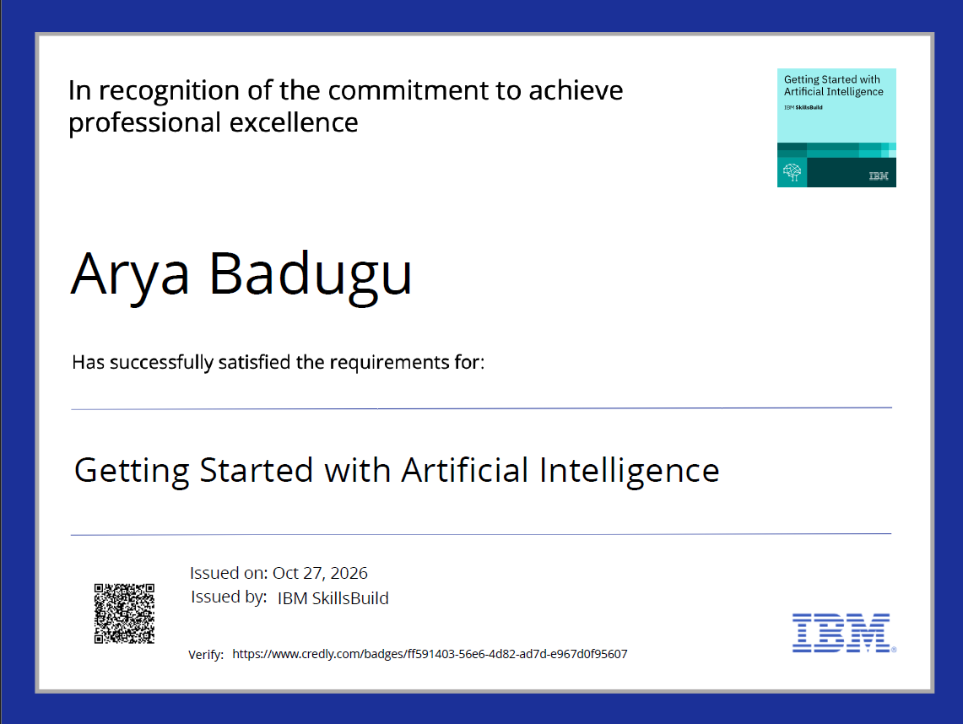
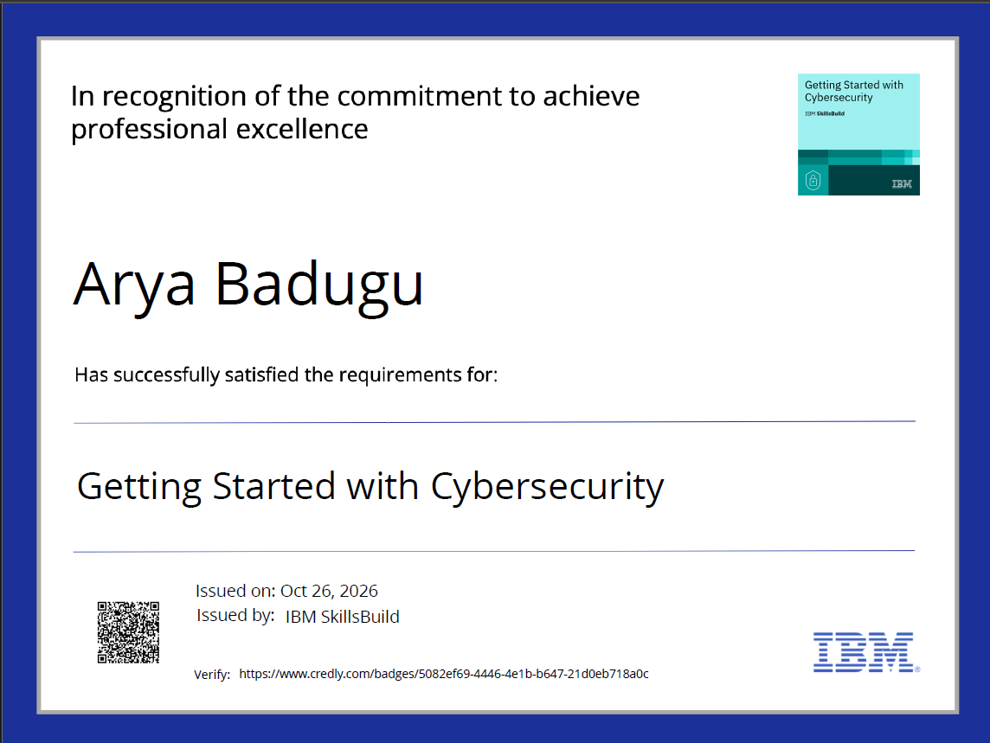
Certificates Earned:
IBM SkillsBuild / watsonx.ai Credly certificate —

Slide 15
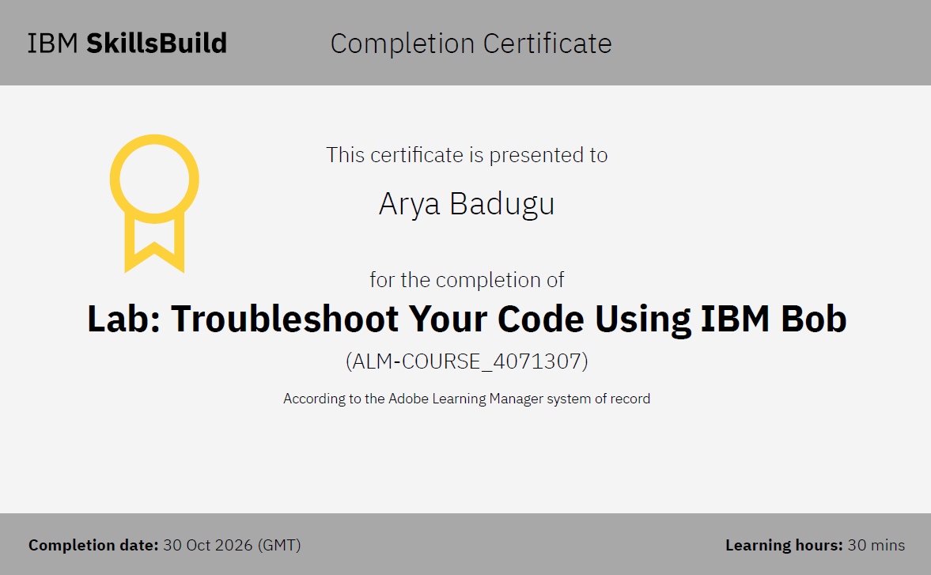
Certificates Earned:
IBM Bob / IBM watsonx.ai certificate —

Slide 16


