Slide 1


SMART INDIA HACKATHON 2026
ORBITLENS: Tactical Geospatial Intelligence Platform
• Problem Statement ID – 26142
• Problem Statement Title –
Deep Learning Based Super Resolution Mapping (SRM) from Medium Resolution Satellite Imageries
• Theme – Software / Geospatial Intelligence
• PS Category – Software
• Organization – National Technical Research Organisation (NTRO)
• Team Name – GitGrow

Slide 2
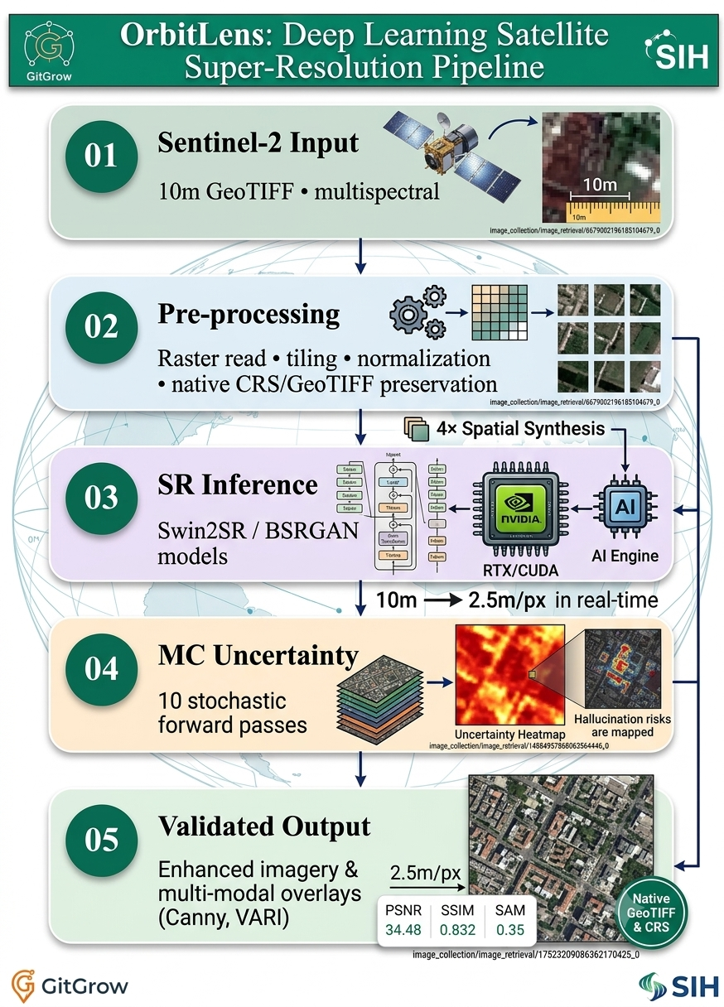
GitGrow
IDEA TITLE
Proposed Solution
Uniqueness
Proposed Solution
• Hallucination Awareness – Uncertainty heatmaps expose areas where reconstructed details are less reliable.
• Spectral Preservation – SAM validation checks band-to-band consistency.
• Native GeoTIFF – CRS and metadata are preserved for geospatial use.
• Edge Inference – Designed for local NVIDIA RTX/CUDA environments.
• Multi-Modal Overlays – Visual enhancement, Canny edges and VARI views.
• Quantitative Validation – PSNR, SSIM and SAM provide measurable assessment.
• Input imagery – 10m Sentinel-2 L2A satellite imagery.
• Pre-processing – tile, normalize and prepare geospatial bands.
• Generative SR – Swin2SR / BSRGAN based super-resolution.
• 4× enhancement – generate <4m products; target 2.5m/px output.
• GeoTIFF preservation – retain CRS and geospatial metadata.
• Uncertainty engine – 10 stochastic MC Dropout passes.
• Validation – PSNR, SSIM and SAM against reference/baseline.
• Outputs – enhanced imagery, overlays and uncertainty heatmaps.
MC
Uncertainty
GeoTIFF
Native
Edge
CUDA
Spectral
SAM
2

Slide 3
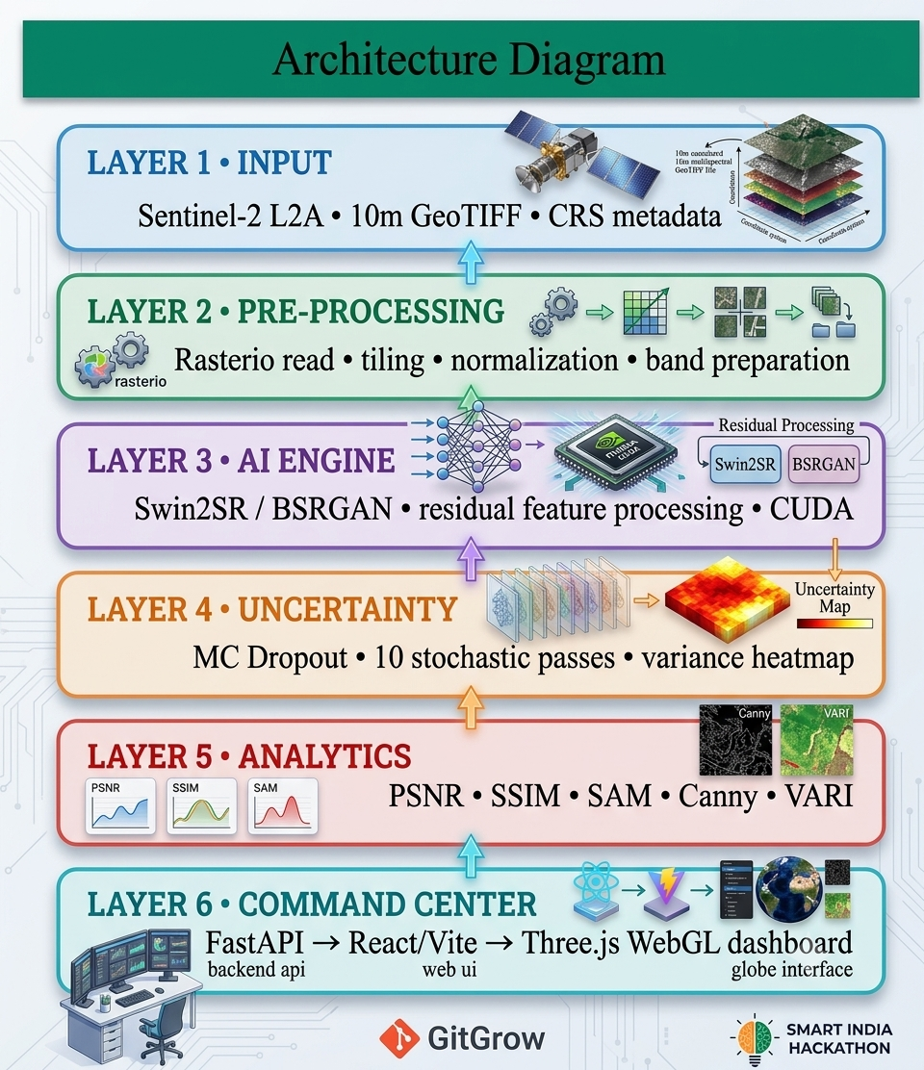
GitGrow
TECHNICAL APPROACH
Tech Stack
Quantitative Validation
Frontend
React (Vite) + Three.js WebGL
Target Performance Metrics
Spatial Enhancement
10m → 2.5m/px
Backend
FastAPI + Python
4× synthesis
Inference Latency
~290–450 ms
SR Models
Swin2SR / BSRGAN
per 256×256 tile
Geo Processing
rasterio + GeoTIFF
Deployment
Local Edge Node
CUDA accelerated
Acceleration
NVIDIA RTX + CUDA
Spectral Integrity
SAM validation
multi-band consistency
Analytics
PSNR • SSIM • SAM
Image Quality
PSNR: +4.2 dB | SSIM: 0.89
against baseline/reference
Overlays
Canny Edge • VARI • Uncertainty
Goal: improve interpretability while accounting for
uncertainty and reconstruction error.
3

Slide 4
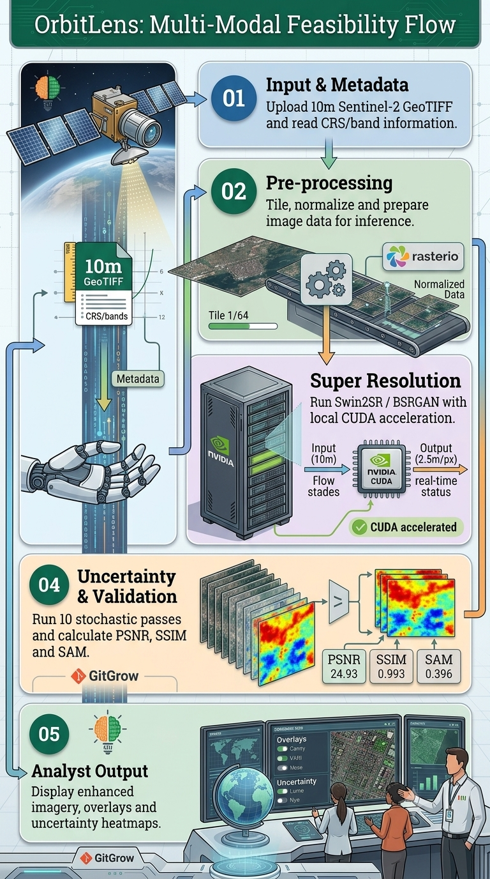
GitGrow
FEASIBILITY AND VIABILITY
Technical Feasibility
Operational Viability
• Satellite Input – 10m Sentinel-2 imagery is the defined input.
• AI/ML Engine – Swin2SR / BSRGAN performs super-resolution.
• Geo-Spatial Processing – rasterio preserves CRS and GeoTIFF metadata.
• Edge Acceleration – NVIDIA RTX/CUDA supports local inference.
• Uncertainty – MC Dropout estimates pixel-wise variability.
• Validation – PSNR, SSIM and SAM quantify output quality.
• Scalable UI – FastAPI + React/Vite + Three.js support interactive analysis.
• Local / Air-Gapped – Designed to avoid cloud dependency for inference.
• Analyst-Centric – Shows both enhanced imagery and uncertainty.
• Geo-Consistent – Preserves coordinate reference information.
• Low-Latency Target – ~290–450ms per 256×256 tile.
• Multi-Modal – Visual, edge and spectral/terrain overlays.
• Application Ready – Supports urban analysis, crop monitoring and disaster assessment.
• Decision Support – Provides enhanced analytical products while exposing uncertainty.
4

Slide 5
GitGrow
IMPACT AND BENEFITS
Measurable Impacts
Future Scope
Benefits
• Higher Spatial Detail – Transforms 10m imagery toward a 2.5m/px target.
• Better Feature Visibility – Improves visibility of small buildings, narrow roads and field boundaries.
• Analytical Utility – Supports crop monitoring, urban mapping, change detection and disaster assessment.
• Uncertainty Awareness – Highlights reconstructed areas that require additional verification.
• Spectral Consistency – SAM-based validation checks preservation of multi-band relationships.
• Higher-Resolution Training – Expand paired datasets with more high-resolution references.
• Diffusion Models – Evaluate diffusion-based generative SR approaches.
• More Sensors – Extend beyond Sentinel-2 to additional Earth-observation sources.
• Better Uncertainty – Use calibrated confidence and error estimation.
• Edge Deployment – Optimize models for compact GPU/edge devices.
Sharper imagery
Safer interpretation
2.5m/px target
uncertainty heatmap
Geo consistency
Quantified quality
GeoTIFF + CRS
PSNR • SSIM • SAM
Advantages
Deployment / Sustainability Model
• Generative AI – learns fine-scale spatial patterns from paired imagery.
• Spectral-Aware – uses SAM to assess spectral consistency.
• Explainable Uncertainty – MC variance gives an explicit confidence signal.
• Secure Local Processing – supports air-gapped/local deployment.
• Edge Deployment – Deploy inference on local NVIDIA RTX/CUDA systems.
• Institutional Use – Potential use by remote-sensing, disaster-response and geospatial analysis teams.
• Model Service – Offer local inference and validation modules as a reusable platform component.
• Research Expansion – Extend models, sensors and validation datasets over time.
5

Slide 6

GitGrow
RESEARCH AND REFERENCES
Prototype / Project Components
• Sentinel-2 / Copernicus – Medium-resolution multispectral Earth observation imagery used as the defined input source.
• ESA Copernicus Sentinel-2 – Mission and sensor information for Earth-observation imagery and multispectral bands.
• Swin2SR – Image super-resolution approach based on Swin Transformer V2 architecture.
• BSRGAN – Practical degradation modelling approach for blind image super-resolution.
• rasterio – Python geospatial raster processing library used for GeoTIFF and CRS handling.
• FastAPI – Python framework used for local inference API serving.
• React / Vite / Three.js – Frontend and WebGL technologies for the interactive visual analytics interface.
• React + Vite command center
• Three.js WebGL visualization
• FastAPI inference backend
• Swin2SR / BSRGAN model layer
• rasterio GeoTIFF pipeline
• MC Dropout uncertainty engine
• PSNR / SSIM / SAM validation
• Canny Edge + VARI overlays
• Local NVIDIA RTX / CUDA target
“Super-resolution for satellite imagery with measurable quality, geospatial consistency and explicit uncertainty.”
6

