Slide 1
Diskusi Tutorial 3: Kinematika, Dinamika, Usaha dan Energi (Soal)
Sparisoma Viridi, Septian Ulan Dini
Nuclear Physics and Biophysics Research Division
Department of Physics, Institut Teknologi Bandung, Bandung 40132, Indonesia
20220921-v3| https://doi.org/10.5281/zenodo.7099409

Slide 2
Kerangka
Kinematika 3
Dinamika 19
Usaha dan Energi 35
Diskusi 51

Slide 3
Kinematika
Harry Mahardika (Koord.), RQ, AU, “Modul Tutorial 3 Fisika Dasar IA (FI-1101) Semester 1 Tahun Akademiki 2022-2023”, Prodi Sarjana Fisika, FMIPA, ITB, 2020, url https://cdn-edunex.itb.ac.id/43779-Elementary-Physics-IA-Parallel-Class/117325-Dinamika-Benda-Titik-1/1662248053745_SOAL-Modul-1-Fidas-IA_2021-2022.pdf [20220921]

Slide 4
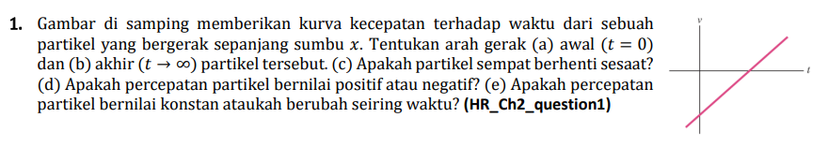
KIN-A

Slide 5
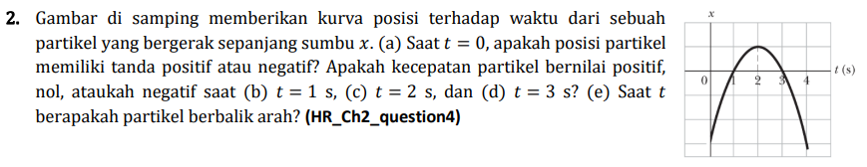
KIN-A

Slide 6
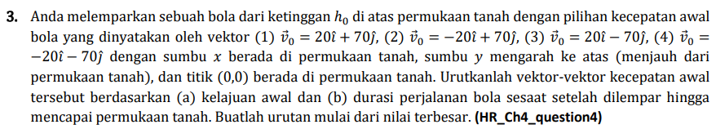
KIN-A

Slide 7
KIN-A

Slide 8
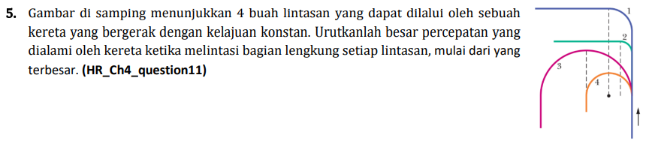
KIN-A

Slide 9
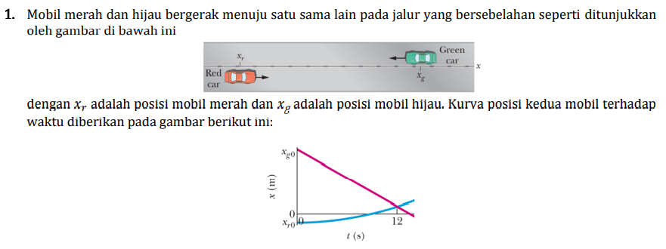
KIN-B

Slide 10
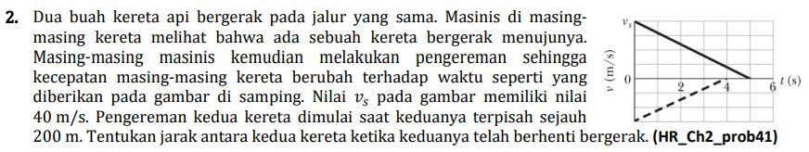
KIN-B

Slide 11
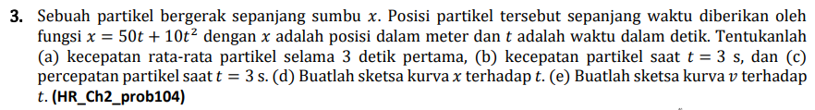
KIN-B

Slide 12
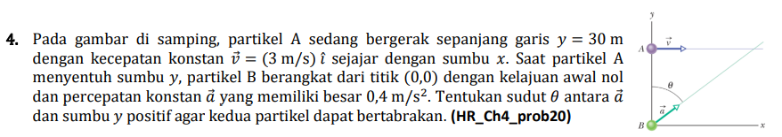
KIN-B

Slide 13
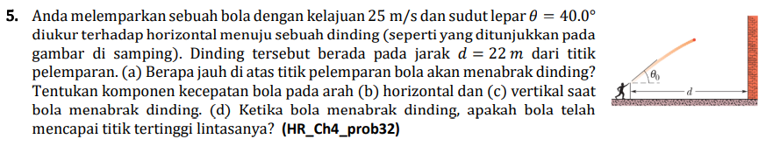
KIN-B

Slide 14
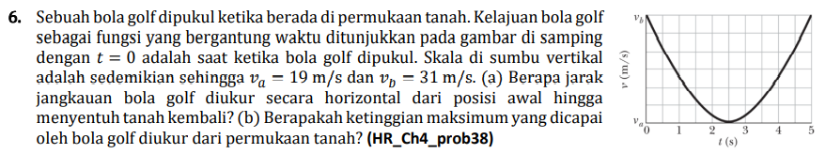
KIN-B

Slide 15
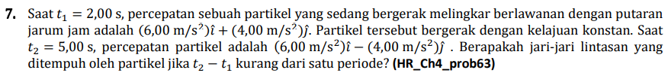
KIN-B

Slide 16
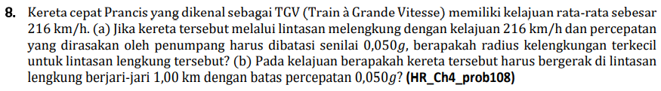
KIN-B

Slide 17
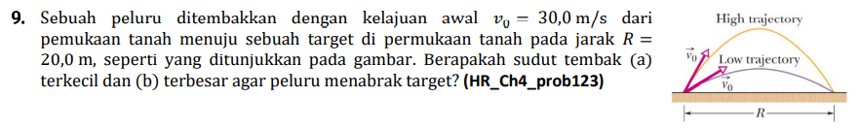
KIN-B

Slide 18
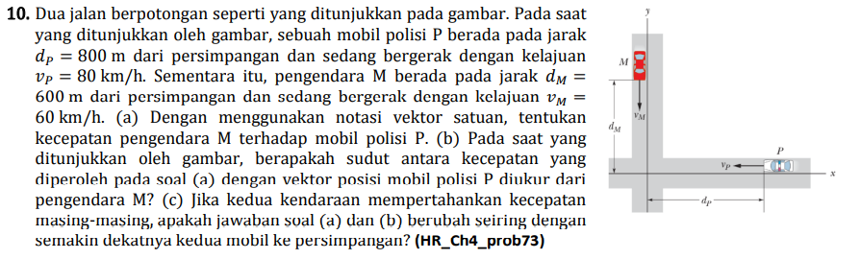
KIN-B

Slide 19
Dinamika
Harry Mahardika (Koord.), AU, AO, “Modul Tutorial 3 Fisika Dasar IA (FI-1101) Semester 1 Tahun Akademiki 2022-2023”, Prodi Sarjana Fisika, FMIPA, ITB, 2020, url https://cdn-edunex.itb.ac.id/43779-Elementary-Physics-IA-Parallel-Class/117326-Dinamika-Benda-Titik-2/1662867109300_SOAL-Modul-2-Fidas-IA_2022-2023.pdf [20220921]

Slide 20
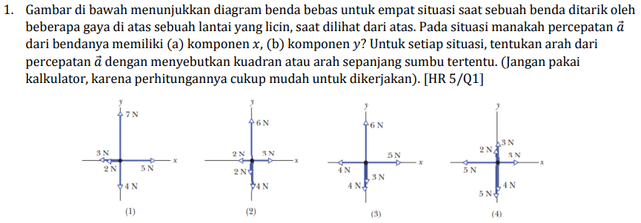
DIN-A

Slide 21
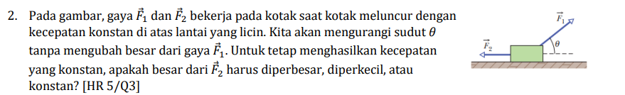
DIN-A

Slide 22
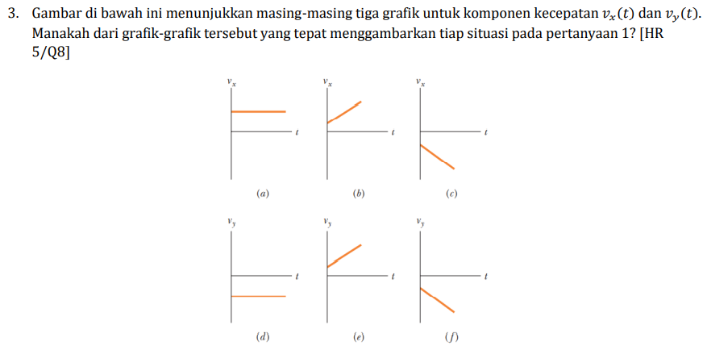
DIN-A

Slide 23
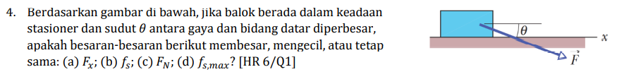
DIN-A

Slide 24
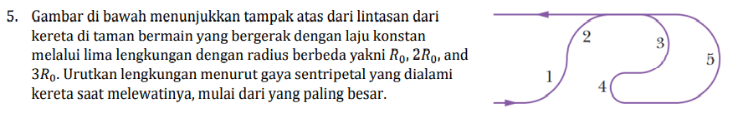
DIN-A

Slide 25
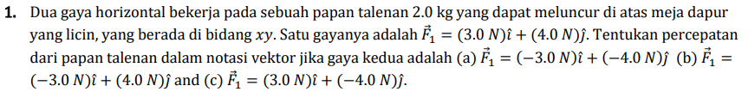
DIN-B

Slide 26
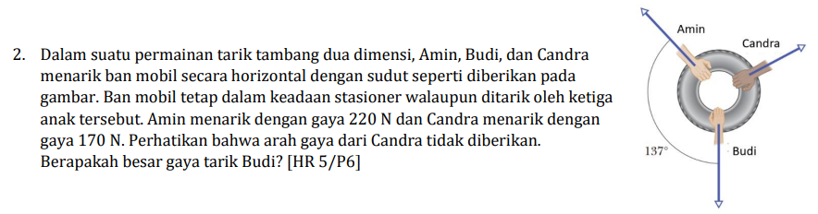
DIN-B

Slide 27
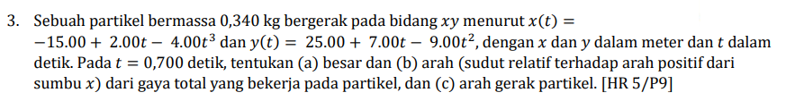
DIN-B

Slide 28
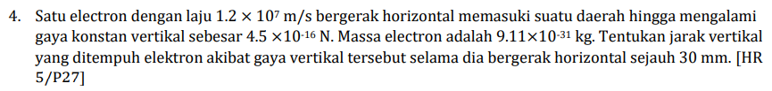
DIN-B

Slide 29
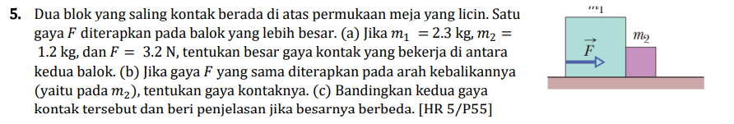
DIN-B

Slide 30
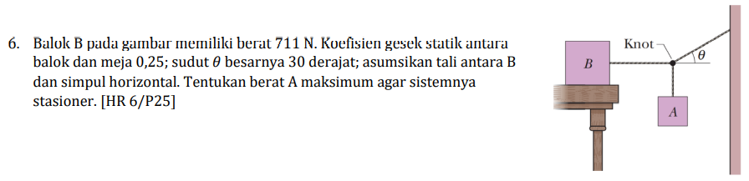
DIN-B

Slide 31
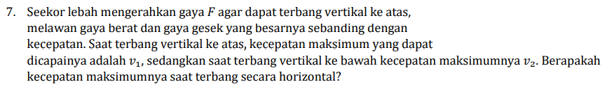
DIN-B

Slide 32
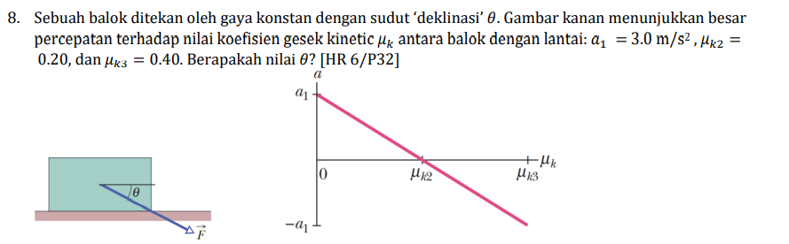
DIN-B

Slide 33
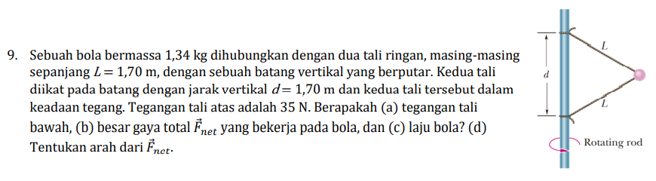
DIN-B

Slide 34
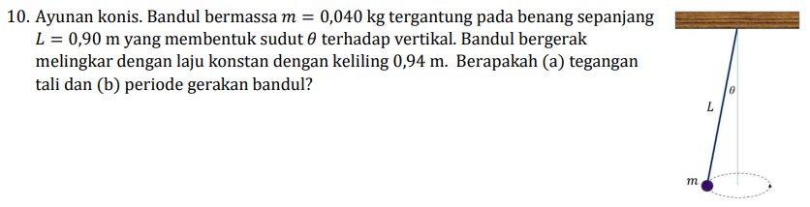
DIN-B

Slide 35
Usaha dan Energi
Harry Mahardika (Koord.), AO, PW, “Modul Tutorial 3 Fisika Dasar IA (FI-1101) Semester 1 Tahun Akademiki 2022-2023”, Prodi Sarjana Fisika, FMIPA, ITB, 2020, url https://cdn-edunex.itb.ac.id/43779-Elementary-Physics-IA-Parallel-Class/117328-Usaha-dan-Energi/1663535095106_SOAL-Modul-3-Fidas-IA_2022-2023.pdf [20220921]

Slide 36
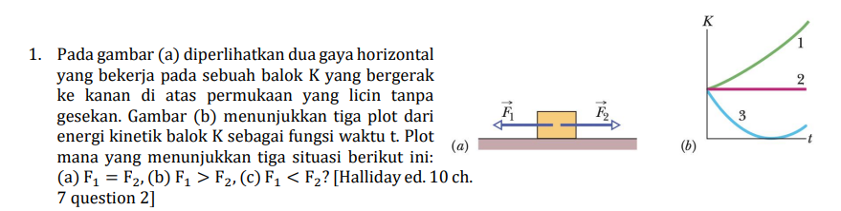
WEN-A

Slide 37
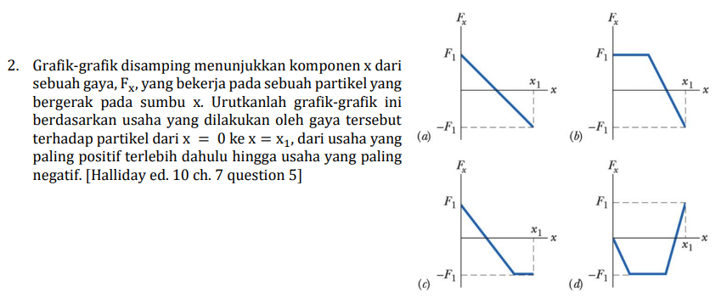
WEN-A

Slide 38
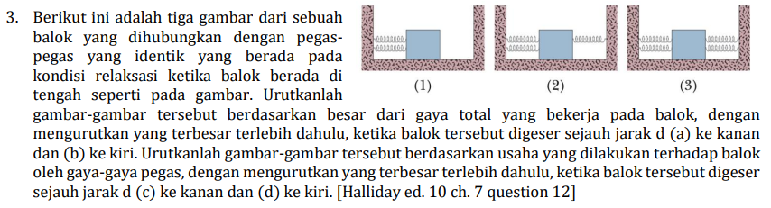
WEN-A

Slide 39
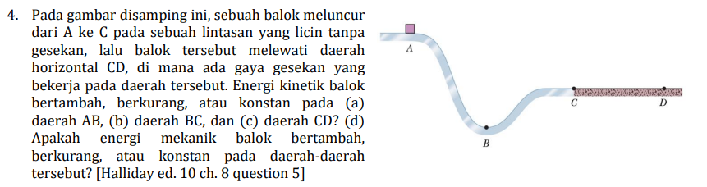
WEN-A

Slide 40
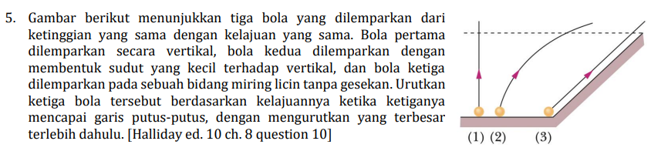
WEN-A

Slide 41
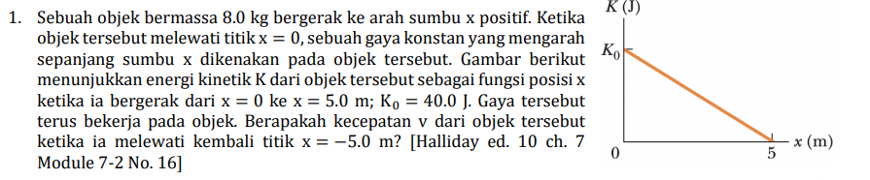
WEN-B

Slide 42
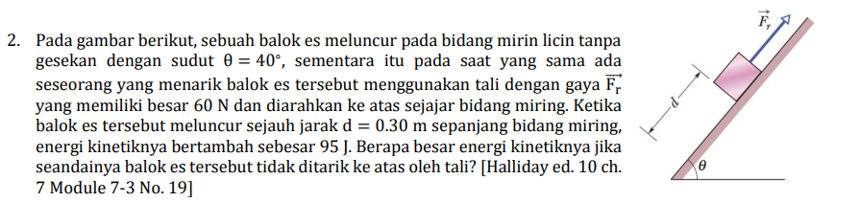
WEN-B

Slide 43
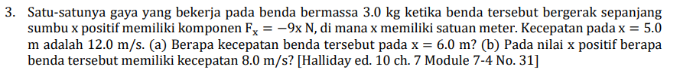
WEN-B

Slide 44
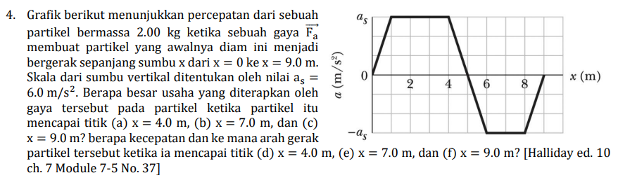
WEN-B

Slide 45
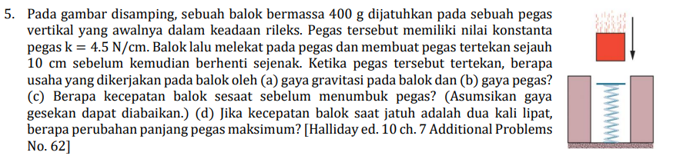
WEN-B

Slide 46
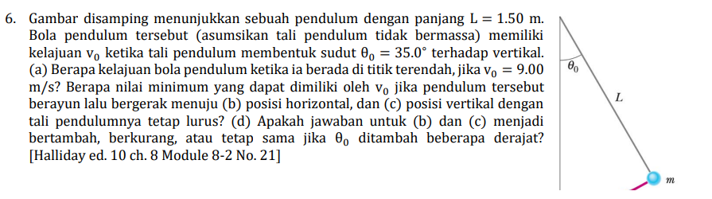
WEN-B

Slide 47
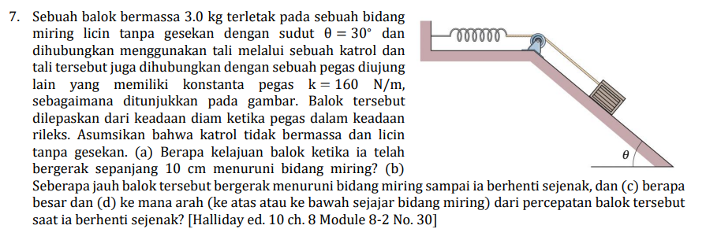
WEN-B

Slide 48
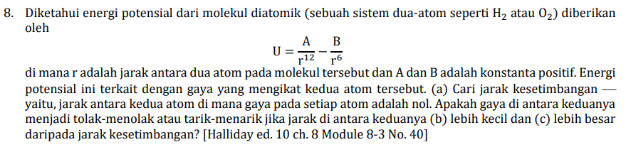
WEN-B

Slide 49
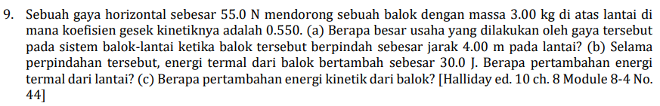
WEN-B

Slide 50
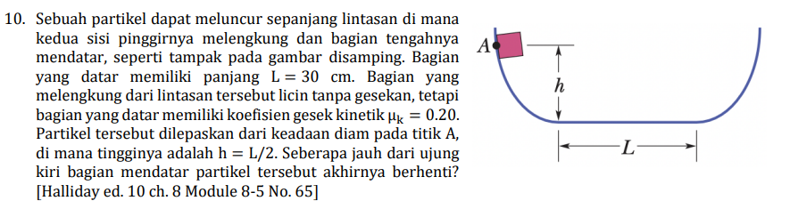
WEN-B

Slide 51
Diskusi

Slide 52
Diskusi
Mari berdiskusi ☺
Komentar dan saran dapat disampaikan ke https://github.com/dudung/py-jupyter-notebook/issues/6

Slide 53
Terima kasih

