Slide 1

Customer Shopping Behavior Analysis
Analyzing transactional data from 3,900 purchases across multiple product categories to uncover insights into spending patterns, customer segments, product preferences, and subscription behavior. This comprehensive analysis guides strategic business decisions through data-driven insights.

Slide 2
About Me
Hello! I'm Arya Bhattacharya, an undergraduate student deeply immersed in the transformative world of Data Analytics. My passion lies in translating complex information into clear, actionable insights that drive real-world impact. This project is a testament to that commitment, meticulously analyzing thousands of customer purchases to uncover behaviors, predict preferences, and equip businesses with the intelligence needed for strategic, informed decision-making. Together, we'll unlock the power of data to fuel smarter growth.

Slide 3
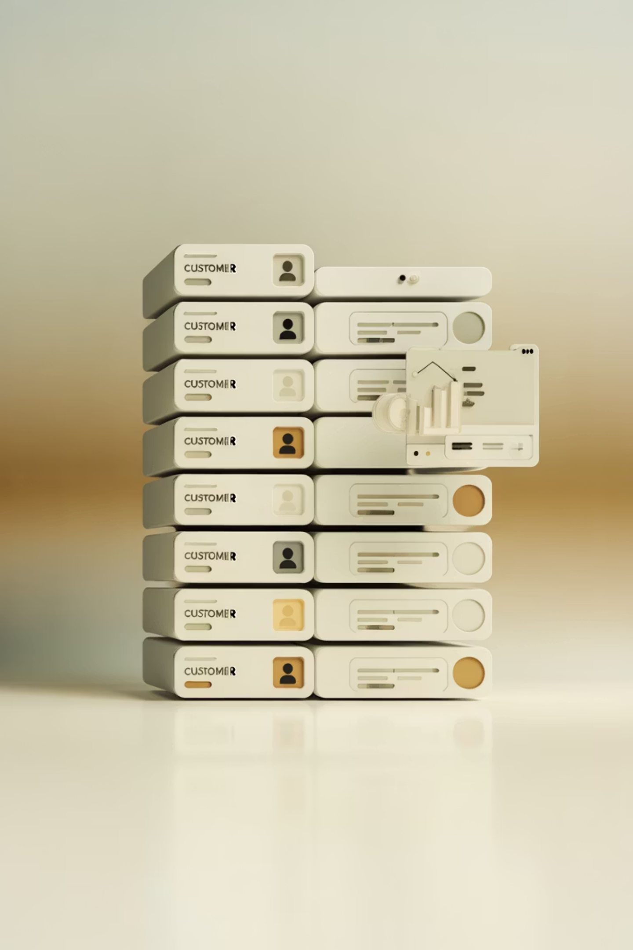
Dataset Overview
Dataset Scale
3,900 purchases analyzed across 18 columns capturing comprehensive customer and transaction data.
Customer Demographics
Age, gender, location, and subscription status tracked across all transactions.
Purchase Details
Item purchased, category, amount, season, size, color, and shipping type documented.
Data Quality
37 missing values in Review Rating column; all other fields complete and validated.

Slide 4
Data Preparation & Cleaning
01
02
03
Data Loading
Missing Data Handling
Column Standardization
Imported 3,900 transaction records using pandas for initial exploration and validation.
Imputed 37 missing Review Rating values using median ratings by product category.
Renamed all columns to snake_case format for consistency and improved readability.
04
05
Feature Engineering
Database Integration
Created age_group bins and purchase_frequency_days columns for deeper segmentation analysis.
Connected Python script to PostgreSQL and loaded cleaned data for SQL-based business analysis.

Slide 5
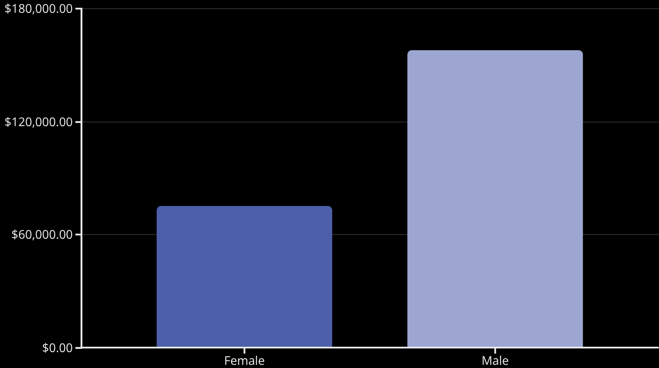
Revenue Analysis by Customer Segment
Revenue by Gender
Male customers generated significantly higher revenue at $157,890 compared to female customers at $75,191, representing a 2:1 ratio in spending contribution.

Slide 6
Customer Segmentation & Subscription Insights
3,116
701
83
Loyal Customers
Returning Customers
New Customers
Established customer base with strong repeat purchase history.
Growing segment showing consistent engagement and repeat behavior.
Entry-level segment representing growth opportunity for conversion.
Subscribers (1,053 customers) averaged $59.49 per purchase with $62,645 total revenue, while non-subscribers (2,847 customers) averaged $59.87 per purchase with $170,436 total revenue. Despite higher individual spending, non-subscribers represent the larger revenue base due to volume.

Slide 7
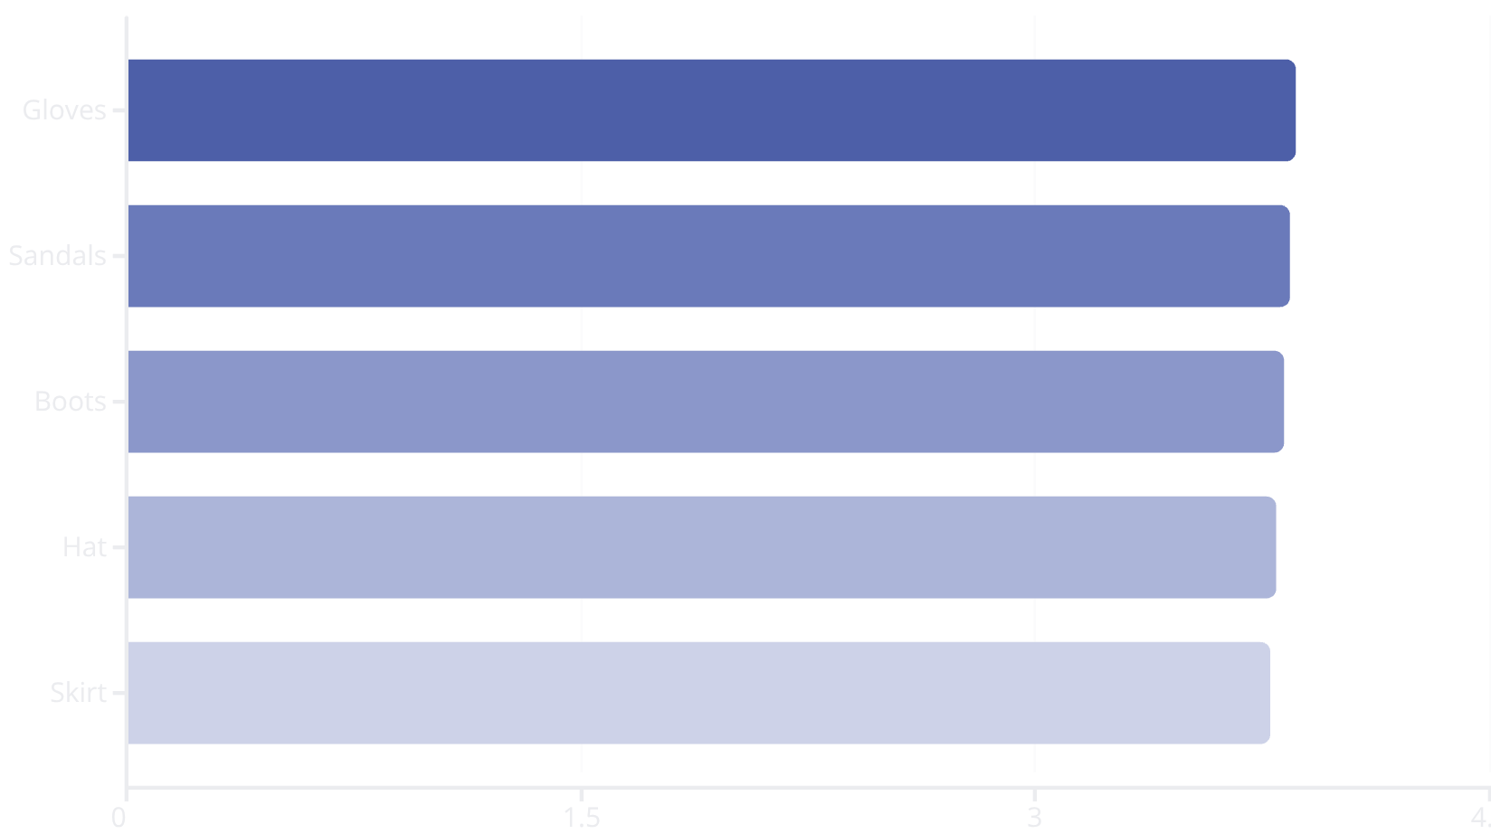
Product Performance & Ratings
Top-Rated Products
Gloves lead with 3.86 average rating, followed by Sandals (3.84), Boots (3.82), Hat (3.80), and Skirt (3.78). These products consistently deliver customer satisfaction and represent quality benchmarks for the portfolio.

Slide 8

Discount Strategy & Shipping Analysis
Discount-Dependent Products
High-Spending Discount Users
Hat (50%), Sneakers (49.66%), and Coat (49.07%) show highest discount rates, indicating price sensitivity in these categories.
839 customers used discounts while spending above average purchase amount, demonstrating effective promotional strategy.
Shipping Preferences
Express shipping averages $60.48 per order versus Standard shipping at $58.46, showing customers value speed for higher-value purchases.

Slide 9
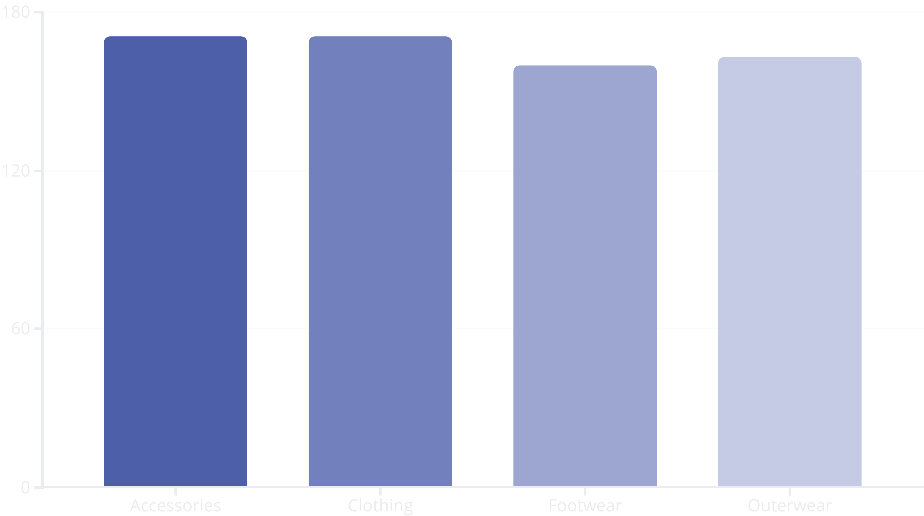
Category & Product Performance
Analysis across four major categories reveals distinct purchasing patterns. Accessories leads with Jewelry (171 orders), followed by Clothing with Blouse (171 orders), Footwear with Sandals (160 orders), and Outerwear with Jacket (163 orders). Each category demonstrates strong performance with balanced product distribution.

Slide 10
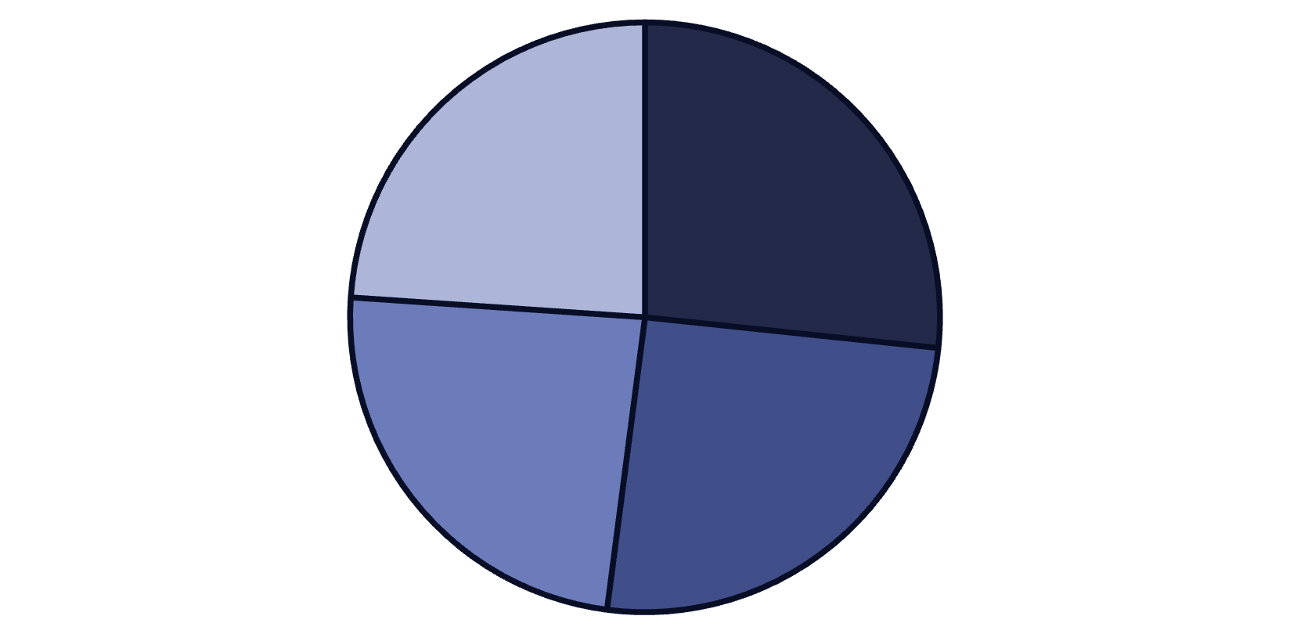
Revenue by Age Group & Repeat Buyer Insights
Age Group Revenue Distribution
Young Adults lead with $62,143 total revenue, followed by Middle-aged ($59,197), Adult ($55,978), and Senior ($55,763) segments. Young Adults represent the highest-value demographic, suggesting targeted marketing opportunities.
Young Adult
Middle-aged
Adult
Senior
Repeat buyers with 5+ purchases show strong subscription correlation: 958 subscribers versus 2,518 non-subscribers, indicating subscription programs effectively retain high-frequency purchasers.

Slide 11
Strategic Business Recommendations
1
Boost Subscriptions
Promote exclusive subscriber benefits and loyalty rewards to increase the 1,053 current subscribers and capture higher lifetime value from repeat customers.
2
Customer Loyalty Programs
Reward repeat buyers to move 701 returning customers into the 3,116-strong loyal segment, maximizing retention and repeat purchase frequency.
3
Review Discount Policy
Balance promotional effectiveness with margin control by analyzing the 50% discount rate on Hats and similar high-discount products for profitability optimization.
4
Product Positioning
Highlight top-rated products (Gloves 3.86, Sandals 3.84) and best-sellers (Blouse, Jewelry 171 orders) in marketing campaigns to drive conversion.
5
Targeted Marketing
Focus efforts on high-revenue Young Adult segment ($62,143), male customers ($157,890), and express-shipping users who demonstrate higher purchase values.

