Slide 1

Leaf Disease Prediction
By
Abhay Prasad
(B.Tech 3rd Year, Enrollment No.: 12021002026024)
Arya Kumar Johary
(B.Tech 3rd Year, Enrollment No.: 12021002026028)
Under the Supervision of
Prof Hriday Banerjee & Prof. Sagarika Ghosh
Dept. of Computer Science & Engineering
University of Engineering & Management, Jaipur

Slide 2
Outlines
Introduction
Literature Review
Objectives
Proposed Model
Experimental Setup
Result Analysis
Conclusion & Future Scope
Reference
Acknowledgement

Slide 3
Introduction
Problem Statement- To develop a model which can predict the crop disease by providing the images of the leaves .
Agriculture is crucial for economies like India. Key challenges include weather conditions and crop diseases, which can significantly impact yield. Digitalizing the identification and classification of diseases can help agriculturists by reducing time and increasing precision. Potatoes, a staple in India, can suffer from diseases like late blight and early blight. Traditional identification methods are time-consuming and require expertise. Image analysis can effectively monitor and identify plant diseases by recognizing patterns on leaves. These patterns are compared with historical data to classify the disease using machine learning and deep learning methodologies. This combination is effective in disease identification and classification, leading to better crop management and yield.
.

Slide 4
Literature Review
Author(s) | Date | Description
Monzurul Islam | 2017 | Proposed an automated system that uses image processing and machine learning to diagnose leaf diseases. The system, which uses multiclass SVM for image segmentation, can identify primary diseases in potatoes with high accuracy.
Harshal Waghmare and Radha Kokare | 2016 | Developed a method for detecting grape leaf diseases. The method uses image segmentation and a high-pass filter to analyze diseased components, and multiclass SVM to classify the diseases based on texture patterns.
Mrs. Shruthi U | 2019 | Demonstrated the use of machine learning methods for disease classification. The paper outlines the process of disease identification, from data acquisition to feature extraction and classification.

Slide 5
Objectives
Develop a reliable, convenient, and accurate system.
Identify causal agents of potato diseases, including fungi, bacteria, viruses, and nematodes.
Characterize symptoms and damage caused by each type of potato disease and their impact on yield and economic outcomes
Develop a classification system for potato diseases based on their characteristics, transmission mode, favorable environmental conditions, and diagnosis methods.
Provide guidance to growers, researchers, and stakeholders on effective disease management and control strategies

Slide 6
Proposed Model
Image Acquisition
Image Pre
Image Segmentation
-
Processing
Evaluate
the affected
Extraction of Features
regions
Processed Data
Testing Data
Training Data
Classifier Model
Classification
Evaluation Metrics

Slide 7
Experimental Set-up
IMAGE
CNN
TEXT DATA
SOFTMAX
DISEASE PREDICTION

Slide 8
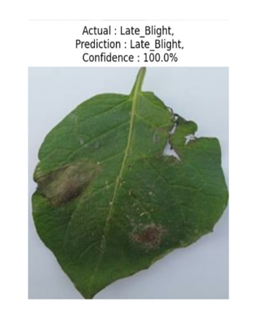
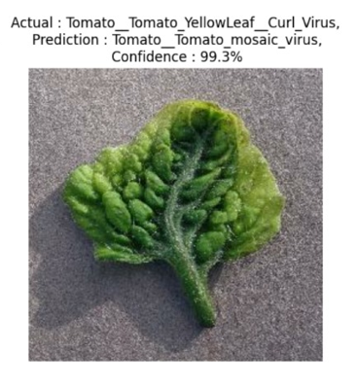
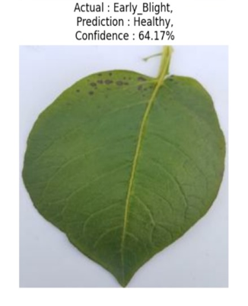
Result: Example
Fig. Tomato Leaf Prediction
Fig. Potato Leaf Prediction
Fig. Pepper Leaf Prediction

Slide 9
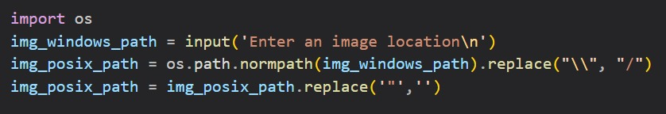
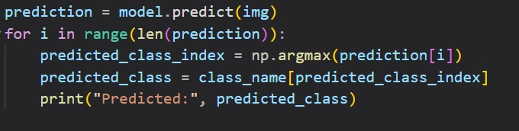

Result Analysis

Slide 10
Limitation
Difficulty with Unusual or Unseen Content
Sensitivity to Image Quality
Over-Reliance on Training Data
Difficulty in Abstract Conceptualization
Inability to Provide Real-Time Descriptions

Slide 11
Conclusions & Future Scope
A CNN-based model was developed to classify potato leaf conditions, achieving 96.93% accuracy. The aim is to digitalize agriculture for better crop protection. The model can detect and classify affected and healthy potato leaves with over 90% accuracy. However, this can be improved by further research on CNN methodologies, including activation functions, batch normalizations, convolutional layers, and fully connected layers.
Future Scope:
Refining Deep Learning and CNN models can improve accuracy in predicting potato leaf diseases. Real-time prediction models, possibly using mobile devices or drones, can quickly detect and treat diseases in the field. Multi-class classification can predict different types of diseases simultaneously for comprehensive management. Leveraging pre-trained models from related datasets or crops through transfer learning can enhance the prediction model's performance. Developing interpretable models can provide insights into important features in potato leaf images, increasing trust and adoption.

Slide 12
References
M. Islam, A. Dinh, K. Wahid, and P. Bhowmik, Detection of potato diseases using image segmentation and multiclass support vector machine 2017, Can. Conf. Electr. Comput. Eng.,
H. Waghmare, R. Kokare, and Y. Dandawate, Detection and classification of diseases of Grape plant using opposite color Local Binary Pattern feature and machine learning for automated Decision Support System 2016, 3rd Int. Conf. Signal Process. Integ. Networks,
U. Shruthi, V. Nagaveni, and B. K. Raghavendra, A Review on Machine Learning Classification Techniques for Plant Disease Detection 2019, 2019 5th Int. Conf. Adv. Comput. Commun.
R. Kaur and S. S. Kang, An enhancement in classifier support vector machine to improve plant disease detection, Proc. 2015 IEEE 3rd Int. Conf. MOOCs, Innov. Technol. Educ.,135–
S. Ramesh and D. Vydeki, Rice blast disease detection and classification using machine learning algorithm 2018, Proc.- 2nd Int. Conf. Micro-Electronics Telecommun. Eng., 255–9

Slide 13
Acknowledgement
The endless thanks goes to Lord Almighty for all the blessings he has showered onto us, which has enabled us to write this last note in our research work. During the period of our research, as in the rest of our life, we have been blessed by Almighty with some extraordinary people who have spun a web of support around us. Words can never be enough in expressing how grateful we are to those incredible people in our life who made this project possible. We would like an attempt to thank them for making our time during our research in the Institute a period we will treasure. We are deeply indebted to our research supervisor, Professor Sagarika Ghosh, who gave us such an interesting project topic. Each meeting with him added in valuable aspects to the implementation and broadened our perspective. He has guided us with his invaluable suggestions, lightened up the way in our darkest times and encouraged us a lot in the academic life.

Slide 14

Dept. of CSE, University of Engineering & Management Jaipur

