Slide 1

Sorting Algorithm Visualizer
By
Arya Kumar Johary and Abhay Prasad
Under the Supervision of
Prof. Sagarika Ghosh, Prof. Hriday Banerjee
Dept. of Computer Science & Engineering
University of Engineering & Management, Jaipur

Slide 2
Outlines
Introduction
Literature Review
Objectives
Proposed Model
Experimental Setup
Result Analysis
Conclusion
Future Scope
Reference
Acknowledgement

Slide 3
Introduction
The Sorting Algorithm Visualizer is a web-based tool developed with React.js. It provides real-time animations of various sorting algorithms, aiding in the comprehension of these fundamental computer science concepts. The visualizer operates on an array of data, each element represented as a box in a histogram. As the sorting progresses, the boxes rearrange, visually demonstrating the data manipulation. It includes algorithms like Bubble Sort, Selection Sort, Insertion Sort, and Merge Sort, catering to different complexity levels. The use of React.js ensures efficient component updates and rendering, enhancing user experience. This tool serves as a valuable resource for learners, educators, and enthusiasts, offering insights into the mechanics of sorting algorithms.

Slide 4
Literature Review
Author(s) | Date | Description
Shubham Nath, Jatin Gupta, Abhinav Gupta, Teena Verma | 2021 | The research paper presents a web-based animation tool for visualizing sorting algorithms, aiding algorithm comprehension. Despite memory issues, student feedback was generally positive. Future work includes addressing memory constraints and making the tool publicly available.
Shankar M. Patil, Ankit Josh | 2022 | introduces web-based visualization tools for famous sorting and pathfinding algorithms. It utilizes WebGL libraries like ThreeJS for 3D rendering and React for frontend. Sorting algorithms are animated using bar charts, while pathfinding algorithms are visualized in a 3D maze environment
Prof. Abhijeet Thakare1 , Naziya Siddiqui2 , Kalyani Dhoke | 2023 | A comprehensive tool built to understand sorting algorithms through visual representations. With features like speech recognition for note-taking and customizable array sizing, it facilitates efficient learning.

Slide 5
Objectives
Interactive Learning: To provide an interactive interface and enable users to manipulate data sets and observe the sorting process in real-time.
Algorithm Comparison: Allow users to compare different sorting algorithms based on their execution time and efficiency, providing insights into their performance characteristics.
User-Friendly Interface: The application must features a clean, intuitive interface, ensuring a seamless user experience and easy navigation.
Open Source Contribution: This project is going to be open-source, encouraging community contributions and fostering a collaborative learning environment.
Educational Tool: This visualizer should serve as a practical learning resource, transforming abstract sorting algorithms into tangible visuals, enhancing comprehension and retention.

Slide 6
Proposed Model
Start
Main Page
User Input Array
Random Array
Choose Algorithm
Animation Controller
Time Controller
Main Animation
Sorted Array

Slide 7
Experimental Set-up
Landing Page using React JS
Array Creation – User Given/Random
Perform Sorting /
Select Algorithm
Visualization /
Comparison of different algorithms
Sorting Performed
By showing animations
Sorted Array

Slide 8
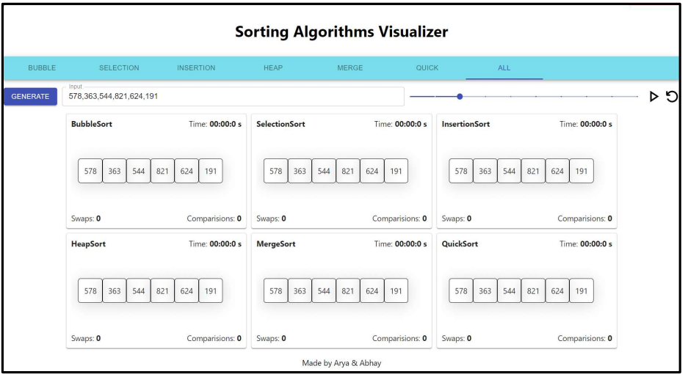
Result Analysis
Fig. After selecting the "generate new
array" button, random array boxes are created.

Slide 9
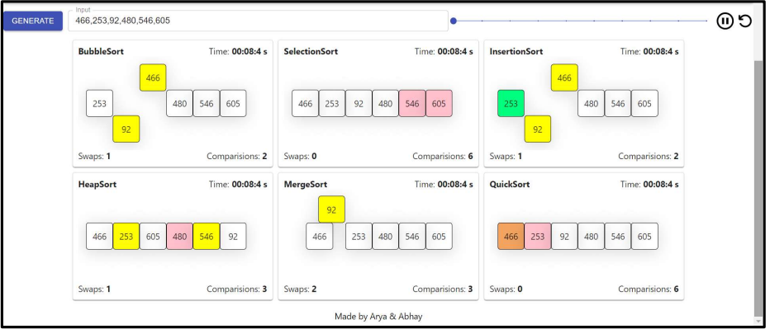
Result Analysis
Fig. The outcome of the merge sort visualization.

Slide 10
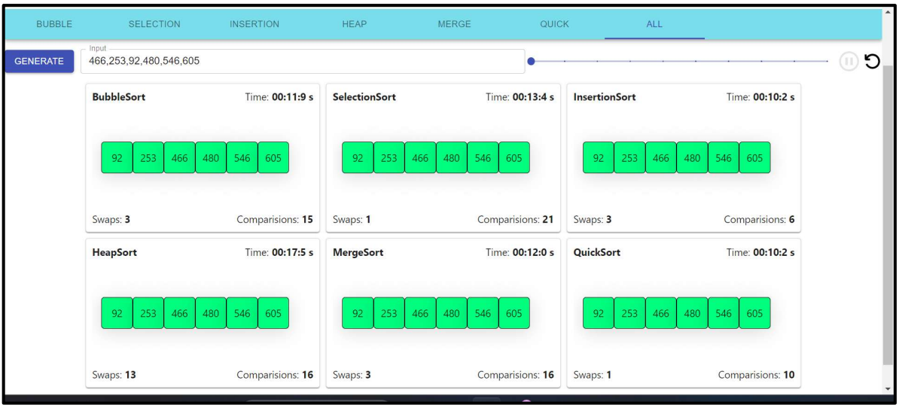
Result Analysis
Fig. Outcome obtained upon the completion of the merge sort visualization

Slide 11
Limitations
Algorithm Selection: The visualizer may not include all sorting algorithms, limiting the range of algorithms users can learn and compare.
Performance: The real-time animation of sorting processes can be slow for large data sets, potentially affecting user experience and learning outcomes.
Complexity: The visualizer simplifies algorithm operations for visualization purposes, which may not fully convey the mathematical complexity of these algorithms.
Interactivity: The visualizer may lack advanced interactive features like step-by-step execution or breakpoints, which could enhance the learning experience.
Scalability: The visualizer is designed for a certain range of data set sizes and may not work as expected with very small or very large data sets, limiting its scalability.

Slide 12
Conclusion
In conclusion, the Sorting Algorithm Visualizer serves as a powerful tool for understanding and comparing various sorting algorithms. Its interactive and visual nature makes learning more engaging and effective. Despite some limitations, the project demonstrates the potential of web technologies like HTML, CSS, JavaScript, and React in creating educational tools. The project not only contributes to the open-source community but also provides a platform for continuous learning and improvement. As we continue to enhance its features and expand its capabilities, we believe this tool will become even more valuable to both beginners and experienced programmers alike. We look forward to seeing how it evolves and contributes to the broader programming and educational community.

Slide 13
Future Scope
The tool could be expanded to include more sorting algorithms, such as Shell Sort, Radix Sort, and Bucket Sort. This would provide users with a more comprehensive understanding of sorting algorithms.
A feature could be added that allows users to modify existing algorithms or create their own. This would make the tool more interactive and could help users better understand the impact of different operations on the sorting process.
The tool could provide real-time performance metrics, such as the number of comparisons or swaps made, the time taken, and the memory used. This would help users understand the efficiency of different algorithms.
The visualizer could show pseudocode or actual code in multiple programming languages. This would make the tool useful to a wider audience.

Slide 14
References
[1] T. Bingmann. “The Sound of Sorting - ‘Audibilization’ and Visualization of Sorting Algorithms.” Panthemanet Weblog. Impressum, 22 May 2013. Web. 29 Mar. 2017.
<http://panthema.net/2013/sound-of-sorting/>.
[2] Bubble-sort with Hungarian (“Cs´ang´o”) Folk Dance. Dir. K´atai Zolt´an and T´oth L´aszl´o. YouTube. Sapientia University, 29 Mar. 2011. Web. 29 Mar.2017.
<https://www.youtube.com/watch?v=lyZQPjUT5B4> .
[3] A. Kerren and J. T. Stasko. (2002) Chapter 1 Algorithm Animation. In: Diehl S.(eds) Software Visualization. Lecture Notes in Computer Science, vol 2269. Springer, Berlin, Heidelberg.
[4] JHAVE: supporting algorithm visualization
https://ieeexplore.ieee.org/abstract/document/1 510539

Slide 15
Acknowledgement
The endless thanks goes to Lord Almighty for all the blessings he has showered onto us, which has enabled us to write this last note in our research work. During the period of our research, as in the rest of our life, we have been blessed by Almighty with some extraordinary people who have spun a web of support around us. Words can never be enough in expressing how grateful we are to those incredible people in our life who made this project possible. We would like an attempt to thank them for making our time during our research in the Institute a period we will treasure. We are deeply indebted to our research supervisor, Asst. Prof. Sagarika Ghosh , Asst. Prof. Hriday Banerjee who gave us such an interesting project topic. Each meeting with him added in valuable aspects to the implementation and broadened our perspective. He has guided us with his invaluable suggestions, lightened up the way in our darkest times and encouraged us a lot in the academic life.

Slide 16

Dept. of CSE, University of Engineering & Management Jaipur

