Slide 1
AI-Powered Collections Strategy
Leveraging Agentic AI for Scalable, Fair, and Effective Debt Management at Geldium

Slide 2
How the AI-Powered Collections System Works
1. Data Collection: Aggregate customer data from internal (transaction history, payment records) and external sources (credit bureaus, public records).
2. Data Processing & Feature Engineering: Clean, encode, and standardize data; engineer features such as missed payments, credit utilization, and account tenure.
3. Predictive Modeling: Apply trained AI models (Logistic Regression, XGBoost) to score delinquency risk for each customer.
4. Segmentation & Decision Logic: Segment customers by risk level and determine recommended actions (e.g., reminders, offers, escalations).
5. Action Execution: Trigger automated communications (email/SMS), assign cases to agents, or offer support programs.
6. Learning Loop: Collect feedback on outcomes, monitor model performance, and retrain models regularly for continuous improvement.
Notes:
Prompts to try:
Generate a simple outline for an AI collections system workflow, including inputs, decision logic, action triggers, and learning loop.
List 3–5 key customer attributes that would be most predictive for collections decision-making, and explain why each one matters.
Suggest examples of business rules and AI-driven actions the system could use at different risk levels (e.g., low, medium, high risk).
Create a rough sketch or step-by-step description of how customer data flows through the system from intake to action.

Slide 3
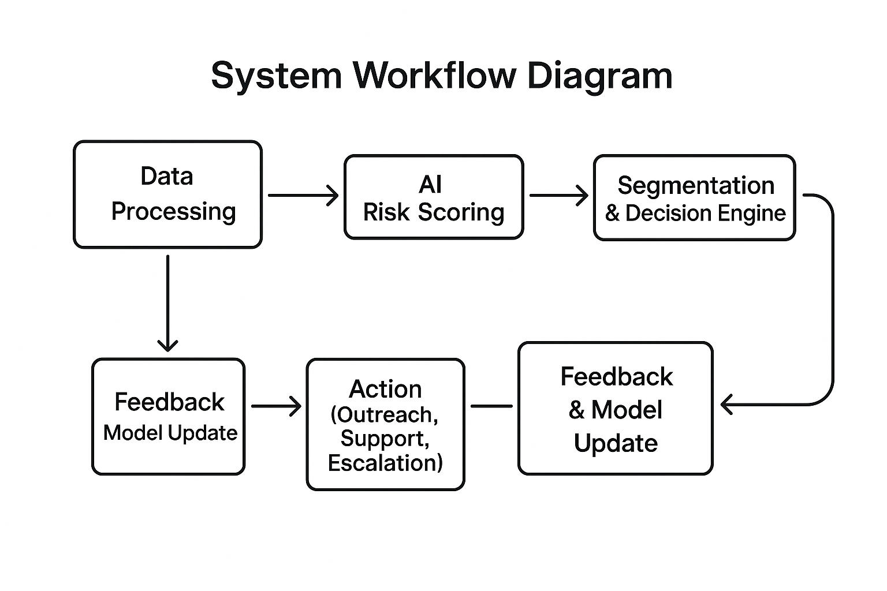

Slide 4
Data Inputs and Feature Importance
Key Data Inputs :
Payment history (missed payments, on-time payments)
Credit utilization ratio
Debt-to-income ratio
Loan balance and account tenure
Demographic data (age, income)
Feature Importance :
Models consistently identify missed payments and high credit utilization as the strongest predictors of delinquency.

Slide 5
Model Decision Logic
Customers are assigned a risk score based on model outputs.
Decision thresholds are set to segment customers into low, medium, and high risk.
High-risk customers receive proactive outreach and support offers.
Medium-risk customers are monitored and receive periodic reminders.
Low-risk customers follow standard collection protocols.

Slide 6
Role of Agentic AI
Autonomous Activities | Human Oversight Activities
Automated risk scoring and segmentation | Reviewing edge cases or escalations
Triggering standard reminders and outreach | Approving high-impact or sensitive actions
Routine model retraining and monitoring | Monitoring model fairness and compliance
Generating reports and dashboards | Handling customer complaints/appeals
Notes:
Prompts to try:
Explain how agentic AI could automate financial collections while keeping humans in critical decision points.
List 3–5 examples of collection actions, and classify each as best suited for full automation or requiring human oversight, with a brief reason why.

Slide 7
Responsible AI Guardrails
Bias & Fairness Audits: Regularly test for disparate impact across demographic groups; adjust models as needed.
Explainability: Use interpretable models and provide clear explanations for decisions to customers and staff.
Regulatory Compliance: Ensure all processes comply with financial regulations (e.g., fair lending, data privacy).
Human-in-the-Loop: Maintain human review for high-stakes or sensitive decisions.
Data Privacy & Security: Protect customer data throughout the lifecycle.
Notes:
Prompts to try:
List key fairness, transparency, and compliance practices to build into an AI-powered credit collections system.
Suggest specific ways to monitor and audit the system over time to ensure it stays fair, compliant, and effective.

Slide 8
Expected Business Impact
Business KPIs :
Reduced delinquency rates and charge-offs
Increased collections efficiency and cost savings
Improved risk segmentation and resource allocation
Enhanced compliance and audit readiness
Customer Outcomes :
More personalized and timely outreach
Improved customer experience and trust
Proactive support for at-risk customers
Greater transparency and fairness in decision-making
Notes:
Prompts to try:
Suggest KPIs for an AI-powered collections strategy that balances business outcomes with customer fairness.
Describe 2–3 ways an AI collections system could improve both operational efficiency and customer experience.

