Slide 1
Basics of robotics
Arya Rajiv Chaloli

Slide 2
THE CONCEPT
The basic concept behind the engineering of any robot is the union of the microcontroller, the actuators and the sensors.
SENSORS : are the physical interface of the robotic system with the environment. They take in readings of the surrounding conditions and give it to the microcontroller for further processing.
MICROCONTROLLER : is that unit of a robotic system that takes in data from the sensors, and accordingly gives instructions to the actuators.
ACTUATORS : are the elements of the robotic system that perform operations on the surroundings according to the instructions given by the microcontroller. They may also give a feedback to the system through the sensors.

Slide 3
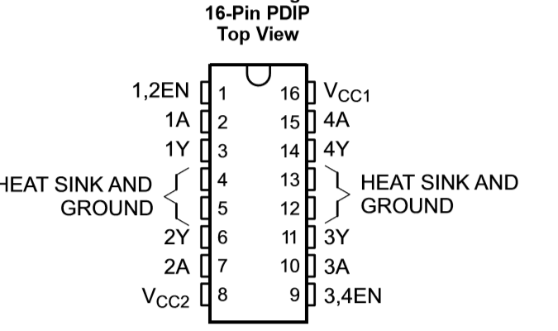
ACTUATORS
ACTUATORS : are the elements of the robotic system that perform operations on the surroundings according to the instructions given by the microcontroller. They may also give a feedback to the system through the sensors.
For Eg : The DC motors. To control it one needs a motor driver like the L293D this is required to meet the desired current requirements of the DC motor. Alternatively one could also used the H Bridge.
Other actuators may include LEDs, buzzers, a display panel, various other kinds of motors like the servo motor, stepper motor etc.

Slide 4
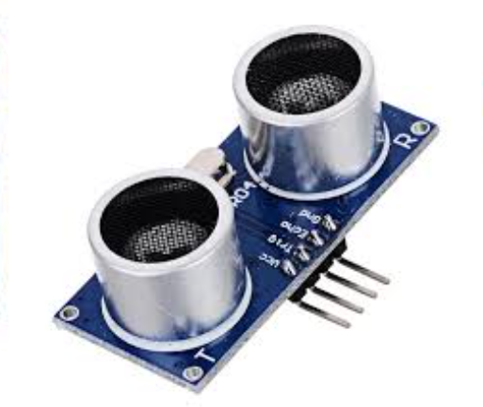
SENSORS
SENSORS : are the physical interface of the robotic system with the environment. They take in readings of the surrounding conditions and give it to the microcontroller for further processing.
For example : UV, IR, Ultrasonic, temperature sensors , LDRs etc.

Slide 5
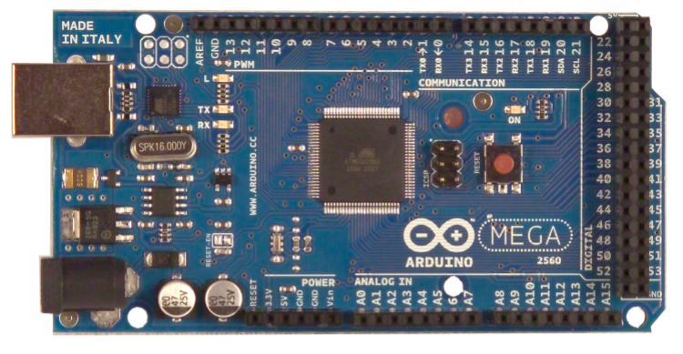
MICROCONTROLLERS
A micro-controller is a small computer on a single integrated circuit containing a processor core, memory, and programmable input/output peripherals
Eg : ATMEGA328 microcontroller of the Arduino Uno
And the ATMEGA2560 microcontroller of the Arduino Mega

Slide 6
THE ARDUINO-MEGA 2560
Microcontroller | ATmega2560
Operating Voltage | 5V
Input Voltage (recommended) | 7-12V
Input Voltage (limits) | 6-20V
Digital I/O Pins | 54 (of which 14 provide PWM output)
Analog Input Pins | 16
DC Current per I/O pin | 40 mA
Flash Memory | 256 KB
Clock Speed | 16 MHz

Slide 7
PROGRAMMING IT …. ;
Using the arduino IDE
Programming is very similar to the C++ programming style
Setup() : is run once. Used to initialize the variables and configure the ports that are going to be used. (the ports are initialised using the pinMode(pin,mode) finction).
The loop() is the part of the program that is executed continuously over and over again.
Can perform digital operations using the :
digitalWrite(pin ,value)
DigitalRead(pin)
Can perform analog operations using the :
analogWrite(pin ,value) //0-255 //PWM
analogRead(pin) //0-1023

Slide 8
COMMUNICATION
UART (Universal Asynchronous Receiver/Transmitter)is the harbour that takes care of all the data movement
Usually has a start bit ,stopbit and parity
The ATmega2560 provides four hardware UARTs for TTL (5V) serial communication.
In general pins 0 and 1 are the receiver and the transmitter pins of the Arduino board respectively
Baud Rate : the speed at which communication occurs.fro proper communication to take place one must ensure that the speed of reception is equal to the speed of transmission
SoftwareSerial library allows for serial communication
Begin() : starts the communication.

Slide 9
WIRED COMMUNICATION
The python serial library called Pyserial is a python implementation of accessing the serial ports of the PC.
It has the serial functions like :
Serial.available() // to check if there is data waiting at the port.
Serial.write()
Serial.println() etc
The usb port to which the Arduino is connected is accessed using the “COM” port option.
Pyserial helps read data from the Arduino to the python program and also send an output back to the Arduino.

Slide 10
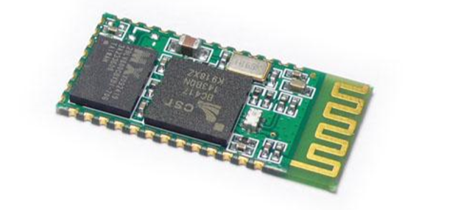
BLUETOOTH COMMUNIACTION
HC 05
HC-05 module is an easy to use Bluetooth SPP (Serial Port Protocol) module, designed for transparent wireless serial connection setup.
This Bluetooth module receives and transmits data serially (bit by bit).
Default Baud rate: 38400 but also supports baud rates 9600, 19200 etc
Can take 3.3 to 5 V

Slide 11
THE PROCESSOR AND THE SIMULATOR
The Arduino has limited processing capabilities (for eg ; the clock speed of the arduino is just 16 MHz)
Hence it needs an external processor or operating system.
This in the present scenario can be done using the help of ROS (Robotic operating system)
We also use simulators. To simulate the system before practical application. For eg : VREP, Gazebo etc

Slide 12
THE PROCESSOR
When a robotic system is programmed professionally, we use exteral operating systems for the following purposes:
Management of resourses
Abstarction
A example for a custom OS for robotic systems is ROS
4 Major parts of a typical ROS system is :
Nodes : the individual elements of the robotic system
Messages : the data that is transferred between the nodes of the system. this is the way the nodes communicate to each other.
Publishers : are the nodes that are sending data
Subscribers : are the nodes on the receiving end.

Slide 13
AN EXAMPLE
In devising a robotic arm : there could be three fingers with 2 joints each.
When the tips or the lower ends of the fingers recognise the presence of the object, it passes a message to the main arm to lower itself down.
Once the arm is lowered, the upper finger-joints are brought closer to each other , to grab the object.
After the object is grabbed, the main arm is sent a message to be raised up.
In this process, the nodes are the motors at the finger joints, and the motor that raises and lowers the arm.
The data sent from one node to another are the messages.
The data senders are the publishers and the data receivers are the subscribers.

Slide 14
THANK-YOU

