Slide 1


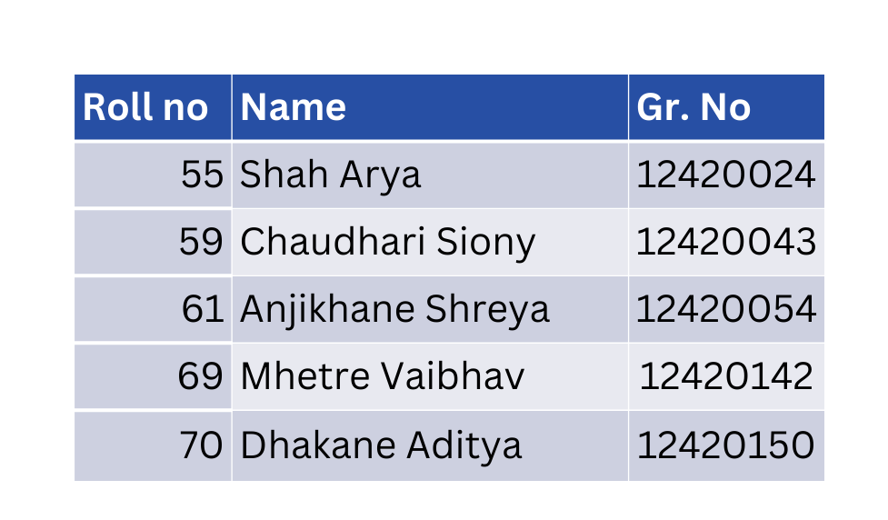
Vishwakarma Institute of Technology,Pune
Department of Artificial Intelligence and Data Science
A.Y.(2025-2026) SEM I
Division – AI&DS B
Date – 23/09/2025
GR_ID - 07
Real-Timed Object Detection using YOLO
Presented By:
Project Guide :
Prof. (Dr.) Minal Yadavrao Barhate

Slide 2


Agenda
Abstract
Introduction
Literature Review
Motivation
Problem Statement
Objectives
Methodology, System Architecture
Domains, Technology, Tools
Individual Responsibilities
Conclusion & References

Slide 3
Abstract
This project focuses on developing a real-time object detection system using YOLO. Unlike traditional methods that struggle with speed and accuracy, YOLO performs detection in a single pass, enabling fast and reliable results. The system involves dataset collection, preprocessing, YOLO model training, optimization, and deployment using OpenCV. The outcome will be a high-performance detection model suitable for applications in surveillance, autonomous driving, and robotics.

Slide 4

Introduction
Object detection - identifying and locating objects in images/videos.
Real-time detection is essential for security, autonomous driving, robotics, and automation.
Traditional methods struggle with speed and accuracy.
YOLO (You Only Look Once) → A deep learning approach that achieves fast and accurate real-time object detection.

Slide 5

Literature Review
Sr No | Title of the Paper | Year Of Publication | Author | Methodology
01 | The YOLO Framework: A Comprehensive Review of Evolution, Applications, and Benchmarks in Object Detection | 2024 | Momina Liaqat Ali & Zhou Zhang | Survey of YOLO series up to YOLO-11: tracks architectural improvements, performance benchmarks, comparison across variants; covers applications & challenges like small object detection and robustness.
02 | Comparative Analysis of YOLO-Based Algorithms for Vehicle Detection in Aerial Imagery | 2025 | Amin Dustali, Mahdi Hasanlou, Seyed Majid Azimi | Empirical comparison of YOLO-v8-n, YOLO-v9-t, YOLO-v10-n, YOLO-v11-n on aerial imagery (vehicle detection); metrics: inference time, average precision; also tested on embedded GPU (Jetson) in challenging conditions.
03 | DP-YOLO: A Lightweight Real-Time Detection Algorithm for Rail Fastener Defects | 2025 | Lihua Chen, Qi Sun, Ziyang Han, Fengwen Zhai | Designed DP-YOLO from YOLOv5s with optimizations: Depthwise Separable Convolution Stage Partial (DSP), Position-Sensitive Channel Attention (PSCA), Ghost-C3 neck, loss function changes; improved mAP, reduced parameter count + compute cost.

Slide 6
Sr No | Title of the Paper | Year Of Publication | Author | Methodology
04 | A Decade of You Only Look Once (YOLO) for Object Detection | 2025 | Leo Thomas Ramos, Angel D. Sappa | Review over 10 years of YOLO: surveys architectural evolution, application domains, evaluation trends; also discusses ethical, deployment, and cross-domain concerns.
05 | YOLOv5, YOLOv8 and YOLOv10: The Go-To Detectors for Real-Time Vision | 2024 | Muhammad Hussain | Comparative review of YOLOv5, v8, v10: architecture changes (backbones, anchor vs anchor-free, feature extraction), suitability for deployment on edge devices; trade-offs between complexity and speed.

Slide 7
Motivation
Growing demand for real-time intelligent systems in surveillance, autonomous vehicles, and robotics.
Traditional detection methods lack speed and accuracy needed for live applications.
YOLO provides a solution with fast, reliable, and accurate object detection in real-world scenarios.
Motivated to build a system that can contribute to safety, automation, and advanced AI applications.

Slide 8

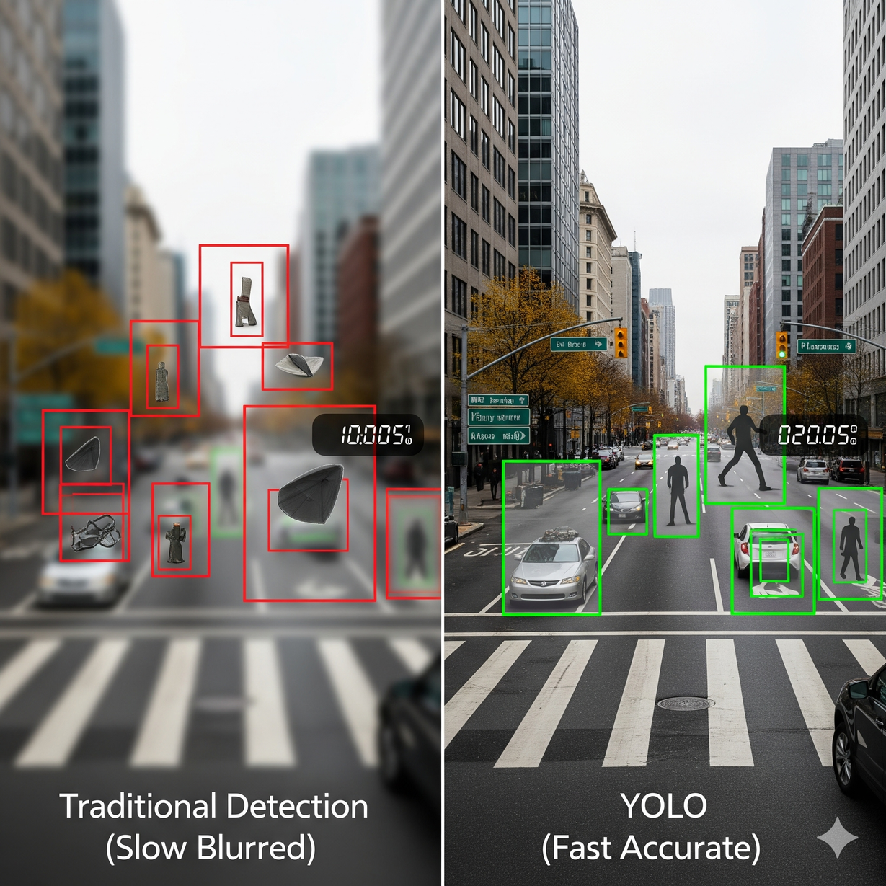
Problem Statement
Object detection is a key task in computer vision (identifying & locating objects in images/videos).
Traditional methods struggle with accuracy and real-time performance.
Need for a system that balances speed + accuracy in live video streams.
YOLO (You Only Look Once) provides fast and accurate detection, enabling applications in surveillance, autonomous driving, and robotics.

Slide 9
Objectives
Goals of the Project
01
02
03
04
Collect and preprocess image/video datasets containing various object classes.
Implement and train a YOLO-based model for real-time object detection.
Optimize the model for speed and accuracy also Test and evaluate performance using precision, recall, and mAP
Deploy the system as a real-time application using a webcam or video stream.

Slide 10
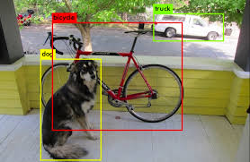
What is YOLO ?
YOLO (You Only Look Once) is a state-of-the-art, real-time object detection system.
Key Points:
YOLO treats object detection as a single regression problem.
It divides the image into a grid and directly predicts bounding boxes & class probabilities.
Popular for real-time applications (e.g., surveillance, autonomous driving).

Slide 11
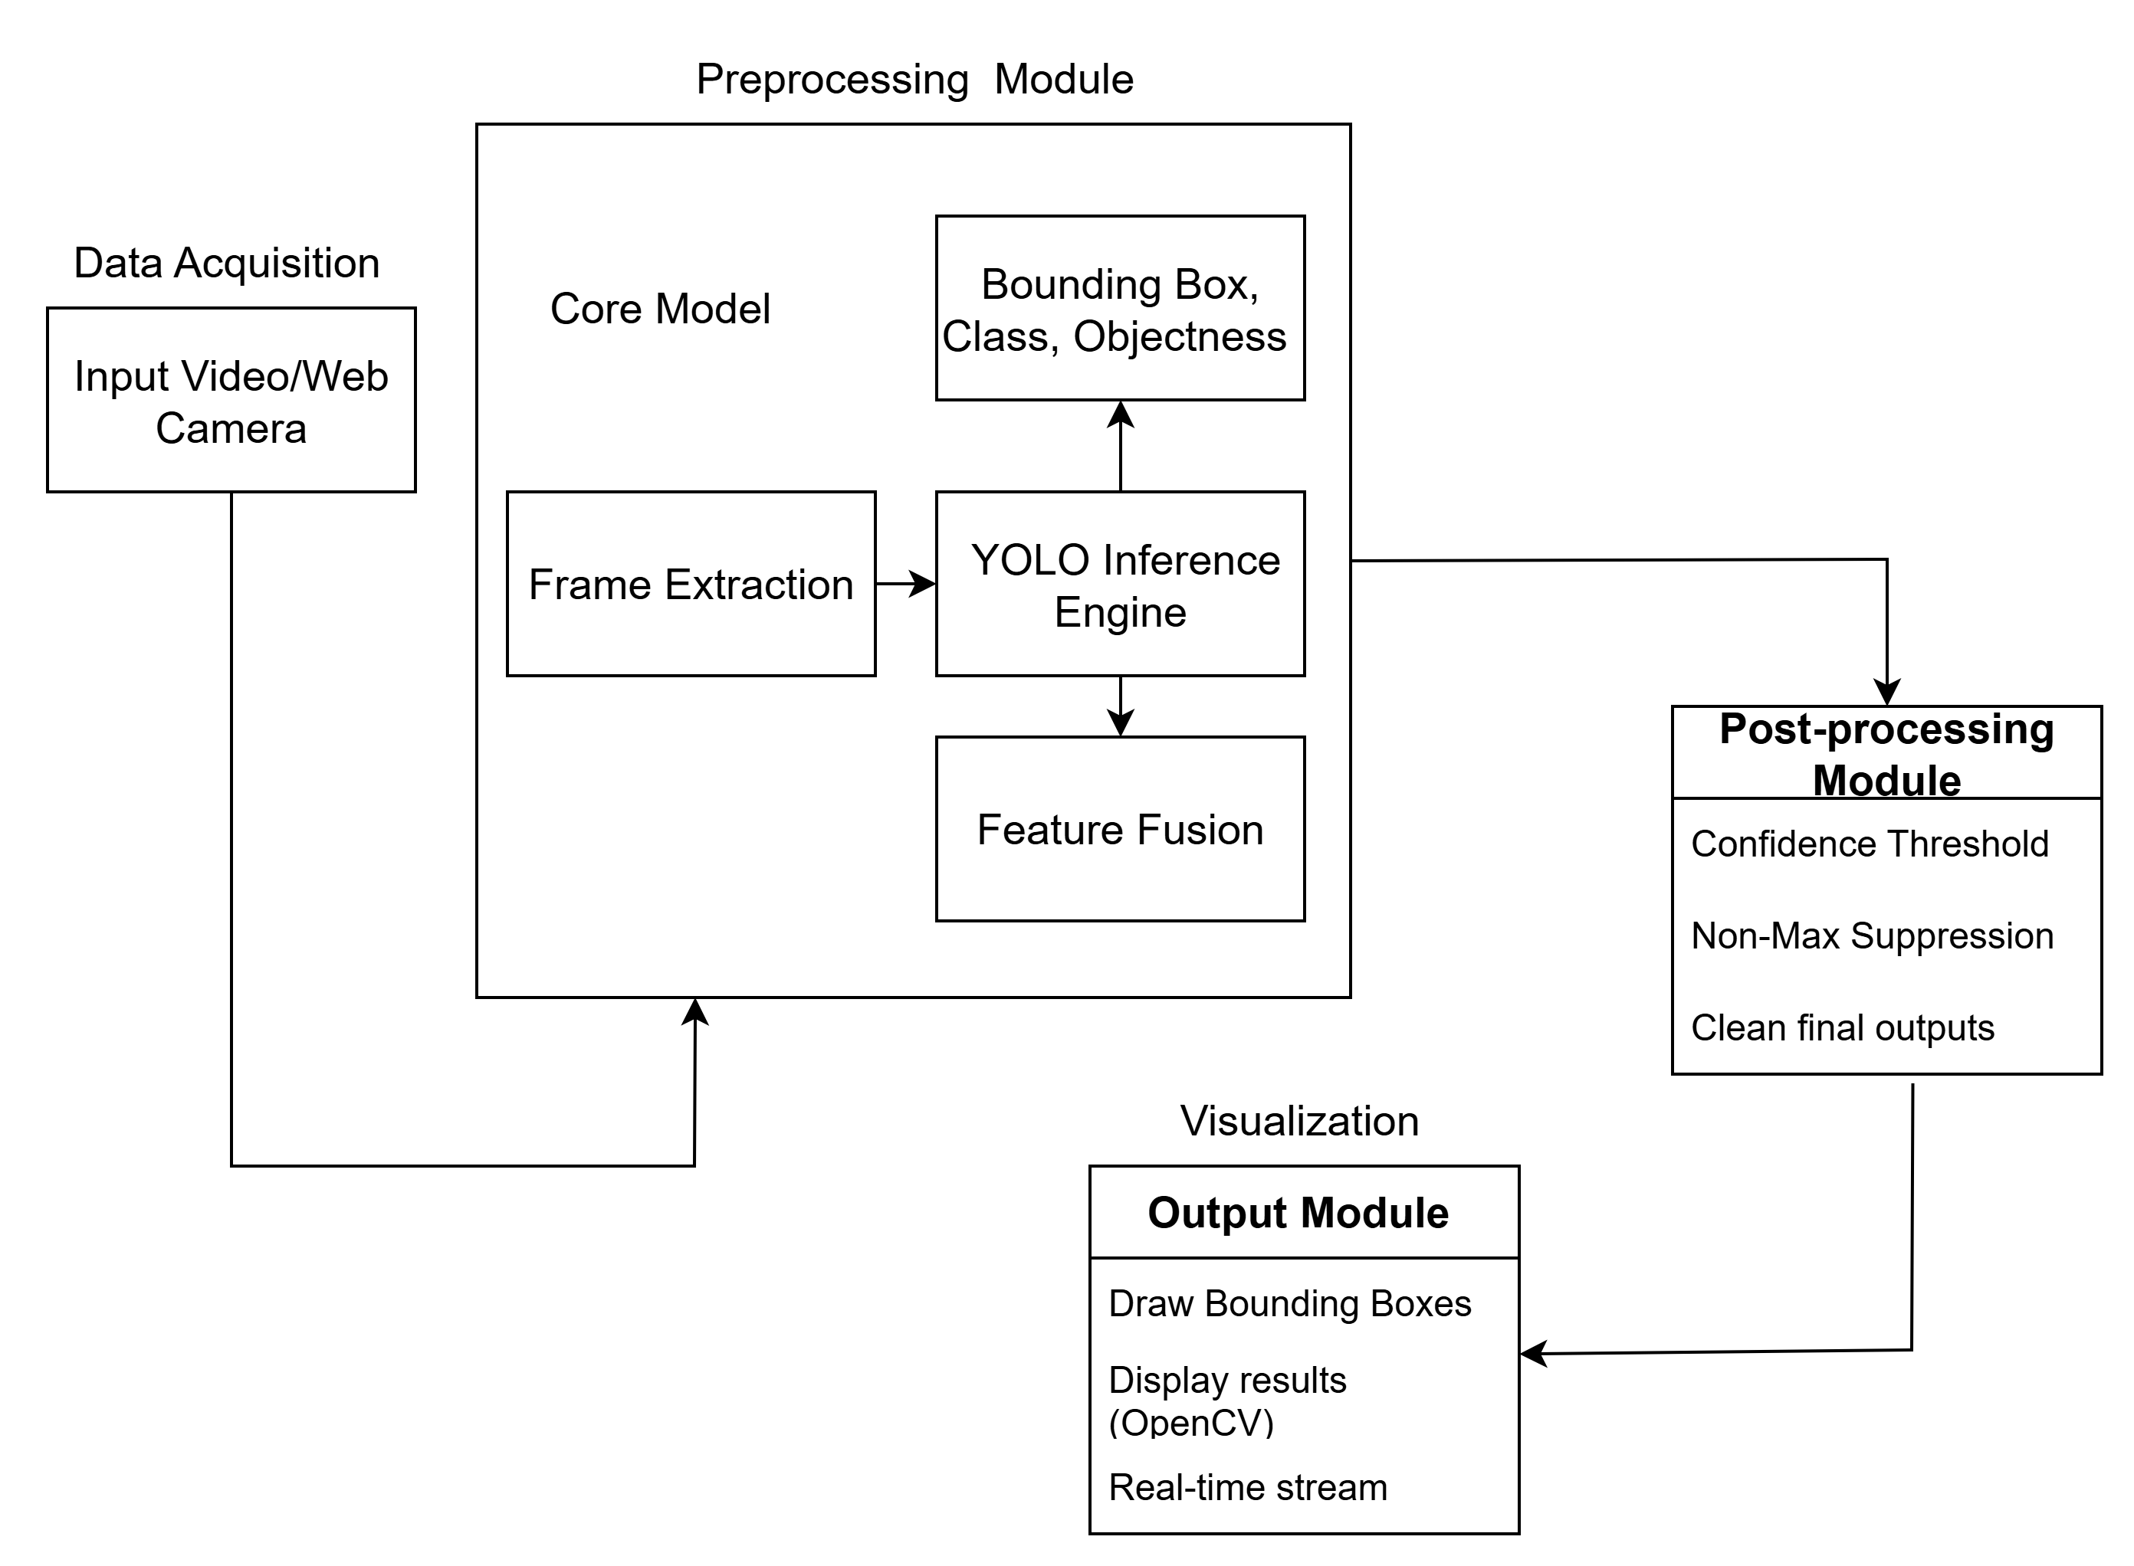
System Architecture

Slide 12
Methodology
Data Collection | Use datasets like COCO, Pascal VOC, or custom datasets.
Preprocessing | Perform image resizing, annotation formatting, and data augmentation.
Model Development | Implement YOLOv5/YOLOv8 using PyTorch framework.
Training & Testing | Train on GPU-enabled systems, fine-tune hyperparameters, and validate results.
Evaluation | Measure performance using Precision, Recall, F1-score, and mAP.
Deployment | Integrate with OpenCV for real-time detection on webcam/video streams.

Slide 13
Technologies
YOLOv5/YOLOv8, Deep Learning, PyTorch.
Domain
AI, ML, DL, Computer Vision, Image Processing, Edge AI, Robotics.
Tools
Python, OpenCV, LabelImg, Jupyter Notebook/Google Colab , GPU-enabled systems.

Slide 14
Roll no | Responsibility
55 | Data Collection & Preprocessing
59 | Model Development (YOLO setup)
61 | Training & Hyperparameter Tuning
69 | Evaluation & Performance Analysis
70 | Deployment (OpenCV integration, live detection)
INDIVIDUAL RESPONSIBILITIES

Slide 15
Conclusion
This project will implement a YOLO-based real-time object detection system capable of identifying and locating multiple objects within a video stream with high accuracy. It will enable applications in areas such as security, autonomous vehicles, and industrial automation, where rapid and reliable detection is essential.

Slide 16
References
Roboflow. Microsoft COCO Dataset on Roboflow Universe. Available at: https://universe.roboflow.com/microsoft/coco
Ultralytics. YOLOv8 Documentation. Available at: https://docs.ultralytics.com/models/yolov8/
Roboflow Blog. YOLO Object Detection Explained. Available at: https://blog.roboflow.com/yolo-object-detection/
OpenCV.ai Blog. YOLO Unraveled: A Clear Guide. Available at: https://www.opencv.ai/blog/yolo-unraveled-a-clear-guide
Neptune.ai. Object Detection with YOLO: Hands-on Tutorial. Available at: https://neptune.ai/blog/object-detection-with-yolo-hands-on-tutorial
PyTorch. PyTorch Documentation. Available at: https://pytorch.org

Slide 17

THANK YOU....!!

