Slide 1
SALES ANALYSIS & DASHBOARD
SALES PERFORMANCE
Beginner Level
By: ARYA SINHA
Data Analyst
ShadowFox Internship
https://github.com/AryaSinha075/ShadowFox_data_analyst

Slide 2
CONTENTS
1. Acknowledgement
6. Category & Regional Analysis
2. Beginner Level Task
7. Sales Representative & Product Analysis
3. Dataset & Data Cleaning
8. Customer Type & Sales Channel
4. Key Metrics
9. Dashboard & Business Insights
5. Monthly Sales Trend
10. Conclusion
2

Slide 3
ACKNOWLEDGEMENT
I would like to express my gratitude to ShadowFox for providing the opportunity to complete this Data Analyst internship task.
I am thankful for the opportunity to work on a practical sales dataset and apply spreadsheet-based data cleaning, analysis and visualization techniques.
The project was completed using Excel with a focus on clear analysis and business-oriented reporting.
3

Slide 4
BEGINNER LEVEL
Task: Sales Data Analysis and Spreadsheet Dashboard
Clean and organize the provided sales dataset.
Calculate key summary metrics for sales performance.
Analyze monthly, category, regional and sales representative performance.
Identify top-performing products and compare customer types and sales channels.
Create charts and a simple dashboard to communicate the findings.
4

Slide 5
DATASET & DATA CLEANING
Dataset structure
Cleaning / validation performed
Raw_Data — original dataset retained.
Cleaned_Data — validated dataset used for analysis.
Analysis — formulas, summaries, charts and insights.
Dashboard — final visual report.
Checked Sale_Date for blank values.
Checked Sales_Rep entries.
Removed duplicate records using all columns.
Validated quantity and price-related values.
Checked Discount values; observed range was 0%–30%.
5

Slide 6
KEY METRICS
TOTAL SALES
TOTAL QUANTITY SOLD
AVERAGE SALES
TRANSACTIONS
₹5,019,265.23
25,355
₹5,019.27
1,000
Average Discount: 15.24%
The analysis covers 1,000 transactions and total sales of more than ₹5 million. Average sales per transaction were approximately ₹5,019.27.
6

Slide 7
MONTHLY SALES TREND
Highest: January
₹495,420.37
Lowest: September
₹367,837.60
Sales fluctuate over the year, with stronger results in January, October and November.
7

Slide 8
CATEGORY & REGIONAL PERFORMANCE
Highest category: Clothing — ₹1,313,474.36
Highest region: North — ₹1,369,612.51
8

Slide 9
SALES REPRESENTATIVE & TOP PRODUCTS
Top representative: David — ₹1,141,737.36
Top product: 1099 — ₹101,773.87
9

Slide 10
CUSTOMER TYPE & SALES CHANNEL
Returning: ₹2,513,006.93
Retail: ₹2,560,431.30
10

Slide 11
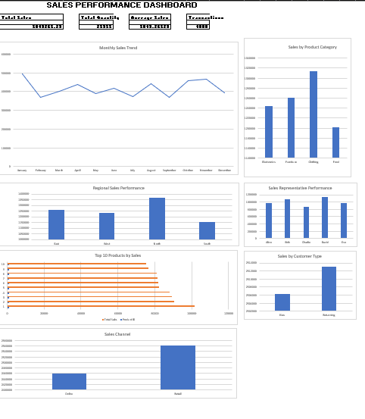
SALES PERFORMANCE DASHBOARD
11

Slide 12
BUSINESS INSIGHTS
North region recorded the highest sales, while South recorded the lowest.
Clothing was the highest-performing category, while Food had the lowest sales.
David was the top-performing sales representative, while Charlie had the lowest sales.
January recorded the highest monthly sales, while September recorded the lowest.
New and returning customers contributed almost equally to total sales.
Retail sales were slightly higher than online sales.
Product 1099 was the top-selling product in the Top 10 analysis.
The findings provide a clear view of where sales performance is strongest and where performance can be monitored further.
12

Slide 13
CONCLUSION
This beginner-level project provided practical experience in Excel-based data analysis and visualization.
Prepared and validated the sales dataset.
Calculated key sales and transaction metrics.
Analyzed time, category, region, representative, product, customer and channel performance.
Created charts and a consolidated dashboard.
Converted analysis results into concise business insights.
13

Slide 14
THANK YOU
SALES ANALYSIS & DASHBOARD
ARYA SINHA • DATA ANALYST
ShadowFox Internship • Beginner Level

