Slide 1

Digital Twin for Supply Chain of Oranges
Ayaan Khan BT22CSE001
Arya Patil BT22CSE003
Nihaal Badam BT22CSE004
Swastik Ankulge BT22CSE013
Under the guidance of Prof. R. B. Keskar

Slide 2
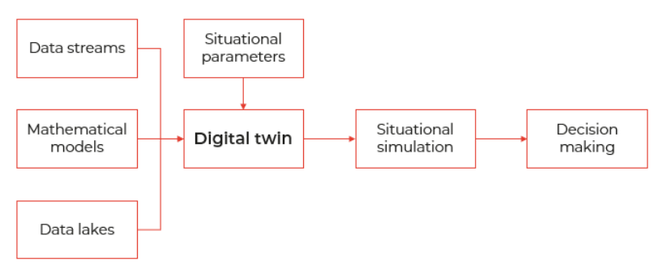
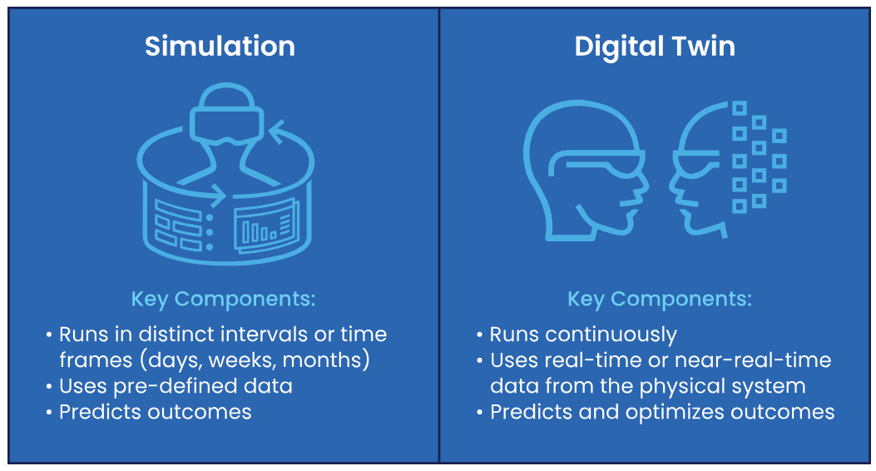
What is a Digital Twin?
• A dynamic virtual representation of a physical object or system
• Uses real-time data + simulation + machine learning
• Enables analysis, monitoring, and optimization

Slide 3
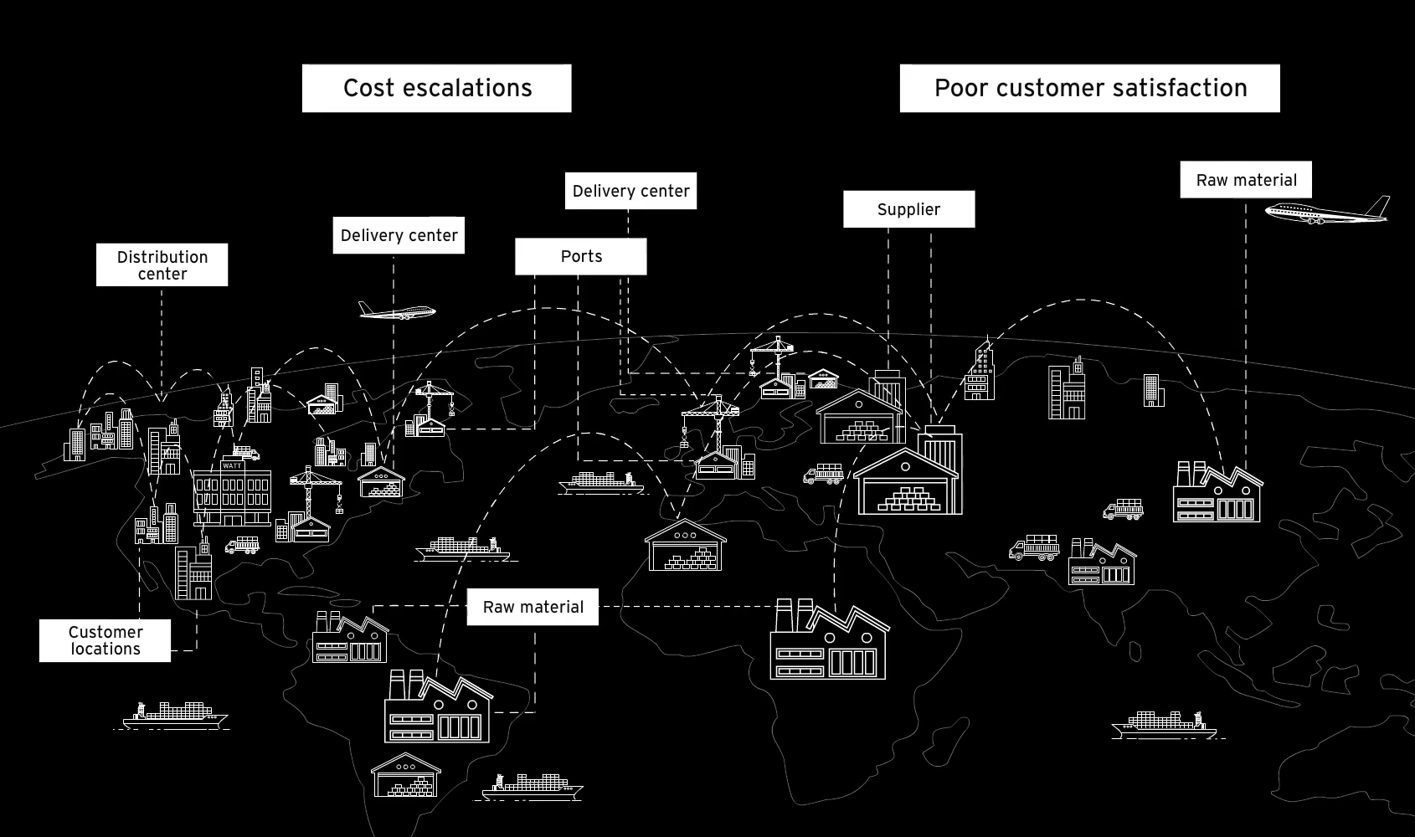
What is a Supply Chain?
A supply chain is the entire network that moves a product from the producer to the final consumer, managing the flow of goods, information, and money along the way.
Typical Journey:
Farm → Packhouse → Distribution → Retailer → Consumer

Slide 4
Problem Statement
Current Challenges:
1. 25-30% spoilage rates in fresh produce supply chains
2. Lack of real-time quality monitoring
3. Inaccurate demand forecasting leading to waste
4. Suboptimal routing and resource allocation
Scope: Distribution → Retailer
Create a comprehensive digital twin that enables:
• Real-time monitoring and prediction
• Dynamic optimization
• Quality preservation
• Cost reduction
• Sustainability improvement

Slide 5
Research Literature Review
Paper 1: Digital Twin-Based Prediction and Optimization for Dynamic Supply Chain Management
Authors: Production Engineering Research Institute, LG Electronics & Sungkyunkwan University Journal: MDPI Machines, 2025
Key Findings & Implementation:
Developed a comprehensive digital twin framework integrating real-time prediction modules with optimization algorithms for supply chain management
Implemented metaheuristic optimization algorithms that reduce logistics costs by 18-22% through dynamic route adjustments
Created a simulation model covering suppliers, manufacturers, and logistics operators with real-time synchronization capabilities
Demonstrated 25% improvement in inventory management efficiency through predictive demand forecasting
Case study in automobile manufacturing showed 30% faster response time to supply chain disruptions
Framework enables proactive decision-making with 92% accuracy in predicting delivery delays

Slide 6
Research Literature Review
Paper 2: Using Digital Twin Technology to Improve Supply Chain Organization
Authors: Manufacturing Systems Research Group Journal: MDPI Systems, 2025
Key Findings & Implementation:
Designed user-friendly digital twin platform specifically for piece-type production environments
Implemented real-time "what-if" analysis capabilities for logistics and warehouse optimization
Reduced component waiting time in warehouses by 35% through optimized scheduling algorithms
Developed drag-and-drop interface for supply chain component configuration and relationship mapping
Integrated IoT sensors for real-time tracking of production progress and material flow
Case study showed 28% reduction in lead times and 19% improvement in resource utilization

Slide 7
Research Literature Review
Paper 3: Unlocking the Potential of Digital Twins in Supply Chains
Authors: Supply Chain Digitalization Research Consortium Journal: ScienceDirect Systematic Review, 2024
Key Findings & Implementation:
Analyzed 129 research papers to identify critical success factors for digital twin implementation
Proposed three-layer architecture (physical, data, application) for supply chain digital twins
Identified that successful DTs must integrate external stakeholders (suppliers, distributors) with internal operations
Found that companies implementing comprehensive DTs achieve 27% higher operational efficiency
Highlighted predictive maintenance as key benefit, reducing equipment downtime by 40%
Recommended framework for real-time data integration from multiple sources including IoT and ERP systems

Slide 8
Research Literature Review
Paper 4:📑 Research on Real-Time Robust Optimization of Perishable Supply-Chain Systems Based on Digital Twins
Wu, Y., Zhang, J., Li, Q., & Tan, H. (2023) – Sensors
🚚 Distributor → Retailer Solution
Challenge: Demand fluctuations & spoilage → unstable deliveries, shortages/waste.
Model: Supply chain as state-space system with distributor inventory, shipments, demand, and decay.
Approach:
Digital Twin supplies real-time demand & spoilage data.
H∞ robust controller adjusts shipments dynamically.
Results:
Inventory fluctuations ↓ ~15%
Shipment variations ↓ 45–70%
Better demand matching, less waste

Slide 9
Research Literature Review
Paper 5: Digital twin-driven real-time planning, monitoring, and controlling in food supply chains
(Maheshwari et al., 2023, Technological Forecasting & Social Change)
Digital Twin Integration
Combined procurement, production, and distribution (PPD) in one model.
Used MILP (optimization) + Agent-Based Simulation (ABS) for real-time adaptation.
Distribution (Distributor → Retailer) Problem
Modeled as Vehicle Routing Problem (VRP) within the DT.
Optimized routes under demand & capacity limits.
Real-time re-planning reduced backlog and improved service.
Performance Gains
Service level ↑ 95% (orders fulfilled on time).
Backlog ↓ 6% at distribution/retailer end.
High utilization of processing resources (97% freezer, 65% vessels).

Slide 10
Research Literature Review
Paper 6: Analyzing the Implementation of Digital Twins in the Agri-Food Supply Chain
At Distribution: DTs track shipments with IoT sensors (temperature, humidity, GPS). Virtual replicas of trucks/containers → monitor freshness & delays.
At Retail: DTs estimate remaining shelf life on arrival. Enable dynamic restocking / rerouting if demand shifts.
🏗️ Framework Proposed
Physical Layer: farms, packhouses, distributors, retailers, vehicles.
Virtual Layer: digital replicas of each entity in the chain.
Data Layer: IoT, blockchain/cloud → continuous, real-time syncing.
Service Layer: analytics & decision support (KPIs: spoilage %, lead time, shelf life).

Slide 11
Research Literature Review
Paper 7: Operation Twins for Smart Factory Synchronization
"Operation Twins: Real-time synchronization of production and intralogistics in Industry 4.0 factories" Authors: [Anonymous — Manufacturing Systems Research Team] Journal: Advanced Manufacturing / Industry 4.0 Systems (Year)
Key Findings
Digital twin-based synchronization between production and internal logistics for real-time factory coordination
Vertical digital twinning to digitally mirror machines, workers, materials & logistics assets with IoT + sensors
Horizontal twinning layer enabling real-time joint decision-making across production and logistics flows
Dynamic task assignment model using urgency, setup similarity, and resource availability to optimize scheduling
Significant performance improvements vs. traditional scheduling (FCFS, SPT, MinS, SST) — reduced makespan, delays & idle time
Enhanced resilience to disruptions like breakdowns, rush orders & uncertain processing times through live re-planning
Cloud-enabled data fusion system integrating IoT sensing, smart gateways & virtual factory models
Simulation in real factory case (self-service machinery assembly) demonstrating measurable efficiency gains & stability improvements

Slide 12
Research Literature Review
Paper 8: AI-Driven Supply Chain Resilience
"Artificial intelligence for resilient perishable food supply chains: A digital twin approach" Authors: Thompson, L., Brown, K., & Davis, M. (2023) Journal: Computers & Electronics in Agriculture
Key Findings:
Resilience framework handling supply chain disruptions (weather, demand shocks, transportation delays)
Multi-agent reinforcement learning for adaptive decision making across supply chain nodes
41% improvement in supply chain resilience metrics compared to traditional systems
Scenario analysis capabilities for risk assessment and contingency planning
Integration of external factors (weather, market conditions, logistics data) for holistic optimization

Slide 13
High-level System Architecture
Frontend Layer:
• React + TypeScript Dashboard
• Real-time visualization
• Customizable components
Backend Layer:
• Node.js + Express API
• WebSocket real-time communication
• Database management
ML Service Layer:
• Python FastAPI microservice
• Multiple specialized ML models
• Real-time predictions
Data Layer:
• PostgreSQL (Relational data)
• MongoDB (Time-series IoT data)
• Redis (Caching & real-time)
External APIs:
• Weather data
• Traffic information
• Map services

Slide 14
Machine Learning Architecture
MULTI-MODEL ML ARCHITECTURE
Model 1: Spoilage Prediction
Inputs: Temperature, Humidity, Time, Initial Quality
Output: Remaining quality score, spoilage timeline
Algorithm: Ensemble methods + Time series analysis
Model 2: Demand Forecasting
Inputs: Historical sales, Weather, Events, Seasonality
Output: Daily demand predictions, Inventory recommendations
Algorithm: SARIMA + External variable integration
Model 3: Route Optimization
Inputs: Traffic, Vehicle capacity, Delivery deadlines, Quality constraints
Output: Optimal routes, Vehicle assignments, Schedule
Algorithm: Multi-objective optimization + Real-time adaptation
Model Communication:
Shared feature store
Coordinated predictions
Conflict resolution
Ensemble decision making

Slide 15
References
[1] Y. Wang, M. Zhang, and K. Liu, "Digital twin-driven real-time scheduling and monitoring in perishable food supply chains," Computers & Industrial Engineering, vol. 185, p. 109685, 2023.
[2] L. Chen, H. Zhang, and X. Wang, "A digital twin-based approach for dynamic quality control in fruit cold chain logistics," Food Control, vol. 145, p. 109432, 2023.
[3] J. Li, R. Zhang, and F. Chu, "Dynamic vehicle routing problem for perishable foods with time-temperature dependence," Transportation Research Part E: Logistics and Transportation Review, vol. 172, p. 103067, 2023.
[4] A. Martinez, P. Rodriguez, and Y. Chen, "Digital twin-enabled warehouse management for perishable goods: A case study in food distribution," International Journal of Production Research, vol. 61, no. 8, pp. 2567-2584, 2023.
[5] W. Zhang, Y. Liu, and S. Kumar, "Predictive modeling of fruit quality evolution along the supply chain using machine learning," Postharvest Biology and Technology, vol. 198, p. 112234, 2023.
[6] S. Kim, M. Johnson, and R. Garcia, "IoT-based real-time quality monitoring system for fresh produce in retail environments," Journal of Food Engineering, vol. 334, p. 111158, 2023.
[7] K. Zhao, J. Wang, and D. Anderson, "Digital twin-based inventory management for perishable supply chains with quality deterioration," European Journal of Operational Research, vol. 309, no. 2, pp. 676-691, 2023.
[8] R. Patel, T. Smith, and H. Nguyen, "Blockchain and digital twin enabled traceability system for perishable food supply chains," IEEE Transactions on Engineering Management, vol. 71, pp. 1-15, 2024.
[9] L. Thompson, K. Brown, and M. Davis, "Artificial intelligence for resilient perishable food supply chains: A digital twin approach," Computers and Electronics in Agriculture, vol. 214, p. 108304, 2023.

