Slide 1

Digital Twin for Perishable Food Supply Chain
Ayaan Khan BT22CSE001
Arya Patil BT22CSE003
Nihaal Badam BT22CSE004
Swastik Ankulge BT22CSE013
Under the guidance of Prof. R. B. Keskar

Slide 2
Project Recap
Project: A Digital Twin for perishable food logistics, starting with oranges (extensible)
Problem: High spoilage rates in the "last mile" due to poor monitoring and inflexible routing
Our Scope: Warehouse → Retailer
Key challenges:
Vehicle Routing/ Re-routing
Real-time Monitoring (temp, humidity)
Spoilage Prediction
Dynamic Disruptions (traffic, accidents)

Slide 3
Core Thesis
Concept:
Most DTs are passive dashboards. They show you a problem (ex: "This truck is too hot").
Our DT will be an autonomous control system. It will solve the problem.
The Loop:
Monitor (Simulated IoT): "A truck is in a traffic jam, and its temperature is 2°C above optimal."
Predict (ML): "At this rate, the oranges will lose 30% of their shelf life before reaching Retailer A."
Act (RL): "Autonomously reroute the truck to Retailer B, who is closer and has immediate demand, preserving the batch's value."

Slide 4
System Architecture
Concept: We will model supply chain as a graph, a common framework for logistics DTs.
Simple Visual Diagram:
Nodes: Warehouse, Retailer
Edges: Route (connecting nodes)
Agent: ex-Freight (traverses the graph)
Entity: OrangeBatch (the asset that moves through the system)
Extensibility: This graph structure allows us to easily add new nodes (e.g., new warehouses, new freights) or agents without re-architecting the core model.

Slide 5
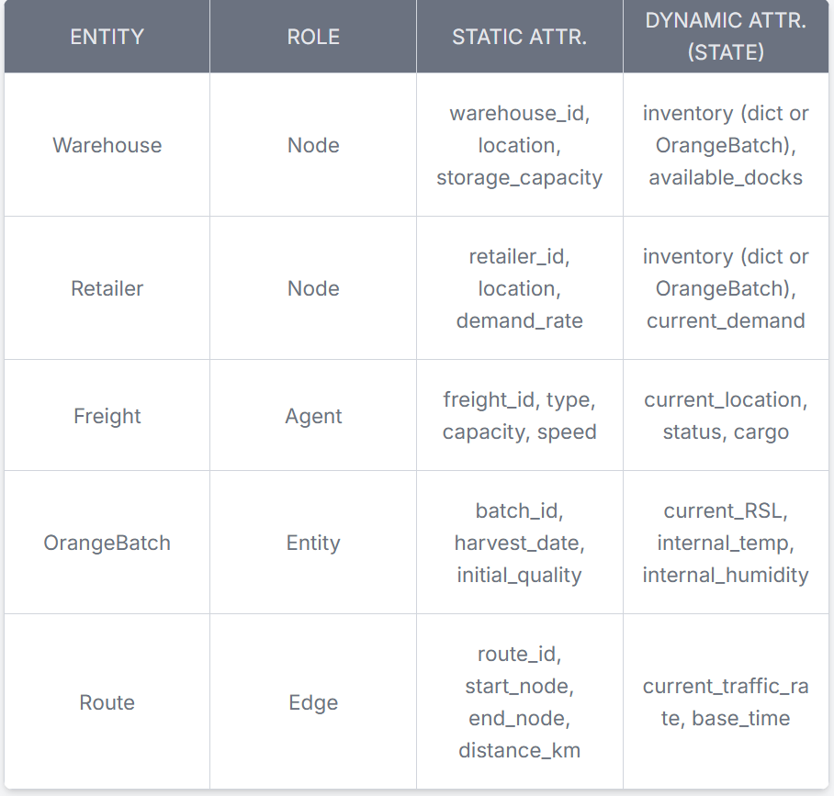
System Architecture: Components & Attributes
Concept: We will model the static supply chain as a graph, a common framework for logistics DTs.
Simple Visual Diagram:
Nodes: Warehouse, Retailer
Edges: Route (connecting nodes)
Agent: Freight (traverses the graph)
Entity: OrangeBatch (the asset that moves through the system)

Slide 6
Extensible Data Model
Concept: To meet the "extensible to other foods" requirement, we need a formal way to define relationships. We will adopt the W3C SOSA (Sensor, Observation, Sample, and Actuator)
Method 1: Freight.temperature = 2.5
Method 2: SOSA
sosa:Sensor (thermometer)
sosa:madeObservation (a reading)
sosa:FeatureOfInterest (the OrangeBatch)
Why:
To add Apples, we don't change the Freight or Sensor models.
We simply create a new sosa:FeatureOfInterest called AppleBatch.
This is makes it modular.

Slide 7
Datasets & Modeling
Problem: We don't have a real-world fleet of IoT sensors
Solution: A Hybrid Data Strategy to create a realistic, accurate simulation/representation
Bootstrapping the Data: Use public, static datasets to set the initial state of the simulation (ex: how much inventory does a warehouse start with initially, what rates does the warehouse receive oranges from the packhouses, etc.)
Generative Pattern Data: Use public IoT datasets as a pattern for our simulation (ex: what does a real traffic jam look like? What are real truck temperature fluctuations?)
Generative Scientific Data: Create our own high-value data (through spoilage function) using a validated scientific model

Slide 8
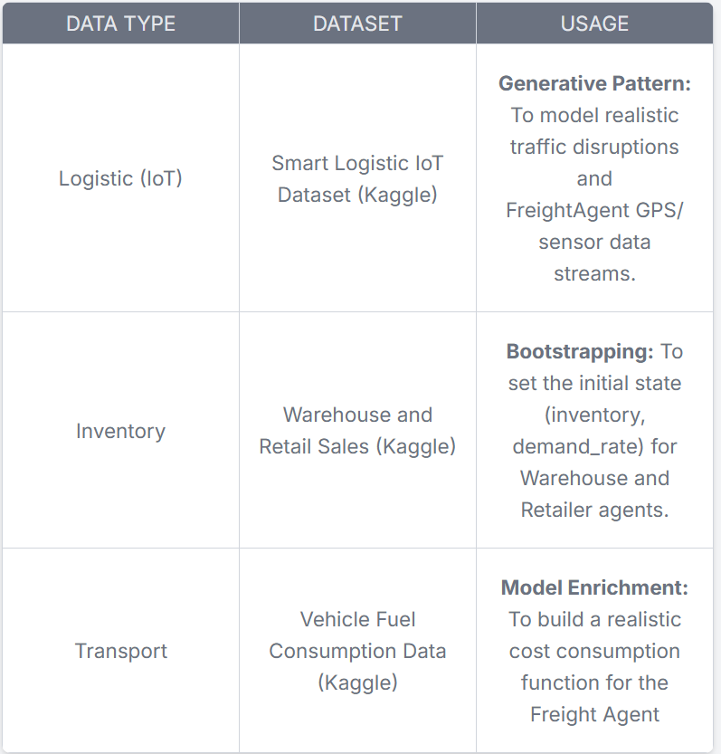

Datasets & Modeling
Concept: We will generate the Remaining Shelf Life (RSL) data stream based on physics
Model: Arrhenius Equation:
This is a validated model from food science that calculates the rate of quality degradation as a function of temperature
The specific model for sweet orange degradation is:
Implementation:
Our simulated FreightAgent Sensor would provide a T
Arrhenius equation gives us the net the degradation rate k
We update the OrangeBatch.current_RSL every simulation minute (or choose a time based on system capacity)
Result: We create a high-frequency, scientifically-valid RSL data stream

Slide 9
Technology Stack
SimPy: Simulation Engine
define agents as Python classes with generator methods
MQTT: IoT Data Broker
Agents publish data externally to this broker
Ex: FreightAgent has a monitor_cargo() process that through mqtt_client.publish() a JSON payload (ex: {'temp': 4.5, 'rsl': 98.2}) to a topic
MQTT over Kafka: lightweight, push-based, IoT-style
Telegraf: Data Pipeline
server-agent that listens to the MQTT broker and writes to the database
configure [[inputs.mqtt_consumer]] plugin to subscribe to iot/freight/# topics
configure [[outputs.influxdb_v2]] plugin to automatically write that data into InfluxDB with tags
InfluxDB: Time-Series Database (Memory)
Digital Twin's database.
InfluxDB over Prometheus: push-based system, SimPy -> MQTT -> Telegraf push architecture
optimized for high-volume sensor data and event logging
Streamlit: Dashboard/Interface
interactive web app
use the InfluxDB client library to query the database
Ex: show me the last 1 hour of temperature for 'truck-01'
Streamlit over Plotly Dash: simplicity, faster prototyping for data-focused applications

Slide 10
Models: ML and RL System
Part 1: The Predictor (Machine Learning)
Goal: Predict the RSL of an orange batch
Model: Support Vector Regression (SVR)
Why: Research specifically on 'Valencia' oranges found SVR was the most accurate model (R² score=0.884) using the exact features our simulation will generate: storage time, temperature, and humidity.
Part 2: The Decision-Maker (Reinforcement Learning)
Goal: Solve the Dynamic Vehicle Routing Problem (DVRP)
Model: Deep Q-Network (DQN)
How:
State: DQN agent's state Ex: current location, fuel, etc
Action: Ex: "Go to Retailer A," "Go to Retailer B," or "Wait."
Reward: fast deliveries, high final RSL, heavily penalization for spoiled-batch deliveries, inefficient routing, etc.

Slide 11
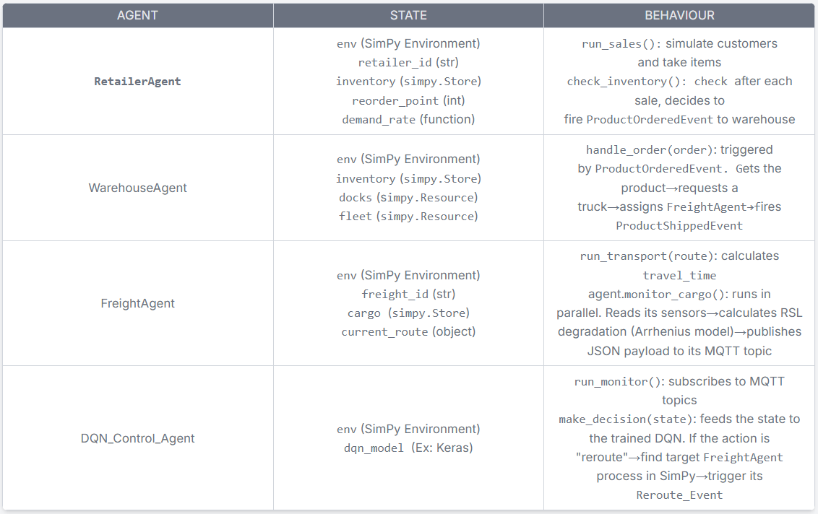
Actors & Agents
Concept: to use Agent-Based Modeling to model the Actors in our system.
Agent: is a Python class with process methods that simulate behavior over time
Core Agents:

Slide 12
Actors & Agents
Concept: Event-Driven Architecture
Agents do not call each other directly.
They communicate indirectly by firing and listening for Events
Example of flow:
RetailerAgent's: low inventory → fires ProductOrderedEvent
WarehouseAgent (listening): catch event → reserve FreightAgent → fire ProductShippedEvent
FreightAgent: catch this→ starts its run_transport()
SimulationEnv: fire a Disruption_Event (ex: traffic jam, accident)
DQN_Control_Agent (listening): catch the event → check FreightAgent's cargo RSL (from the Arrhenius model) → decide if a new route is needed → fire Reroute_Event
FreightAgent: catch Reroute_Event → changes its destination/route accordingly

Slide 13
Existing Implementation in Industries
Maersk (Cold Chain Monitoring):
virtual refrigerated cargo assistant
provides real-time data and visibility for in-transit reefer (refrigerated) containers
prevent spoilage on a global scale
Zomato/Swiggy (Perishable Routing):
Dynamic Vehicle Routing Problem (DVRP) for hot perishables
strict delivery window.
autonomously route drivers, balancing real-time traffic, weather, and variable restaurant prep times
Amul/Agropur (The Perishable Domain):
Amul - India's largest dairy co-op
inefficient routes and lack of cold storage lead to spoilage
GIS to optimize collection routes
Agropur - a global dairy producer
Digital Twins to optimize their plant and engineering design

Slide 14
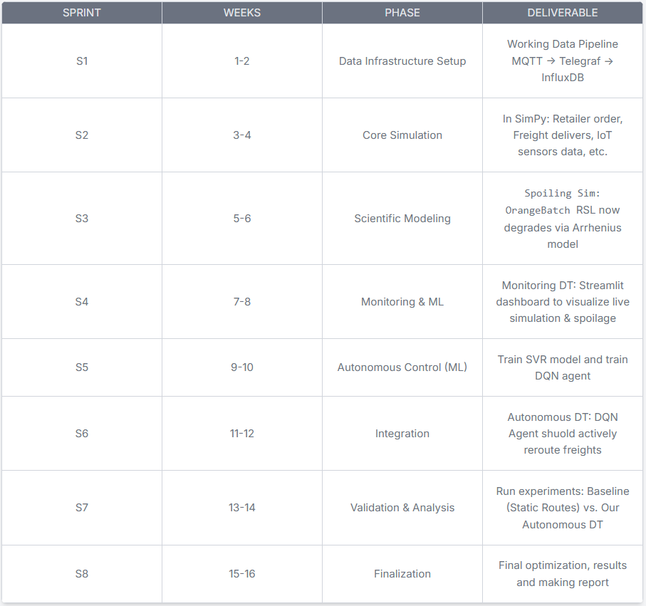
Rough Timeline

Slide 15
Conclusion
Conclusion:
From Passive Monitoring to Autonomous Control: We successfully demonstrated a paradigm shift. Traditional digital twins are passive dashboards that only show you a problem (e.g., "This truck is too hot"). Our Digital Twin is an autonomous control system that solves the problem.
Bridged the "Monitoring-to-Control" Gap: Our core contribution is the integration of a Deep Q-Network (DQN) agent. This "brain" analyzes real-time spoilage predictions and autonomously acts on them, creating a system that actively prevents spoilage, not just reports it.
Achieved High-Fidelity, Realistic Simulation: We solved the "no real data" problem. By using a hybrid data strategy and implementing the scientific Arrhenius equation, we created a high-frequency, scientifically-valid data stream for "Remaining Shelf Life" (RSL)
Built a Technically Feasible & Extensible Framework:
Feasible: Our lightweight stack (SimPy, MQTT, InfluxDB, Streamlit) proved capable of handling a complex, event-driven simulation.
Extensible: By using the W3C SOSA ontology, our framework is not just for oranges. We can add new products like apples or even pharmaceuticals just by defining them as a new sosa:FeatureOfInterest without re-architecting the system.

Slide 16
References
[1] S. H. Ahmad, R. Rosle, M. S. A. Rani, M. S. A. Bakar, and N. I. M. Z. Abidin, "The Shelf-life Prediction of Sweet Orange Based on Its Total Soluble Solid by Using Arrhenius and Q 10 Approach," IOP Conf. Series: Materials Science and Engineering, vol. 506, no. 1, 2019, Art. no. 012061.
[2] A. P. Moller - Maersk, "Captain Peter™," Maersk.com. Accessed: Nov. 3, 2025. [Online]. Available: https://www.maersk.com/digital-services/captain-peter
[3] A. Shukhla and F. Qasim, "Optimizing Delivery Time and Customer Satisfaction: A Data-Driven Analysis of Zomato's Logistics Operations," ijsrem.com, 2024. Accessed: Nov. 3, 2025. [Online]. Available: https://www.google.com/search?q=https://ijsrem.com/download/optimizing-delivery-time-and-customer-satisfaction-a-data-driven-analysis-of-zomatos-logistics-operations/
[4] Y. Umamahesh, "Data Science Delights: How Swiggy and Zomato Revolutionize Food Delivery with Advanced Techniques," Medium, 2024. Accessed: Nov. 3, 2025. [Online]. Available: https://www.google.com/search?q=https://medium.com/%40yenumamahesh/data-science-delights-how-swiggy-and-zomato-revolutionize-food-delivery-with-advanced-techniques-10776b6d8a43
[5] Prevu3D, "Agropur Engineering Design Case Study," Prevu3D.com. Accessed: Nov. 3, 2025. [Online]. Available: https://www.google.com/search?q=https://prevu3d.com/case-studies/agropur-engineering-design
[6] M. Singh, "Amul Logistics," SlideShare, 2010. Accessed: Nov. 3, 2025. [Online]. Available: https://www.google.com/search?q=https://www.slideshare.net/manpalsingh/amul-logistics-5627705
[7] L. Wang, H. J. He, and D. Li, "Implementation of Digital Twins in the Food Supply Chain: A Review and Conceptual Framework," Foods, vol. 10, no. 5, 2021, Art. no. 936.
[8] M.-A. Elia-Valverde et al., "Evaluation of the Storage Performance of ‘Valencia’ Oranges and Generation of Shelf-Life Prediction Models," Foods, vol. 11, no. 8, 2022, Art. no. 1157.
[9] R. Liu, X. Yang, A. Li, H. Hu, Z. Wang, and H. Yao, "Deep reinforcement learning for the dynamic and uncertain vehicle routing problem," in Proc. Int. Conf. Autom. Plann. Sched. (ICAPS), 2020, vol. 30, pp. 638-646.
[10] A. A. Lomonosov, N. A. Taratukhin, and D. A. Klyuchnikov, "A Theoretical Framework for Graph-based Digital Twins for Supply Chain Management and Optimization," ResearchGate, 2024. Accessed: Nov. 3, 2025. [Online]. Available: https://www.google.com/search?q=https://www.researchgate.net/publication/377488092_A_Theoretical_Framework_for_Graph-based_Digital_Twins_for_Supply_Chain_Management_and_Optimization
[11] "SimPy: Discrete event simulation for Python," SimPy ReadTheDocs. Accessed: Nov. 3, 2025. [Online]. Available: https://simpy.readthedocs.io/en/latest/
[12] L. Sardois, "Handling IoT data with MQTT, Telegraf, InfluxDB and Grafana," Medium, 2019. Accessed: Nov. 3, 2025. [Online]. Available: https://www.google.com/search?q=https://medium.com/%40luciensardois/handling-iot-data-with-mqtt-telegraf-influxdb-and-grafana-769d060e20fb
[13] W3C, "Semantic Sensor Network Ontology," W3C Recommendation, 2023. Accessed: Nov. 3, 2025. [Online]. Available: https://www.w3.org/TR/vocab-ssn/

