Slide 1

Supply Chain Digital Twin using Reinforcement Learning
Group Members:
Ayaan Khan
Arya Patil
Nihaal Badam
Swastik Ankulge
Guidance : Dr. Ravindra B. Keskar
Visvesvaraya National Institute of Technology, Nagpur

Slide 2
The Urban Logistics
Urban supply chains operate in highly stochastic environments.
Factors like weather, rush hours, and road accidents constantly change travel times.
Traditional static routing models (e.g., standard A*) fail to adapt to these real-time changes.

Slide 3
Freshness vs Fuel Cost Optimization
Fast deliveries preserve the Remaining Shelf Life (RSL) of perishable cargo.
However, fast routes often require using congested highways, which drastically increases fuel consumption.
Standard algorithms struggle to balance these conflicting multi-objective goals.

Slide 4
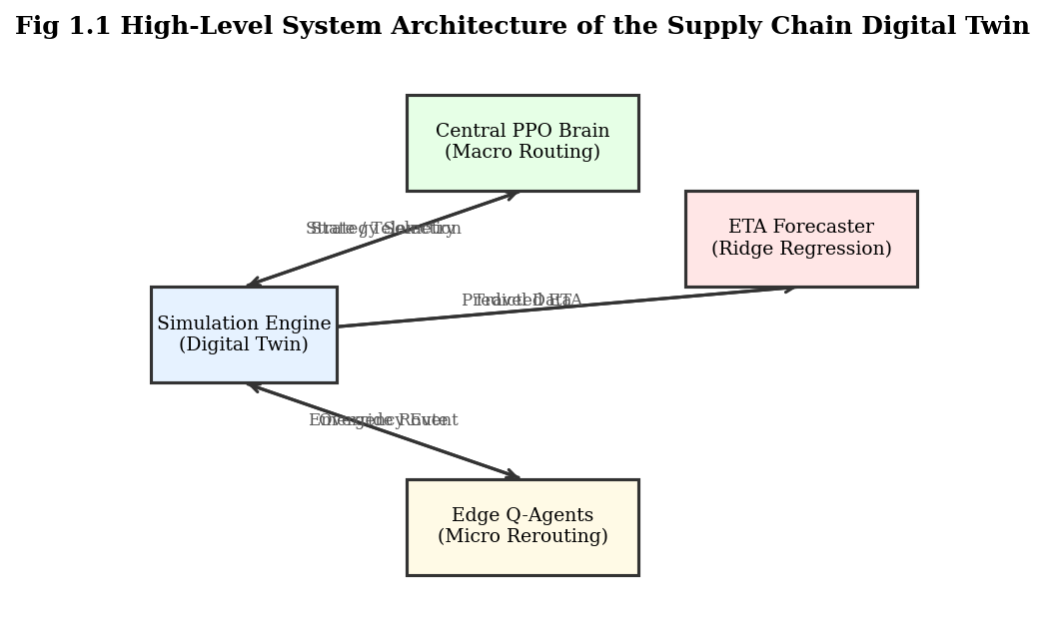
Project Objectives
Develop a discrete-event Simulation Engine (Digital Twin) of Nagpur city.
Implement a Macro-Routing Agent using Proximal Policy Optimization (PPO).
Implement Micro-Rerouting Edge Agents using Q-Learning.
Predict real-time traffic using an online Ridge Regression model.

Slide 5
Simulation Engine Overview
A custom discrete-event engine stepping in 15-minute simulated intervals.
Deterministic random seeding ensures fair benchmarking between algorithms.
Continuously injects dynamic environmental events (rain, heat, accidents).

Slide 6
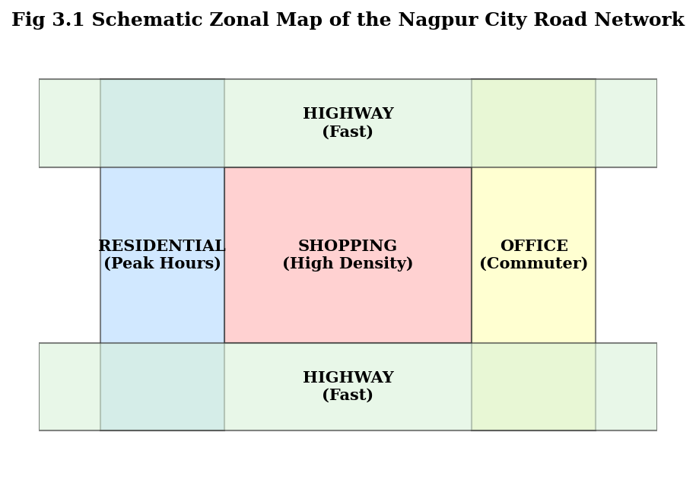
The Nagpur City Graph
Road network modeled mathematically using the NetworkX library.
Segmented into 4 unique geographic zones: HIGHWAY, RESIDENTIAL, OFFICE, SHOPPING.
Each zone features distinct hourly and weekly traffic cyclicity.

Slide 7
Actor 1: Retailer Nodes
Generate stochastic consumer demand based on geographic zone.
Automatically trigger an `order_placed` event when local inventory drops below threshold.
Log a permanent `stockout` penalty if inventory hits zero before replenishment.

Slide 8
Actor 2: The Warehouse Depot
Acts as the central supply hub for the entire city graph.
Maintains the global queue of pending retailer orders.
Responsible for executing the fleet allocation algorithm to dispatch idle trucks.

Slide 9
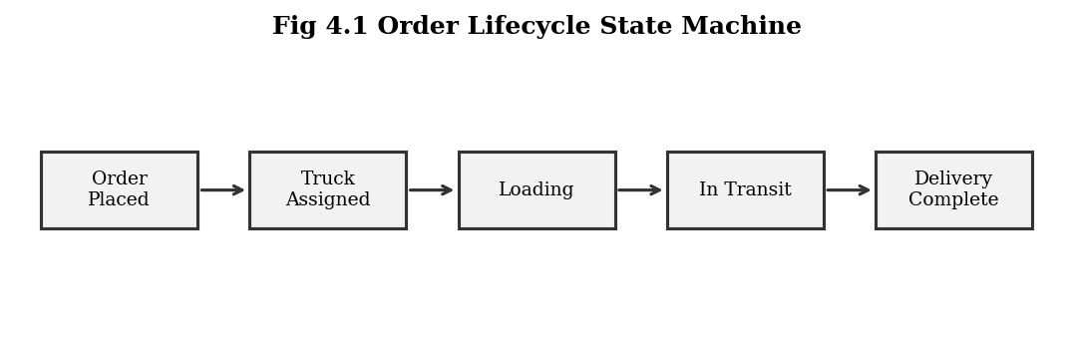
Actor 3: Truck Fleet & State Machine
Fleet of 10 autonomous delivery vehicles.
Follows a strict lifecycle:
Idle → Loading → In-Transit → Delivering → Returning.
Physically tracks fuel consumption over distance and RSL decay over time.

Slide 10
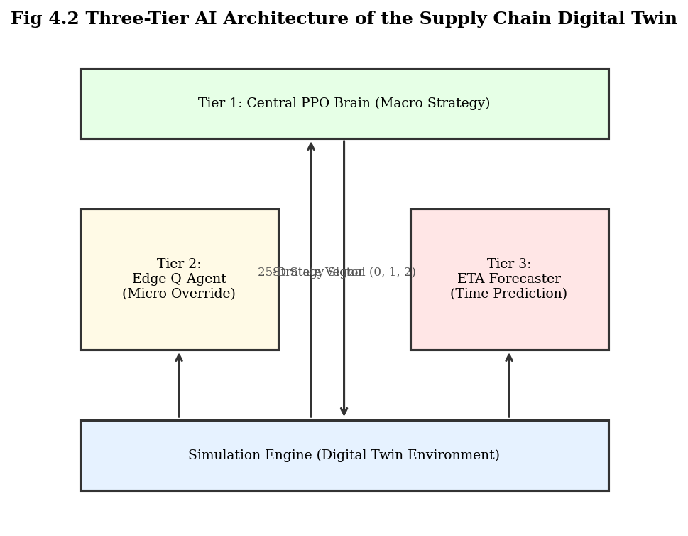
Three Layered AI Architecture
Replaced the baseline A* heuristic with a 3-tier intelligence stack.
Level 1: Central PPO Brain for macro-strategy.
Level 2: Edge Q-Agents for micro-tactics.
Level 3: ETA Forecaster for predictive intelligence.

Slide 11
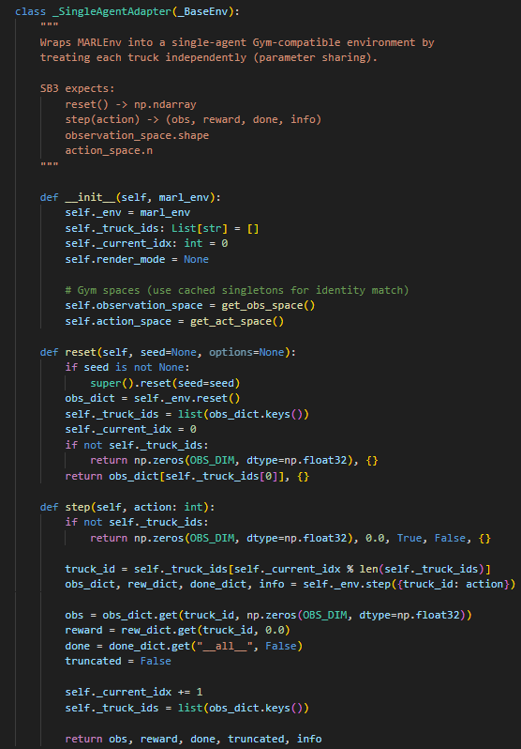
Level 1: Central PPO Brain
Implemented using the Stable-Baselines3 library.
Multi-agent environment flattened into a single-agent Gymnasium wrapper via parameter sharing.
Neural Network Policy: 25-nodes → two 64-node hidden layers → 3-node output.

Slide 12
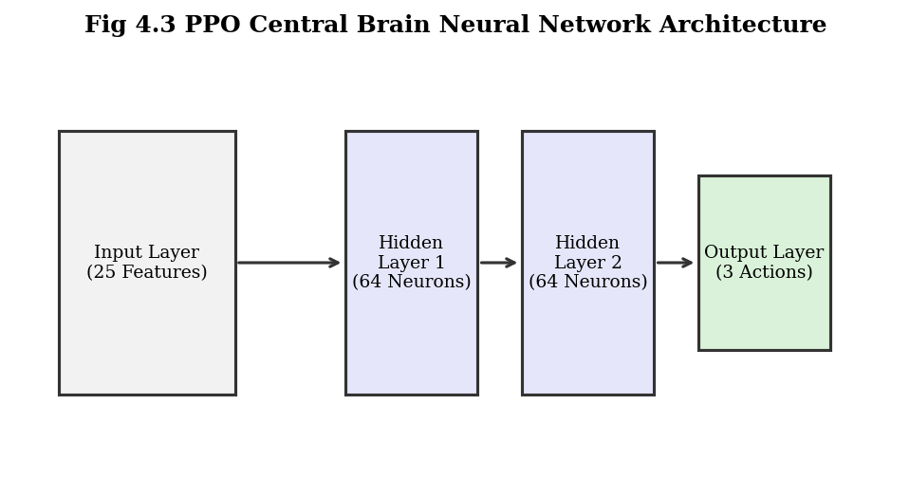
PPO State and Action Space
25-Dimension State: Observes truck fuel, cargo RSL, weather severity, and fleet averages.
3-Discrete Actions: Speed-Priority, Fuel-Priority, Balanced.
Operates sequentially at every dispatch decision point.

Slide 13

The Reward Normalization Framework
Fuel physically drops ~15% per trip, while RSL drops only ~2%.
We established a strict 5:1 penalty ratio (W(RSL) = 50.0, W(fuel) = 10.0).
This forces the PPO agent to treat cargo freshness and fuel as equally critical.

Slide 14
Level 2: Edge Q-Learning Agents
Embedded individually on all 10 trucks.
Triggered strictly by stochastic road accidents blocking the active route.
Utilizes a 9-state tabular Q-learning matrix with Epsilon-Greedy exploration.
Overrides the Central Brain to execute immediate evasive maneuvers.

Slide 15
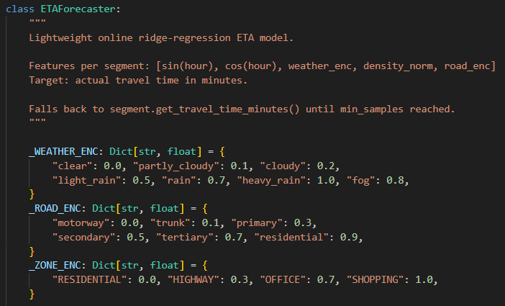
Level 3: ETA Forecaster Design
Implemented via Scikit-learn's `SGDRegressor` (Ridge Regression).
Replaces static average-based heuristics with dynamic edge-cost predictions.
Trains online using `partial_fit()` as trucks successfully traverse the city.

Slide 16
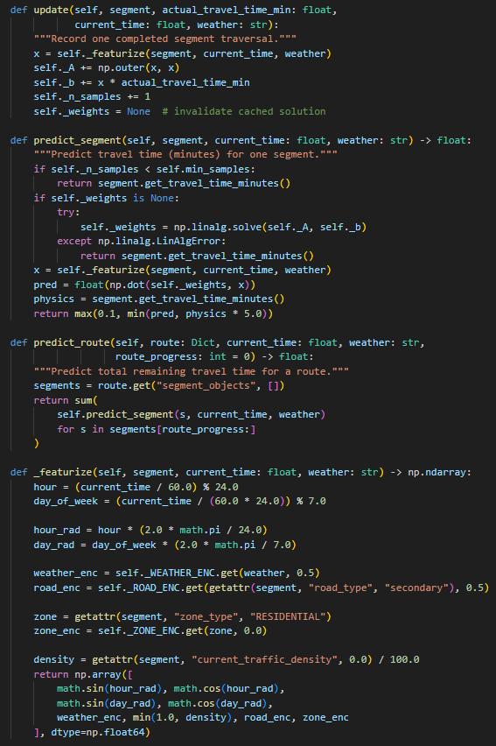
ETA Feature Engineering
Utilizes a highly optimized 8-Dimensional feature vector.
Encodes time-of-day and day-of-week using Sine/Cosine transformations.
Why? Prevents the mathematical discontinuity of Sunday (Day 7) appearing far from Monday (Day 1).

Slide 17
Telemetry & Data Logging
Simulation writes to permanent CSV artifacts (`events_sim.csv` and `telemetry_sim.csv`).
Captured over 2.4 million truck states across the 365-day benchmark.
Telemetry files serve as the ground truth for all performance comparisons.

Slide 18
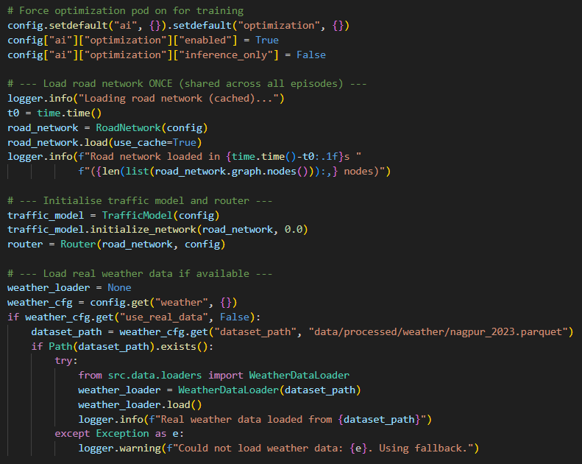
PPO Training Pipeline
Agent trained offline for 50,000 timesteps.
Hyperparameters: Learning Rate 3e-4, Batch Size 64.
Set Entropy Coefficient to 0.01 to force exploration of RSL-Priority paths.

Slide 19
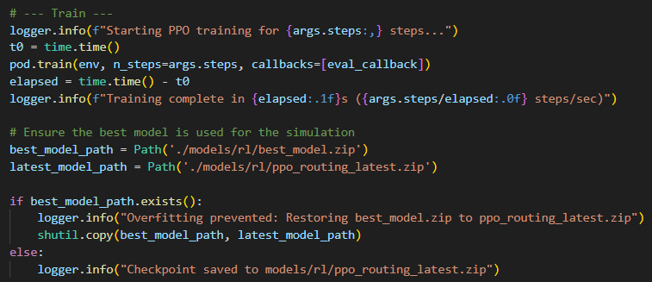
Preventing Overfitting
PPO models are highly susceptible to overfitting to training seeds.
Integrated an `EvalCallback` to evaluate the model on a held-out environment every 5,000 steps.
Saved and deployed the absolute best policy (`best_model.zip`), not just the final step.

Slide 20
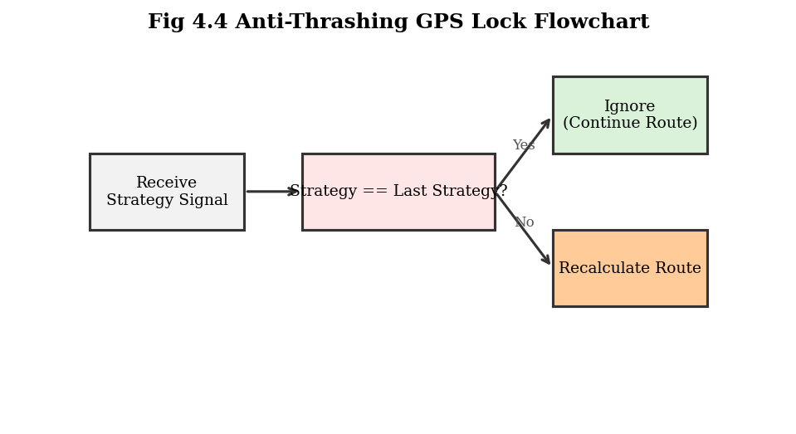
Route Thrashing
The Bug: Trucks recalculated routes every 15 minutes upon receiving a PPO signal, paralyzing the fleet (49% delivery rate).
The Solution: Implemented an Anti-Thrashing GPS Lock state machine.
Trucks now ignore redundant signals, immediately restoring service levels to 99.9%.

Slide 21
365-Day Comparative Benchmark
Goal: Prove RL outperforms static algorithms in long-term scenarios.
Run 1: 365-Day Baseline Simulation (Standard A* Heuristics).
Run 2: 365-Day RL-Enabled Simulation (PPO + Edge Q-Agent + Forecaster).
Both runs experienced identical weather, accidents, and retailer demand.

Slide 22
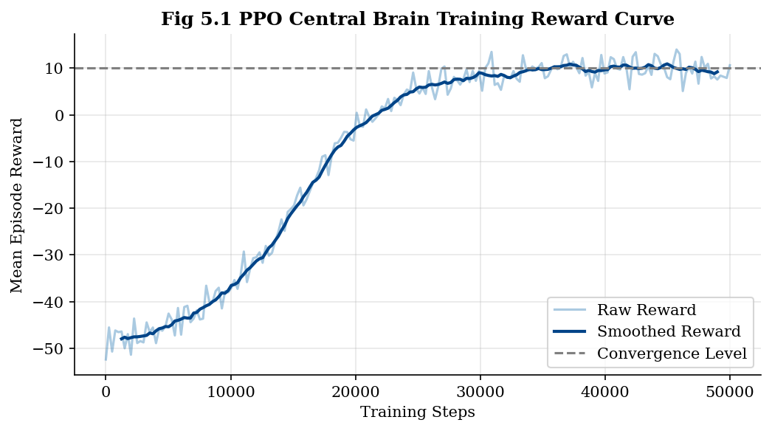
PPO Training Convergence
The learning curve displays the mean episode reward over 50,000 steps.
Reward starts highly negative (random exploration) and climbs steeply.
The model successfully converged and plateaued around step 35,000.

Slide 23
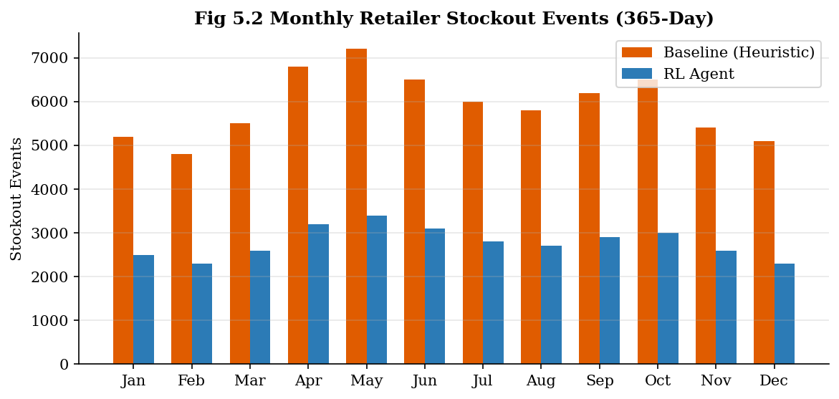
Result: Service Level & Throughput
Baseline Router: 70,898 retailer stockout events.
RL Architecture: 33,401 retailer stockout events.
Achieved a massive 52.9% reduction in stockouts.
Successfully delivered an additional +474,708 kg of cargo.

Slide 24
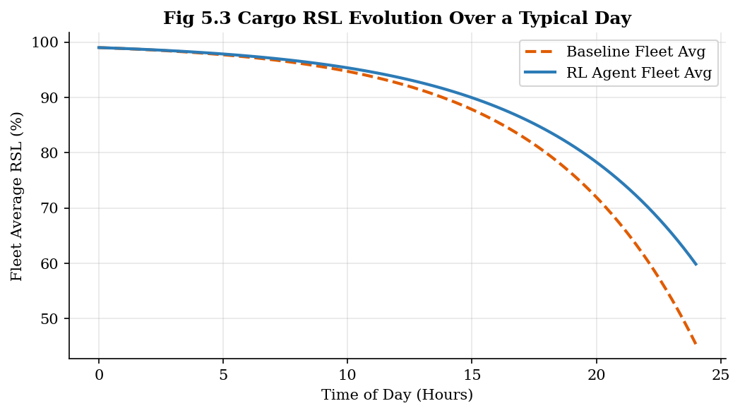
Result: RSL & Fuel Parity
Proved the 5:1 reward math worked flawlessly.
Average fleet fuel remained perfectly identical to the baseline (78.7%).
Average cargo freshness at delivery remained identical (99.7%).
The AI increased throughput without sacrificing efficiency or quality.

Slide 25
Result: Emergent Safety Behavior
The RL Architecture recorded 135 fewer road accidents over the year.
This was an unprogrammed, emergent behavior.
The ETA Forecaster implicitly learned which zones had high accident probabilities during specific hours, naturally routing trucks away from danger.

Slide 26
Achieving Pareto Optimality
A system achieves Pareto improvement if it betters one objective without worsening another.
Our RL system strictly improved 6 metrics (throughput, service level, stockouts, accidents) while holding Fuel and RSL constant.
Conclusion: The multi-agent RL framework is strictly superior to static heuristics.

Slide 27
Future Scope
Scale the environment to multi-depot and multi-city configurations.
Integrate real-time physical IoT sensors (GPS, refrigerated container thermometers) into the Digital Twin.
Deploy the trained Central PPO Brain to embedded physical edge devices.

Slide 28
References
Schulman, J. et al., "Proximal Policy Optimization Algorithms," 2017.
Mnih, V. et al., "Human-level control through deep reinforcement learning," Nature, 2015.
Sutton, R. S. and Barto, A. G., Reinforcement Learning: An Introduction, 2nd ed., MIT Press, 2018.
Raffin, A. et al., "Stable-Baselines3: Reliable Reinforcement Learning Implementations," JMLR, 2021.
Hart, P. E. et al., "A Formal Basis for the Heuristic Determination of Minimum Cost Paths," IEEE Transactions, 1968.
Hoerl, A. E. and Kennard, R. W., "Ridge Regression: Biased Estimation for Nonorthogonal Problems," Technometrics, 1970.
Giannoccaro, I. and Pontrandolfo, P., "Inventory management in supply chains: A reinforcement learning approach," Int. J. of Production Economics, 2002.
Towers, M. et al., "Gymnasium: A Standard Interface for Reinforcement Learning Environments," 2023.

