Slide 1
Neural Style Transfer: A Review
IEEE 2018
Yongcheng Jing, Yezhou Yang, Zunlei Feng, Jingwen Ye, Yizhou Yu, Mingli Song

Slide 2
Submission history
[v1] Thu, 11 May 2017 08:08:44 UTC (8,492 KB)
[v2] Fri, 13 Apr 2018 09:21:36 UTC (7,459 KB)
[v3] Mon, 16 Apr 2018 13:25:07 UTC (7,459 KB)
[v4] Thu, 26 Apr 2018 12:35:19 UTC (7,614 KB)
[v5] Wed, 16 May 2018 11:59:51 UTC (7,797 KB)
[v6] Sun, 17 Jun 2018 08:40:41 UTC (7,981 KB)
[v7] Tue, 30 Oct 2018 09:48:05 UTC (32,888 KB)

Slide 3
A Neural Algorithm of Artistic Style
Submission history
[v1] Wed, 26 Aug 2015 17:14:42 UTC (5,474 KB)
[v2] Wed, 2 Sep 2015 08:24:59 UTC (5,474 KB)
Leon A. Gatys, Alexander S. Ecker, Matthias Bethge

Slide 4
references
https://medium.com/tensorflow/neural-style-transfer-creating-art-with-deep-learning-using-tf-keras-and-eager-execution-7d541ac31398

Slide 5
Subjects:
Computer Vision and Pattern Recognition ; Neural and Evolutionary Computing ; Image and Video Processing ; Machine Learning (stat.ML)

Slide 6
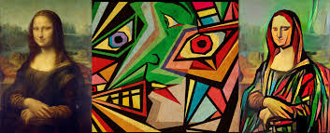
What is nst :
This process of using CNNs to render a content image in different styles is referred to as Neural Style Transfer (NST).

Slide 7
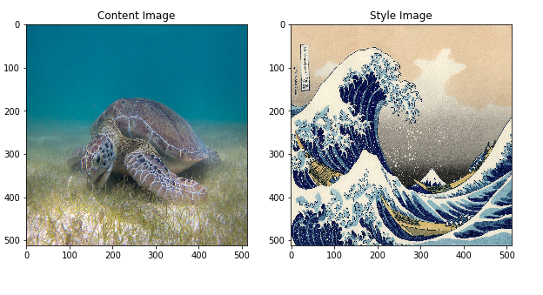
Content and style image

Slide 8
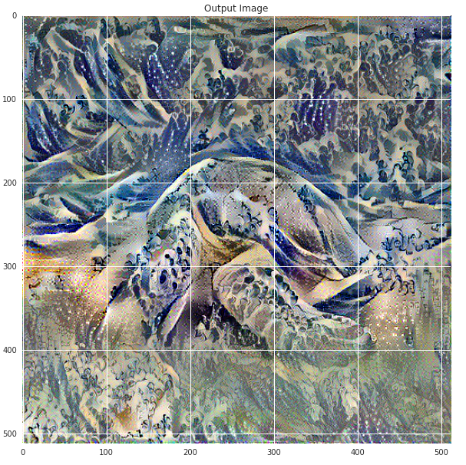

Slide 9
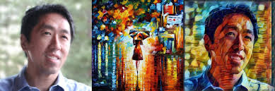
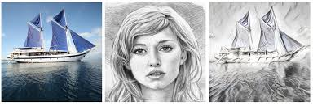

Slide 10
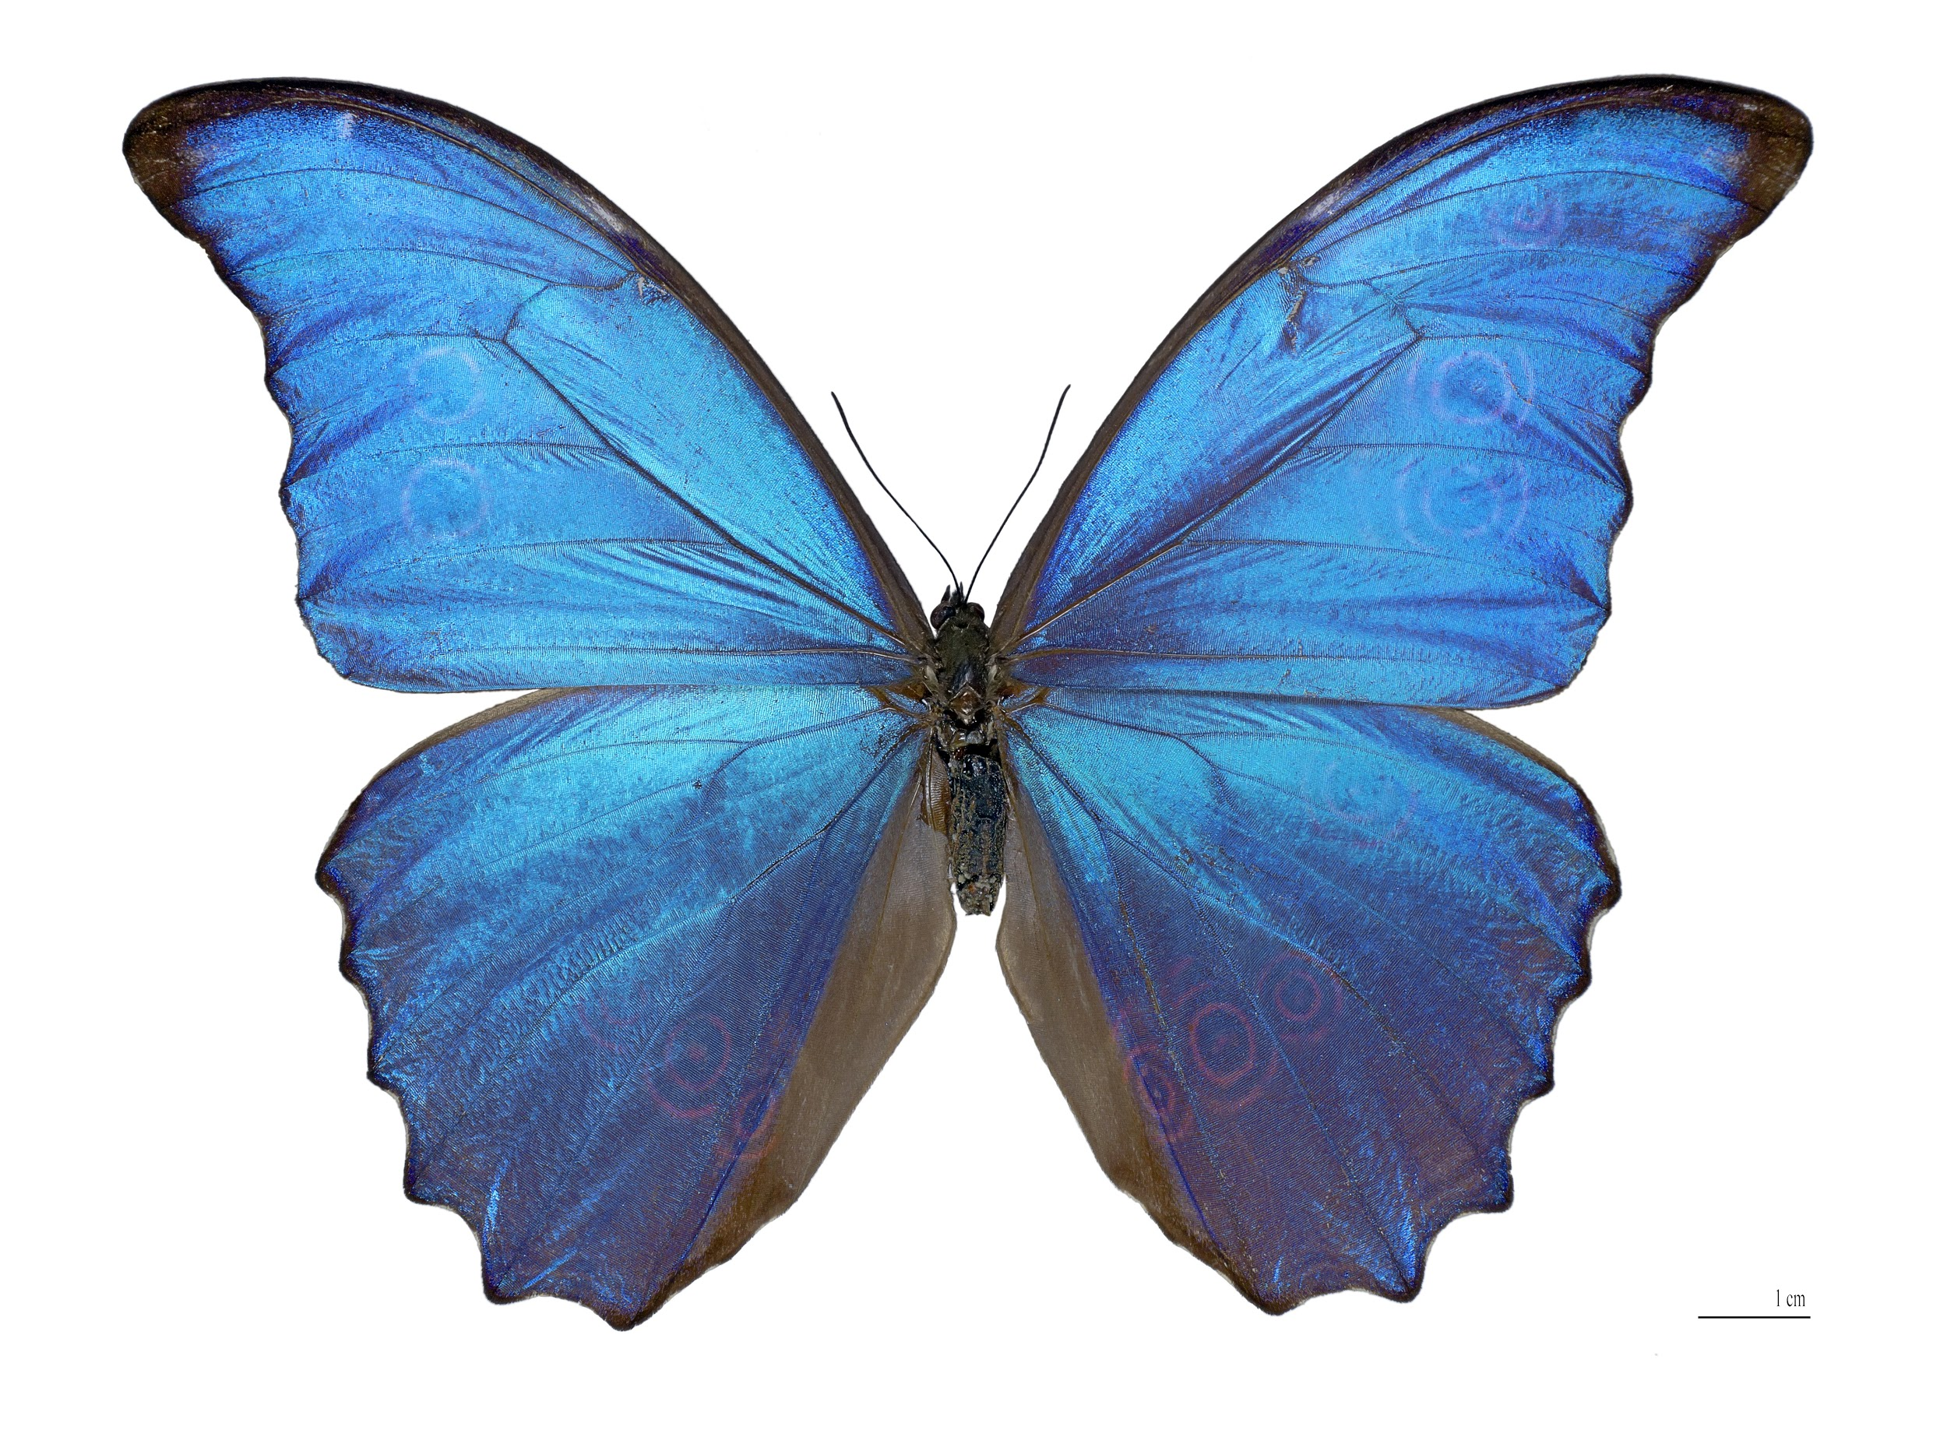
Who doesn’t like Art and its fusion

Slide 11
Interest factor :
Demonstrated the power of Convolutional Neural Networks (CNNs) in creating artistic imagery by separating and recombining image content and style.
In this paper, they have provided a comprehensive overview of the current progress towards NST.
The review concludes with a discussion of various applications of NST and open problems for future research.
A list of papers discussed in this review, corresponding codes, pre-trained models and more comparison results.

Slide 12
Agenda:
Understanding Research paper.
Understanding a bit of maths behind it.

Slide 13
Few excerpts :
The class of deep neural networks are most powerful in image processing tasks are called convolutional neural network.
CNN consist of layers of small computational units that process visual information hierarchically in a feed-forward manner.
Each layer of units can be understood as a collection of image filters each of which extracts a certain feature from the input image.
Thus, the output of a given layer consists of so-called feature maps: differently filtered versions of the input image.

Slide 14
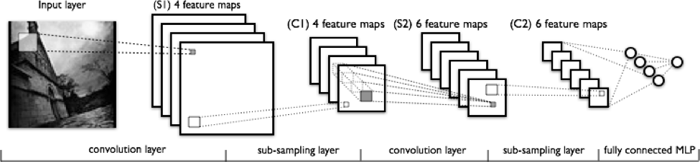
cnn

Slide 15
Extraction of content from an image
“Along the processing hierarchy of the network, the input image is transformed into representations that increasingly care about the actual content of the image compared to its detailed pixel values.
We therefore refer to the feature responses in higher layers of the network as the content representation.”
The 4_2 convolution layer of pre-trained VGG-19 network is used as content extractor.

Slide 16
Extraction of style from an image:
“To obtain a representation of the style of an input image, we use correlations between the different filter responses over the spatial extent of the feature maps.We obtain a stationary, multi-scale representation of the input image, which captures its texture information but not the global arrangement.
There correlations between feature maps is known as gram matrix.
The layers used for calculation of gram matrix are 1_1, 2_1, 3_1, 4_1, 5_1 with varied style weight constant for each layer.
This constant can be seen as a hyperparameter used for changing style

Slide 17
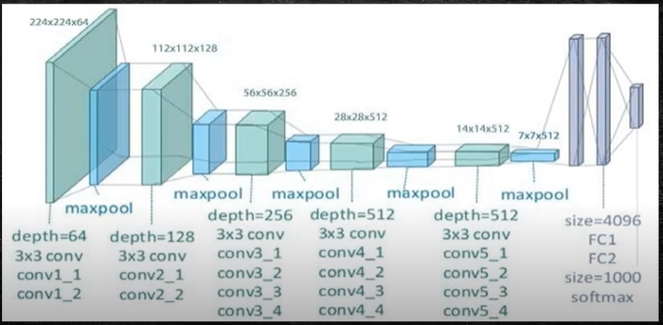
Model overview:

Slide 18
Key finding
The representation of the content and style in convolutional neural network are separable.

Slide 19
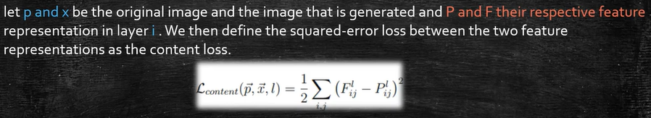
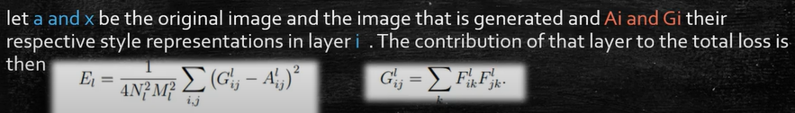
Content loss and style loss:

Slide 20
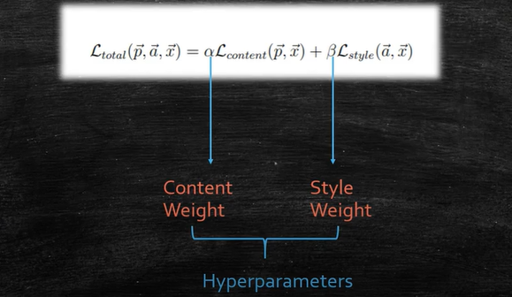
Combined loss function

Slide 21
Now we will implement neural style transfer algorithm and build it from scratch
With understanding code

Slide 22
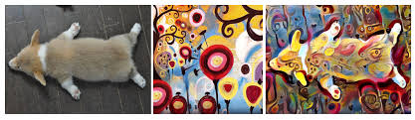
Thank you for your patience

Slide 23
By: Arya vashisht

