Slide 1
AI / ML INTERNSHIP · NAVIOTECH SOLUTION · JUNE 2026
Cancer Classification
and Prediction Using Neural Networks
A deep learning diagnostic support system that classifies breast tumors as Benign or Malignant from clinical measurements.
Arya Anshuman Panda | B.Tech CSE (Data Science) | Gandhi Engineering College
01

Slide 2
PROBLEM STATEMENT
Diagnosing breast cancer, faster
Breast cancer is the most commonly diagnosed cancer among women worldwide. Early, accurate diagnosis dramatically improves treatment outcomes and survival rates — but relies heavily on expert interpretation of biopsy samples.
WHY IT MATTERS
A reliable classification model can act as a fast, consistent second opinion — supporting, not replacing, expert pathologists.
2.3M+
New breast cancer cases diagnosed globally each year
Dataset: Breast Cancer Wisconsin (Diagnostic) Dataset — a benchmark used widely in medical ML research since 1995.
569
Patient biopsy records used to train this model
30
Diagnostic cell-nuclei measurements per patient
02

Slide 3
OBJECTIVES
What this project set out to do
01
02
03
Classify Tumors
Design & Train
Validate & Deploy
Build a neural network that classifies tumors as Benign or Malignant from 30 diagnostic features.
Design a feed-forward neural network architecture and train it using TensorFlow/Keras.
Evaluate performance on unseen test data and build a working real-time predictive system.
03

Slide 4
DATASET OVERVIEW
Breast Cancer Wisconsin dataset
569
30
2
0
Target distribution
Patients
Features
Classes
Missing Values
Feature groups (10 measurements × 3 variants each)
Radius, Texture, Perimeter (mean / SE / worst)
Area, Smoothness (mean / SE / worst)
Compactness, Concavity (mean / SE / worst)
Concave Points, Symmetry (mean / SE / worst)
04

Slide 5
DATA PREPARATION
From raw data to model-ready input
1
Load & Structure
Loaded directly from scikit-learn's built-in dataset and converted to a labeled DataFrame.
2
Feature-Target Split
Separated 30 input features (X) from the target label (Y) — 1 = Benign, 0 = Malignant.
3
Train-Test Split
Split into 455 training samples (80%) and 114 test samples (20%).
4
Standardization
Applied StandardScaler — fit on training data only, then applied to both sets.
05

Slide 6
MODEL ARCHITECTURE
A simple feed-forward neural network
Input Layer
Hidden Layer
Output Layer
Flatten
Dense · 20 units
Dense · 2 units
Shape (30,) — accepts standardized features
ReLU activation — learns non-linear patterns
Sigmoid activation — outputs class probabilities
06

Slide 7
TRAINING CONFIGURATION
How the model was trained
Optimizer
Adam
TRAIN / TEST SPLIT
Loss Function
Sparse Categorical Cross-Entropy
455
training samples
Epochs
10
114
Validation Split
10% of training data
test samples
07

Slide 8
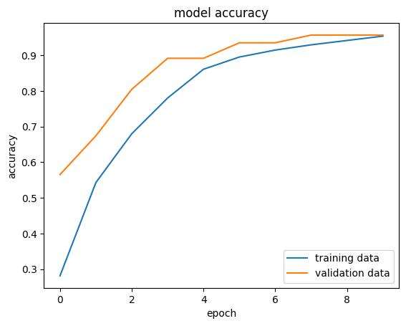
TRAINING PERFORMANCE
Accuracy across training epochs
Training and validation accuracy converge closely by epoch 9 — both reaching approximately 95%.
This close alignment is a strong sign the model is not overfitting to the training data.
08

Slide 9
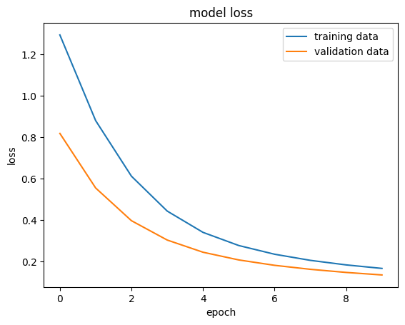
TRAINING PERFORMANCE
Loss across training epochs
Both training and validation loss decrease smoothly and consistently across all 10 epochs.
No divergence between the two curves confirms stable, well-behaved training.
09

Slide 10
RESULTS
Final model performance
95.61%
0.1469
114
Test Accuracy
Test Loss
Test Samples Evaluated
10

Slide 11
PREDICTIVE SYSTEM
Testing on a new patient sample
A new set of 30 diagnostic measurements was passed through the full pipeline — standardization, prediction, and label conversion:
Model Output Probabilities
PREDICTION
Malignant
4.2%
Benign
Benign
74.5%
Correctly matched the known ground-truth label for this sample record.
Predicted class: argmax of the two probability scores
11

Slide 12
CONCLUSION & LEARNINGS
What this project achieved
Designed and trained a feed-forward neural network for breast cancer classification using TensorFlow/Keras
FUTURE SCOPE
Achieved a strong 95.61% test accuracy with stable, well-converged training and validation curves
Compare against SVM, Random Forest
Add explainability (SHAP values)
Deploy as a clinician screening tool
Learned the complete ML lifecycle: data collection, preprocessing, architecture design, training, and evaluation
Built a working predictive system, and understood why interpretability and validation matter in healthcare AI
Thank you — Questions welcome
12

