Slide 1

Signature Verifier

Slide 2
Team Members
Team Number - 22
Dikshika Sachdeva | 23BAI10331
Riya Garg | 23BAI10432
Payal Singh | 23BAI10483
Mohd Uruj Khan | 23BAI10669
Himanshu Mishra | 23BAI10855
Pranjal Shrivastava | 23BAI11024

Slide 3
Introduction
This project focuses on the development of a robust and intelligent signature verification system utilizing machine learning techniques. The primary objective of this system is to accurately determine whether a given signature is genuine or forged, based on a set of carefully extracted features from the signature image.
Signature verification is a critical component in various fields such as banking, legal document processing, and secure authentication systems. Manual verification is not only time-consuming but also prone to human error, making the need for an automated solution increasingly important.

Slide 4
Existing Work with Limitations
Reliance on Visual Inspection or Static Feature Matching:
Traditional systems depend heavily on manual review or basic feature comparison which often misses subtle differences in skilled forgeries.
Lack of Robustness Against Skilled Forgeries:
These methods struggle to detect forged signatures that closely mimic genuine ones, especially without analyzing behavioral or dynamic traits.
Manual Verification is Time-Consuming and Error-Prone:
Human-based verification introduces subjectivity and inconsistency, making the process slow and unreliable for large-scale use.
Limited Scalability for Large Datasets or Real-Time Use:
Traditional systems are not well-suited for handling large volumes of data or providing instant verification, limiting their effectiveness in modern applications.

Slide 5
Proposed Work and Methodology
Use of Supervised Machine Learning Models
The core of the system relies on supervised learning algorithms, which learn from labeled training data. These models are trained to identify complex patterns and relationships in signature features that distinguish authentic signatures from forgeries.
Feature Extraction using Image Processing Techniques
Prior to model training, signatures undergo preprocessing and feature extraction to derive meaningful information from the raw images.
Dataset Preparation with Labeled Signatures
A well-structured dataset is crucial for model performance. The dataset used consists of a large number of signature images, each labeled as genuine or forged.
Model Training and Validation
Once the dataset is prepared and features are extracted, the machine learning models are trained.

Slide 6
Novelty of the Project
Utilizes Deep Learning Techniques for Higher Accuracy
The system leverages advanced deep learning architectures, particularly Convolutional Neural Networks (CNNs), to automatically learn and extract hierarchical features from signature images.
Robust Against Both Random and Skilled Forgeries
One of the key strengths of this system is its robustness against different types of forgeries.
Potential Integration with Real-Time Verification Systems
Designed with performance and scalability in mind, the system can be integrated into real-time verification workflows.
Adaptive Learning Capabilities with New Data

Slide 7
Hardware & Software Requirements
HARDWARE:
Computer with Minimum 8GB RAM
A computer with at least 8GB of RAM is necessary to handle data preprocessing, feature extraction, and model training processes efficiently. Higher RAM (16GB or more) is preferred for smoother multitasking and faster processing of large datasets.
GPU (Graphics Processing Unit) - Optional but Recommended
A dedicated GPU (such as NVIDIA GTX/RTX series) significantly accelerates deep learning model training, particularly when using large datasets or complex architectures like CNNs.
Software:
Programming Language: Python 3.x
Key Libraries and Frameworks: TensorFlow, OpenCV, Scikit-Learn, NumPy, Matplotlib.
Development Environments: Jupyter Notebook, Visual Studio Code.

Slide 8
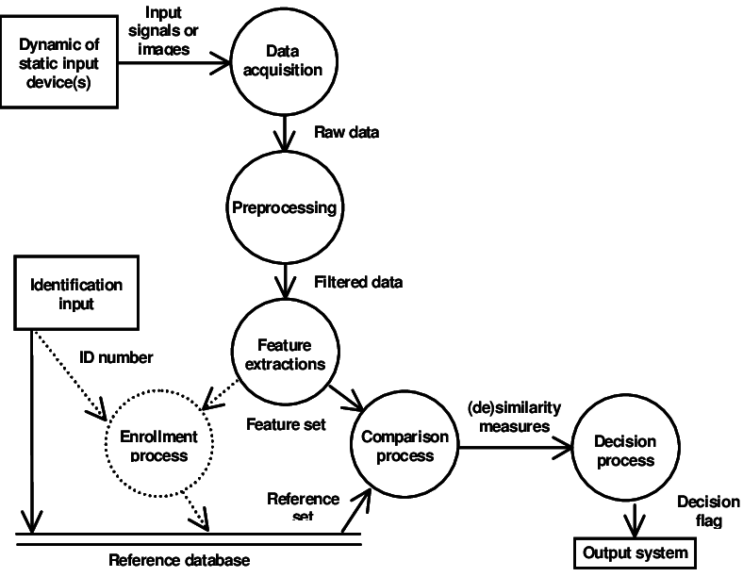
Overall System Architecture Diagram

Slide 9
Module Description
1. Data Collection Module
This module is responsible for gathering the raw signature data required for training and testing the machine learning models.
2. Preprocessing Module
This module prepares the raw signature images for feature extraction and modeling by cleaning and normalizing the data.
3. Feature Extraction Module
This module extracts meaningful and discriminative features from the preprocessed
images to feed into the machine learning models.
4. Model Training Module
This module is responsible for building and training the machine learning models on the extracted features.

Slide 10
Module Workflow Explanation
1. Collect Signature Samples
The process begins with the acquisition of signature data, which includes both genuine and forged signatures.
2. Preprocess Signature Images
Raw signature images often contain noise and inconsistencies in size or alignment. The preprocessing stage standardizes and cleans the data for better feature extraction.
3. Extract Relevant Features
After preprocessing, important features are extracted to capture unique patterns within each signature. These features serve as input to the machine learning model.
4. Train Machine Learning Model on Labeled Data
With features and labels available, a supervised machine learning model is trained to distinguish between genuine and forged signatures.
5. Predict and Classify New Input Signature
Once trained, the model is used to verify new signatures.

Slide 11
Implementation and Coding
1. Implemented in Python Using TensorFlow/Keras for Model Building
The core machine learning logic was written in Python, chosen for its simplicity, flexibility, and extensive support for data science and AI.
2. Image Processing with OpenCV
The preprocessing and feature extraction stages relied heavily on OpenCV, a powerful open-source computer vision library.
3. Trained on a Labeled Dataset of Genuine and Forged Signatures
A well-organized labeled dataset was used, containing a large number of signature samples categorized as either genuine or forged.
4. Evaluated with Accuracy, Precision, and Recall Metrics
After training, the model's performance was assessed using standard classification evaluation metrics: Accuracy, Precision, Recall(Sensitivity).

Slide 12
Result and Discussion (Input and Output)
1. Input: Scanned Image of a Handwritten Signature
The system takes as input a scanned or uploaded image of a signature, typically in .jpg, .png, or .bmp format.
2. Output: Classification Result (Genuine or Forged)
The trained machine learning model analyzes the input signature and classifies it into one of two categories Genuine or Forged.
3. Achieved Accuracy of [To be added]% on Validation Set
The system was evaluated on a validation set containing previously unseen samples of both genuine and forged signatures.
4. Visual Examples of Correctly and Incorrectly Classified Samples
As part of the evaluation, visual samples were analyzed to understand model performance more intuitively.

Slide 13
Conclusion
The project successfully shows that machine learning algorithms, particularly deep learning models like CNNs, can learn complex patterns and nuances in signature images to make accurate authenticity decisions.
By automating the verification process, the system offers a scalable and robust alternative to manual signature checking, which is often slow, subjective, and error-prone.
The integration of tools such as OpenCV, TensorFlow, and Scikit-learn ensures that the system is both efficient and extensible, making it suitable for real-world applications in banking, legal services, educational institutions, and secure identity verification platforms.

Slide 14
Future Work
Integration with Biometric Authentication Systems:
Combining signature verification with other biometric methods (e.g., fingerprint, facial recognition) can create a multi-factor authentication system, increasing overall security.
2. Enhanced Forgery Detection:
Future versions can incorporate more sophisticated deep learning techniques like transformers or recurrent neural networks (RNNs) for analyzing temporal dynamics in online signature data (e.g., stroke order, speed, pressure).
3. Real-Time Verification and Deployment:
Optimizing the system for deployment in mobile or web-based applications to allow for real-time signature verification in practical environments.
4. Larger and More Diverse Datasets:
Training on a more diverse set of signatures from different demographics and languages would improve the system’s generalization capability.
5. User Feedback Loop and Adaptive Learning:
Introducing a feedback mechanism that allows the model to retrain incrementally on new signature data, improving accuracy over time.

Slide 15


thank you

