Slide 1
Phase 3 : DLBCSPJWD01
https://github.com/Aryabod/ToDo---DLBCSPJWD01
Aryabod Nikpour

Slide 2
Purpose OF THE APP
Simple to do list allowing users within their own profile, to input the tasks they need to get done, edit tasks or delete them as well as mark them as completed.

Slide 3
Target group
Designed for students, adults and any individual with tasks that need to be done, to have all tasks in a simple and intuitive environment allowing for improved clarity and organization.

Slide 4
Features
Sign up and Login for each individual user
Add Tasks, Edit Tasks, Delete Tasks.
Mark Tasks as complete/incomplete.
Filter view to show/hide completed tasks.

Slide 5
Tech Stack
Front-end: React.js + Tailwind CSS: fast performance & modern UI
Back-end: Node.js + Express.js: Handles task related user inputs
Database: JSON Database: Stores user profiles and task lists

Slide 6
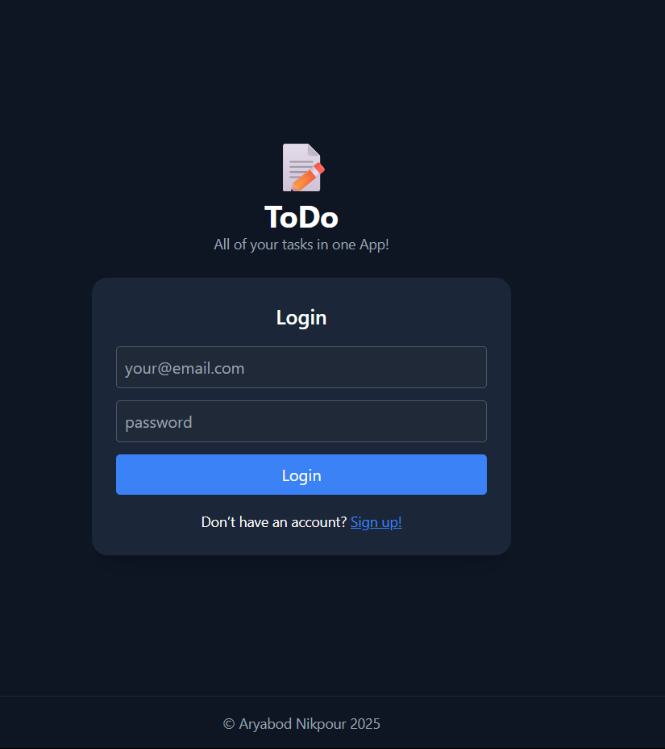
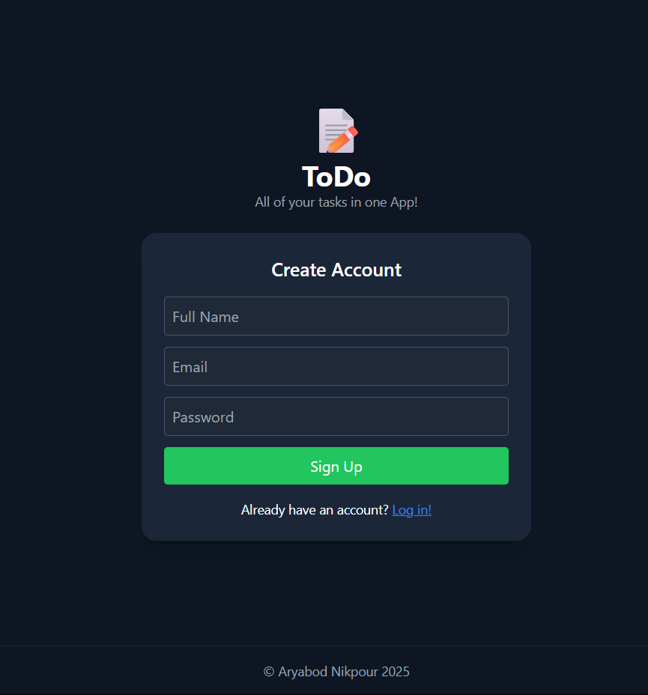
Sign Up Box Requiring: - Full Name
- Email
- Password
Login Box Requiring: - Email
- Password
Footer

Slide 7
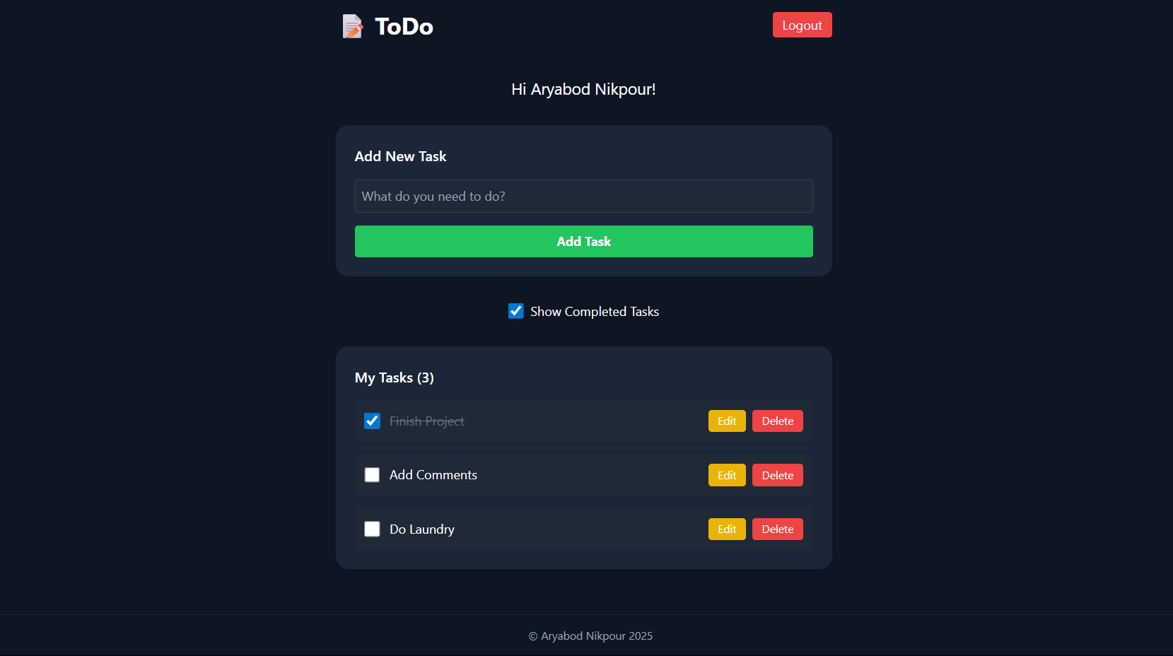
Logout Button
Welcome Message
Input Taks Box
Add Task Button
Show Completed Tasks Toggle Button
Completed Task
Edit/Delete Task Buttons

Slide 8
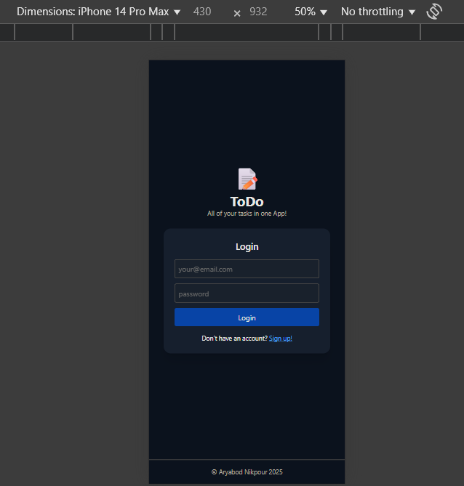
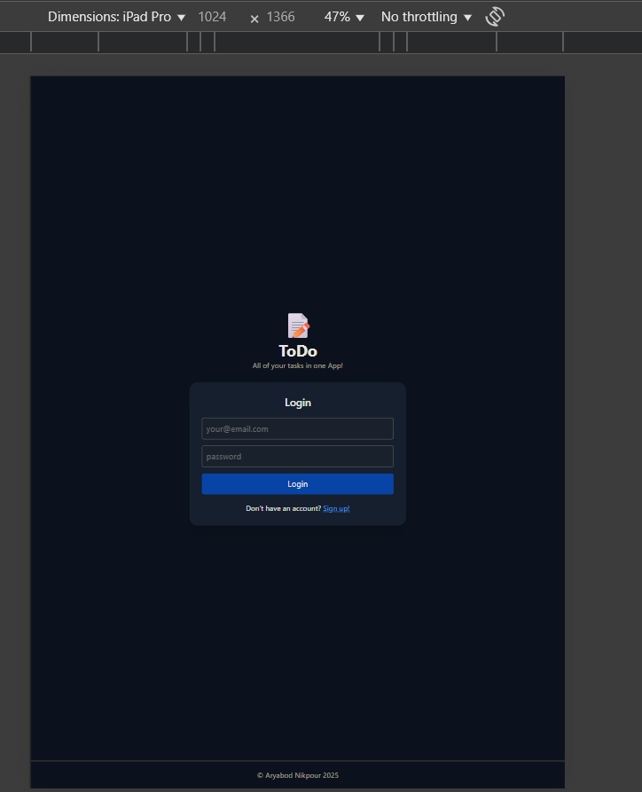

Slide 9
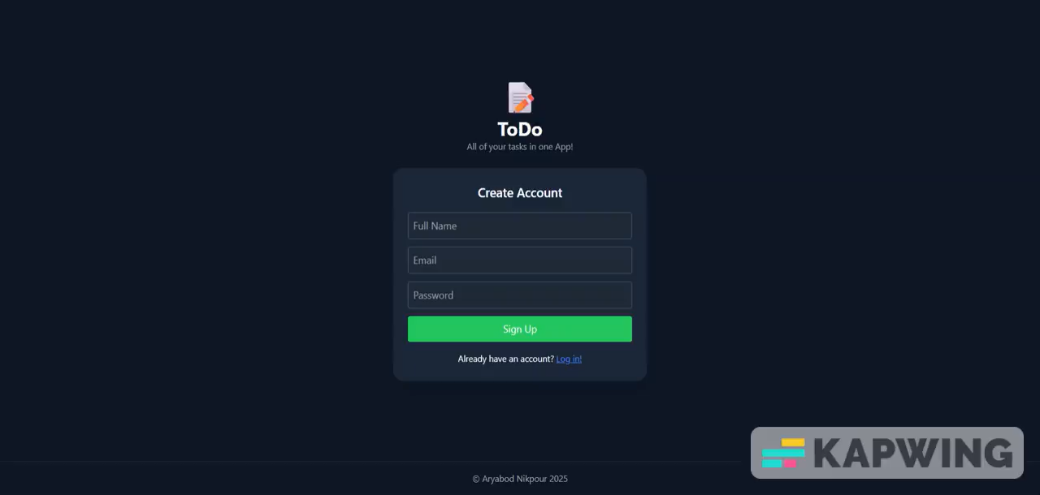
Screencast

Slide 10
Changes To initial Proposal & Test Cases
As I did not receive feedback regarding any necessary changes to elements regarding the project itself and as my initial choices effectively met the requirements, no further adjustments were needed following the initial phase. I remain open to any suggestions or improvements that may be available following this phase. All Test Cases can be found in the README.md file in the Github repository.

Slide 11
Changes To initial Proposal & Test Cases
As I did not receive feedback regarding any necessary changes to elements regarding the project itself and as my initial choices effectively met the requirements, no further adjustments were needed following the initial phase. I remain open to any suggestions or improvements that may be available following this phase. All Test Cases can be found in the README.md file in the Github repository.

Slide 12
Objectives
The goal of this project was to build a full stack To do list and task management web application allowing users to manage daily tasks with efficiency.
The app provides users with registration and login, task creation, task editing, marking tasks as complete, and filtering them based on their complete or incomplete status.

Slide 13
Concept
The App is created with the intent of helping users to stay productive with a simple interface. ToDo users can:
• Create an account and Login to their account securely
• Add/edit/delete tasks
• Mark tasks as completed
• Filter by task completion

Slide 14
Implementation
During the Initial development, I focused mainly on the frontend functionality with simple task handling. Once the interface was finalized and the core basic functions were functional, I integrated the backend API.

Slide 15
Design Process
I initially knew that I wanted a very simplistic dark mode task interface with all the tasks at the centre of the web page, using Tailwind CSS I managed to implement this simple yet intuitive interface. This design allows efficient and quick interaction between the user and app.

Slide 16
Backend Development
Express was used to create the endpoints for registering users, logging in with credentials , create, read, update, and delete operations for tasks.
LowDB was chosen for its simplicity, and it is an ideal simple too for file-based storage.

Slide 17
Testing & Debugging
I tested the app by creating multiple accounts, ensuring that sign in and login processes were efficient and without error, I then created multiple tasks in each account ensuring that tasks were saved in the final form and any update or edits made to the tasks or the task list were promptly saved in the database, any issues were debugged and fixed promptly.

Slide 18
Documentation & GitHub
All project files, code, and setup instructions are stored in the public GitHub repository, comments are added throughout to ensure clarity, setup instructions are included in the README file.

Slide 19
Lessons Learned
This project was before all a test of patience as it seemed like when one issue was fixed, another took its place, however by breaking down each aspect of the development into smaller parts, allowed for a more efficient and thorough coding experience.
As I had been more familiar with front-end rather than the backend processes, I learned a lot regarding how to properly integrate a back end and all the issues that may appear throughout the development process.

Slide 20
Reflections & Future Improvements
The final product meets all requirements of a simple yet efficient To do list app with organization and productivity in mind. Some Future improvements that could further enhance the app are:
• Deadline functionality
• Task Priority filter
• Multi-user task collaboration
• Sync with Google Tasks/Calendar

