Slide 1
Phase 2 : DLBCSPJWD01
https://github.com/Aryabod/ToDo---DLBCSPJWD01
Aryabod Nikpour

Slide 2
Purpose OF THE APP
Simple to do list allowing users within their own profile, to input the tasks they need to get done, edit tasks or delete them as well as mark them as completed.

Slide 3
Target group
Designed for students, adults and any individual with tasks that need to be done, to have all tasks in a simple and intuitive environment allowing for improved clarity and organization.

Slide 4
Features
Sign up and Login for each individual user
Add Tasks, Edit Tasks, Delete Tasks.
Mark Tasks as complete/incomplete.
Filter view to show/hide completed tasks.

Slide 5
Tech Stack
Front-end: React.js + Tailwind CSS: fast performance & modern UI
Back-end: Node.js + Express.js: Handles task related user inputs
Database: JSON Database: Stores user profiles and task lists

Slide 6
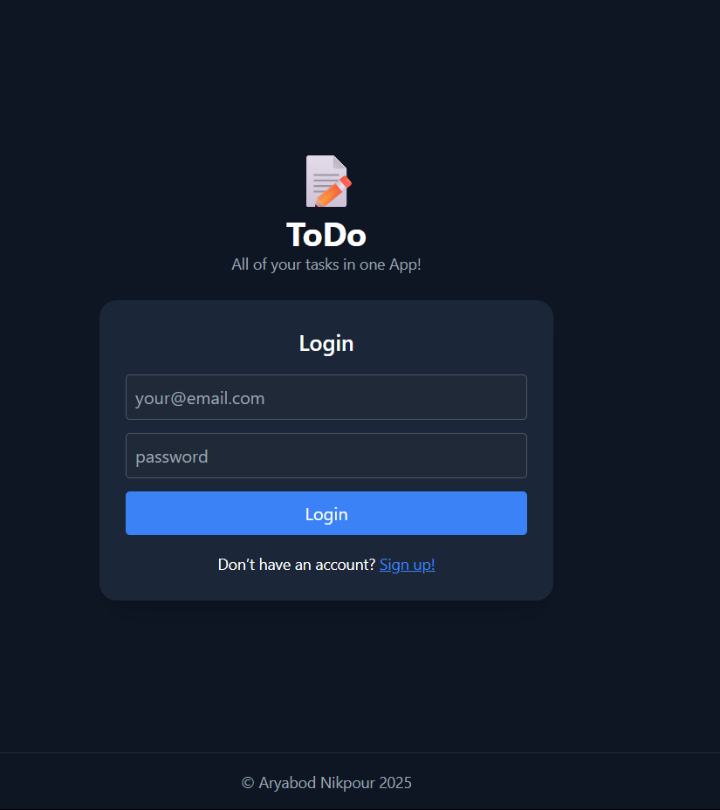
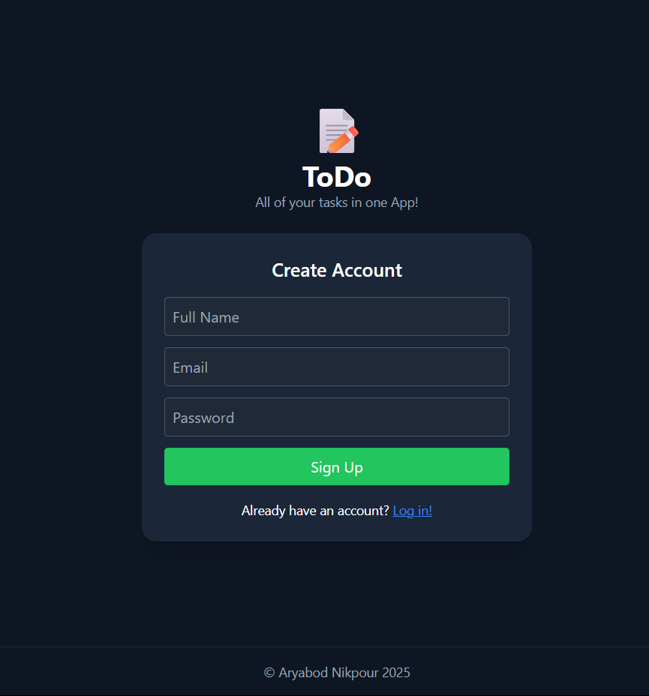
Sign Up Box Requiring: - Full Name
- Email
- Password
Login Box Requiring: - Email
- Password
Footer

Slide 7
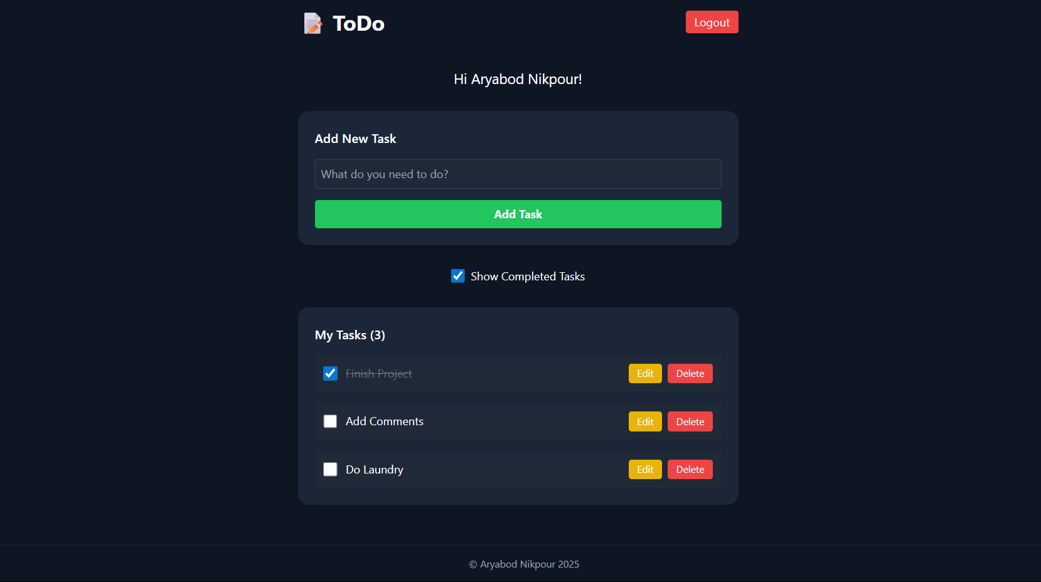
Logout Button
Welcome Message
Input Task Box
Add Task Button
Show Completed Tasks Toggle Button
Completed Task
Edit/Delete Task Buttons

Slide 8
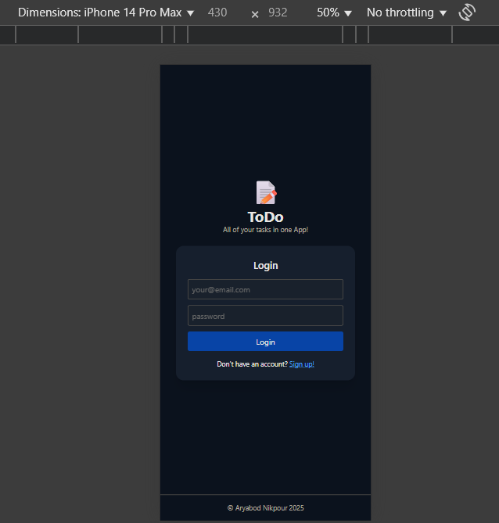
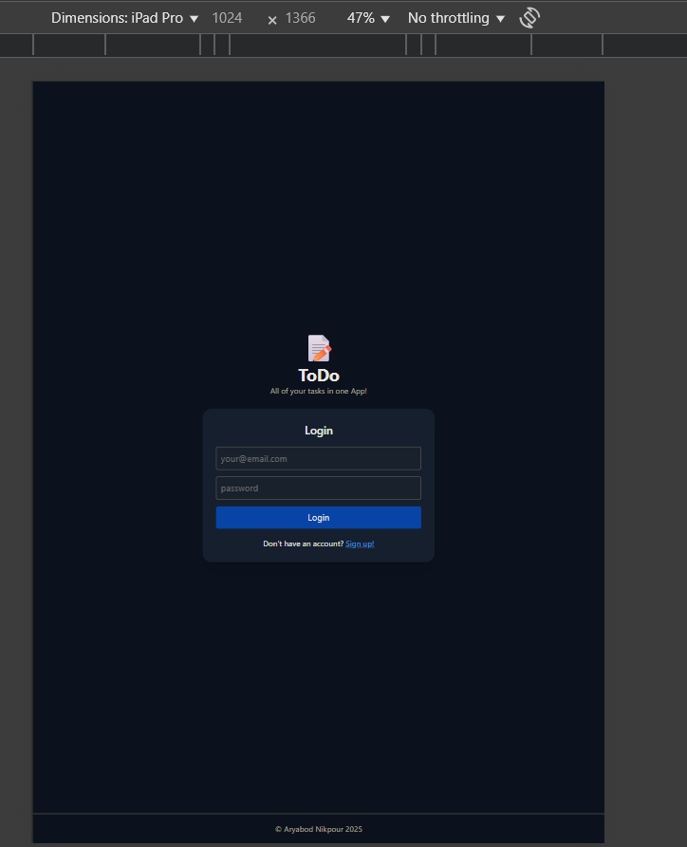

Slide 9
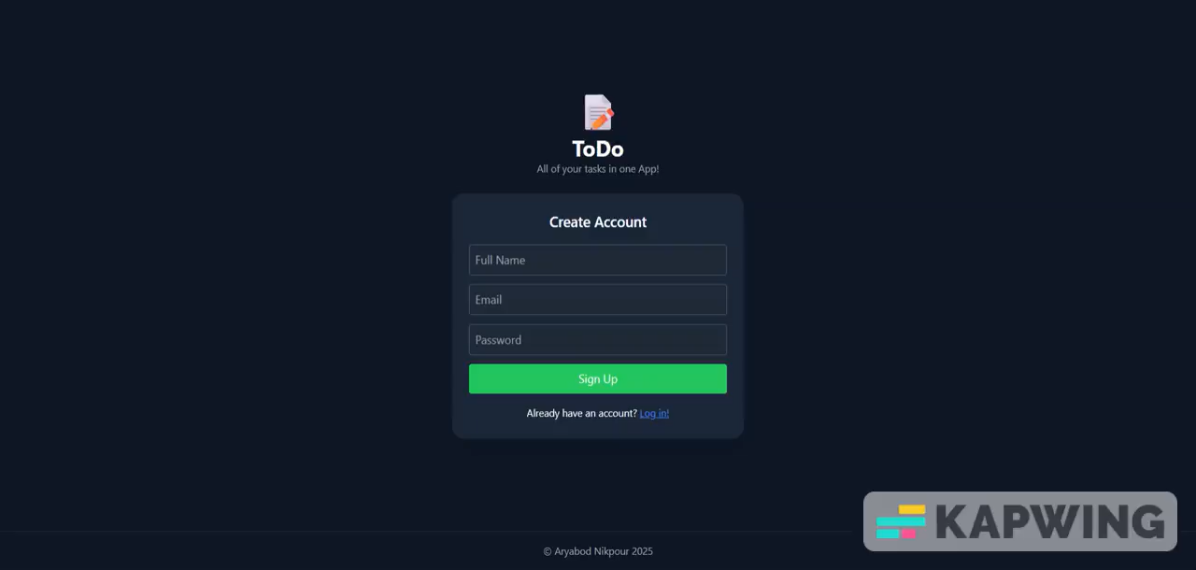
Screencast

Slide 10
Changes To initial Proposal & Test Cases
As I did not receive feedback regarding any necessary changes to elements regarding the project itself and as my initial choices effectively met the requirements, no further adjustments were needed following the initial phase. I remain open to any suggestions or improvements that may be available following this phase. All Test Cases can be found in the README.md file in the Github repository.

