Slide 1
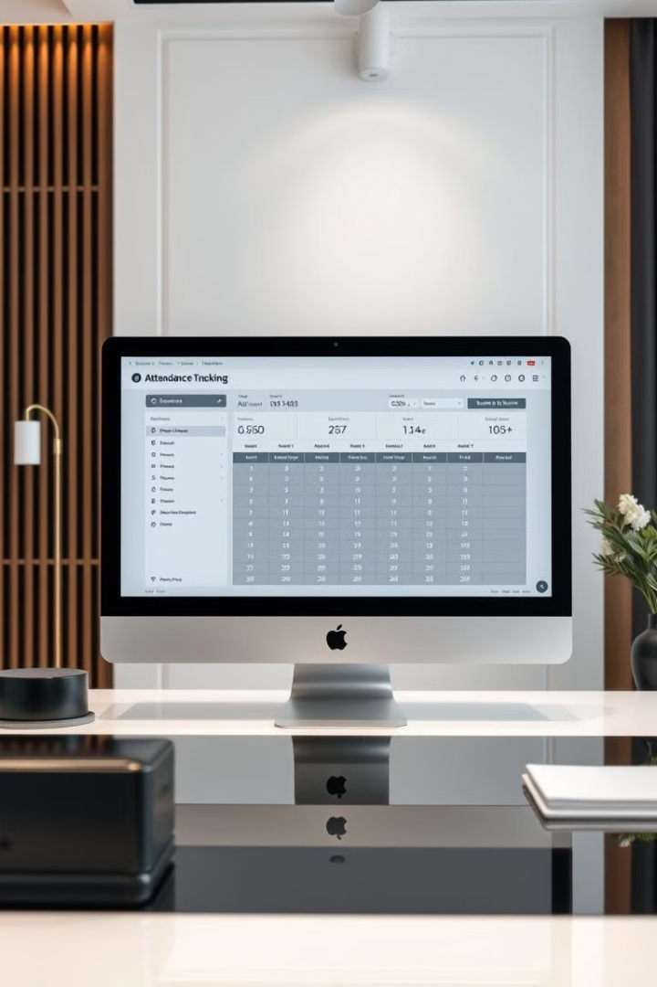
Attendance Tracking System in C
A Simple and Efficient Solution.
Group 13

Slide 2
Presentation Overview
1
Introduction
2
Features
Background and problem statement
Key functionalities of the system
3
Concepts Used in Code
4
Model Flowchart
Underlying programming techniques
Visual representation of the workflow
5
Results
6
Future Scope
Performance metrics and outcomes
Potential enhancements and scalability
7
Conclusion
8
Group Member List
Summary and key takeaways
Team contributions

Slide 3
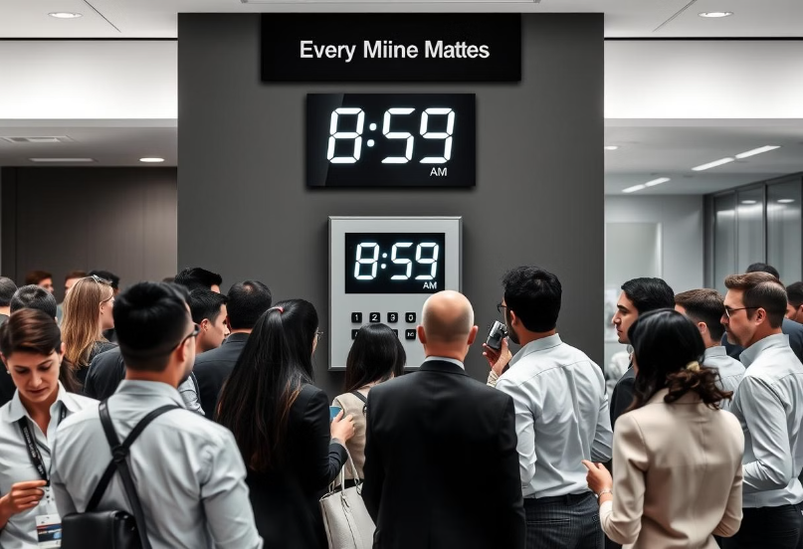
The Need for Accurate Attendance Tracking
Traditional Methods
Manual Timesheets: Error-prone.
Card-based Systems: Easily manipulated.
The Solution
C-based Attendance Tracking System
Lightweight and efficient.
Customizable.

Slide 4





Core System Features
User Authentication
Attendance Marking
Data Storage
Reporting
Secure and efficient attendance management.

Slide 5
Key Programming Concepts
Data Structures
1
Organizing user and attendance data.
File I/O
2
Reading and writing to data files.
String Manipulation
3
Handling usernames and passwords securely.
Fundamental C concepts for system functionality.

Slide 6
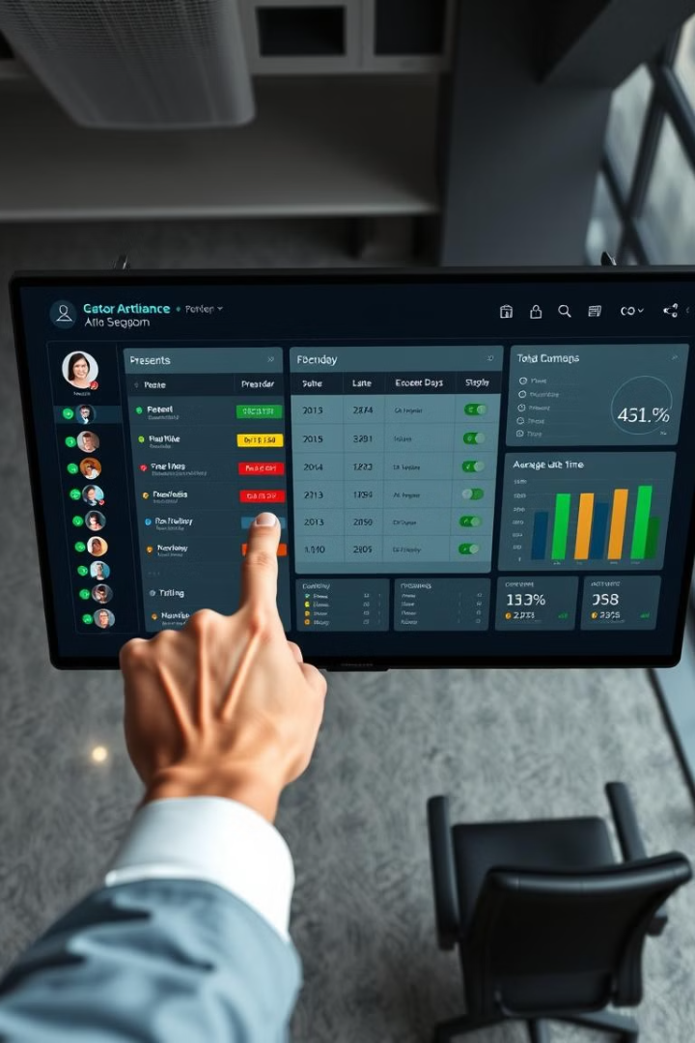




System Workflow
User Login
Verification process
Attendance Marking
Timestamp recording
Data Storage
File updating
Report Generation
Data filtering and summary
Step-by-step process of attendance management.

Slide 7
Results and Future Improvements
Results
Future Scope
Accurate tracking.
Biometric integration.
Reduced manual effort.
Web-based interface.
High uptime.
Cloud storage.

Slide 8
Conclusion
Efficiency
Customizability
Simplicity
Streamlined attendance tracking.
Adaptable to specific needs.
User-friendly interface.
Group Members:
Paritosh Kumar
Ashirwad Shekhar
Apoorb Raj
Ashish Kumar
Aryabrat Sahoo

