Slide 1

SHOPPING MANAGEMENT SYSTEM
CV RAMAN GLOBAL UNIVERSITY

Slide 2
GROUP MEMBERS
SL. NO. | NAME | REGD. NO
1 | ASHIRWAD SHEKHAR | CL2025010601919829
2 | APOORB RAJ | CL20250106019422126
3 | ARYABRAT SAHOO | CL2025010601919728
4 | ASHISH KUMAR | CL20250106018922104

Slide 3

SHOPPING MANAGEMENT SYSTEM

Slide 4
TABLE OF CONTENTS
01
02
03
INTRODUCTION
FEATURES
CONCEPTS USED IN CODE
04
05
06
FLOWCHART
FUTURE WORK
CONCLUSION

Slide 5
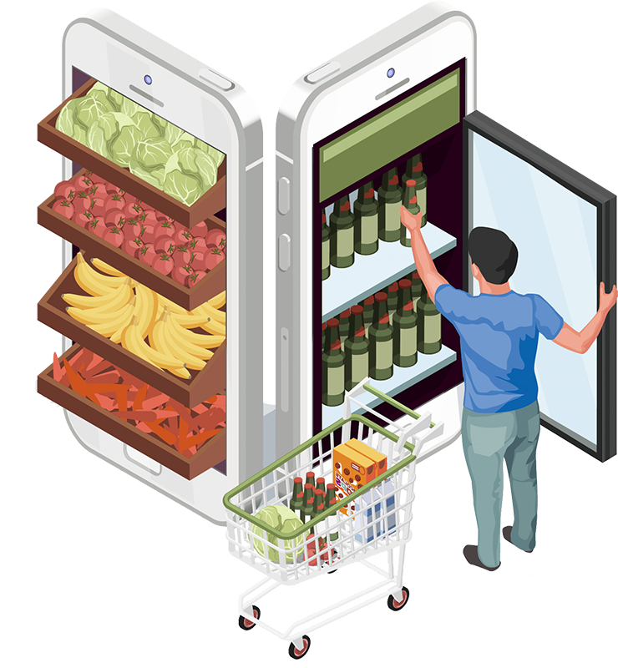
INTRODUCTION
A shopping management system is a software application that facilitates the management of various aspects of an retail business. It typically includes features for inventory management, order processing, customer management, and sometimes integrated payment processing. The system helps streamline the operations of an store, making it easier for businesses to handle product listings, track sales, manage customer information, and fulfill orders efficiently.

Slide 6
Modify added products
Add product to bill
Remove added product
Show final price of bill
FEATURES

Slide 7
CONCEPTS USED IN OUR CODE
HEADER FILE
CLASS
ENCAPSULA-TIONS
CODE
CONSTRU-CTOR
FUNCTION
CONDITIO-NAL
STATEME-NTES

Slide 8
HEADER FILES
Header files contain definitions of function and data types . These header files are imported into any C++ program using the preprocessor directive #include. The preprocessor directive tells the compiler to process these files before compilation.
<iostream>:- It is used as a stream of Input and Output using cin and cout.
<string>:-header file defines one variable type, one macro, and many functions which can be used to manipulate a string or array of characters
<vector>:-It contains the definition of the vector class container of STL.
<fstream>:-It is used to control the data to read from a file as an input and data to write into the file as an output.
<sstream>:-Stringstreams can be used to both read strings and write data into strings. It mainly functions with a string buffer, but without a real I/O channel

Slide 9
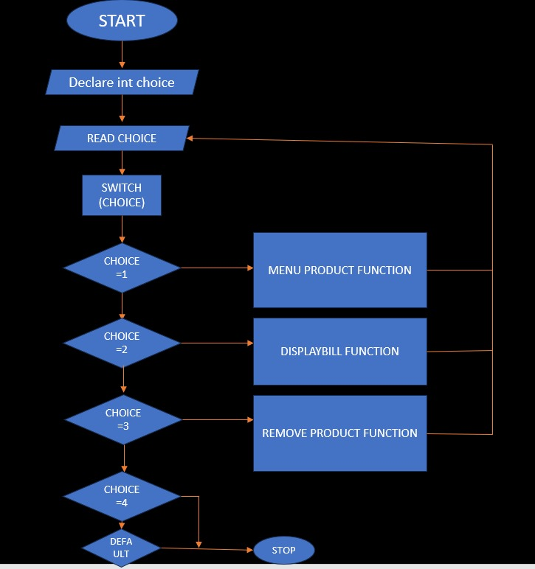
MODEL FLOWCHART

Slide 10
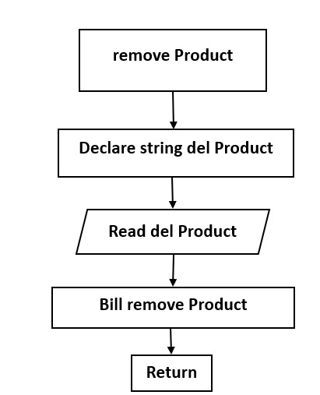
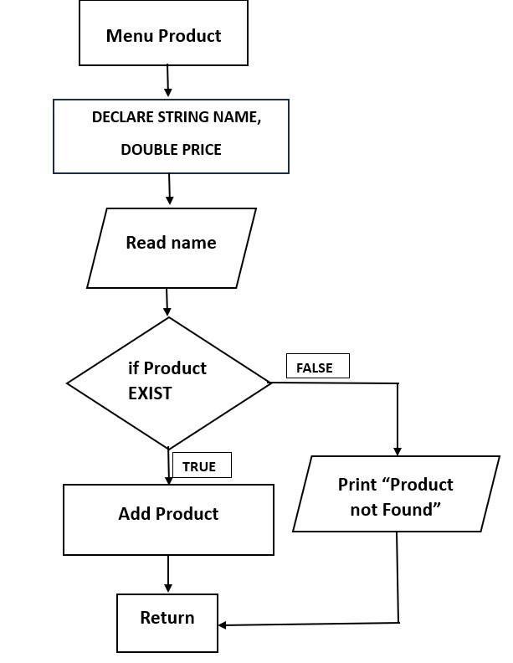
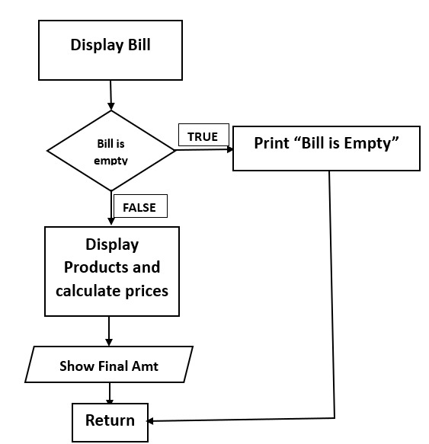
FLOWCHART OF FUNCTIONS

Slide 11
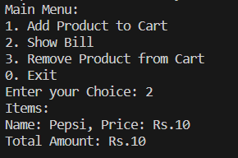
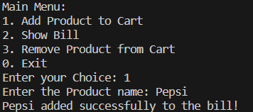
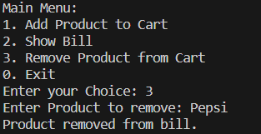
RESULTS

Slide 12
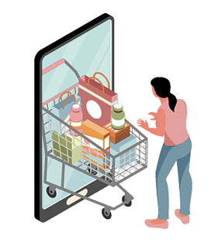
FUTURE WORK
Integration of AI and Machine Learning : Incorporating artificial intelligence (AI) and machine learning (ML) into management systems can enhance automation, decision-making processes, and predictive analysis.
Blockchain Technology : Implementing blockchain can enhance the security and transparency of data in management systems. It can be particularly useful in financial management, supply chain management, and record-keeping.
Mobile Accessibility : Increasing emphasis on mobile accessibility and responsive design to ensure that management systems are easily accessible and user-friendly on various devices, including smartphones and tablets.
4.Data Analytics and Business Intelligence : Enhanced data analytics and business intelligence capabilities to help organizations derive meaningful insights from the vast amounts of data generated by management systems. This can aid in better decision-making and strategic planning.
5.Collaboration and Communication Tools : Integration of collaboration and communication tools directly into management systems to streamline workflows and enhance team collaboration. This includes features such as instant messaging, video conferencing, and collaborative document editing.

Slide 13

CONCLUSION
In wrapping up our exploration of the Shopping Management System, we find ourselves at the nexus of efficiency, user convenience, and adaptability. This project, aimed at simplifying the shopping experience, has successfully integrated fundamental features essential for a seamless user journey. As we conclude, it is essential to highlight the adaptability and scalability inherent in this system. Its modular design and thoughtful integration of features pave the way for future enhancements and expansions. Whether in response to evolving user needs, market trends, or technological advancements, the Shopping Management System is poised to grow and adapt.
SHOPPING MANAGEMENT STYSTEM

Slide 14

THANK YOU

