Slide 1

COMPUTER SCIENCE CLUB
COMPUTER SCIENCE CLUB
Intro to Competitive Programming (Pt. 4)
Praneeth Suryadevara

Slide 2
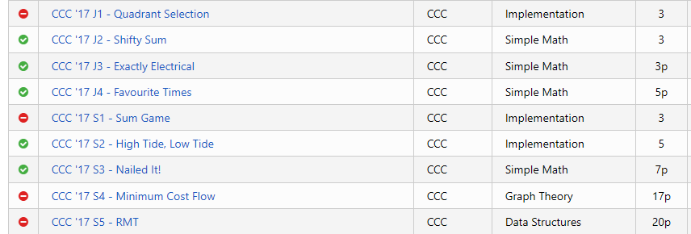
Implementation/Simple Math Problems
Most problems on the CCC (especially J1-J5, S1-S2)
Important to master before we proceed to complex topics like graph theory and dynamic programming

Slide 3
Strategy
Most of these problems have solutions that can be first expressed in words/thoughts/diagrams, then implemented
Can try a simple algorithm in your head/on paper and match it with the example inputs/outputs
Discovering the correct strategy is 50% of the work: the other 50% is implementing it

Slide 4
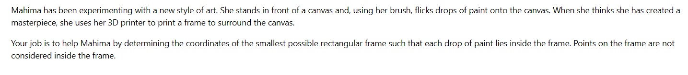
Example Problem: J3 - Art
Identify the objective:
Determine the coordinates of the smallest rectangle that fits all paint drops

Slide 5
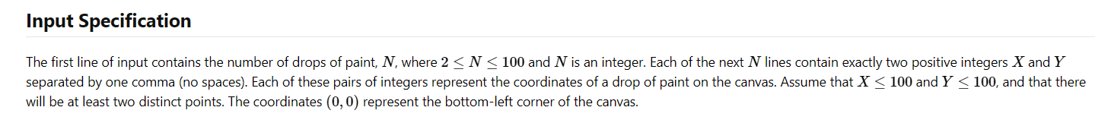
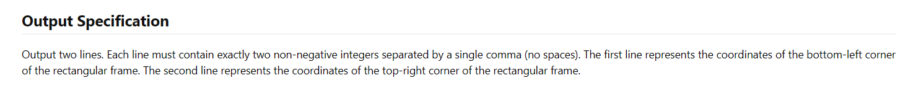
Input/Output Specification
First input: N - the amount of coordinates to be collected
Next N lines - X,Y coordinates for drops of points
Output: Create the smallest possible canvas to fit all points
Output the bottom-left and top-right corner of the rectangle

Slide 6
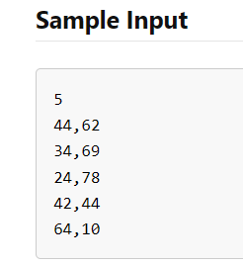
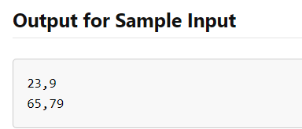
Input/Output Example
Based on this, what would be your first approach to solving this problem?
Take 2 minutes to brainstorm: Look at patterns in the input/output

Slide 7
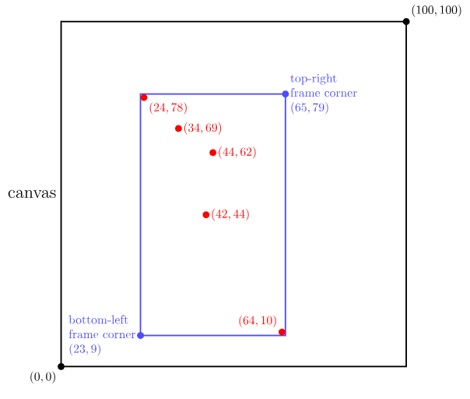
Solution
Strategy:
The corners of the frame are one greater/less than the highest/lowest x and y coordinates
Any more would be wasting space; any less wouldn’t fit all points

Slide 8
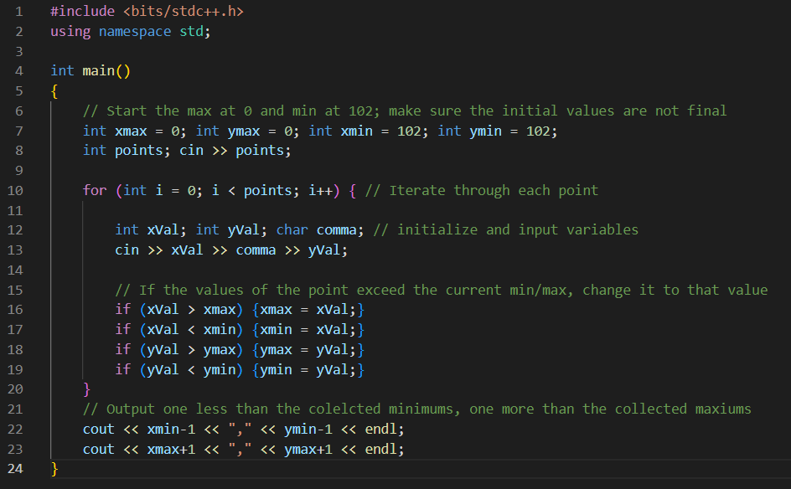
Code Solution
Setting the max value to a value lower than the range, and a min value to something higher than the range
Makes sure the initial values aren’t the final values from the collected data

Slide 9
Problems to Solve
Beginner:
Exactly Electrical (2017) - J3/3p
Intermediate:
Crazy Fencing (2021) - S1/5p
Advanced:
Geneva Confection (2014) - S3/7p
Nailed It (2017) - S3/7p
Questions 10p+ fall into other categories
Find these problems on DMOJ by searching the title or looking for the year and name under the CCC category

Slide 10
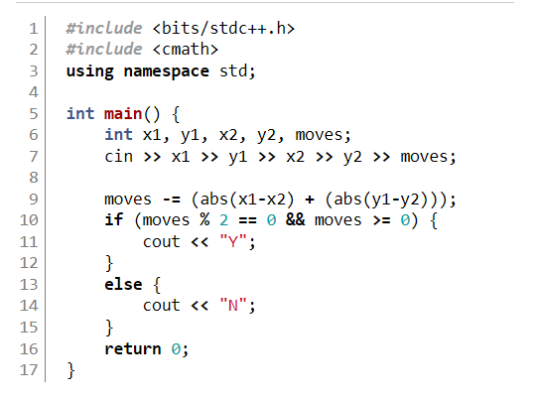
Code Solutions: Exactly Electrical
Strategy:
The net path is the difference between the initial and final x and y coordinates
Any other movements need to be offset by a move in the other direction
Hence, if the remaining moves is divisible by 2, it’s doable

Slide 11
Solutions: Any other Problems?
Can solve any of the other problems on DMOJ live
Any other questions? Can email me (708517@pdsb.net) if you have any questions about the three other problems linked in the slideshow

