Slide 1
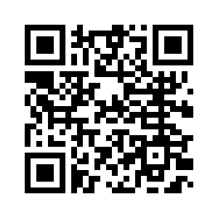
COMPUTER SCIENCE CLUB
COMPUTER SCIENCE CLUB
Intro to Competitive Programming (Pt. 5)
Edward Wang

Slide 2
What is a data structure?
A data structure is a way of representing data in a way that allows for certain specialized tasks
Examples:
String
List
Dictionary
Set

Slide 3
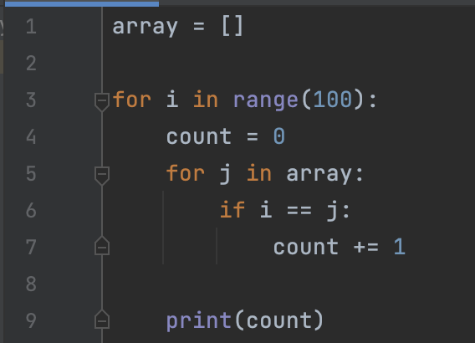
Problem:
Given an array of n integers, find how many times each value from 0-100 occurs.
Naive: Use .count() or for loops: O(n) per value

Slide 4
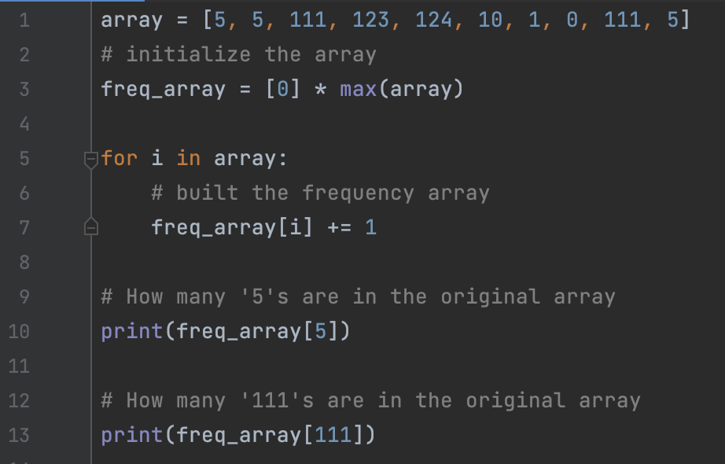
Frequency Array
Stores the amount of element n in the original at index n of the new array
Freq_array[5] evaluates to how many ‘5’s are in the original array

Slide 5
Frequency Array
Initializing array:
Create an array with the length max(array), filled with 0’s
Iterate through original array, add one to the index corresponding to the value

Slide 6
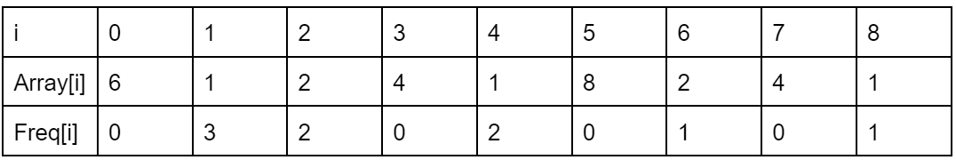
Frequency Array Example
Index 1 of the frequency array shows how many 1’s are in the original array

Slide 7

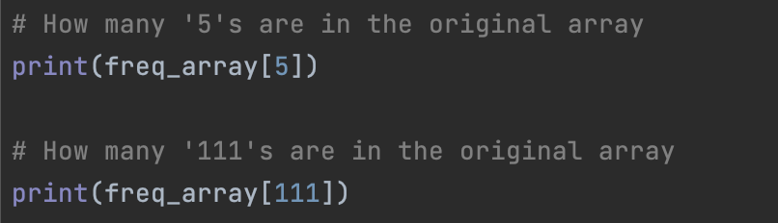
Frequency Array
Initializing frequency array: max(array) elements,
O(max(array)) or O(n) with dictionary
Query frequency array: array access, O(1) time

Slide 8
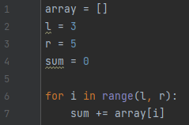
Problem:
Given an array of n integers, find the sum from index l to index r
Naive: Use sum() or for loop iteration

Slide 9
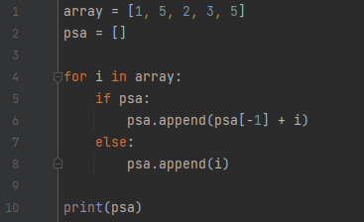
Prefix Sum Array
Stores the sum from index 0 to index i at every index i
psa[5] evaluates to the sum from elements 0 to 5

Slide 10
Prefix Sum Array
To find value at index i, find the difference between index i and index i-1
To find sum in a range (inclusive), psa[r] - psa[l]

Slide 11
Prefix Sum Array
Initializing PSA: O(n) time, iterating through original array
Query sum in PSA: O(1) time

Slide 12
Practice Problems
Beginner (PSA):
https://dmoj.ca/problem/dmopc14c2p4
Intermediate (PSA):
https://dmoj.ca/problem/sac21ccp4
Advanced (frequency array):
https://dmoj.ca/problem/ccc21s2
https://dmoj.ca/problem/ccc17s3

