Slide 1

CLOUD BASED BUSS PASS SYSTEM
Submitted by:
AAYUSHI RAI (171510003)
PRANJUL SINGHAL (171510040)
SAKSHAM JOHRI (171510046)
DEPARTMENT OF COMPUTER ENGINEERING AND APPLICATIONS
Institute Of Engineering and Technology
GLA University
Mathura-281406,INDIA
2019

Slide 2
CONTENTS
INTRODUCTION
WHAT IS CLOUD
LANGUAGES USED
CLOUD USED
ADVANTAGES
SOME GLIMPSE OF PROJECT

Slide 3
INTRODUCTION
Customer can buy the bus ticket over the Internet, 24 hours a day, this solves the issue of ticket being misplaced or stolen.
This system is built up using cloud infrastructure for improved performance.
Using this website we can check all details related Bus pass.
This website keeps all information of all Bus passes.
Passengers first need to verify themselves through registration.
Users can recharge through cc debit cards

Slide 4
WHAT IS CLOUD
Cloud computing is the on-demand delivery of compute power, database and other IT resources via the internet with pay-as-you-go pricing.
A cloud services platform provides rapid access to flexible and low cost IT resources.
Cloud computing is a general term for anything that involves delivering hosted services over the Internet.
Example: Google Drive, Apple iCloud, Amazon Cloud Drive etc.

Slide 5
PYTHON DATATYPES
Variables can hold values of different data types. The interpreter implicitly
binds the value with its type.
Number
String
List
Tuple
Dictionary
PYTHON KEYWORDS
Python Keywords are special reserved words which convey a special meaning to the compiler/interpreter. These keywords can't be used as variable.

Slide 6
LITERALS OPERATORS
Literals can be defined as a data that is given in a variable or constant.
Python support the following literals like Numeric Literals, String literals, Boolean literals, etc.
The operator can be defined as a symbol which is responsible for a particular operation between two operands. Python provides a variety of operators , out of which few are mentioned below:
Arithmetic operators
Comparison operators
Assignment Operators
Logical Operators
Bitwise Operators

Slide 7
PYTHON TKINTER
Python provides the standard library Tkinter for creating the graphical user interface for desktop based applications.
Developing desktop based applications with python Tkinter is not a complex task.
An empty Tkinter top-level window can be created by using the following steps.
import the Tkinter module.
Create the main application window.
Add the widgets like labels, buttons, frames, etc. to the window.
Call the main event loop so that the actions can take place on the user's computer screen.

Slide 8
Syntax for Importing tkinter
There are basically two ways to import tkinter in python:-
Import everything from tkinter module >>> from tkinter import *
>>> import tkinter
m = tkinter.Tk()
'''
widgets are added here
'''
m.mainloop()

Slide 9
gui = Tk() # whole code for adding widgets such as button, text area, etc were coded in between this section # mainloop() is holding the GUI output gui.mainloop()

Slide 10
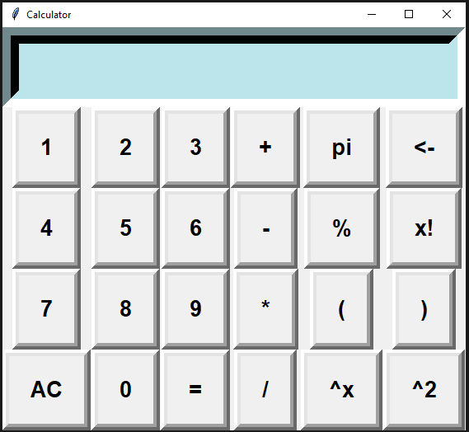
Buttons, Text area, etc.
TITLE
BUTTONS
TEXT AREA

Slide 11

root = Tk()#creating window root.title('Calculator') root.geometry("265x125")
# lambda is used calling a function get variable which is user defined and passing argument while calling

Slide 12
PROJECT
GUI CALCULATOR

Slide 13
SOURCE CODE

Slide 14
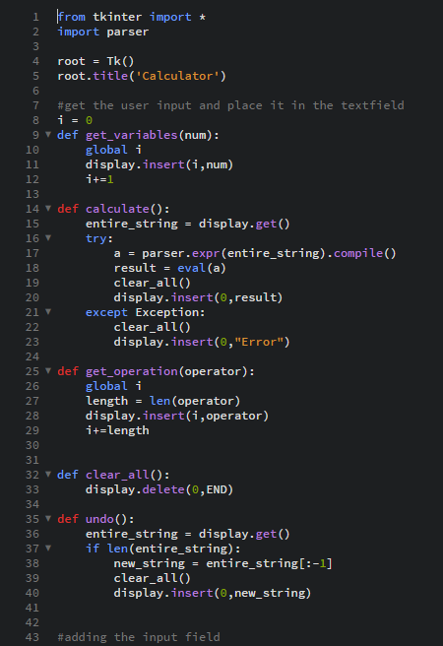

Slide 15
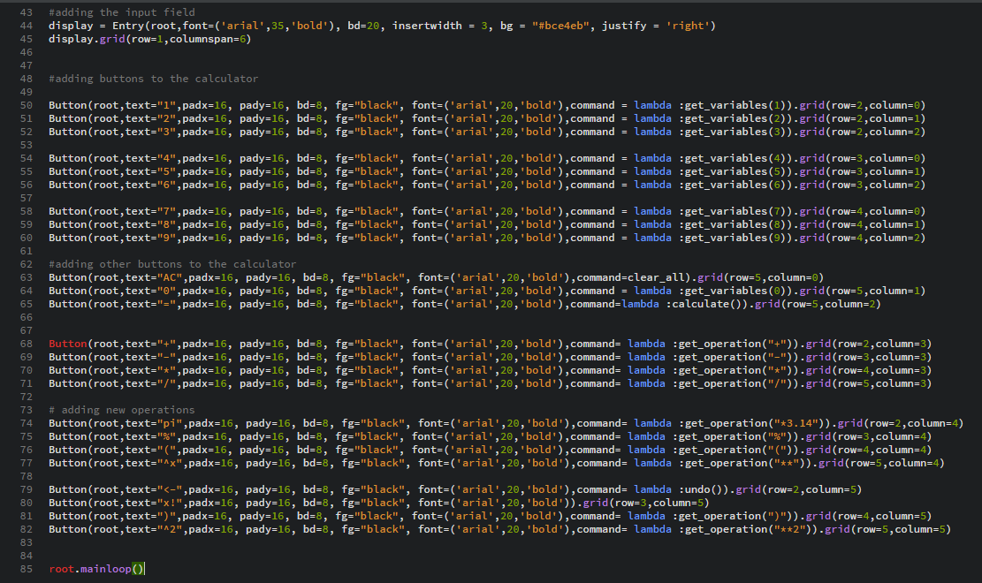

Slide 16
Here is simple GUI calculator using tkinter in python

Slide 17
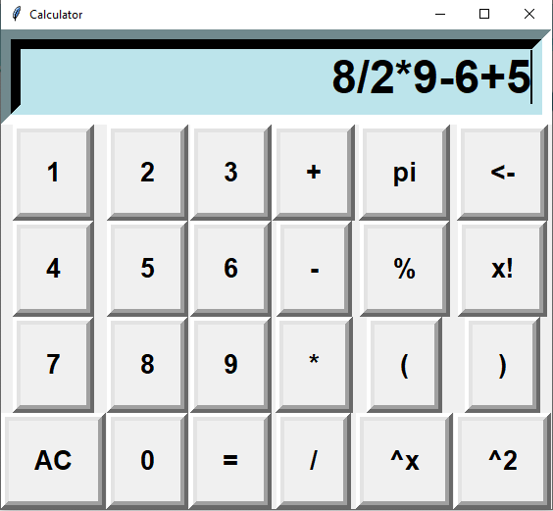
PERFORMING CALCULATION

Slide 18
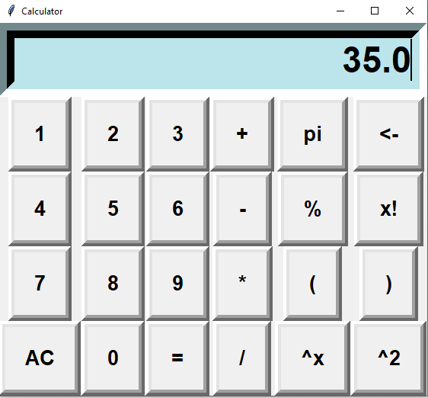
OUTPUT

Slide 19
THANK YOU

