Slide 1
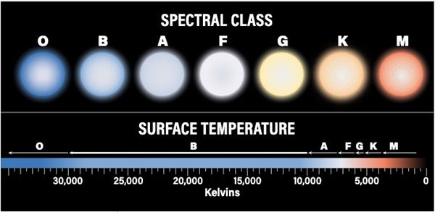
Star Classification Using Spectral Data

Slide 2
Why Classification Matters
Spectral classification helps in planet search, life exploration, and
understanding stellar evolution.

Slide 3
Dataset
Used Vmag, B-V index, Parallax, and SpType from 'Star Categorization -
Giants and Dwarfs'.

Slide 4
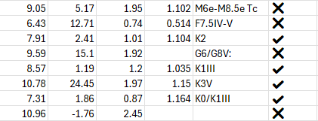
Cleaning Raw Data
Removed malformed entries and filtered based on parallax error threshold.

Slide 5
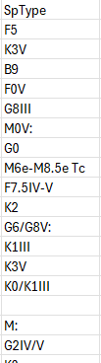
SpType Challenges
The SpType entries were a mess.

Slide 6
Feature Engineering
Using parallax, I engineered a new feature called Distance.

Slide 7
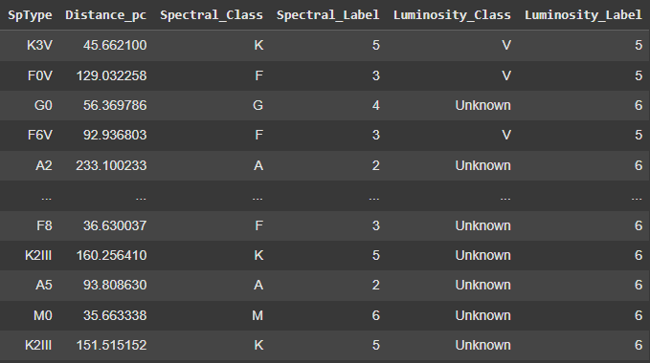
Extracting Labels
Splitting the SpType set to expand

Slide 8
Feature Selection
Used Vmag, Distance (1000/Plx), and B-V as input features.

Slide 9
Normalization
Standardized features using StandardScaler before training.

Slide 10
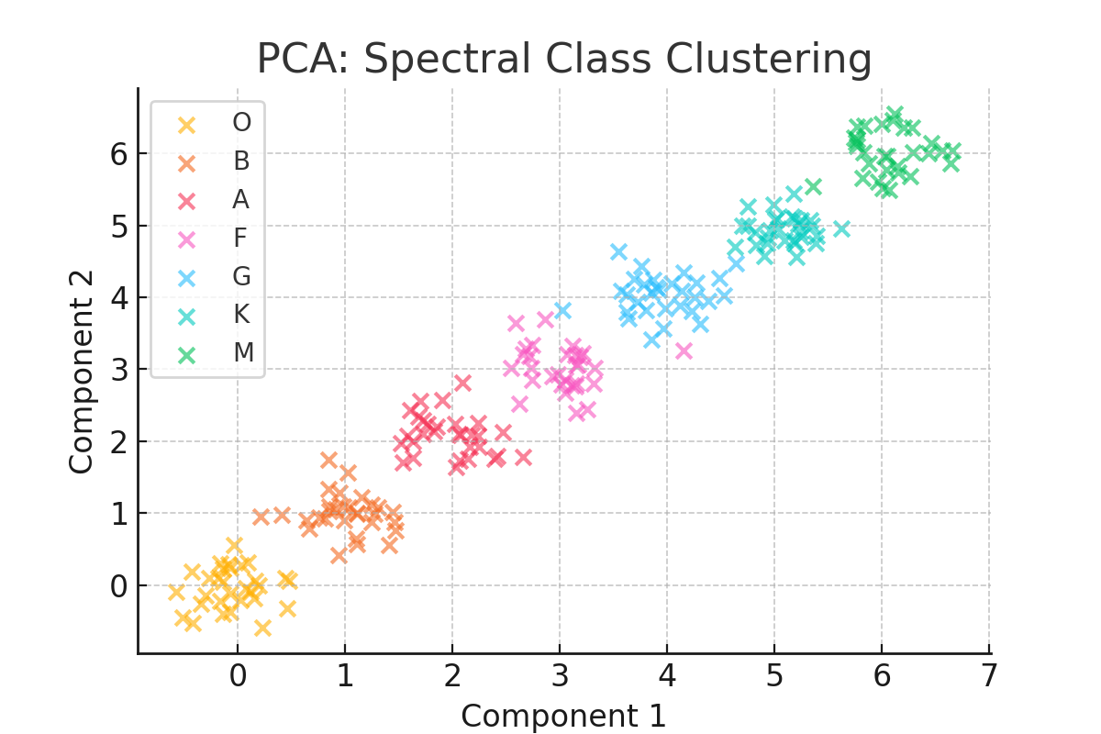
PCA for Reduction
Applied PCA to reduce dimensionality to 2D space.

Slide 11
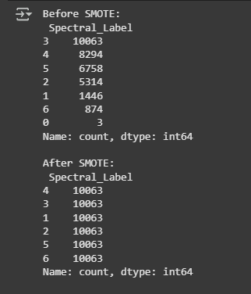
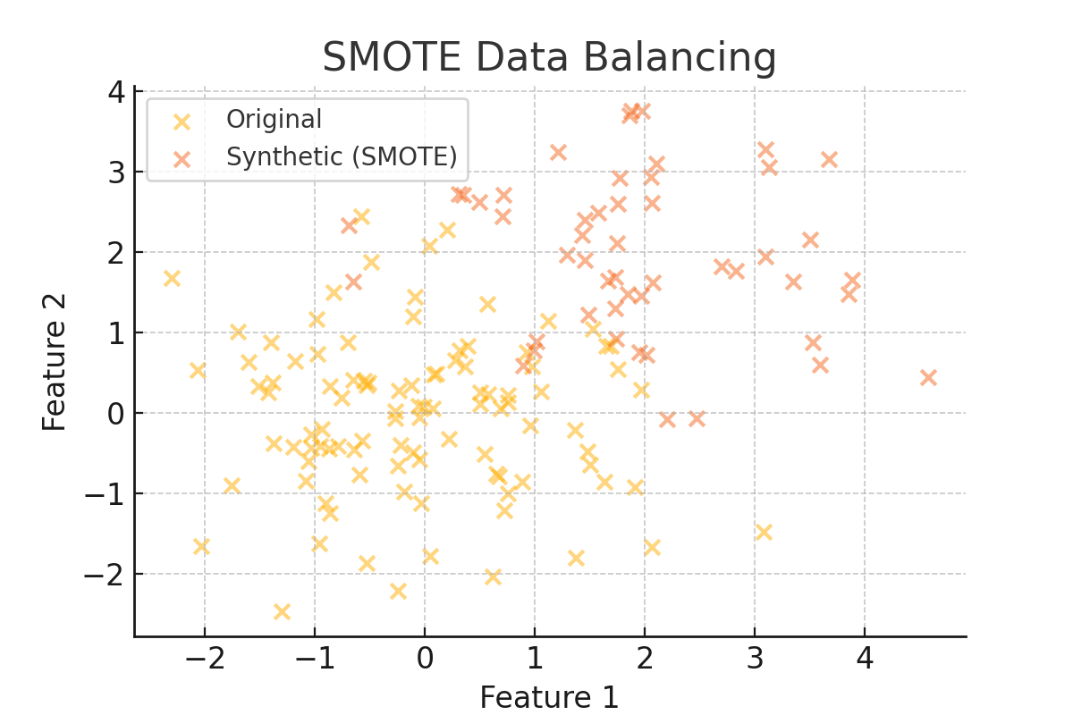
Handling Imbalance
Used SMOTE to balance classes and generate synthetic samples.

Slide 12
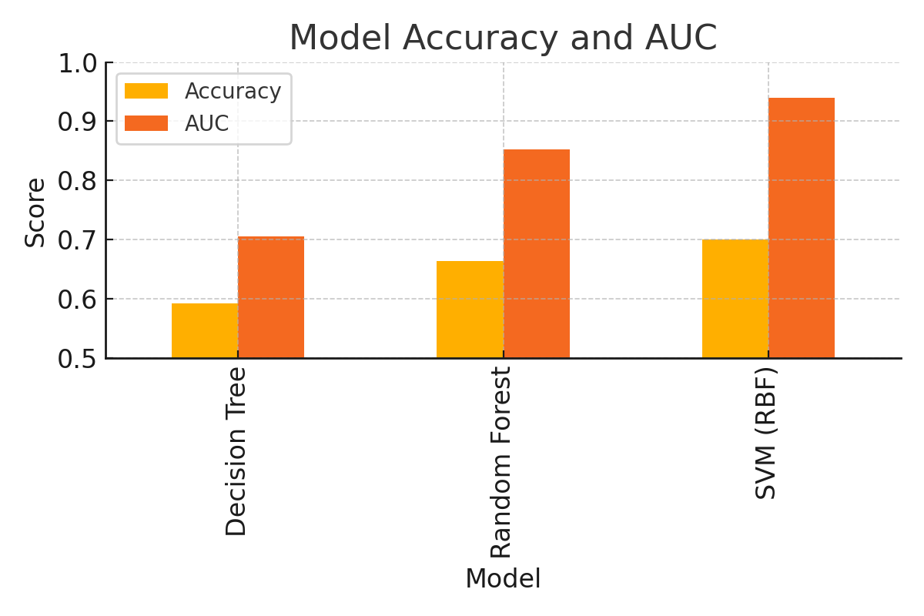
Models Trained
Decision Tree, Random Forest, and SVM (RBF) were evaluated.
Classifiers | Accuracy | Precision | Recall | F1-Score | AUC | CV Accuracy | CV Runtime
Decision Tree | 0.5918 | 0.5929 | 0.5918 | 0.5923 | 0.7054 | 0.5903 | 0.49
Random Forest | 0.6637 | 0.6625 | 0.6637 | 0.6625 | 0.8520 | 0.6665 | 16.26
SVM | 0.7006 | 0.7001 | 0.7006 | 0.6973 | 0.9402 | 0.7073 | 215.51

Slide 13
Selected Model
Random Forest offered best trade-off between accuracy and efficiency.

Slide 14
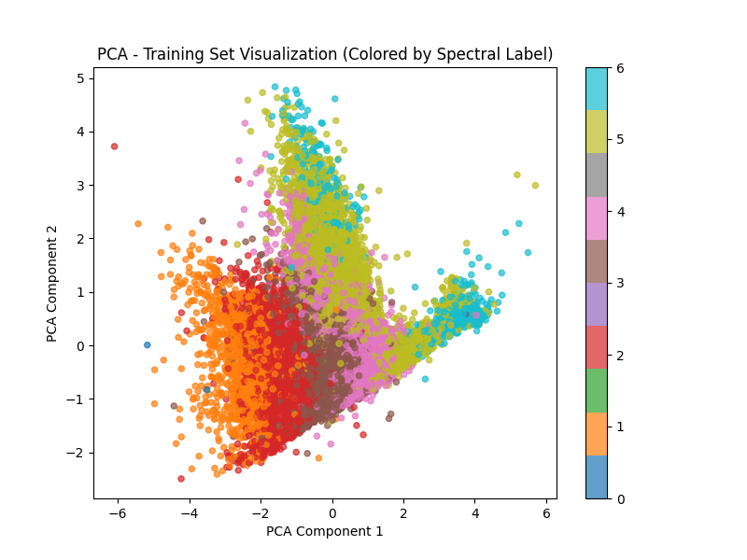
Visualization
Clear clustering observed in PCA plot among spectral classes.

Slide 15
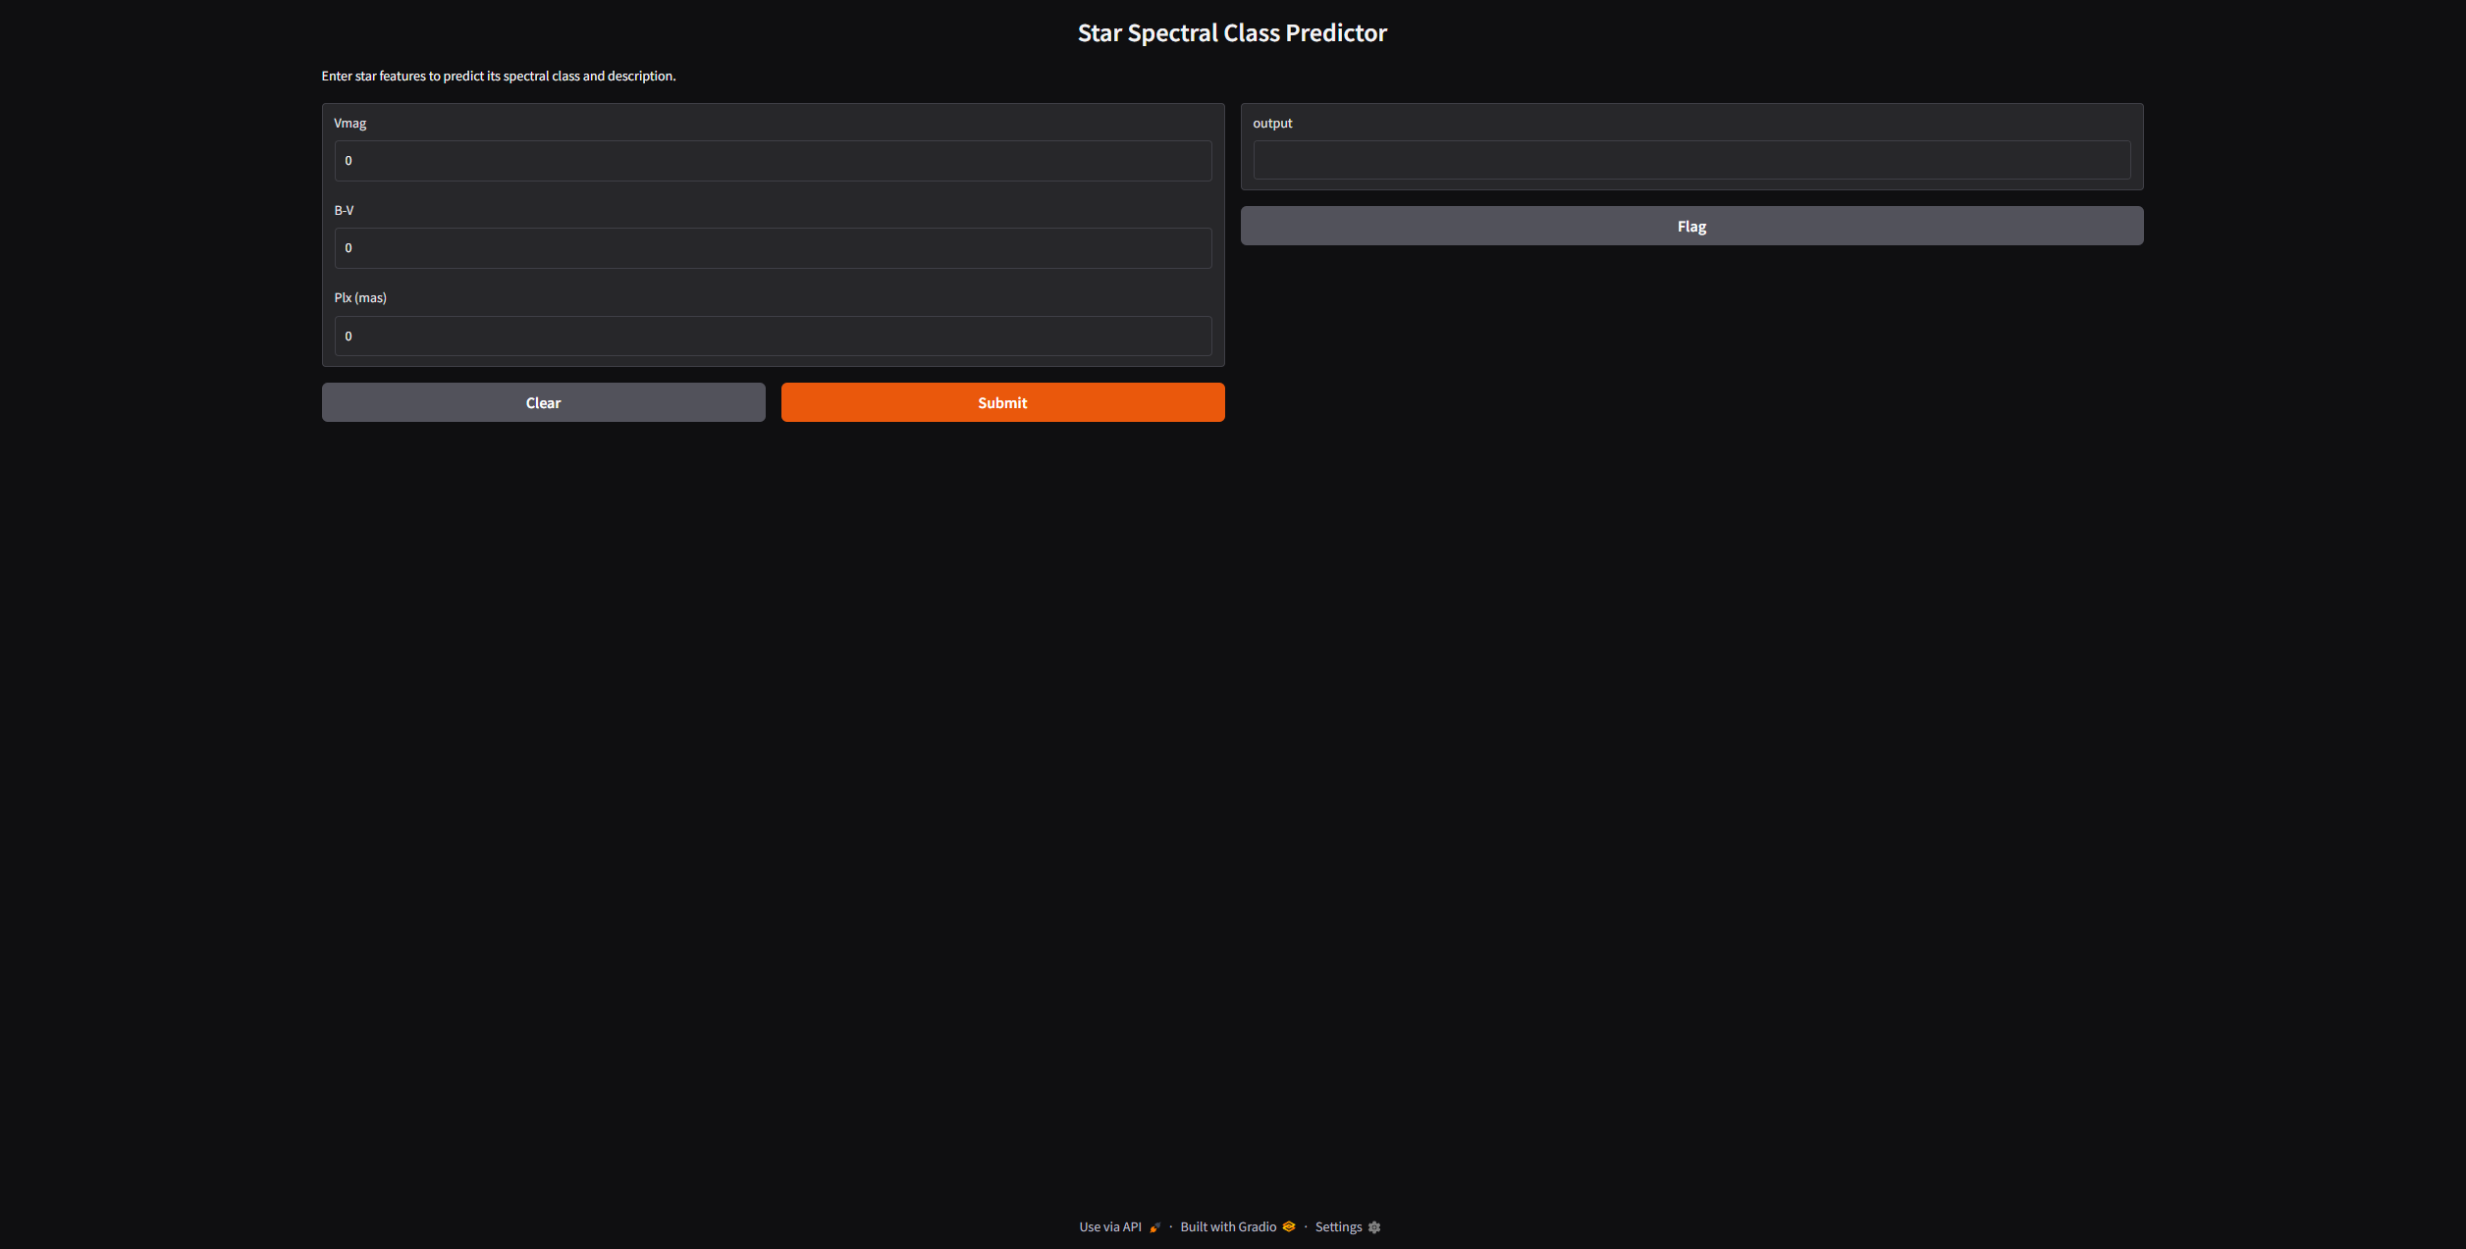
Deployment
Model integrated with Gradio for live predictions from user input.

Slide 16
Challenges
Dropped luminosity class due to missing values in many records.

Slide 17
Limitations
Only 3 features used; richer features could improve prediction.

Slide 18
Real World Issue
Useful in space exploration.

Slide 19
Future Scope
Plan to infer luminosity, use additional features and deep models.

Slide 20
Project Outcome
Built and deployed a robust star classification pipeline.

