Slide 1

CAPSTONE FINAL PROJECT

Slide 2
INTRODUCTION:
This project is aimed at someone who wants to open a new business in Toronto and wants ideas regarding the same.
In this project I have used location data of Toronto and Foursquare API to generate venues in the city.
Further, I have used data analysis to figure out which are the most common venues in the city. The data reveals that cafés and coffee shops are quite popular and spread all over Toronto.
This suggests high demand for beverages in Toronto.
Consequently, I have considered a hypothetical case if someone wants to open a Tea Shop, how he can use the data related to coffee shops to figure out the best location for him to open the tea shop.

Slide 3
BUSINESS PROBLEM:
The aim of the project is:
to leverage location data to figure out trends in Toronto, which can help an Entrepreneur identify some business opportunities.

Slide 4
DATA:
The data used in the project includes:
List of neighborhoods in Toronto (Wikipedia)
Latitudes and Longitudes corresponding to the neighborhoods
Venues related to the neighborhoods

Slide 5
DATA EXTRACTION:
Web scrapping for extracting data from Wikipedia
Use of Geocoder package to extract the latitudinal and longitudinal data
Use of Foursquare API to get venues related to the neighborhoods

Slide 6
METHODOLOGY:
Using web scrapping to scrap data related to the neighborhoods in Toronto
Adding latitudes and longitudes to the neighborhoods
Using foursquare API to get a list of venues for the neighborhoods
Sorting data to find out unique and frequent venue categories
Visualizing Tea and Coffee Shops on maps
Clustering the data to find a suitable location for a new tea shop

Slide 7
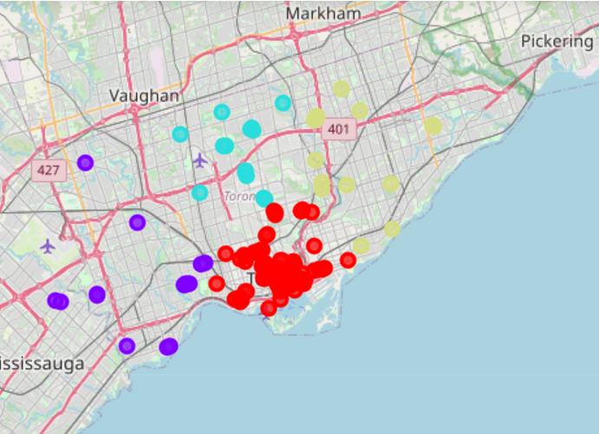
CLUSTERING:
 | Venue | Observations
Cluster Labels
0 (RED) | 124 | Densely Packed - may be chosen by someone with a high risk appetite.
1 (PURPLE) | 16 | Scattered – well suited to set up a new Tea Shop (Personal commendation)
2 (BLUE) | 16 | Evenly spaced – difficult to find an empty space
3 (YELLOW) | 16 | Less Scattered – this area can be a second choice

Slide 8
SUGGESTION:
In my opinion, Cluster 1 should be chosen to set up a new Tea Shop, because:
it has very less coffee shops
the coffee shops are scattered
it has a single tea shop (from map_tea)
there is enough area with no coffee or tea shop in the vicinity.
Therefore, this area has a benefit of low competition compared to other areas in the map.

