Slide 1

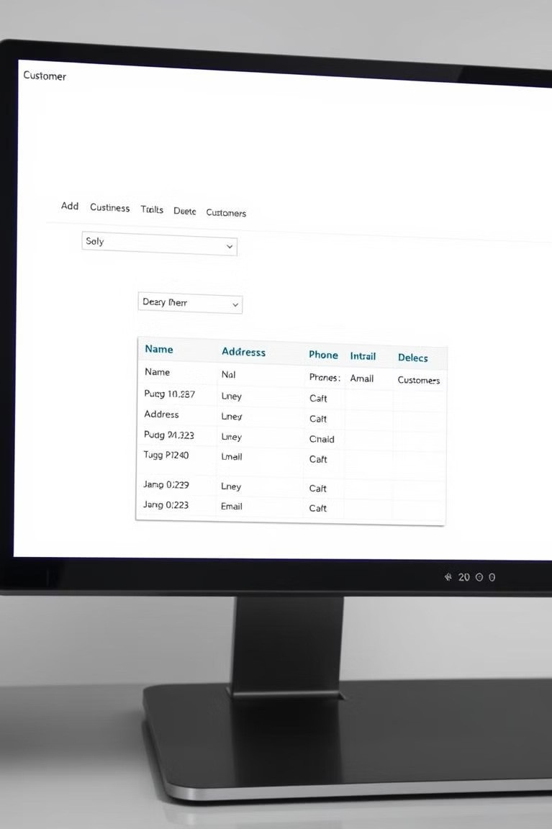

Java Swing Quiz App: An Introduction
Welcome to the Java Swing Quiz App presentation! We'll explore Java Swing for GUI development. Our project goal is to build a quiz application. This guide is tailored for beginners. Swing offers cross-platform compatibility and a lightweight structure.

Slide 2
Setting Up Your Environment
Install JDK
Download JDK from Oracle or OpenJDK.
Set JAVA_HOME environment variable.
Verify with java -version and javac
-version.
Choose IDE
IntelliJ IDEA (feature-rich, commercial).
Eclipse (open-source, customizable).
New Java Project
Set up project structure and dependencies.

Slide 3

Core Swing Components
JFrame: Main Window
JFrame frame = new JFrame("Quiz App");
Sets size and visibility.
JPanel: Organizing Components
JPanel panel = new JPanel();
Uses layout managers.
JLabel: Text & Images
JLabel label = new JLabel("Welcome!");
Displays text.
JButton: User Input
JButton button = new JButton("Submit");
Handles actions.

Slide 4
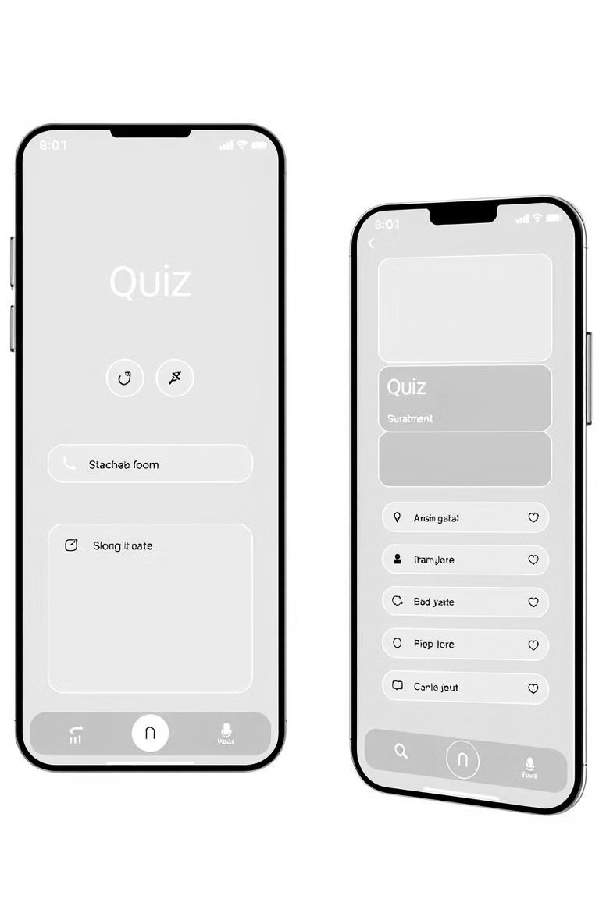
Designing the User Interface (UI)
FlowLayout
Components in a flow.
1
BorderLayout
North, South, East, West, Center.
2
GridLayout
Grid of rows and columns.
3
Basic UI: JFrame -> JPanel -> JLabels & JButtons.

Slide 5
Implementing Quiz Functionality
1
Handle Input
Implement ActionListener
for button clicks.
2
Scoring
int score = 0; increments on correct answers.
3
Question Management
Array or List stores questions and answers.

Slide 6
Enhancements: Timer and MCQs
Timer
javax.swing.Timer creates a timer. Updates JLabel with remaining time.
MCQs
JRadioButton or JCheckBox for choices.
ButtonGroup ensures single selection.

Slide 7

Database Integration (Optional)
2
Import Driver
Establish connection.
JDBC
Connect to MySQL or SQLite.
1
Execute Queries
Fetch questions, store scores.
3
Benefits: scalability and maintainability.

Slide 8

Code Snippets
JFrame frame = new JFrame("Quiz App"); frame.setSize(600, 400); frame.setDefaultCloseOperation(JFrame.EXIT_ON_CLOSE);
JPanel panel = new JPanel(); frame.add(panel);
JLabel label = new JLabel("Welcome to the Quiz!"); panel.add(label);
Simple JFrame Example.

Slide 9

Conclusion
Summary
Java Swing quiz app development overview.
Improvements
Consider future enhancements.
Further Learning
Explore advanced Swing concepts.
Build upon this foundation for advanced quizzes.

