Slide 1

Segmented Page Mapping: A Deep Dive
Efficient memory management technique for virtual memory systems.
Divides both logical and physical address spaces into segments.
Provides better memory protection and sharing capabilities compared to pure paging.
Reduces external fragmentation by allowing variable-sized segments.

Slide 2

Understanding Segmentation: The Building Blocks
Logical Address: Consists of a segment number and an offset within that segment.
Segment Table: Maps segment numbers to physical memory addresses (base address and limit).
Base Address: Starting physical address of the segment in memory.
Limit: Size of the segment in bytes, preventing access beyond its boundaries.

Slide 3

The Segmentation Process: A Step-by-Step Guide
CPU generates a logical address (segment number, offset).
The segment table is consulted using the segment number as an index.
Base address and limit are retrieved from the segment table entry.
The CPU adds the offset to the base address to calculate the physical address.
Access to memory is granted only if the offset is within the segment limit.

Slide 4
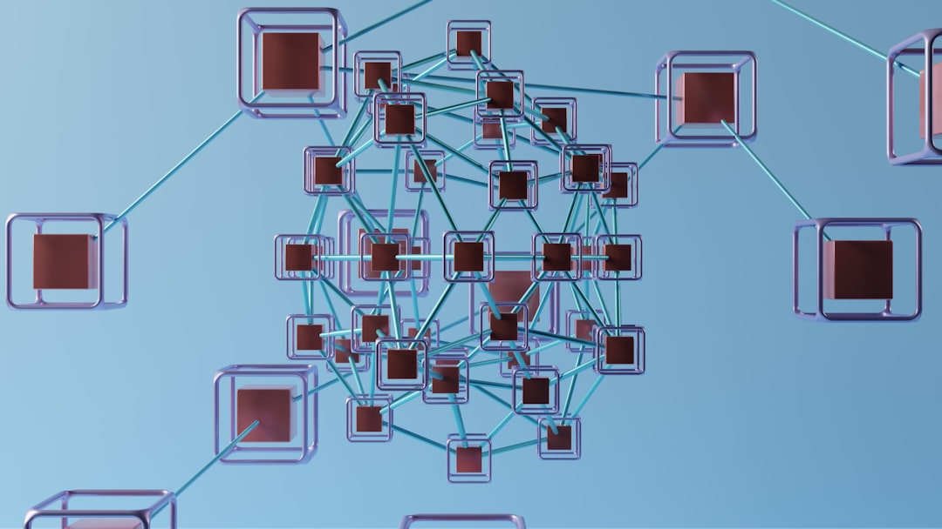
Advantages of Segmented Page Mapping
Improved memory protection: Each segment has its own access rights.
Efficient code sharing: Multiple processes can share the same code segment.
Reduced external fragmentation: Variable-sized segments reduce wasted space.
Supports modular programming: Segments can represent different program modules.
Relatively simple implementation compared to complex memory schemes.

Slide 5

Segmented Page Mapping: Conclusion & Future Trends
A powerful approach for memory management in modern operating systems.
Combines the benefits of both segmentation and paging.
Future research could focus on dynamic segment allocation and optimization algorithms.
Continued relevance in embedded systems and specialized applications.

