Slide 1
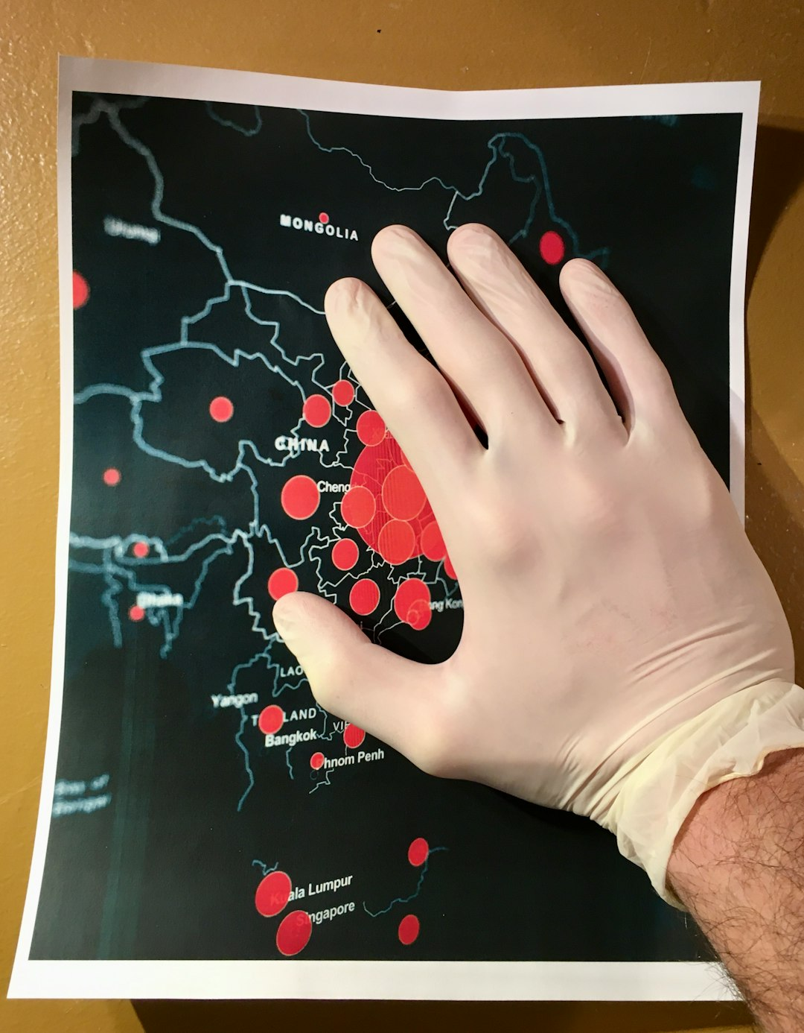
Healthcare's Response to COVID-19: A Global Challenge
Unprecedented strain on healthcare systems worldwide.
Rapid development and deployment of vaccines and treatments.
Increased reliance on telehealth and remote patient monitoring.
Significant impact on healthcare workforce, leading to burnout and shortages.

Slide 2
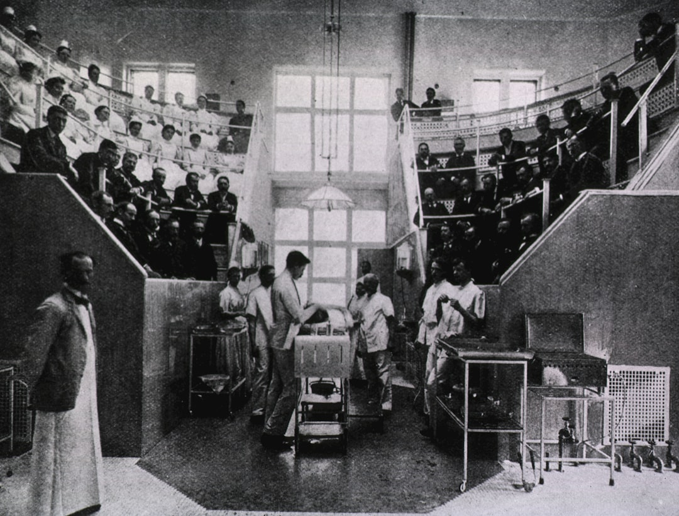
The Impact of COVID-19 on Healthcare Systems
Surge in hospitalizations and ICU admissions.
Shortages of ventilators, PPE, and other critical resources.
Disruption of elective procedures and non-emergency care.
Increased mental health challenges among patients and healthcare workers.

Slide 3

Vaccine Development and Deployment: A Race Against Time
Record-breaking speed in vaccine development using mRNA technology.
Global vaccine rollout initiatives to protect vulnerable populations.
Challenges in equitable vaccine distribution and access.
Ongoing monitoring of vaccine efficacy and safety.

Slide 4
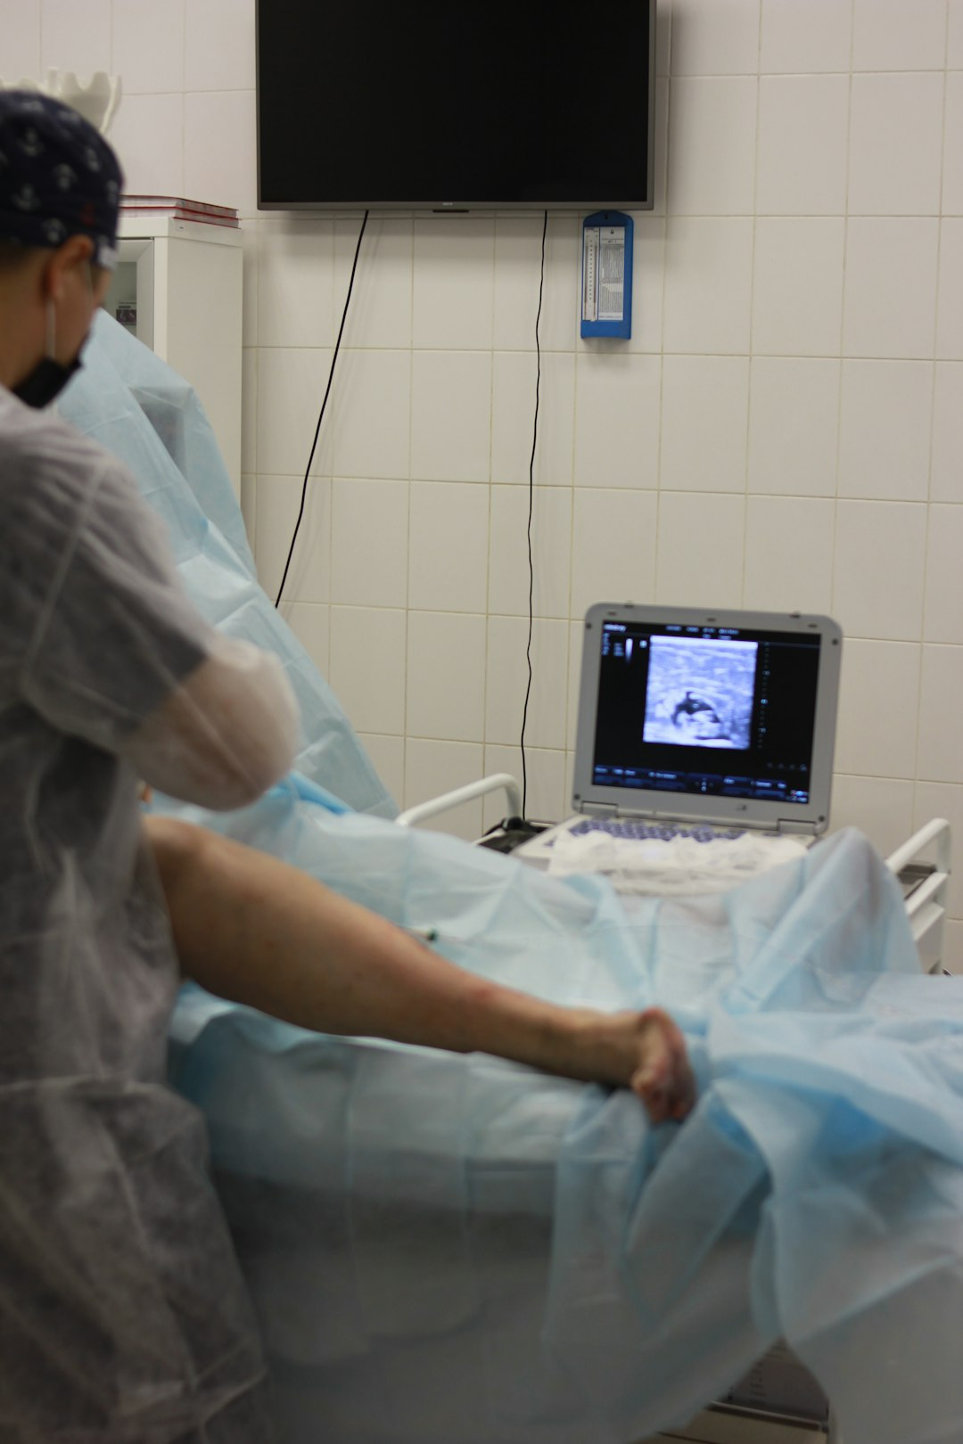
Telehealth and Innovation in Healthcare Delivery
Increased adoption of telehealth platforms for remote consultations and monitoring.
Development of new digital health tools for contact tracing and disease surveillance.
Expansion of virtual care options to improve access to healthcare services.
Challenges in ensuring digital equity and data security.

Slide 5

Lessons Learned and Future Preparedness
Strengthening public health infrastructure and pandemic preparedness.
Investing in research and development of new treatments and vaccines.
Addressing health equity and ensuring access to healthcare for all.
Developing strategies for managing future health crises.

