Slide 1
3D-BBS: Global Localization for 3D Point Cloud
Scan Matching Using Branch-and-Bound Algorithm
Koki Aoki, et al.
IEEE International Conference on Robotics and Automation (ICRA), 2024
Aryaman Shardul
Implemented Aspects:
Branch-and-Bound Search with Pruning for global scan matching
Voxel grid for efficient spatial scoring
Score-based matching using occupancy overlap
3D scan-to-map alignment (aligns incoming LiDAR scan with voxelized map)

Slide 2
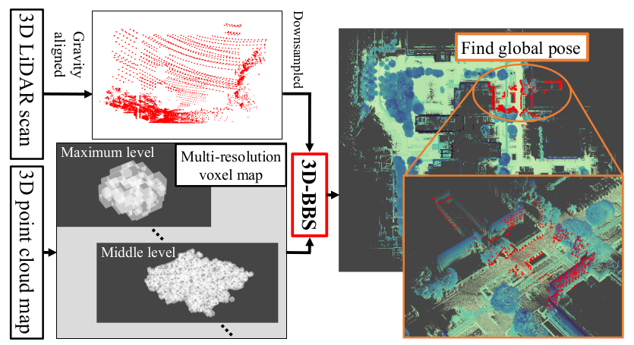
Introduction
Objective:
Global Localization is the problem of determining where a robot is on a known map, without knowing its initial position.
Global localization of a robot using a 3D LiDAR scan and a pre-built 3D map.
Key Idea:
Use Branch-and-Bound (BnB) with Voxel Grid Maps to:
Efficiently search the 4D space: x, y, z, yaw.
We assume the sensor is mounted on a ground vehicle or a relatively flat-moving robot. Hence, Roll and pitch are small or negligible. Yaw (rotation around vertical axis) dominates orientation error.
Avoid full brute-force search using hierarchical pruning.
Score candidate poses based on occupancy overlap.
Motivation:
Traditional methods like ICP or feature-based matching:
Require good initial guesses.
Struggle in large or repetitive environments.
Often get stuck in local minima.
Advantages:
Global search doesn’t need initial guess.
Robust to local minima. Hence, finds best pose (global search, pruning, and hierarchical refinement help avoid local minima).
Efficient scoring via voxel hashing.
Compact memory usage with sparse 3D voxel maps.
Can align single scan even in large maps.

Slide 3
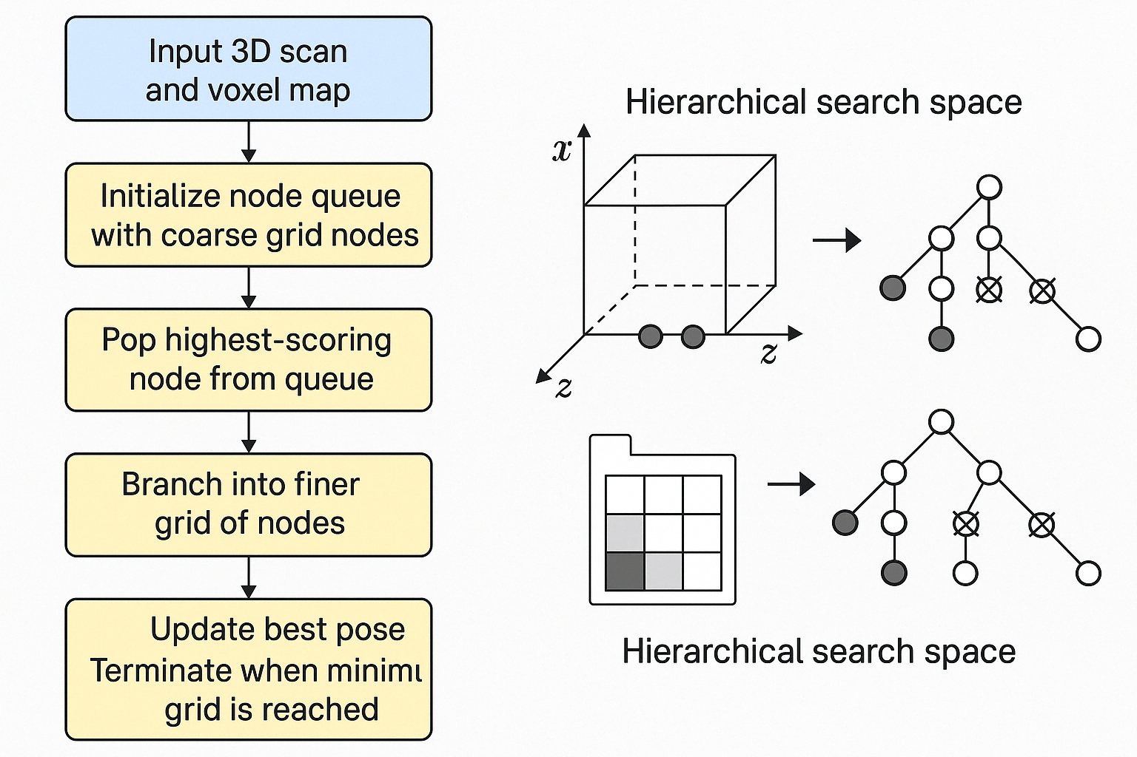
Algorithm
6. Return Best Pose
After exploring tree, return highest scoring pose
Use it to align scan with map
1. Preprocessing (Map Building)
Voxelize map
Store occupied voxels using Hash map
5. Score Pose
Transform the scan using node’s pose
Discretize scan points into voxels
Compute overlap with map voxels
2. Input Scan
Raw LiDAR frame from KITTI dataset
Define 4D search space (x, y, z, yaw)
4. Branch and Bound Search
While queue is not empty:
Pop best scoring node (based on upper bound)
If it's at lowest level (leaf node) → evaluate actual overlap score
Else → branch into finer child nodes
Prune nodes with upper bound score < current best score
3. Generate Initial Nodes
Discretize space into coarse resolution (high-level) grid
Create candidate poses (nodes)
Each node stores a pose + level + score bound

Slide 4
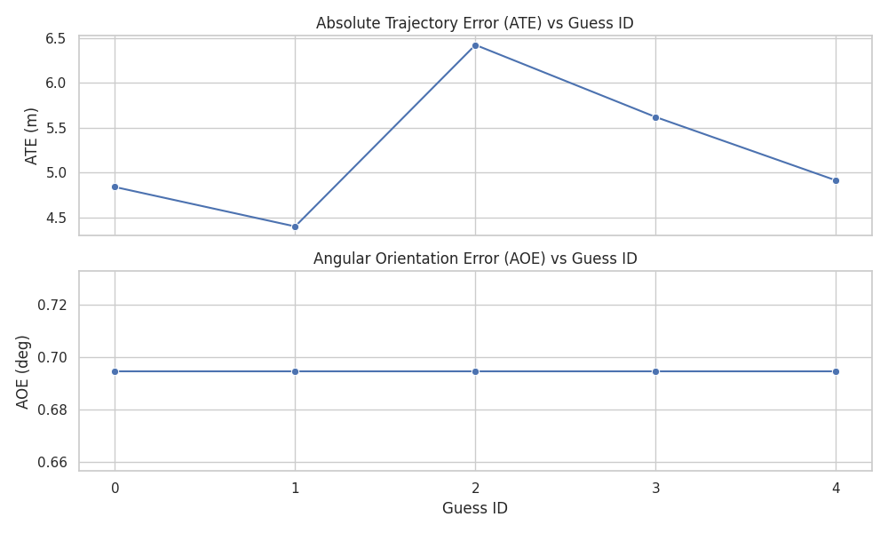
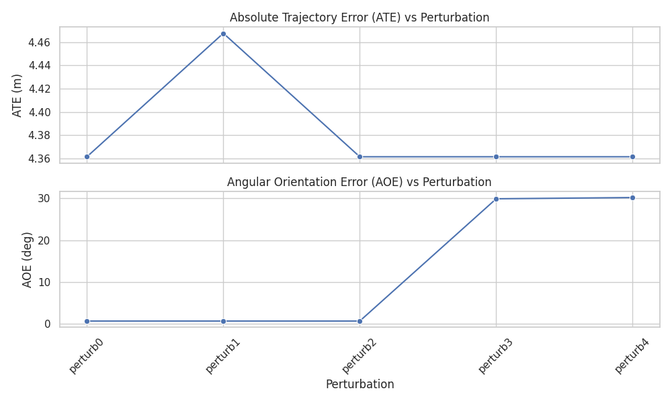
Results
Visualization of Scan 6 being globally aligned to a map built from Scans 0–4. Red points represent the transformed scan under different pose guesses. As the Branch-and-Bound search progresses, the scan shifts from misaligned outskirts to a tightly overlapping position, maximizing alignment with the blue voxel map.

Slide 5
Limitations and Future Work
Limitations
Yaw-only orientation search: Assumes flat terrain; ignores pitch/roll.
High computation time on large maps without GPUs: Full-space BnB search becomes expensive without GPU. Difficult to perform real-time localization only with CPU.
Sensitive to yaw in fake guesses: Poor initial yaw (e.g., 180° flipped) gives high AOE.
Future Work
Hierarchical Map Building: Dynamic resolution maps for faster localization.
Adaptive Search Bounds: Use priors from IMU, GPS, or motion models.
6DoF Extension (Pitch & Roll): Useful for aerial robots or rough terrain.
Find Alternatives to using GPU: Multithreaded BFS on CPU using OpenMP.

