Slide 1



1. Executive
summary
2. Persona &
day in life
3. Where the
day is lost
4. Data
inventory
5. Data →
insight
6. Synthetic
patients
7. Screen 1
Today queue
8. Screen 2
Member 360
9. Screen 3
Outreach
10. Patient
walk-through
11. Prioritise
& measure
12. Pilot &
GTM
Give Maria her judgment back: one trustworthy, prioritised morning instead of seven screens
A Case Management Workbench MVP for a health plan's RN and social-work case managers, built on HiLabs-standardised data
THE PROBLEM
WHAT WE BUILD (MVP: 3 screens, overlay on the plan's existing CM system)
90-DAY PILOT TARGETS
~79%
of a case manager's day goes to hunting for data, dialling numbers that fail and re-typing documentation (our model, slide 3)
Today queue: who needs me, and why
21 → 5 min
prep per member
Ranked by clinical risk, regulatory clock (TRC 2-day, FUH 7-day), impactability and reachability. Exactly three reasons per member and a plan for the day built around each member's best call time.
2.5 → 5
real conversations / CM / day
2.5
real clinical conversations a day, the only part that uses her ICU judgment
−40%
documentation time
Member 360: one screen, every source
An AI 'since last contact' brief where every line cites its source and date, freshness shown per source, and conflicts shown side by side, never auto-resolved. Medication diff across plan list, hospital and pharmacy.
≥ 85%
discharges contacted in 2 business days
~50%
of patients leave hospital with an unintended medication discrepancy (systematic review)
QR code to the live prototype (added after Vercel deploy)
Try it: the clickable prototype has 5 synthetic members and a Monday 08:00 snapshot
Outreach & notes: talk, don't type
12–34%
of first follow-up visits have the discharge summary available (Kripalani, JAMA)
Contact ladder with validated numbers and consent, an assessment that is about 60% pre-filled from data she verifies, and an AI-drafted note that becomes the contact note, care plan and audit record. The clinician signs.
Why HiLabs wins: incumbents (Jiva, GuidingCare, Epic) digitise the form and leave data quality to the nurse. HiLabs already cleans payer data at scale (MCheck, provider accuracy, outreach AI), so the facts arrive trusted, cited and current, and the form fills itself. AI drafts; the clinician decides.
Notes:
Executive summary. Problem, three-screen MVP, pilot targets and HiLabs' right to win. All numbers are sourced on later slides and in the appendix.

Slide 2

1. Executive
summary
2. Persona &
day in life
3. Where the
day is lost
4. Data
inventory
5. Data →
insight
6. Synthetic
patients
7. Screen 1
Today queue
8. Screen 2
Member 360
9. Screen 3
Outreach
10. Patient
walk-through
11. Prioritise
& measure
12. Pilot &
GTM
Maria is an ICU-grade clinician working as a data clerk: two real conversations by 3 pm
Persona (case manager only) and a Monday in her life. Composite built from the case, job postings at large MA and Medicaid plans, and published workflow studies
A. PERSONA: MARIA R., RN, CCM
B. MONDAY, 08:00 → 19:00 (A DAY IN THE LIFE, CASE NARRATIVE + OUR RESEARCH)
Remote telephonic complex CM + TOC nurse
Regional MA, D-SNP and Medicaid plan · 20 yrs ICU · licensed in 3 compact states · 48 active cases
08:00
6 discharge alerts since Friday. None say why the member was admitted.
11:30
Reaches 1 member; must complete a 40-field assessment before closing the contact.
Untimely data
Documentation
Goals
Catch the member who is about to crash. Pass the NCQA/state file audit. Go home on time.
08:20
Member #1: opens 7 screens. Latest claim is 45 days old.
13:00
Hunts for a discharge summary that has not arrived.
Superpower
Pattern-spotting: 'this med list doesn't add up', 'the caregiver is drowning'.
Data hunting
Untimely data
09:05
Hospital list says 'stop lisinopril'; pharmacy refilled it. She calls the hospital to check.
14:30
2nd real conversation. Senses the caregiver is overwhelmed, but there is no field for that.
Tools today
CM system, claims portal, UM/auth, PBM, HIE portal, old notes, her Excel tracker: 6–7 screens per member.
Messy data
Judgment unused
10:00
4 calls: 3 voicemails, 1 disconnected number.
17:30
Re-types the same facts into the care plan and audit forms, after hours.
Frustrations
Alerts with no reason · stale claims · numbers that don't work · the same facts typed 3–4 times · no idea who needs her first.
Hard outreach
Documentation
Constraints
Licensure by member state · consent rules (HIPAA, 42 CFR Part 2, TCPA) · audit-ready notes for every attempt.
C. WHAT A BAD DAY COSTS
Member
Plan
Maria
Supporting cast
Social worker, BH counsellor (LCSW), CHW, UM nurse, supervisor. Not personas here, but the routing must know them.
Missed 2-business-day contact after an HF discharge; a med conflict goes unseen.
One avoidable readmission ≈ $15.2k (HCUP); TRC/FUH misses hit HEDIS and Star ratings.
58% of RNs report burnout most days (AMN 2025); 77% of clinicians do admin after hours (AMIA).
Notes:
Persona is a composite; the quoted narrative points come from the case. Burnout and after-hours stats are for nurses or clinicians broadly, not health plan CMs specifically: flagged as indirect evidence.

Slide 3
1. Executive
summary
2. Persona &
day in life
3. Where the
day is lost
4. Data
inventory
5. Data →
insight
6. Synthetic
patients
7. Screen 1
Today queue
8. Screen 2
Member 360
9. Screen 3
Outreach
10. Patient
walk-through
11. Prioritise
& measure
12. Pilot &
GTM
79% of Maria's day is hunting, failed dialling and re-typing; only 13% is clinical talk
A transparent model: every input is an editable assumption in the annex (Day_Lost_Model tab). Confidence: medium, to be validated with a 2-week time-motion baseline in the pilot
A. WHERE THE DAY GOES (MINUTES PER 8-HOUR DAY)
B. PAIN POINTS RANKED BY IMPACT
Impact = time cost (1–5) × member risk (1–5) × how far a workbench can fix it (1–3)
# | Pain point (obstacle in the case) | Evidence | T | R | F | Score
1 | Data hunting across 6–7 systems; sources disagree (messy data) | 213 min/day; ~50% of discharges have a med discrepancy | 5 | 5 | 3 | 75
2 | Same facts re-typed into assessment, care plan, notes and audit forms (documentation) | 110 min/day; after-hours charting | 4 | 3 | 3 | 36
3 | No ranking and hidden clocks: 'who needs me today?' (work burden) | TRC 2-day and FUH 7-day windows missed silently | 2 | 5 | 3 | 30
4 | Late or partial data: ADT without a reason, summaries missing (untimely data) | Diagnosis optional in ADT rules; summary at 12–34% of first visits | 3 | 5 | 2 | 30
5 | Wrong numbers, wrong times, consent and trust barriers (hard outreach) | ≥ 24% of Medicaid numbers inaccurate (NBER); 78% of calls fail | 3 | 4 | 2 | 24
Bucket | Arithmetic (assumption) | Min | Share
Hunting & prep | 10 members × (6.5 screens × 2.5 min + 5 min reconciling) | 213 | 44%
Documentation | 1 assessment × 35 + 10 notes × 5 + 25 re-entry | 110 | 23%
Failed dialling | 18 attempts × 78% no-connect × 4 min | 56 | 12%
Conversations | 2.5 × 25 min (case: '2 by 3 pm') | 63 | 13%
Coordination + other | 4 tasks × 8 min + remainder | 38 | 8%
So what: fix the facts first. Hunting and documentation are 2/3 of the lost time, and both collapse once facts arrive pre-assembled with sources. Ranking and clocks cost few minutes but carry the most member risk, so they ship in the same MVP. Outreach gets a data fix (valid number, best time) before any new channel.
Connect rate 22% (industry 20–30%; Medicaid reach can be <20%). Screens per member from the case.
Notes:
Model inputs are assumptions; the case gives screens per member and conversations per day. Sensitivity: even at 4 screens × 2 min, hunting is still the #1 bucket (about 130 min).

Slide 4
1. Executive
summary
2. Persona &
day in life
3. Where the
day is lost
4. Data
inventory
5. Data →
insight
6. Synthetic
patients
7. Screen 1
Today queue
8. Screen 2
Member 360
9. Screen 3
Outreach
10. Patient
walk-through
11. Prioritise
& measure
12. Pilot &
GTM
15 must-have datasets, each tied to a decision; claims are the slowest and least useful
Inventory: source, what it tells the clinician, freshness, expected quality problems and how the screen handles them, and priority
Dataset | Source / standard | What Maria decides with it | Fresh | Quality problem → how the screen handles it
ADT event alerts | HL7 v2 A01/A03/A04 via HIE (CMS CoP) | Event now: starts TRC/FUH clocks, re-ranks queue | Minutes | No diagnosis (optional), late batches, name typos → 'reason unknown' chip + CCD request
Discharge summary / CCD | C-CDA / FHIR; Provider Access API (2027) | Why admitted, discharge meds, follow-up plan | Hours–never | Partial or missing sections → shown as 'not provided', never silently blank
Pharmacy fills + rejects | NCPDP via PBM; NDC → RxNorm | What was actually picked up; gaps; blocked new drugs | 1–3 days | Cash fills invisible, rejects hidden → rejects on timeline; gap = 'unknown', not 'non-adherent'
Med list diff (derived) | Plan list × discharge × fills | Reconcile before harm (TRC med rec) | On change | 3 lists disagree → side-by-side diff; AI proposes, clinician resolves
Labs & observations | HL7 ORU / FHIR; LOINC | Control and safety: A1c, NT-proBNP, K+, eGFR, PHQ-9 | 1–3 days | Duplicate feeds, mixed units → normalised, de-duplicated, trend + age badge
Prior auth / UM | Plan UM; CMS-0057 PA API | Is a needed drug blocked? What unblocks it? | Real-time | Siloed from CM → PA status inline on the med + 'evidence available' link
Contact history + call centre | CM system, dialler, CRM | What was tried; signals buried in member-services calls | Real-time | Unrouted inbound notes → AI tags cost / caregiver-strain signals for review
Contact-point quality | Carrier lookup, reassigned-number DB, ADT | Which number first, when, and is it legal to dial | Weekly + events | ≥ 20–24% wrong numbers → confidence per number; reassigned numbers suppressed
Care gaps & clocks | HEDIS engine (TRC, FUH, AMR), SNP MOC | What is due when, which drives urgency | Daily | Gap closure lags → countdown on the queue row
Provider directory | HiLabs MCheck; NPPES | Is the PCP real, active, accepting? Next slot? | Weekly | Directories inaccurate → inactive PCP flagged + in-group alternative
Member & eligibility | 834 enrollment, plan MDM | Who, PCP, language, dual status, who she may speak with | Daily | Stale PCP/address, duplicate IDs → identity resolution, merge request
Care plan & notes | CM system | Goals, barriers, last conversation | Real-time | Long free text, duplicate cases → cited 'since last contact' brief
SDOH screens & HRA | AHC-HRSN / PRAPARE, D-SNP HRA, Z codes | Barriers: housing, food, transport, phone, caregiver | 8–12 months | Stale; Z codes on only 1–1.6% of claims → age badge; newer source wins
Medical claims | 837I/P: ICD-10-CM, CPT/HCPCS, DRG | History and utilisation pattern | 30–60+ days | Lag hides recent events → 'complete through <date>'; absence ≠ negative
Risk scores | LACE, plan ML (input only) | Long-run risk, one of 4 ranking inputs | Monthly | Stale, opaque → drivers shown, not raw scores
Phase 2: appointments feed · BH/SUD records (42 CFR Part 2, consent-gated) · remote monitoring · closed-loop community referrals · supplemental benefits (rides, meals, phone) · OASIS/MDS · PDMP. Deliberately out: HCC/risk-adjustment coding prompts (conflict with clinical trust).
Notes:
Full inventory with 23 datasets, freshness and handling is in the annex (Dataset_Inventory). Ordered by decision value, not by data volume.

Slide 5
1. Executive
summary
2. Persona &
day in life
3. Where the
day is lost
4. Data
inventory
5. Data →
insight
6. Synthetic
patients
7. Screen 1
Today queue
8. Screen 2
Member 360
9. Screen 3
Outreach
10. Patient
walk-through
11. Prioritise
& measure
12. Pilot &
GTM
Insight lives in combinations: 2–4 datasets together tell Maria what no single screen can
Six recipes from the synthetic patients, the trust rules every fact follows on screen, and our answer on SNOMED CT as an 'umbrella'
A. DATASETS COMBINE INTO A DECISION
B. TRUST RULES: EVERY FACT ON SCREEN
Datasets combined
Insight shown on screen
What Maria does differently
Provenance
value + source + event date + date received
ADT discharge
Discharge CCD
New HF drug not dispensed (PA pending); old ACE-inhibitor still at home; diuretic dose doubled
Calls today; 3-way med rec with the 36 h washout rule
Pharmacy rejects
Plan med list
Freshness
pill per source: green days · amber weeks · red lagged
Conflict
both sides shown in amber; never auto-resolved
Provider dir. (MCheck)
Discharge plan
PCP on file has left; in-group PCP has a slot inside the 7-day window
Books the right doctor first time
Appointments
Confidence
dot: identity match %, phone validity, self-report age
Labs ×2 feeds
Fills + rejects
A1c 7.4 → 9.8% since refills ran out and the formulary dropped her drug
Opens with access, not an adherence lecture
Absence ≠ no
'claims complete through 18 Sep', not 'no admissions'
Call-centre log
ADT (fuzzy match)
Fills (6 rescue, 0 controller)
Uncontrolled asthma; old number reassigned; new mobile from Sunday's ED visit
Stops wasted dials; uses the new number + pharmacist
C. CODES → CLINICAL MEANING (SNOMED VERDICT)
Carrier lookup
Source | Code (system)
Claim | I50.23 (ICD-10-CM)
Discharge CCD | 443253003 (SNOMED CT)
Pharmacy | 1656340 (RxNorm) ← NDC 00904758004
Lab | 33762-6 NT-proBNP (LOINC)
Maria sees: 'Heart failure, worsening · LVEF 30% · new Entresto not dispensed'
ADT psych discharge
FUH clock
Buprenorphine runs out Wed and is missing from the discharge list; FUH closes Thu
Prescriber bridge + telehealth before Thu
Fills
Discharge meds
ED CCD
Labs (eGFR 22)
NSAID prescribed with CKD 4 and K+ 5.4
Calls the prescriber before the next dose
SNOMED CT is not one umbrella: CPT has no maintained map, and US drugs run on RxNorm. Use one standard per domain (SNOMED conditions · RxNorm drugs · LOINC labs, as OMOP does), keep the source code, and show plain language.
2nd pharmacy fill
Notes:
SNOMED International release (2026-10-01) ships an extended map to WHO ICD-10; NLM publishes the US ICD-10-CM map; LOINC Ontology links LOINC parts to SNOMED (2025). CPT is AMA-proprietary.

Slide 6
1. Executive
summary
2. Persona &
day in life
3. Where the
day is lost
4. Data
inventory
5. Data →
insight
6. Synthetic
patients
7. Screen 1
Today queue
8. Screen 2
Member 360
9. Screen 3
Outreach
10. Patient
walk-through
11. Prioritise
& measure
12. Pilot &
GTM
Five synthetic members, five different ways the data lies, each with an 8 am Monday answer
Annex: 16 datasets (10–16 per member), 143 records, amber-flagged planted imperfections; every ICD-10-CM, LOINC and RxNorm/NDC code verified against NLM APIs
#1 · 94
#2 · 91
#3 · 86
#4 · 78
#5 · 61
Harold Brennan, 71
Tanya Brooks, 33
Thi Mai Tran, 82
Tyler Kowalski, 29
Denise Carter, 54
MA HMO · TOC
Medicaid · BH CM
D-SNP dual · MOC
Medicaid · Complex CM
Medicaid · Diabetes
Fresh heart-failure discharge
BH discharge + housing loss
2nd fall · caregiver strain
Unreachable frequent ED user
Rising risk; stopped refills
PLANTED IMPERFECTIONS
PLANTED IMPERFECTIONS
PLANTED IMPERFECTIONS
PLANTED IMPERFECTIONS
PLANTED IMPERFECTIONS
ADT admit had no diagnosis
Discharge list omits buprenorphine
Duplicate Medicaid ID + open LTSS case
Name/DOB differ across hospitals (92%)
Same A1c in 2 units (2 feeds)
PCP on file left practice (834 stale)
SDOH 'housed' vs shelter on ADT
NSAID with CKD 4 at a 2nd pharmacy
Phone on file reassigned
Rejected Jardiance hidden on paid claims
3 med lists disagree
Prepaid phone out of minutes
Caregiver strain only in call log
Claims show 2 of 4 ED visits
Cost call never routed to CM
Claims 52 days behind
Part 2 SUD records restricted
ICD code sent without decimal
Controller prescribed, never filled
Risk model still says 'low'
8 AM MONDAY
8 AM MONDAY
8 AM MONDAY
8 AM MONDAY
8 AM MONDAY
Call this morning (TRC clock Tue). Reconcile lisinopril / Entresto / furosemide, send LVEF to the PA, book Dr. Nair Thu.
Shelter-desk callback (no PHI). Telehealth Tue (FUH Thu). Bridge buprenorphine; loop in the LCSW.
Stop ibuprofen via prescriber now. Merge record with Dana P. Call daughter after 17:00. Post-fall HRA.
Suppress old number. SMS + call the ED-captured mobile at noon. Pharmacist note at QuickRx. PCP Wed.
Not urgent today. SMS now, call 18:30. Metformin renewal + preferred SGLT2i. Thu evening clinic.
Notes:
Ranks come from the prototype's priority formula. Denise has the lowest rank even though her plan risk model is stale: she is important this week, not this morning.

Slide 7
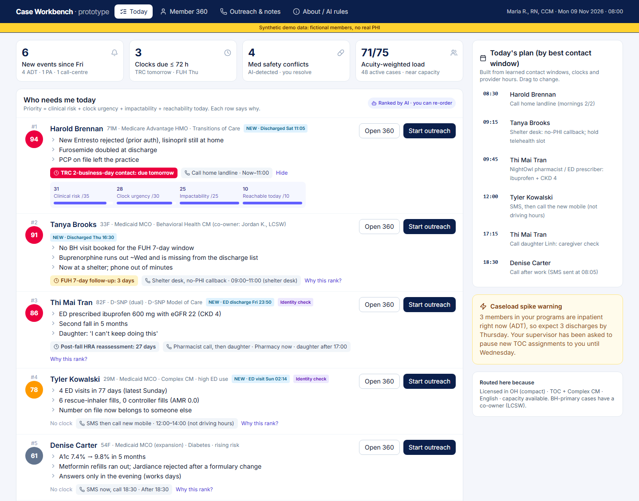
1. Executive
summary
2. Persona &
day in life
3. Where the
day is lost
4. Data
inventory
5. Data →
insight
6. Synthetic
patients
7. Screen 1
Today queue
8. Screen 2
Member 360
9. Screen 3
Outreach
10. Patient
walk-through
11. Prioritise
& measure
12. Pilot &
GTM
Screen 1, Today queue: 'who needs me, and why' answered before 08:05
Above the fold: only what changes Maria's next hour. Ranked, explained, clock-aware, and timed to when each member actually answers
WHAT SITS WHERE, AND WHY
1
5
1
Overnight delta: 6 new events, 3 clocks ≤ 72 h, 4 med-safety conflicts, acuity-weighted load (71/75), not raw case counts
2
Ranked rows, 3 reasons each: No unexplained scores. Each reason is a fact Maria can verify in one click
2
3
4
3
Regulatory clocks: TRC 2-business-day contact, FUH 7-day, post-fall HRA shown as a countdown on the row
6
4
'Why this rank?': Priority = clinical risk /35 + clock urgency /30 + impactability /25 + reachable today /10. She can override; overrides train the model
5
Today's plan: Calls slotted into each member's learned answer window (Harold mornings, Denise 18:30)
6
Spike warning: ADT shows 3 members inpatient now, so the supervisor pauses new TOC assignments before the wave hits
Notes:
Deliberately hidden: 43 routine cases are collapsed; raw risk scores are never shown as a number.

Slide 8
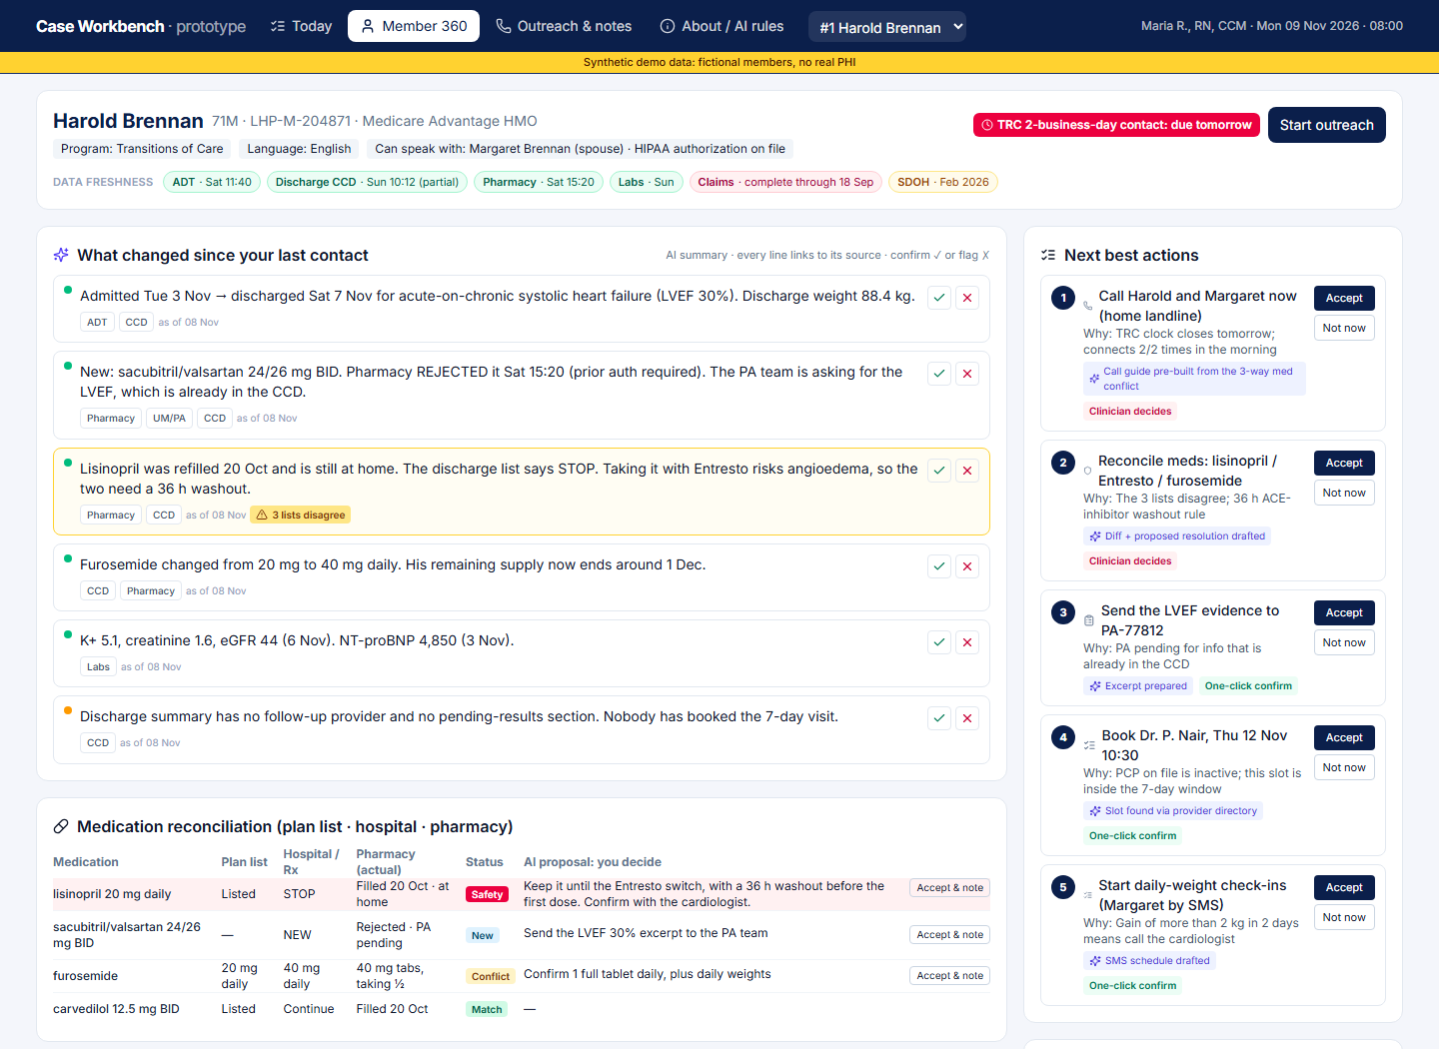
1. Executive
summary
2. Persona &
day in life
3. Where the
day is lost
4. Data
inventory
5. Data →
insight
6. Synthetic
patients
7. Screen 1
Today queue
8. Screen 2
Member 360
9. Screen 3
Outreach
10. Patient
walk-through
11. Prioritise
& measure
12. Pilot &
GTM
Screen 2, Member 360: the 7 screens become 1, with sources, freshness and conflicts visible
Walk-through: Harold Brennan, 2 days post HF discharge. Everything Maria needs to call him with confidence, in about 2 minutes of reading
WHAT SITS WHERE, AND WHY
1
1
Header: Who she may speak with (HIPAA authorisation), language, active clock and one-click outreach
2
3
6
2
Freshness strip: One pill per source. Claims are red ('complete through 18 Sep'), so she knows why the admission isn't on them
3
Since-last-contact brief (AI): Every line cites sources and dates, with a confidence dot. ✓ confirm or ✗ flag; flags go to the HiLabs data team
4
4
Conflict cards: Amber when sources disagree ('3 lists disagree'); both sides are shown and nothing is auto-resolved
5
Medication diff: Plan list vs. hospital vs. pharmacy. AI proposes a resolution, the clinician decides and documents
5
6
Next best actions: Ranked, each with a why, an AI-prepared artifact and an owner tag: clinician decides / one-click confirm / automated
Notes:
Below the fold: timeline showing event time vs received time, providers (inactive PCP flagged via HiLabs MCheck), SDOH with age of data.

Slide 9
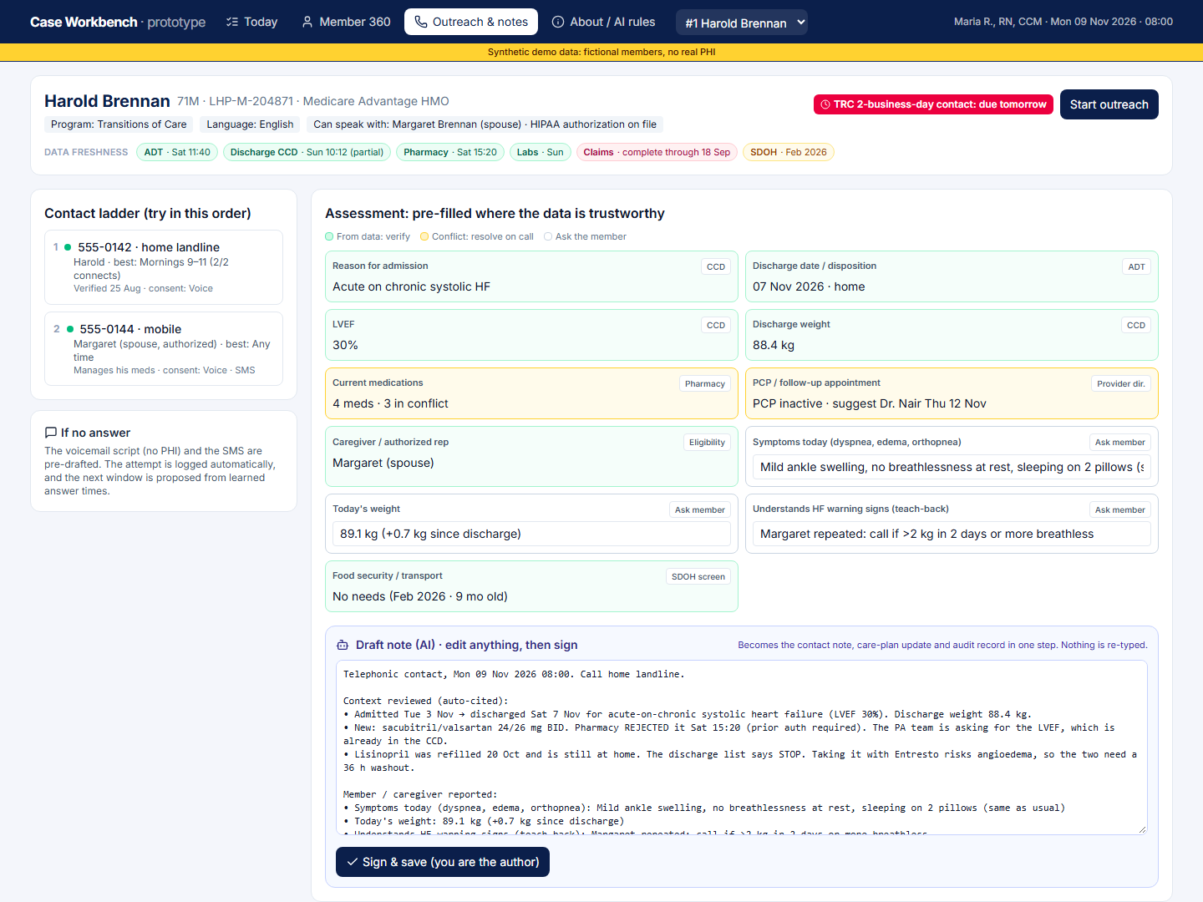
1. Executive
summary
2. Persona &
day in life
3. Where the
day is lost
4. Data
inventory
5. Data →
insight
6. Synthetic
patients
7. Screen 1
Today queue
8. Screen 2
Member 360
9. Screen 3
Outreach
10. Patient
walk-through
11. Prioritise
& measure
12. Pilot &
GTM
Screen 3, Outreach & notes: Maria talks; the system drafts, she verifies and signs
Walk-through: Harold's call. 8 of 11 assessment fields pre-filled from data; one AI draft replaces four rounds of re-typing
WHAT SITS WHERE, AND WHY
1
Contact ladder: Numbers ranked by confidence, owner, learned best window and consent; reassigned numbers suppressed (TCPA)
2
Pre-filled assessment: Green = from data (verify), amber = conflict to resolve on the call, white = ask the member
1
2
3
Ask only what data can't tell: Symptoms, today's weight, teach-back: the judgment questions
4
One draft, many outputs: The note becomes contact note + care-plan update + audit evidence (TRC/FUH), so nothing is re-typed
5
Clinician signs: Maria is the author. Edits and unedited acceptance are logged as guardrails
3
4
AI CONTRACT: WHAT IS AUTOMATED VS CONFIRMED
Automated: de-dup, unit/code normalisation, freshness, number validation, call logging
AI drafts → you confirm: brief, ranking, med diff, pre-fill, note, tasks, PA evidence
5
Clinician only: med changes, escalation, safety assessment, goals, merges < 95%, closure
Notes:
CMS Feb 2024 FAQ and California SB 1120 require individual, clinician-made decisions in coverage; we apply the same human-in-the-loop principle to care management even though this is not UM.

Slide 10
1. Executive
summary
2. Persona &
day in life
3. Where the
day is lost
4. Data
inventory
5. Data →
insight
6. Synthetic
patients
7. Screen 1
Today queue
8. Screen 2
Member 360
9. Screen 3
Outreach
10. Patient
walk-through
11. Prioritise
& measure
12. Pilot &
GTM
Three members, three screens: 135 minutes of hunting become 38 of care
Before/after minutes are our estimates from the day model (prep + dialling + documentation per member), to be measured in the pilot
1 · Today queue shows
2 · Member 360 reveals
3 · Outreach & notes
4 · Outcome, documented once
Min before → after
Harold · HF discharge
#1 (94): TRC contact due tomorrow; Entresto rejected; PCP left
Brief: PA needs LVEF (in CCD); lisinopril at home; furosemide doubled. Med diff marks a safety conflict
08:30 landline (2/2 morning connects); 8/11 fields pre-filled; teach-back with Margaret
Med rec signed; LVEF sent to PA; Dr. Nair Thu booked; TRC engagement + med-rec evidence captured
45 → 12
Tanya · BH + housing
#2 (91): FUH closes Thu; buprenorphine missing; phone out of minutes
Part 2 banner (consent needed); address conflict → shelter; med diff: buprenorphine ABSENT
Shelter-desk callback, no PHI; SMS Wi-Fi telehealth link; C-SSRS safety check on the call
Telehealth Tue 14:00 (FUH met); prescriber bridge requested; LCSW co-owner notified; phone + housing referrals
60 → 16
Tyler · frequent ED
#4 (78): 4 ED / 77 days; 'identity check' chip
92% match across hospitals → confirm; AMR 0.0; old number reassigned; new mobile from ED
Old number suppressed; SMS then call 555-0193 at noon; pharmacist note at QuickRx
Identity + SMS consent captured; $0 controller filled; PCP Wed; ED pattern on watch
30 → 10
Notes:
Harold 45 min before = 7 screens (18) + med-list hunting (12) + assessment and notes (15). After = brief (3) + call prep (2) + verify and sign (7). Similar logic for the others.

Slide 11

1. Executive
summary
2. Persona &
day in life
3. Where the
day is lost
4. Data
inventory
5. Data →
insight
6. Synthetic
patients
7. Screen 1
Today queue
8. Screen 2
Member 360
9. Screen 3
Outreach
10. Patient
walk-through
11. Prioritise
& measure
12. Pilot &
GTM
Ship the trust layer first: queue + 360 + med diff; measure conversations, not clicks
RICE prioritisation, baseline → target metrics, and the risks that would kill clinician trust, with mitigations
A. MVP VS LATER (RICE = R × I × C ÷ E)
B. METRICS: BASELINE → 90-DAY TARGET
C. RISKS → MITIGATIONS
Feature | R | I | C | E | Score
Ranked queue + clocks | 5 | 4 | 0.8 | 2 | 8.0 | MVP
Member 360: freshness + conflicts | 5 | 5 | 0.9 | 3 | 7.5 | MVP
Cited 'since last contact' brief | 5 | 4 | 0.7 | 2 | 7.0 | MVP
Contact ladder + number validation | 4 | 4 | 0.8 | 2 | 6.4 | MVP
Medication diff (3 lists) | 4 | 5 | 0.8 | 3 | 5.3 | MVP
Assessment pre-fill + note draft | 5 | 4 | 0.7 | 3 | 4.7 | MVP
Supervisor rebalancing view | 2 | 3 | 0.6 | 3 | 1.2 | Later
Scheduling write-back | 3 | 3 | 0.5 | 4 | 1.1 | Later
Ambient call transcription | 4 | 4 | 0.5 | 4 | 2.0 | Later
Deterioration prediction ML | 3 | 3 | 0.4 | 5 | 0.7 | Later
Metric | Baseline | Target
North star: real conversations / CM / day | 2.5 | 5
Prep time per member | ~21 min | ≤ 5 min
Documentation per contact | ~11 min | −40%
Notes finished after 17:30 | measure wk 0–2 | halve
Outreach connect rate | ~22% | +10 pp
Discharge contact ≤ 2 business days | ~50% (assumed) | ≥ 85%
FUH 7-day / TRC med rec | plan baseline | +10 / +15 pp
Active cases per CM (acuity-wtd) | 48 | 55–60
30-day readmits (TOC cohort, lagging) | ~17% | −1–2 pp
Guardrails: AI drafts accepted unedited | — | watch > 90%
Alerts dismissed as not useful | — | < 15%
Wrong or stale data
Provenance + freshness on every fact; conflicts never auto-resolved; ✗ flags route to the HiLabs data team
Alert fatigue
Ranking instead of alarms; max 3 reasons per row; dismiss reasons logged; target < 15% dismissals
Trust & automation bias
Citations per line; confirm per item; track unedited acceptance; clinician is always the author
Privacy & consent
Part 2 gating, HIPAA minimum-necessary scripts, TCPA suppression of reassigned numbers
Equity
Deliberately out: AI messaging members unsupervised; AI clinical decisions; HCC coding prompts; replacing the CM system of record (we overlay it).
Cost-based models under-call Medicaid needs; impactability adds access barriers; audit ranks by subgroup
Adoption
Overlay inside the existing CM system; learnable in 1 day; supervisors see time saved, not surveillance
Notes:
RICE: Reach = share of the CM day touched (1–5); Impact on minutes or member risk (1–5); Confidence 0.4–0.9; Effort in relative sprints (1–5).

Slide 12



1. Executive
summary
2. Persona &
day in life
3. Where the
day is lost
4. Data
inventory
5. Data →
insight
6. Synthetic
patients
7. Screen 1
Today queue
8. Screen 2
Member 360
9. Screen 3
Outreach
10. Patient
walk-through
11. Prioritise
& measure
12. Pilot &
GTM
Pilot with one regional plan in 90 days; price a seat at ~1/3 of the time it frees
Brownie points: buyer, pilot scope and pricing signal. Assumptions flagged; to be validated with a design-partner plan
A. WHO BUYS, WHO USES, WHO BLOCKS
B. PILOT: 90 DAYS, 20 CASE MANAGERS
C. PRICING SIGNAL
Economic buyer
Day 0–30 · Instrument
$750
VP Care Management / CMO: owns Stars, HEDIS (TRC, FUH), readmissions and the CM headcount budget
Read-only overlay; ingest ADT, pharmacy (incl. rejects), CCD, eligibility, provider directory, CM notes. 2-week time-motion baseline. 10 CMs workbench, 10 matched controls (TOC + BH programs).
per CM seat per month (~$9k / yr)
Value per CM per year
Time freed (2 h/day, half the model) | 2 h
RN loaded cost (BLS median $93.6k × 1.4) | ~$63/h
× 230 working days | ≈ $29k
Capacity ROI on time alone | ~3.2×
Champion
Day 31–60 · Shadow AI
CM directors and supervisors: feel caseload spikes and audit stress daily
Queue + 360 live. AI brief and med diff in shadow mode: clinicians rate accuracy; no drafts saved yet.
Gatekeepers
Day 61–90 · Assist
CIO/CISO (HITRUST, which HiLabs holds), Compliance (NCQA, Part 2, TCPA), clinical governance for AI
Upside not priced in: each avoided readmission ≈ $15.2k; TRC/FUH feed Stars (4+ stars brings a 5% benchmark bonus). Alternative: $0.10–0.25 PMPM on CM-eligible members. Pilot fee $75–100k, credited to Year 1.
Pre-fill + note drafting on, clinician signs. Measure north star, clocks met, after-hours notes, guardrails.
First target
Regional plan with MA + D-SNP + Medicaid, 300k–800k members, an existing HiLabs MCheck customer, running Jiva or GuidingCare
Go/no-go at day 90: ≥ +1.5 conversations/CM/day vs control, ≥ 85% discharges contacted in 2 business days, AI-brief error rate < 5% (rated), CM NPS +20.
Expand: more programs → UM nurses → provider-delegated CM (ACOs)
Notes:
Seat price is a signal, not a quote. Wage: BLS OES May 2024 median RN pay; 1.4× load for benefits is an assumption.

Slide 13
Appendix: sources, assumptions and how to try the prototype
1. HiLabs Product Caselet 2026–27 (provided): workload ranges, narrative, deliverables
13. HEDIS TRC plan tip sheets (e.g. MVP Health Care 2025): four TRC components
TRY THE PROTOTYPE
2. CMS ADT CoP FAQ, 42 CFR 482.24(d): minimum notification content, diagnosis optional
14. CMS MA AI FAQ, Feb 2024 (Norton Rose Fulbright summary); California SB 1120 (2024)
QR code to the live prototype (added after Vercel deploy)
3. Kripalani et al., JAMA 2007 (via JABFM 2017): discharge summary at 12–34% of first visits
15. Becker's / US Surgeon General: nurses spend up to 41% of the day in the EHR
4. Systematic review of post-discharge medication discrepancies (PMC7235049): median ~50%
16. AMN Healthcare 2025 RN survey (58% burnout); AMIA survey (77% after-hours admin work)
5. NBER w34191, Medicaid outreach field experiment: ≥ 24% inaccurate phone numbers
17. Care managers & multiple HIT applications (PMC6557451); Wolters Kluwer (3–5 apps per CM)
6. CMS OMH Z-code data highlights (2017–2019): Z codes on ~1.1–1.6% of beneficiaries
18. KLAS Best in KLAS 2025 payer care management; HealthEdge & Innovaccer AI announcements (vendor claims)
7. AHRQ HCUP Statistical Brief 248: Medicare 30-day readmission ~17%; avg readmission cost $15.2k (2018)
19. HiLabs: Series B ($39M, 2024), MCheck suite, CAQH partnership (Fierce Healthcare, GlobeNewswire)
URL added after deployment
8. KFF, Medicare Advantage in 2026: MA ≈ 55% of eligibles; SNPs 8.2M (78% D-SNP)
20. SNOMED International & Regenstrief LOINC Ontology (2025); HL7 FHIR-to-OMOP IG code mappings
Key assumptions
Day model inputs (annex, blue cells) · 50% of modelled time captured in the pilot · seat price · baseline TRC 2-day contact ~50% · all members, providers, pharmacies and the plan are fictional; 555-01xx numbers are reserved fictional numbers.
9. KFF, Medicaid and pregnancy: Medicaid finances 41% of US births
21. van Walraven et al., CMAJ 2010: LACE index (C-statistic 0.68)
10. CMS-0057-F fact sheet: Provider Access, Payer-to-Payer, PA APIs by 1 Jan 2027
22. NLM Clinical Tables (ICD-10-CM, LOINC) and RxNav (RxNorm/NDC) APIs: all annex codes verified 7 Nov 2026
11. NCQA Case Management Accreditation standards: file review of initial assessment
23. BLS Occupational Employment & Wage Statistics: registered nurse median pay
12. CA DHCS D-SNP reporting specs: HRA and ICP within 90 days of enrollment

