Slide 1



Advanced Micro Devices (AMD)
Capstone Project-Internship
ARYAMAN MISHRA – 19BCE1027

Slide 2
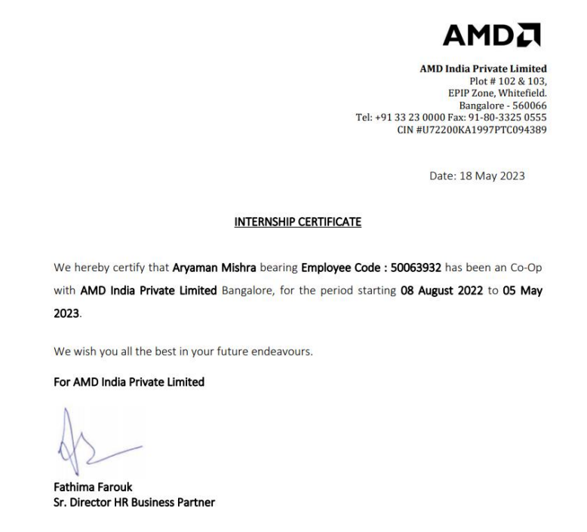
Internship Completion Certificate

Slide 3
HISTORY
Advanced Micro Devices (AMD) is a global semiconductor company.
Founded in 1969, with headquarters in Santa Clara, California.
Leader in high-performance computing, graphics, and visualization technologies.
KEY VALUES
Empower people with innovative computing technologies.
Deliver superior performance, energy efficiency, and reliability.
Transforming industries and pushing the boundaries of what's possible.

Slide 4
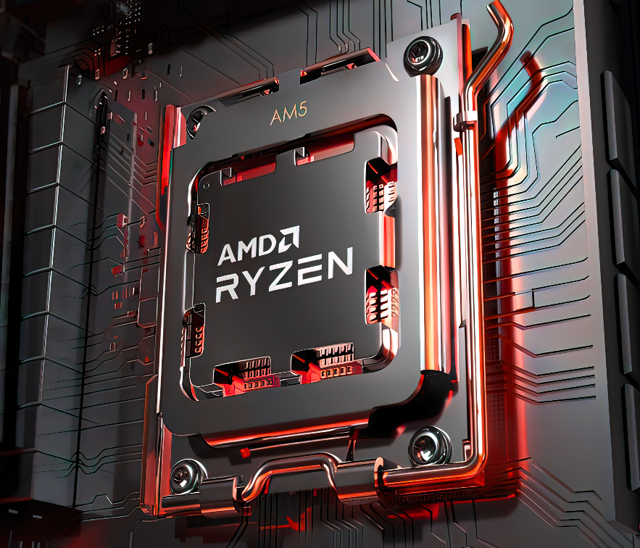
Key Products
Ryzen™ Processors
High-performance CPUs for desktop, mobile, and server applications.
Unleash the power of multi-core processing and efficient architectures.
Radeon™ Graphics Cards
Cutting-edge GPUs for gaming, content creation, and professional workloads.
Provide exceptional visual fidelity, real-time rendering, and AI capabilities.
EPYC™ Processors
Enterprise-grade server CPUs offering superior performance and security.
Enable efficient data centers and cloud computing solutions.

Slide 5
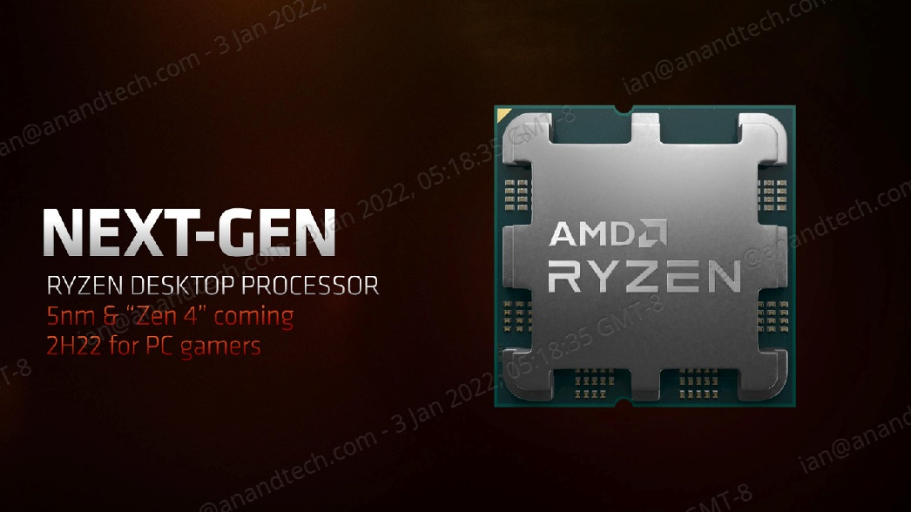
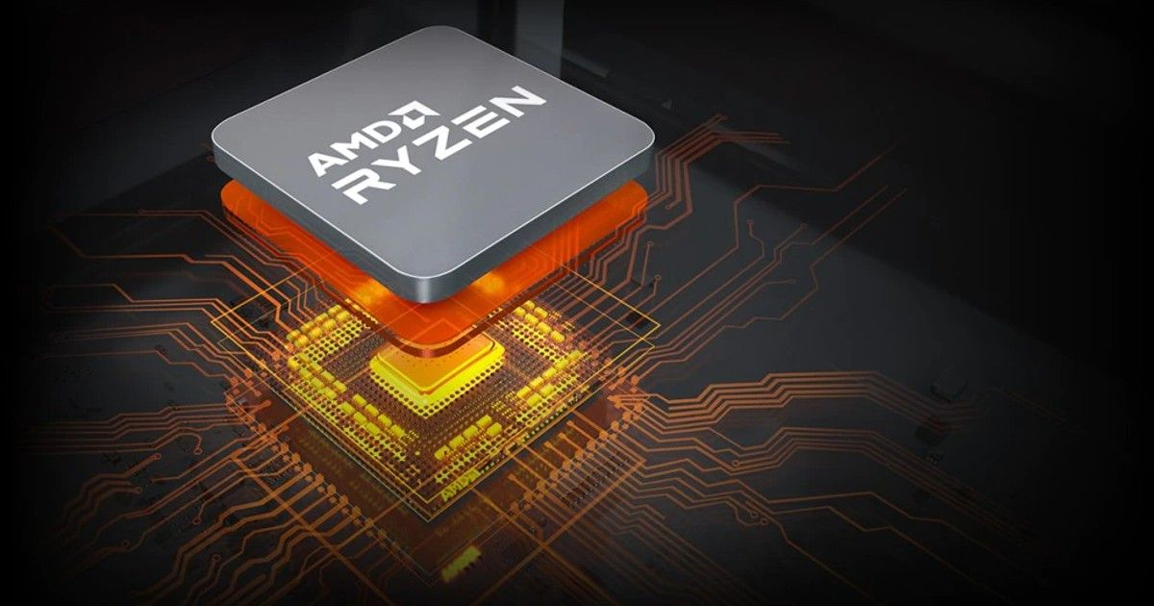
Technological Advancements
Zen Architecture
Groundbreaking CPU architecture delivering remarkable performance.
Enhanced multi-threading, increased core count, and improved power efficiency.
RDNA Architecture
Next-generation GPU architecture optimizing gaming and visual workloads.
Advanced features like hardware-accelerated ray tracing and variable rate shading.
Infinity Fabric
Advanced data fabric interconnect technology.
Enables high-bandwidth communication between CPUs, GPUs, and memory.

Slide 6
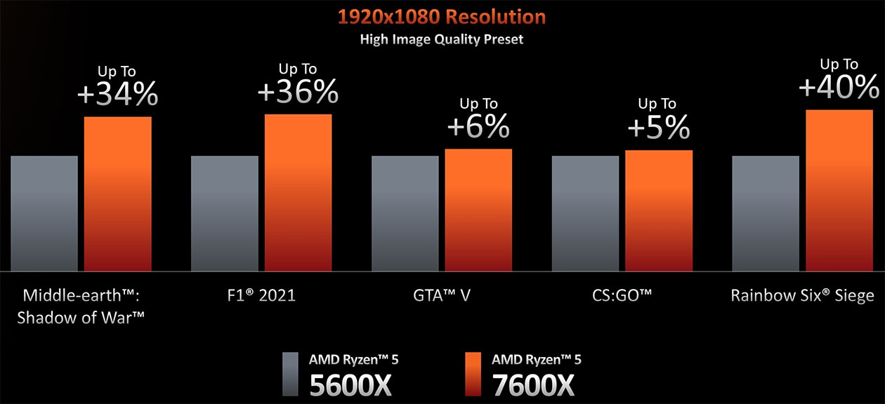
AMD's Impact
Gaming and Entertainment
Unparalleled gaming experiences with smooth frame rates and realistic visuals.
Powering popular gaming consoles, enhancing virtual reality, and streaming.
Data Centers and Cloud Computing
Accelerating data processing, machine learning, and AI workloads.
Offering scalable solutions for cloud-based services and big data analytics.
Workstations and Professional Applications
Enabling professionals to tackle complex tasks with ease.
Superior performance for content creation, 3D modeling, and scientific simulations.

Slide 7
Industry Recognition
Widely recognized for technological advancements and innovation.
AMD products have received numerous awards and positive reviews.
Trusted by leading technology companies and industry experts.
Future Innovations
Continuously pushing the boundaries of computing technology.
Investing in research and development to drive further breakthroughs.
Collaborating with partners to shape the future of computing.
AMD is a global leader in high-performance computing and graphics.
Transforming industries with innovative processors and graphics solutions.
Empowering the world with next-generation computing technologies.

Slide 8
Background
A GPU, or Graphics Processing Unit, is a specialized type of processor designed for performing complex calculations needed for rendering graphics on a computer screen. GPUs can process large amounts of data in parallel, making them useful for tasks that involve heavy computation, such as machine learning, scientific simulations, and cryptography.
CUDA, or Compute Unified Device Architecture, is a parallel computing platform and programming model created by NVIDIA for use with their GPUs. It allows developers to use C or C++ to write programs that run on the GPU, taking advantage of the parallel processing power of the GPU to perform calculations faster than they could on a CPU. CUDA has become very popular among researchers and developers working in fields such as artificial intelligence, scientific simulations, and data analysis.
ROCm, or Radeon Open Compute, is an open-source software platform created by AMD for GPU computing. It provides a set of open-source tools and libraries for developers to use with AMD GPUs, similar to CUDA for NVIDIA GPUs. The ROCm platform is designed to support a variety of programming languages, including C++, Python, and Fortran, and can be used for ROCm, or Radeon Open Compute, is an open-source software platform created by AMD for GPU computing. It provides a set of open-source tools and libraries for developers to use with AMD GPUs, similar to CUDA for NVIDIA GPUs. The ROCm platform is designed to support a variety of programming languages, including C++, Python, and Fortran, and can be used for

Slide 9
Project TestHIPIFY
HIP (Heterogeneous-compute Interface for Portability) is an open-source C++ programming interface developed by AMD that allows developers to write code that can be compiled for either AMD or NVIDIA GPUs. HIP includes a set of libraries and tools that provide a similar programming model to CUDA, allowing developers to use familiar CUDA programming concepts to write code that can be run on both AMD and NVIDIA GPUs.
To convert CUDA code to HIP, tools called hipify-clang is used. This tool is a modified version of the Clang C/C++ compiler that can automatically convert CUDA code to HIP code. The conversion process involves replacing CUDA-specific functions and libraries with their equivalent HIP functions and libraries, so that the resulting code can be compiled for either AMD or NVIDIA GPUs.It’s better alternative which is applied in the project is its Perl script alternative by the name-HIPIFY-Perl.
Project TestHIPIFY is a program that helps developers to convert their code from one programming language to another. It uses a process called "hipifying" which makes the code conform to certain standards and conventions. This can be helpful when working on a project that involves multiple programming languages or when transitioning from one language to another.
The program takes in the source code, either in a file or a directory, and transforms it using various rules and patterns to make it compatible with the desired programming language. The transformed code is then outputted to a new file with a new name.

Slide 10
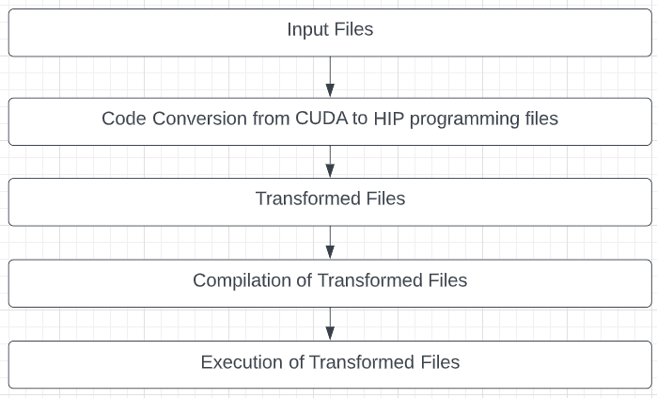
High Level Diagram

Slide 11
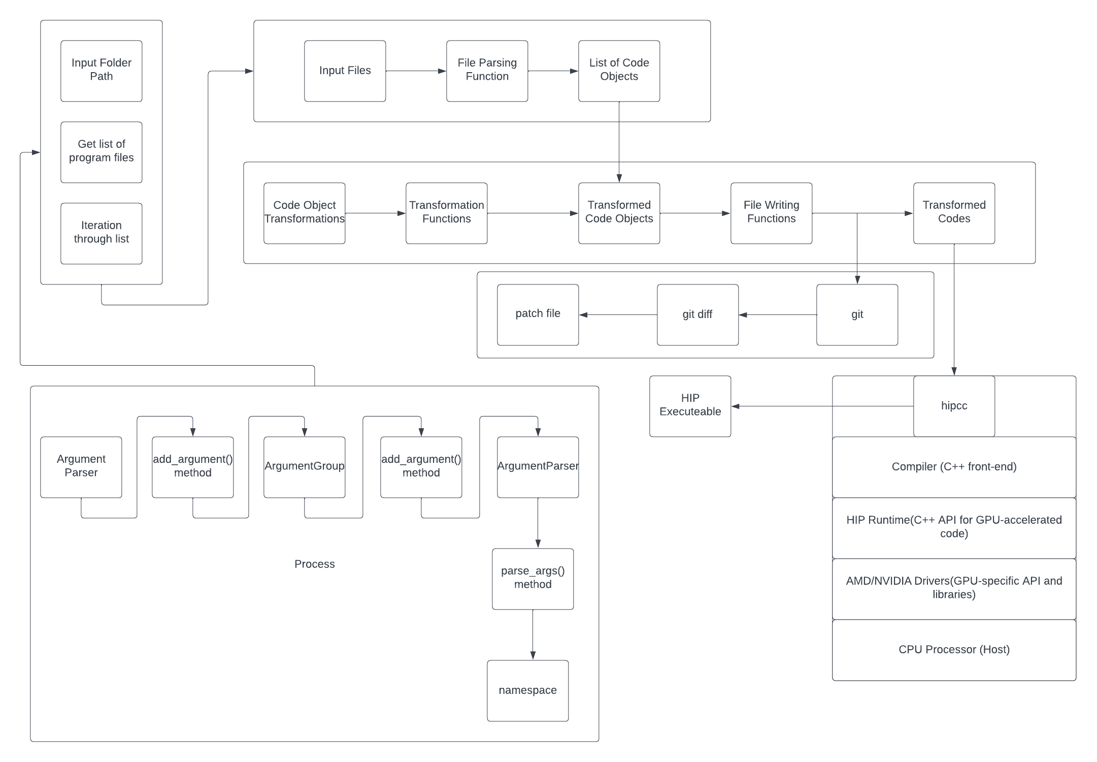
Low Level Diagram

Slide 12
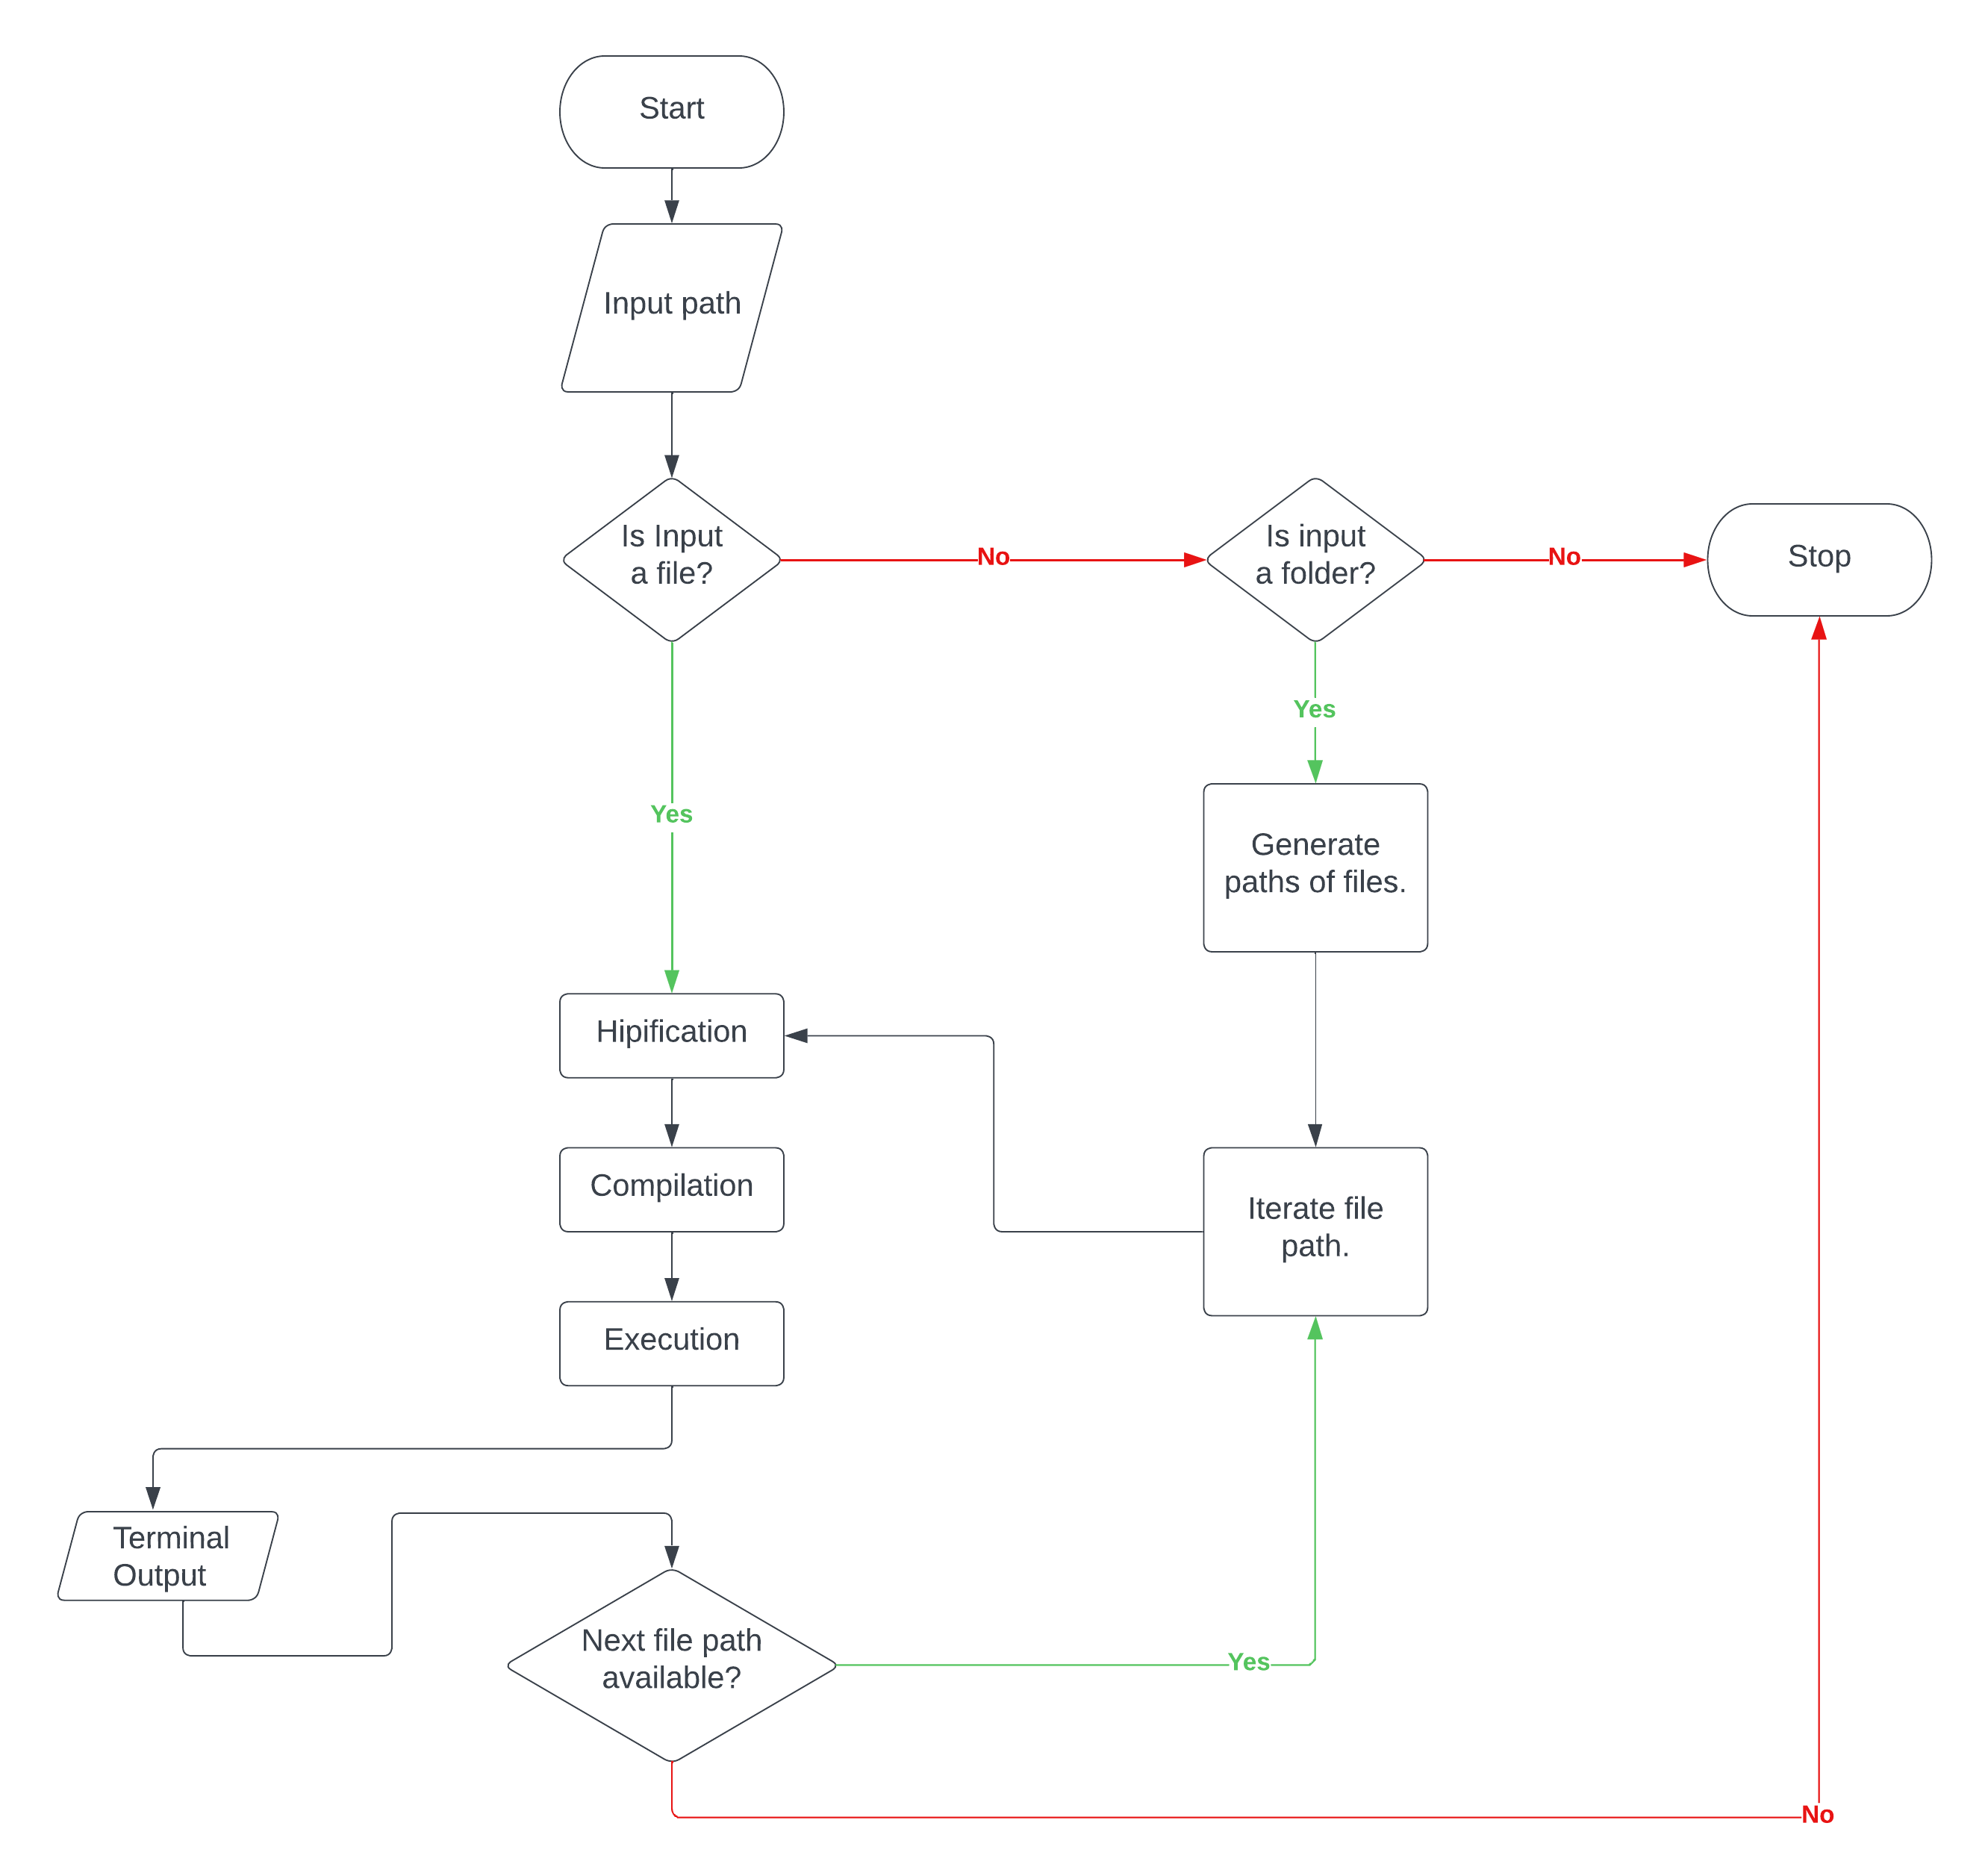
Flowchart

Slide 13
Brief Recap
HIP (Heterogeneous-compute Interface for Portability) is an API and programming model for writing portable and scalable code for heterogeneous systems, such as those consisting of CPUs and GPUs. It was developed by AMD and provides a C++ interface for programming GPU accelerators, similar to Nvidia's CUDA API.
HIP allows developers to write code once and run it on different GPU architectures, such as those from AMD and Nvidia, without having to maintain separate codebases. This makes it easier to target multiple GPU platforms and reduces the amount of code that needs to be maintained.
HIP provides a set of high-level abstractions and primitives for GPU programming, including support for parallelism, memory management, and synchronization. It also provides interoperability with other APIs, such as CUDA, OpenCL, and OpenGL, allowing for integration with a wide range of tools and libraries.
In summary, HIP is an open-source and cross-platform solution for GPU programming that enables developers to write code that is portable, scalable, and interoperable with other APIs.
TestHIPIFY is a command-line based tool developed in Python Programming language, which allows its users to simply pass relative paths of a CUDA sample to convert using either HIPIFY-Perl or HIPIFY-Clang, compile them with or without using -static-lib flags and finally generate an executable. TestHIPIFY’s repository already contains the updated versions of CUDA samples, for the user’s convenience, allowing them to execute them on AMD devices having other hardware specifications.

Slide 14
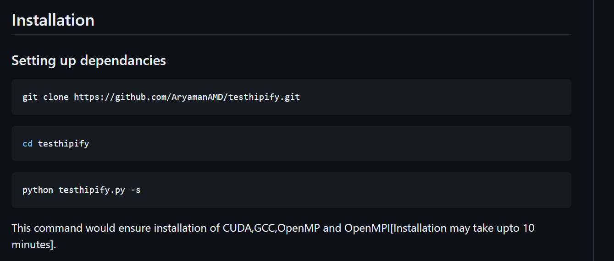
Usage

Slide 15
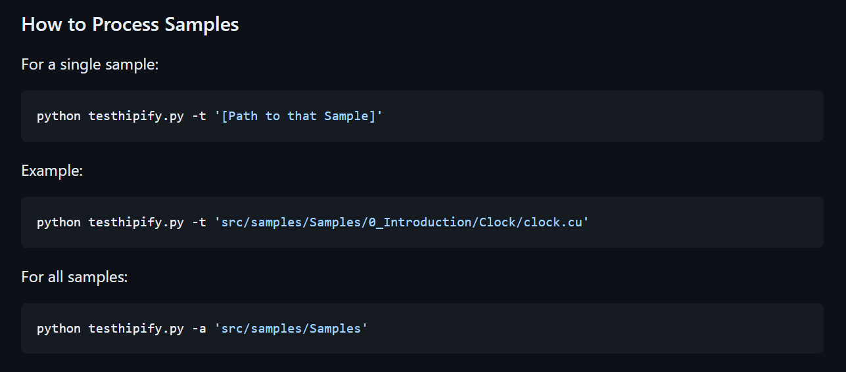
Usage

Slide 16
CUDA Samples
The CUDA Samples repository at https://github.com/NVIDIA/cuda-samples is a collection of CUDA code samples and accompanying documentation. The code samples are meant to illustrate the use of various CUDA APIs and demonstrate how to utilize CUDA to perform general purpose computing on GPUs. The code samples are organized into several categories, such as Matrix multiplication, FFT, Monte Carlo, and Image Processing. The samples are designed to run on a CUDA-capable GPU and can be built on Windows, Linux, and Mac OS. The repository also includes a set of tutorials and guides to help users understand the concepts and techniques used in the code samples.
CUDA Samples are a collection of code examples provided by NVIDIA for learning and using the CUDA platform for parallel computing on GPUs. The samples demonstrate various concepts of parallel programming and algorithms that can be accelerated using GPUs. The CUDA Samples are meant to help developers understand the basic concepts of parallel computing and develop efficient GPU-accelerated applications. The samples are written in C/C++ and cover a wide range of application domains such as image processing, scientific simulations, and machine learning.
CUDA is a parallel computing platform and API model developed by Nvidia for programming GPUs. The CUDA samples provided by Nvidia are designed to help developers learn how to use CUDA to build high performance, parallel computing applications. The samples cover a wide range of topics, including:
Basic CUDA concepts and techniques, such as memory transfers and kernel launches
Image and video processing
Scientific and engineering simulations
Machine learning and deep learning
Database acceleration

Slide 17
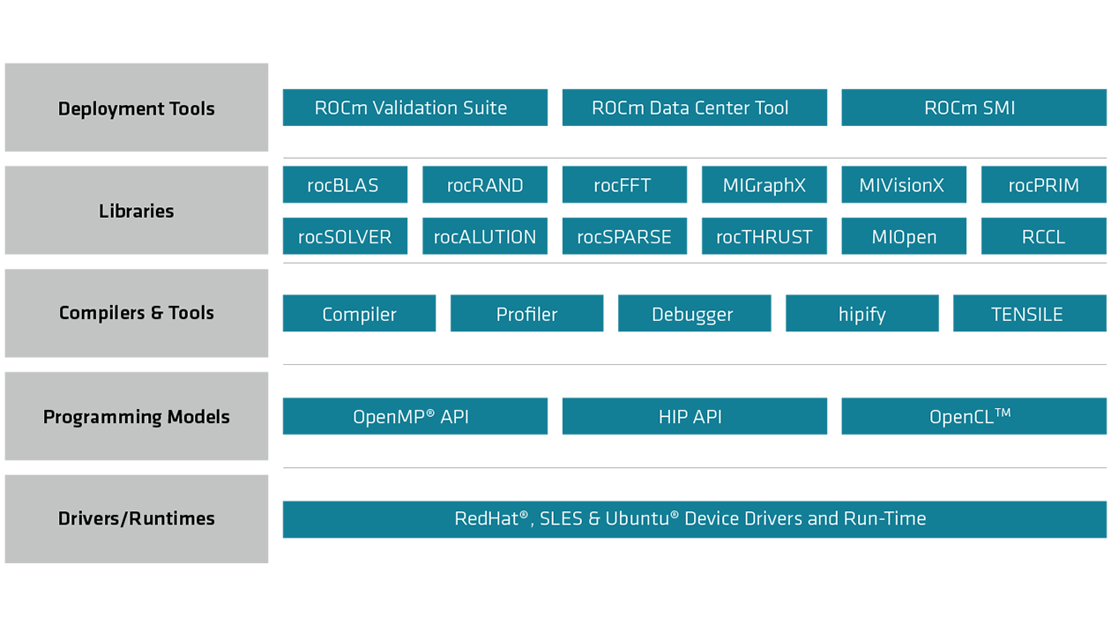
Dependencies
CUDA
ROCm Supported GPU
GCC Compiler
ROCm Stack
OpenMP
OpenMPI

Slide 18
Features
This code is a Python script that uses the argparse library to parse command-line arguments. The script sets up an argparse.ArgumentParser object with a description of the script's purpose, which is to "HIPIFY Cuda Samples." The script then adds several arguments that the user can specify when running the script, such as:
"-a" or "--all" argument runs the hipify-perl tool on all samples within a specified folder.
"-b" or "--generate" argument generates .hip files from .cu files.
"-c" or "--compile1" argument compiles .hip files generated by the hipify-perl tool.
"-d" or "--compile2" argument compiles .hip files with static libraries.
"-e" or "--execute" argument executes the compiled .out files.
"-f" or "--generate_all" argument generates all .hip files from .cu files.
"-g" or "--compile1_all" argument compiles all .hip files generated by the hipify-perl tool.
"-i" or "--compile2_all" argument compiles all .hip files with static libraries.
"-j" or "--execute_all" argument executes all compiled .out files.
"-k" or "--parenthesis_check" argument removes last parts from cu.hip files which are out of bounds.
"-l" or "--parenthesis_check_all" argument removes all last parts from cu.hip files which are out of bounds.
"-n" or "--nvidia_compile" argument compiles and executes via nvcc.*
"-p" or "--patch" argument applies all patches in the src/patches directory.*
"-t" or "--tale" argument runs the hipify-perl tool on a single specified sample.
"-x" or "--remove" argument removes any sample relating to graphical operations e.g. DirectX, Vulcan, OpenGL, OpenCL, and so on.
"-s" or "--setup1" argument configures dependencies automatically.*
"-v" or "--setup2" argument configures dependencies manually.*
"-u" or "--new_samples" argument downloads the latest samples from the NVIDIA CUDA Samples repository.*
Note:Arguments marked with * don’t require a parameter.

Slide 19
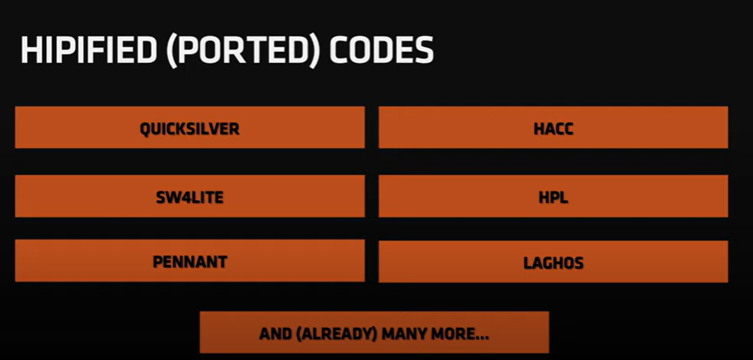

Slide 20
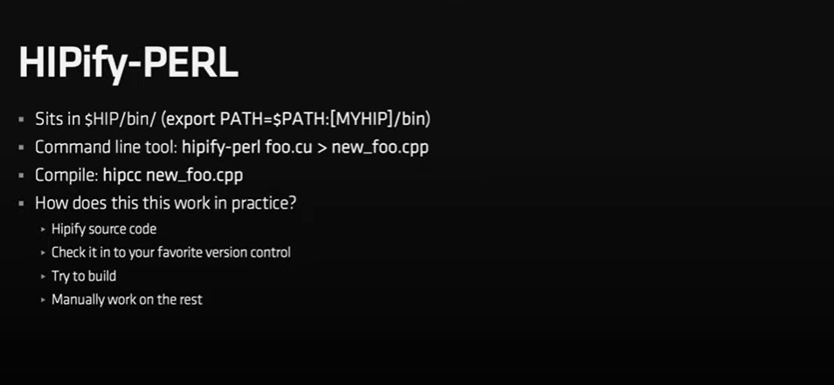

Slide 21
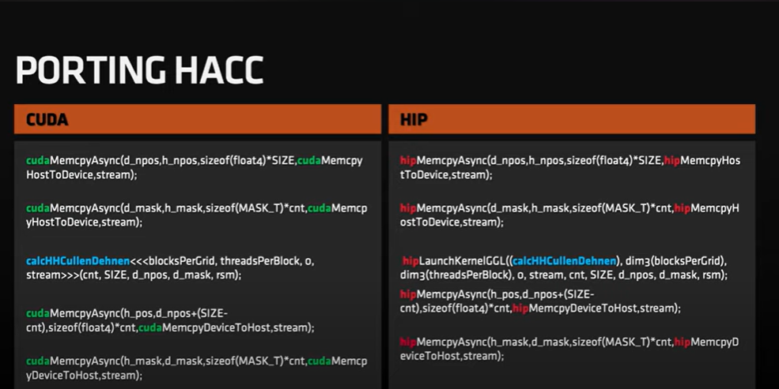

Slide 22
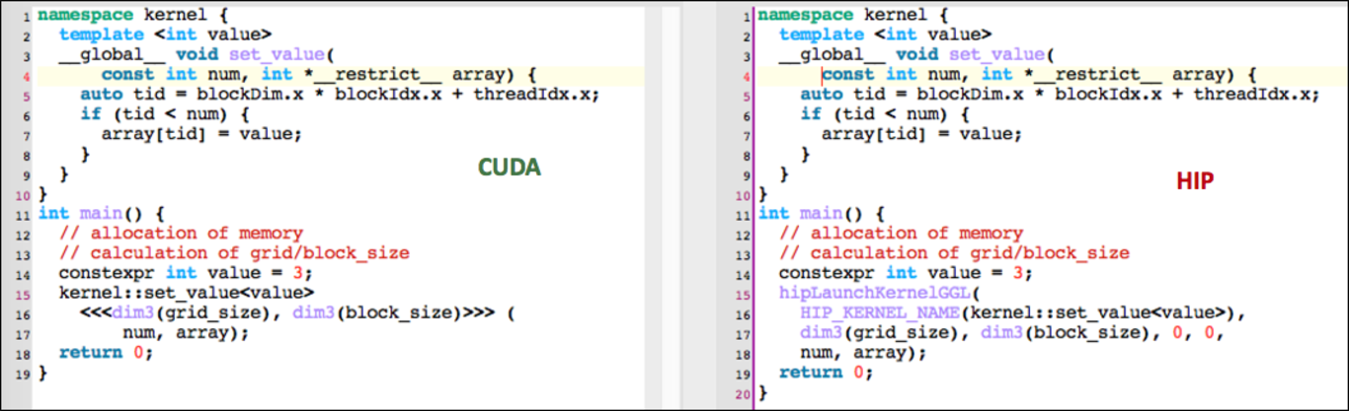

Slide 23
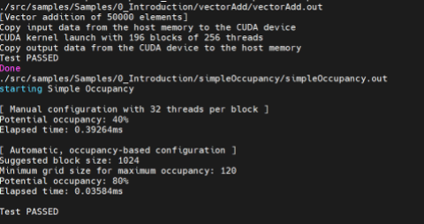
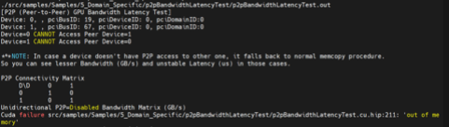
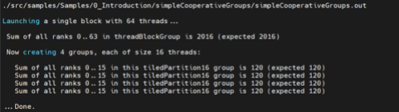
Screenshots

Slide 24
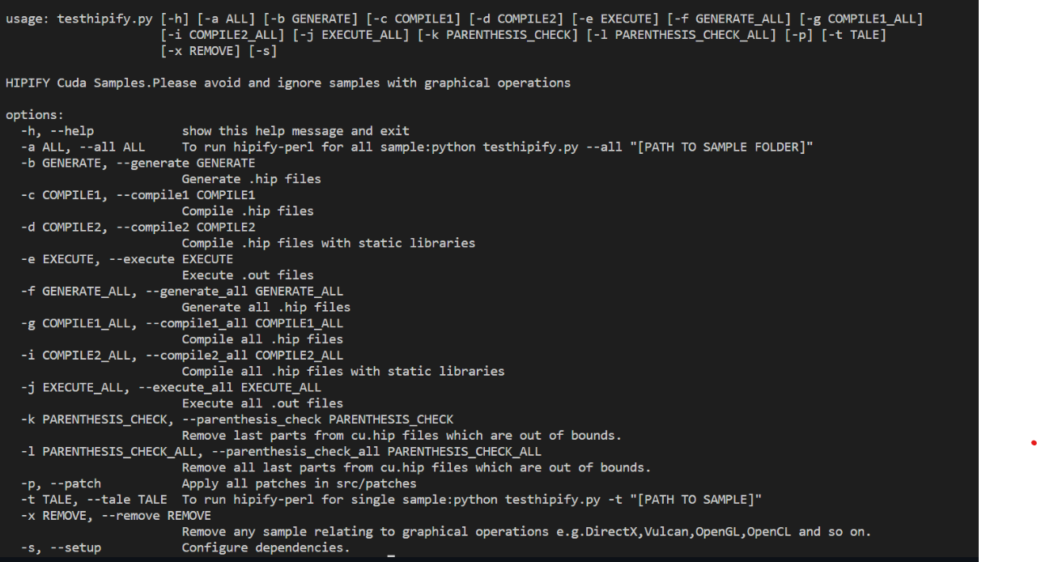
Screenshots

Slide 25
Conclusion
Testhipify adheres to not be dependent on the makefiles of any sample.It has provisions for processing single or multiple samples in a folder.The -h command would give the methods of usage of every function.
The repository also contains the executable files of samples which were successfully processed under HIP Architecture.The project helped in reporting underlying features, which when solved,would aid in execution of increased amount of samples which currently reside in the Ignored Samples Category.
Our project ignored 94 Samples and processed 96 Samples in the end out of a total of 190 Samples.Unlike the original guideline which requires manipulation of the make file,the script will generate the executeable without specifying the hardware information as long as the stated dependencies are met.
It is open-source and the included report explains every system calls and functions to the minutest of details.
Links:
• https://github.com/AryamanAMD/testhipify
• https://github.com/AryamanAMD/testhipify-cli
• https://github.com/ROCm-Developer-Tools/HIPIFY

Slide 26
THANK YOU!

