Slide 1
Drug Prescription Model
Team Members
Siddharth Mehta
Raghav Somani
Aryaman Mishra

Slide 2
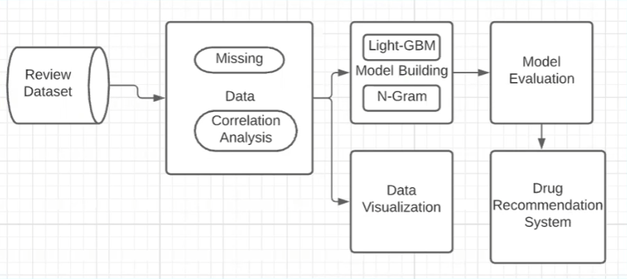
Architecture

Slide 3
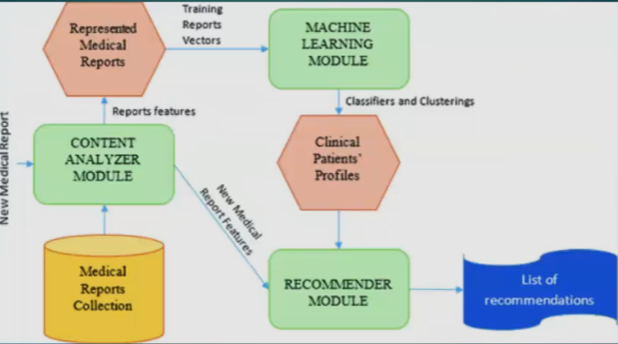
Flow of Product

Slide 4
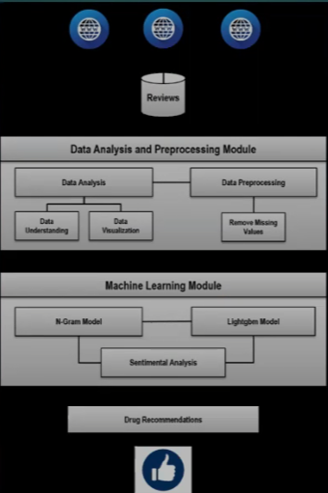
Activity Diagram

Slide 5
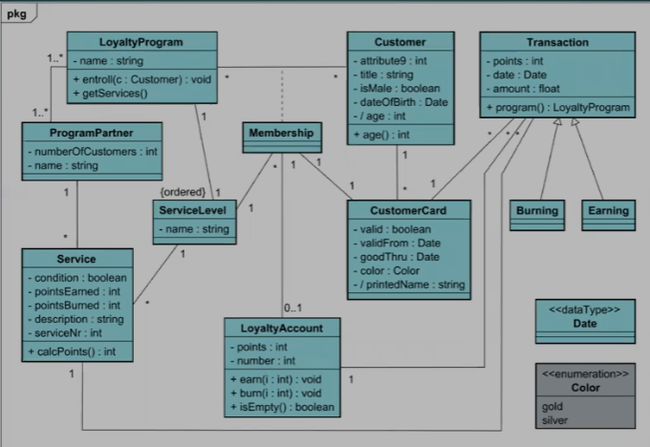
Class Diagram

Slide 6
Modules
1. DRUG PRESCRIPTION MODEL
Data Collection from database module
First we load our dataset which includes patient attributes such as uniqueID, drugName, condition, review, rating, date, usefulCount.
Data Analysis and Interpretation
Here we will classify all the useless and useful drugs separately including analysis based on various statistical methods like mean, std etc.
Data Visualization
Here we will be plotting our data w.r.t distribution of rating and seful count, rating vs usefulness etc.

Slide 7
Sentiment Analysis of the reviews
This module is the heart and core of our project. Here we will be reading the long reviews delivered by our customers and carry out pre processes by implementing functions such as remove punctuations, stopwords etc. Hence make our corpus ready for tokenization. Then we will be executing our Sentiment Intensity Analyzer wherein we will be training the various sentiments and calculating the maximum and minimum score. Finally we will be determining the usefulness of each drug based on the popular conditions such as birth control, depression, Insomnia, B.P, Obesity, Acne etc. This helps us in predicting the patient's conditions accurately.

Slide 8
Integration of chatbot
A software application to conduct an on-line chat conversation via text or text-to-speech, in lieu of providing direct contact with a live human agent will be a special feature of our project. We will be including several chalbols ke Coach (BMI), D.M.D (Dentists), RAE (Remarks) which will be serving a variety of purposes for our patients. These chatbots will be including several API's which will assist us with the information and details which includes location, phone numbers etc. There are interactive buttons which makes it easy and attractive to use for our customer. This will be integrated within our project making it convenient for the user and hence making it useful for patients in case of emergencies.

