Slide 1
Module-3
Exception Handling in Java

Slide 2
Syntax Errors, Runtime Errors, and Logic Errors
There are three categories of errors: syntax errors, runtime errors, and logic errors.
Syntax errors arise because the rules of the language have not been followed. They are detected by the compiler.
Runtime errors occur while the program is running if the environment detects an operation that is impossible to carry out.
Logic errors occur when a program doesn't perform the way it was intended to.

Slide 3
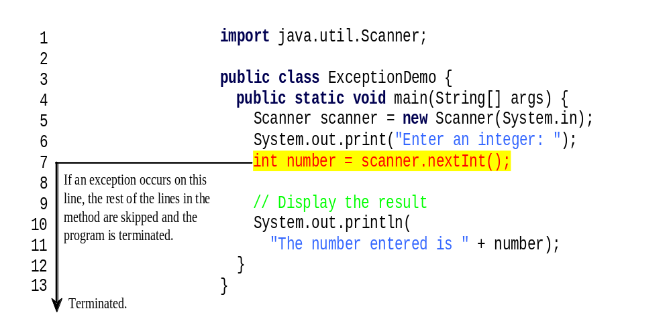
Runtime Errors

Slide 4
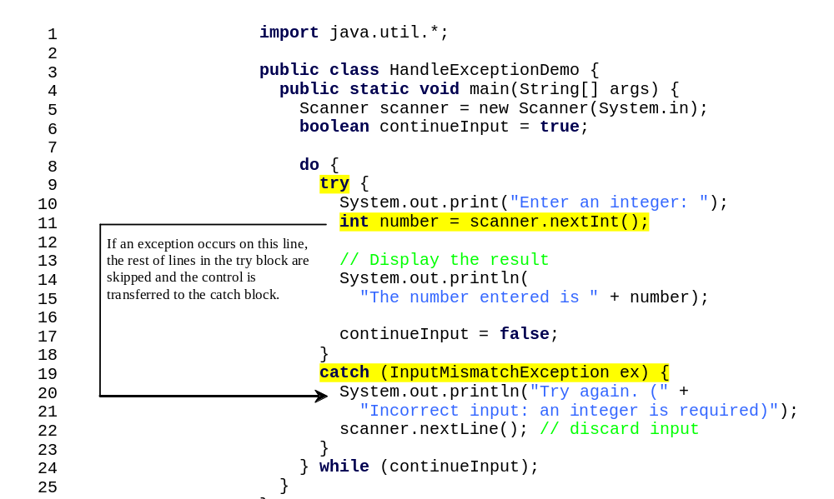
Catch Runtime Errors

Slide 5

Exception Classes

Slide 6
System Errors
System errors are thrown by JVM and represented in the Error class. The Error class describes internal system errors. Such errors rarely occur. If one does, there is little you can do beyond notifying the user and trying to terminate the program gracefully.

Slide 7
Exceptions
Exception describes errors caused by your program and external circumstances. These errors can be caught and handled by your program.

Slide 8
Runtime Exceptions
RuntimeException is caused by programming errors, such as bad casting, accessing an out-of-bounds array, and numeric errors.

Slide 9
Checked Exceptions vs. Unchecked Exceptions
RuntimeException, Error and their subclasses are known as unchecked exceptions. All other exceptions are known as checked exceptions, meaning that the compiler forces the programmer to check and deal with the exceptions.

Slide 10
Unchecked Exceptions
In most cases, unchecked exceptions reflect programming logic errors that are not recoverable. For example, a NullPointerException is thrown if you access an object through a reference variable before an object is assigned to it; an IndexOutOfBoundsException is thrown if you access an element in an array outside the bounds of the array. These are the logic errors that should be corrected in the program. Unchecked exceptions can occur anywhere in the program. To avoid cumbersome overuse of try-catch blocks, Java does not mandate you to write code to catch unchecked exceptions.

Slide 11

Checked or Unchecked Exceptions
Unchecked exception.

Slide 12

Declaring, Throwing, and Catching Exceptions

Slide 13
Declaring Exceptions
Every method must state the types of checked exceptions it might throw. This is known as declaring exceptions.
public void myMethod()
throws IOException
public void myMethod()
throws IOException, OtherException

Slide 14
Throwing Exceptions
When the program detects an error, the program can create an instance of an appropriate exception type and throw it. This is known as throwing an exception. Here is an example,
throw new TheException();
TheException ex = new TheException();
throw ex;

Slide 15
Throwing Exceptions Example
/** Set a new radius */
public void setRadius(double newRadius)
throws IllegalArgumentException {
if (newRadius >= 0)
radius = newRadius;
else
throw new IllegalArgumentException(
"Radius cannot be negative");
}

Slide 16
Catching Exceptions
try {
statements; // Statements that may throw exceptions
}
catch (Exception1 exVar1) {
handler for exception1;
}
catch (Exception2 exVar2) {
handler for exception2;
}
...
catch (ExceptionN exVar3) {
handler for exceptionN;
}

Slide 17
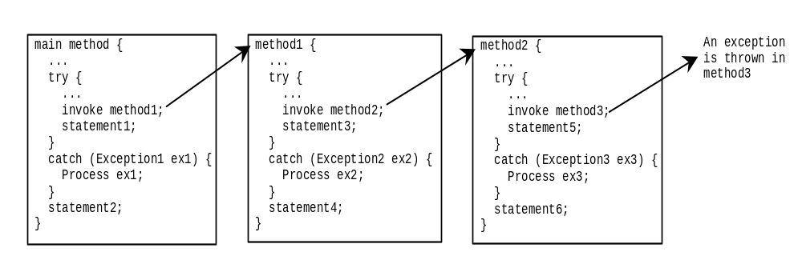
Catching Exceptions

Slide 18
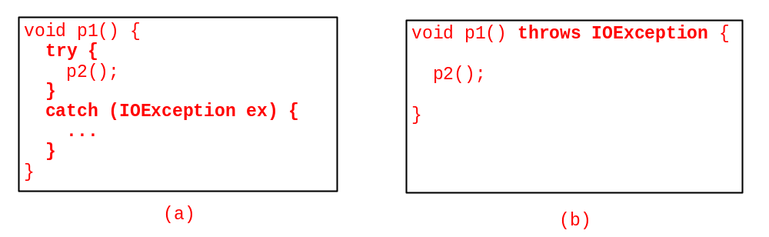
Catch or Declare Checked Exceptions
Java forces you to deal with checked exceptions. If a method declares a checked exception (i.e., an exception other than Error or RuntimeException), you must invoke it in a try-catch block or declare to throw the exception in the calling method. For example, suppose that method p1 invokes method p2 and p2 may throw a checked exception (e.g., IOException), you have to write the code as shown in (a) or (b).

Slide 19
The finally Clause
try {
statements;
}
catch(TheException ex) {
handling ex;
}
finally {
finalStatements;
}

Slide 20
Trace a Program Execution
Suppose no exceptions in the statements
try {
statements;
}
catch(TheException ex) {
handling ex;
}
finally {
finalStatements;
}
Next statement;

Slide 21
Trace a Program Execution
The final block is always executed
try {
statements;
}
catch(TheException ex) {
handling ex;
}
finally {
finalStatements;
}
Next statement;

Slide 22
Trace a Program Execution
Next statement in the method is executed
try {
statements;
}
catch(TheException ex) {
handling ex;
}
finally {
finalStatements;
}
Next statement;

Slide 23
Trace a Program Execution
try {
statement1;
statement2;
statement3;
}
catch(Exception1 ex) {
handling ex;
}
finally {
finalStatements;
}
Next statement;
Suppose an exception of type Exception1 is thrown in statement2

Slide 24
Trace a Program Execution
try {
statement1;
statement2;
statement3;
}
catch(Exception1 ex) {
handling ex;
}
finally {
finalStatements;
}
Next statement;
The exception is handled.

Slide 25
Trace a Program Execution
try {
statement1;
statement2;
statement3;
}
catch(Exception1 ex) {
handling ex;
}
finally {
finalStatements;
}
Next statement;
The final block is always executed.

Slide 26
Trace a Program Execution
animation
try {
statement1;
statement2;
statement3;
}
catch(Exception1 ex) {
handling ex;
}
finally {
finalStatements;
}
Next statement;
The next statement in the method is now executed.

Slide 27
Trace a Program Execution
animation
try {
statement1;
statement2;
statement3;
}
catch(Exception1 ex) {
handling ex;
}
catch(Exception2 ex) {
handling ex;
throw ex;
}
finally {
finalStatements;
}
Next statement;
statement2 throws an exception of type Exception2.

Slide 28
Trace a Program Execution
try {
statement1;
statement2;
statement3;
}
catch(Exception1 ex) {
handling ex;
}
catch(Exception2 ex) {
handling ex;
throw ex;
}
finally {
finalStatements;
}
Next statement;
Handling exception

Slide 29
Trace a Program Execution
try {
statement1;
statement2;
statement3;
}
catch(Exception1 ex) {
handling ex;
}
catch(Exception2 ex) {
handling ex;
throw ex;
}
finally {
finalStatements;
}
Next statement;
Execute the final block

Slide 30
Trace a Program Execution
animation
try {
statement1;
statement2;
statement3;
}
catch(Exception1 ex) {
handling ex;
}
catch(Exception2 ex) {
handling ex;
throw ex;
}
finally {
finalStatements;
}
Next statement;
Rethrow the exception and control is transferred to the caller

Slide 31
Cautions When Using Exceptions
Exception handling separates error-handling code from normal programming tasks, thus making programs easier to read and to modify. Be aware, however, that exception handling usually requires more time and resources because it requires instantiating a new exception object, rolling back the call stack, and propagating the errors to the calling methods.

Slide 32
When to Throw Exceptions
An exception occurs in a method. If you want the exception to be processed by its caller, you should create an exception object and throw it. If you can handle the exception in the method where it occurs, there is no need to throw it.

Slide 33
When to Use Exceptions
When should you use the try-catch block in the code? You should use it to deal with unexpected error conditions. Do not use it to deal with simple, expected situations. For example, the following code
try {
System.out.println(refVar.toString());
}
catch (NullPointerException ex) {
System.out.println("refVar is null");
}

Slide 34
When to Use Exceptions
is better to be replaced by
if (refVar != null)
System.out.println(refVar.toString());
else
System.out.println("refVar is null");

