Slide 1
Introduction to programming in java

Slide 2
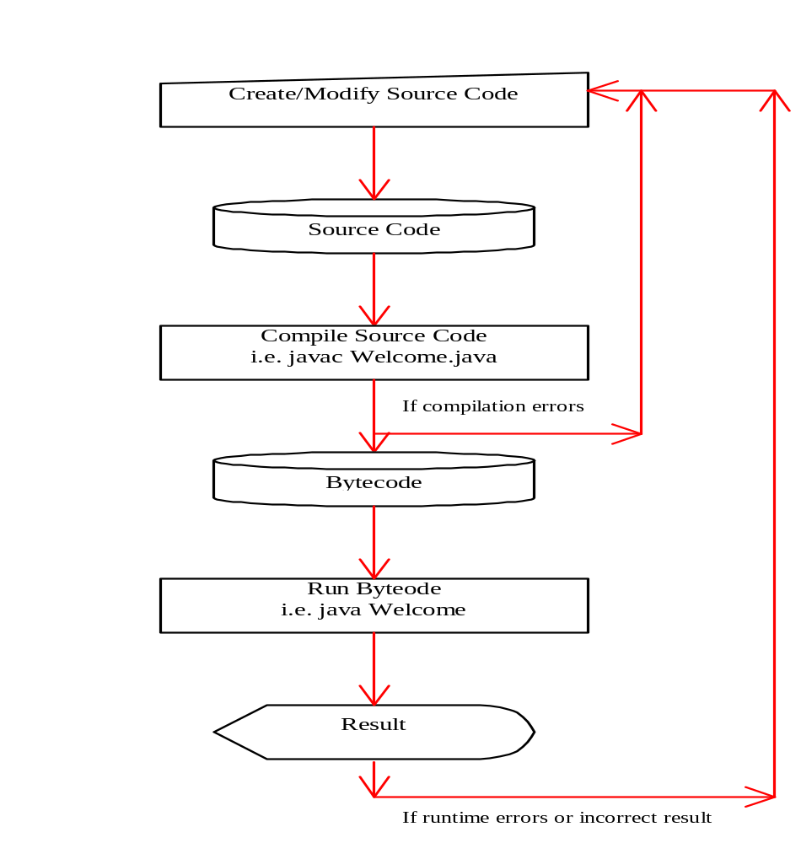
Java Environment

Slide 3
Structure of Java Programs
“class-name.java”
class class-name {
public static void main(String args[]) {
statement1;
statement2;
…
…
}
}
nlp-ai@cse.iitb

Slide 4
A statement written in Java
println(“Hello World!");
String hello = “Hello World!";
println(hello);
every statement is
terminated with a ;

Slide 5
Example Program
“First.java”
Public class First {
public static void main(String args[]) {
System.out.println(“Hello World”);
}
}
statement
nlp-ai@cse.iitb

Slide 6
Creating and Compiling Programs
On command line
  javac file.java

Slide 7
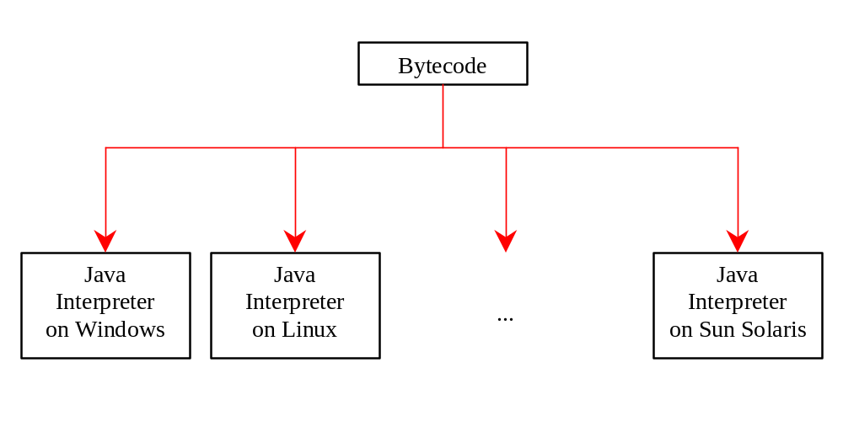
Executing Applications
On command line
  java classname

Slide 8
Example
javac Welcome.java
java Welcome
output:...

Slide 9
Compile and run java command line
Compile javac file-name.java
Run java filename
Example: HelloWorld.java
Compile javac HelloWorld.java
Run java HelloWorld
nlp-ai@cse.iitb

Slide 10
Compiling & Running the Program
Compiling: is the process of translating source code written in a particular programming language into computer-readable machine code that can be executed.
$ javac First.java
This command will produce a file ‘First.class’, which is used for running the program with the command ‘java’.
Running: is the process of executing program on a computer.
$ java First
nlp-ai@cse.iitb

Slide 11
Example Program
“second.java”
class second {
public static void main(String args[]) {
System.out.println(“Hello World”);
}
}
Compile javac second.java
Run java second

Slide 12
Example Program
“HelloWorld.java”
class HelloWorld{
public static void main(String args[]) {
System.out.println(“Hello World”);
}
}
Compile javac HelloWorld.java
Run java HelloWorld

Slide 13
Compile Run a few example using
Command line
HelloWorld java
Welcome.java
Myname.java
MyDate ofBirth.java

Slide 14
About Printing on the Screen
System.out.println(“Hello World”); – outputs the string “Hello World” followed by a new line on the screen.
System.out.print(“Hello World”); - outputs the string “Hello World” on the screen. This string is not followed by a new line.
Some Escape Sequence –
  \n – stands for new line character
  \t – stands for tab character
nlp-ai@cse.iitb

Slide 15
Java print() and println()
Text can be printed on the screen using print() or println().
Using println() puts a new line at the end of the text.
  print("7*3");
  println("=");
  println(7*3);
  This code prints:
  7*3=
  21

Slide 16
Example
Welcome.java
public class Welcome
{
public static void main(String args[])
{
        System.out.print("Welcome ");
        System.out.println("to");
        System.out.println(“java!");
}
}
}
}
Welcome to
java!
Output

Slide 17
Example
Welcome3.java ( includes \n and \t)
public class Welcome
{
public static void main(String args[])
{
        System.out.print("Welcome \n ");
        System.out.print("to \t");
        System.out.println(“java!");
}
}
}
}
Welcome
to java!
Output

Slide 18
Some Tips About Programming
Some common errors in the initial phase of learning programming:
  Mismatch of parentheses
  Missing ‘;’ at the end of statement
  Case sensitivity
Writing programs on your own is the best way to learn how to program.

Slide 19
Comments in java
There are two ways of commenting code.
Comments starting with // and terminated by end of line
// Lahcen Ouarbya
// 1 October 2012
// Hello World
Comments enclosed in /* */
/* Lahcen Ouarbya
1 October 2012
Hello World
*/
good to make several
lines of comments stand
out in your program

Slide 20
Concatenating output with +
print("I like programming in ");
println("Java");
This code prints: I like programming in Java
print("I like programming in “ + “Java” );
This code prints: I like programming in Java
println(“ square root of 4 = " 2 + " or " -2);
This code prints: square root of 4 = 2 or -2

Slide 21
Example
Concatenate.java
public class Concatenate
{
public static void main(String args[])
{
System.out.print("I like programming in ");
System.out.println(“java");
System.out.println("I like programming in “ + “java”);
System.out.println(“ square root of 4 = “+ 2 + " or “ + -2);
}
{
}
}
I like programming in java
I like programming in java
square root of 4 = 2 or -2
Output

Slide 22
Example
Welcome.java
public class Welcome
{
public static void main(String args[])
{
        System.out.print("Welcome ");
        System.out.print("to ");
        System.out.println("Java!");
        System.out.println(“Welcome “ + "to “+ " Java!");
}
}
}
}
Welcome to java!
Welcome to java!
Output

Slide 23
Assignments
1. Write a program which prints the following information about at least 5
persons:
    `Full Name ‘ `Email-Address’ ` Telephone Number’
    use print and println and see the difference.
    Write a program to calculate Simple interest with the variables like p,n,r
    Write a program to calculate Net salary of an employee with the variables like
    Basic salary, da,hra.

Slide 24
Data types
Most programming languages (like Java) have a notion of data types and ask the programmer to specify what type of data is being manipulated.
type: A category or set of data values.
  Example: integer, real number, string
Internally, the computer stores all data as 0s and 1s.
  example: 42 --> 101010
  example: "hi" --> 0110100001101001
Counting with dots exercise

Slide 25
Java primitive Data types
The expressions in today's slides so far have been integers.
  Integers are one of Java's data types.
primitive types: Java's built-in simple data types for numbers, text characters, and logic.
  Java has eight primitive types total.
  Types that are not primitive are called object types.
  We'll use these four primitive types in this class:
  Name Description Examples
  int integers (whole numbers) 42, -3, 0, 926394
  double real numbers 3.14, -0.25, 9.0
  char single text characters 'a', 'X', '?', '\n'
  boolean logical values true, false
Notes:
We're basically going to manipulate letters and numbers.
We make the integer / real number distinction in English as well. We don't ask, "How many do you weigh?" or, "How much sisters do you have?"
Part of the int/double split is related to how a computer processor crunches numbers. A CPU does integer computations and a Floating Point Unit (FPU) does real number computations.
Why does Java separate int and double? Why not use one combined type called number?

Slide 26
Declaring variables
variable declaration statement: A Java statement that creates a new variable of a given type.
  A variable is declared by writing a statement that says its type, and then its name. (The name is an identifier.)
Declaration statement syntax:
  <type> <name> ;
  Example: int x;
  Example: double myGPA;
It is also legal to declare multiple variables of the same type on one line:
  <type> <name>, <name>, ..., <name> ;
  Example: int a, b, c;

Slide 27
More on declaring variables
Declaring a variable sets aside a chunk of memory in which you can store a value.
  int x;
  int y;
  A (crude) diagram of part of the computer's memory:
  +---+ +---+
  x | | y | | (The memory has no value in it yet.)
  +---+ +---+
The compiler will fail if you try to declare a variable twice, or declare two variables with the same name.
  Illegal:
  int x;
  int x; // variable x already exists! ERROR
Notes:
It doesn't matter where in memory the variable goes, nor how much memory is used. Java takes care of that for us.

Slide 28
Assignment statements
assignment statement: A Java statement that stores a value into a variable's memory location.
  Variables must be declared before they can be assigned a value.
Assignment statement syntax:
  <name> = <value> ;
  Example: x = 3;
  Example: myGPA = 3.95;
  Another (crude) diagram of part of the computer's memory:
  +---+ +------+
  x | 3 | myGPA | 3.95 |
  +---+ +------+

Slide 29
Expressions
expression: A data value, or a set of operations that compute a data value.
  Example: 1 + 4 * 3
  The simplest expression is a literal value.
  A more complex expression can have operators
  and/or parentheses.
    The values that an operator applies to are called operands.
5 common arithmetic operators we will use:
  + (addition)
  - (subtraction or negation)
  * (multiplication)
  / (division)
  % (modulus, a.k.a. remainder)

Slide 30
End
Using Command line Arguments
public class TestMain
{
public static void main(String args[])
{
. . .
}
}
java TestMain arg0 arg1 arg2 … argn
}
}
nlp-ai@cse.iitb

Slide 31
Processing
Command-Line Parameters
The main method, get the arguments from
args[0], args[1], ..., args[n]
arg0, arg1, ..., argn
}
}
nlp-ai@cse.iitb

Slide 32
Example
Argument.java
public class Welcome
{
public static void main(String args[])
{
System.out.print("Hi, ");
System.out.print(args[0] + " " );
System.out.println(". How are you?");
}
}
}
}
Java Argument Lahcen
Hi, Lahcen. How are you?

Slide 33
Example
Argument1.java
public class Argument1
{
public static void main(String args[])
{
System.out.print("Hi, ");
System.out.print(args[0] + " " );
System.out.print(args[1] + " " );
System.out.println(". How are you?");
}
}
}
}
Java Argument java programs
Hi, java programs. How are you?

Slide 34
Example
Argument2.java
public class Argument2
{
public static void main(String args[])
{
System.out.print("Hi, “+ args[0] + “ ”args[1] + (". How are you?");
}
}
}
}
Java Argument java programs
Hi, java programs. How are you?

