Slide 1
VisionGuard
AI that catches vehicle theft the moment it happens, on the cheap, dark cameras societies already own.
Investor deck · [your name] · [email / phone]

Slide 2
The problem
A billion cameras watch us. None of them protect us.
Cameras record crime. They never stop it.
🎥
Guards find out the next morning, from the footage.
🌙
Existing AI fails on dark, low-res, real CCTV, and noisy alerts get it switched off.
🔕

Slide 3
The solution
VisionGuard turns a society's existing cameras into a watchful AI.
🔆
Sees in the dark
Enhances low-light frames so it detects the person a raw feed hides.
🎯
Understands the act
Person at a car + a break-in motion + the car leaving = a theft.
🤖
Explains itself
Claude reviews the clip and writes a plain-English verdict with time and severity.
📲
Alerts instantly
Owner and guard are notified at the smash, not the next morning.

Slide 4
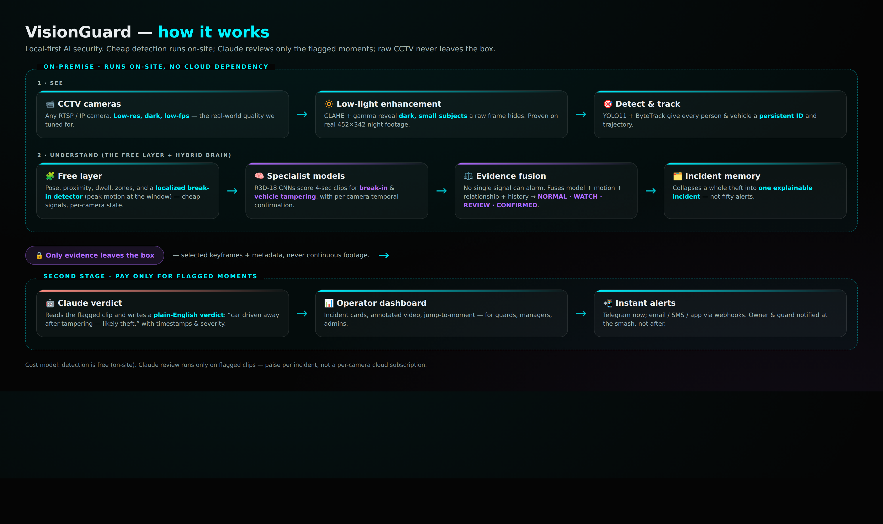
How it works
Local-first. Cheap detection on-site. Only flagged evidence goes to AI. Raw footage never leaves the building.

Slide 5
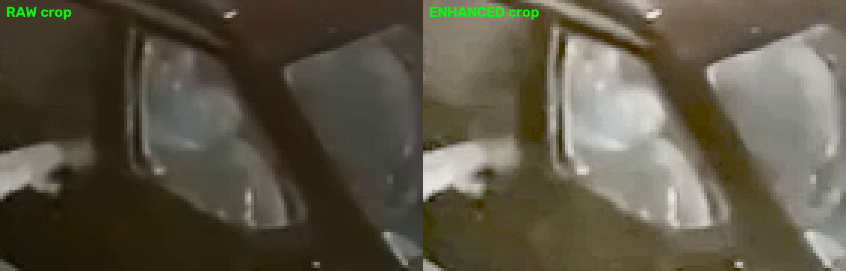
It works on real, bad footage
Diagnosed and fixed on actual 452 x 342 night-CCTV theft footage, not a lab clip.
Same frame, raw vs enhanced: the intruder at the window goes from invisible to clearly visible.
101 → 142
90 – 160
frame brightness after enhancement (person becomes detectable)
localized break-in signal during the act (vs ~15 when quiet)

Slide 6
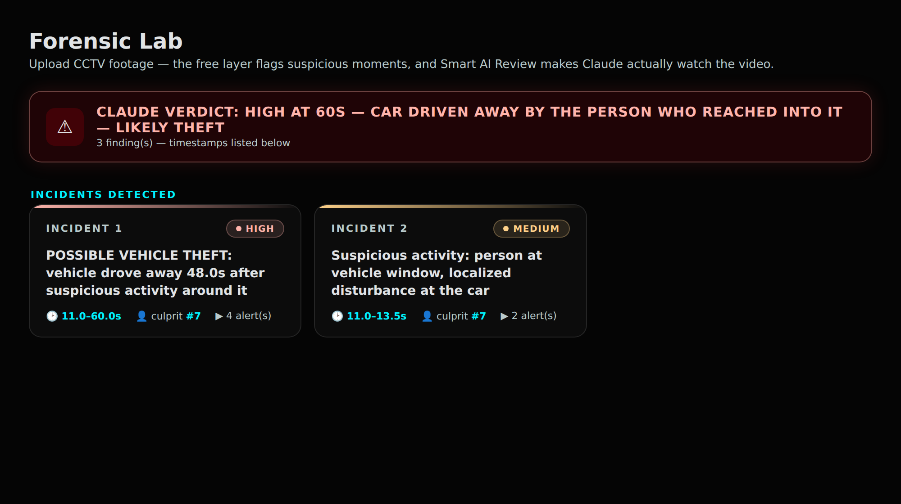
What the operator sees
Claude's verdict on top, the whole theft as ONE incident card. Click a card to jump the video to that moment.

Slide 7
The market TAM · SAM · SOM
TAM
SAM
SOM
$6.8B+
₹3,000 Cr
₹12 Cr ARR
Global AI video-surveillance market in 2026, growing fast toward $20B+.
India: residential societies & small business on existing cameras, per year.*
3-year target: societies across [FILL: cities] at ~₹60k / society / yr.*
* SAM/SOM illustrative, to be finalized with founder's bottom-up data. TAM: AI-in-video-surveillance market reports, 2026.

Slide 8
Business model
SaaS per society
🏢
A monthly subscription per society, tiered by cameras and AI-review volume.
Metered AI verdicts
🪙
Claude review is paise per flagged clip, not a per-camera cloud fee. Transparent in-app cost meter.
No hardware to sell
🔌
Runs on the cameras they already own. Zero upfront hardware barrier to adopt.

Slide 9
Why we win
The space is crowded and well-funded (Verkada, Ambient.ai globally; Staqu, Wobot, Awiros in India). We own a sharp wedge:
Residential societies on existing cheap cameras, the underserved mid-market.
Tuned for low-quality footage, proven on real dark, low-res night CCTV.
🏘️
🌫️
Explainable & local-first: plain-English verdicts, footage stays on-site.
Paise-per-incident cost, vs per-camera cloud subscriptions.
🔒
🪙
Moat: our performance on bad footage + the data flywheel from real deployments.

Slide 10
Where we are
A working, end-to-end prototype, validated on real footage. Honest about what's proven and what's next.
BUILT
IN PROGRESS
NEXT
Detection in the dark
Break-in / theft understanding
Specialist models + fusion
Claude verdict + incident memory
Dashboard + Telegram alerts
Published accuracy number
(needs a labeled, untouched
multi-camera holdout)
Live multi-camera pipeline
Mobile alerts, email / SMS
Harden models on our own
+ surveillance datasets

Slide 11
Use of funds
Raising [FILL: ₹ amount] to reach [FILL: milestone].
Data + GPU
Collect & label real footage; train and harden the models.
[%]
Product
Live multi-camera, mobile app, email/SMS, polished front-end.
[%]
Pilots + GTM
Deployments, install & guard training, first paying societies.
[%]
Team
[FILL: key hires the raise funds].
[%]

Slide 12
The ask
[FILL: ₹ amount] to [FILL: milestone]
A billion cameras watch us. We make them protect us.
[your name] · [email / phone] · working prototype available for a live walkthrough

