Slide 1
Bank of CLI
By Aryaman Tomer

Slide 2
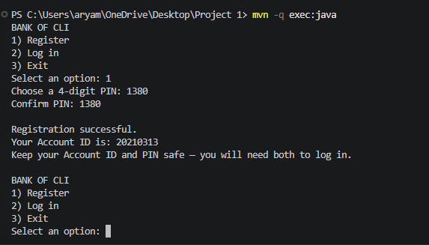
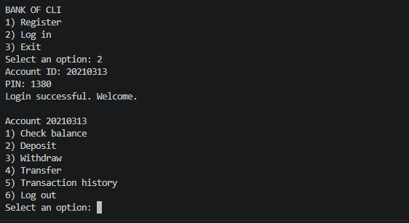
Bank of CLI
Bank of CLI is a terminal-based banking application built in Java that allows users to register, log in, manage account balances, transfer funds, and view transaction history using a PostgreSQL database.

Slide 3
Project Overview
The application provides the core functionality of a banking ledger entirely through the command line.
REGISTER / LOGIN
Create Account
Sign in
CHECK BALANCE
View Current Balance
MANAGE FUNDS
Deposit
Withdraw
Transfer
VIEW ACTIVITY
Transaction History

Slide 4
Architecture
Domain Models - Account Transaction, TransactionType
Java objects used to move banking data between layers.
How does the application move from user input to the database?
Repository Layer - AccountRepository,
AccountRepositoryImpl,
TransactionRepository.,
TransactionRepositoryImpl,
ConnectionFactory,
Executes SQL through JDBC
Creates / retrieves accounts
Updates balances
Stores transaction records
Handles commit / rollback for transfers
Service Layer –
AccountService, AccountServiceImpl
Registration & login logic
PIN validation
Deposit / withdrawal validation
Prevents overdrafts
Validates transfers
Retrieves transaction history
API / CLI layer – Main, BankCli
Starts the Application
Displays Menus
Reads Account ID, PIN, amounts, choices
Prints success/error messages
Postgres – Accounts and Transactions
Account credentials
Current balances
Deposit / withdrawal records
Transfer records
Persistent storage

Slide 5
Tech Stack
Java – Core application language. Used for the CLI, business logic, domain models, repository classes, validation, and exception handling | Maven – Manages the project build and external dependencies such as PostgreSQL JDBC, JUnit 5, and Bcrypt. Also runs automated tests with mvn test.
PostgreSQL – Persistent Relational Database storing accounts, balanced, hashed PINs, and transaction history. | JDBC – Connects the Java Repository layer to PostgreSQL. Used for prepared statements, queries, updates, and database transactions.
JUnit5 – Automated Testing framework used for positive and negative tests across the Service and Repository layers | Git and Github – Version control for tracking project changes, commits, and source-code management.
BCrypt - Hashes account PINs before they are stored in PostgreSQL.

Slide 6
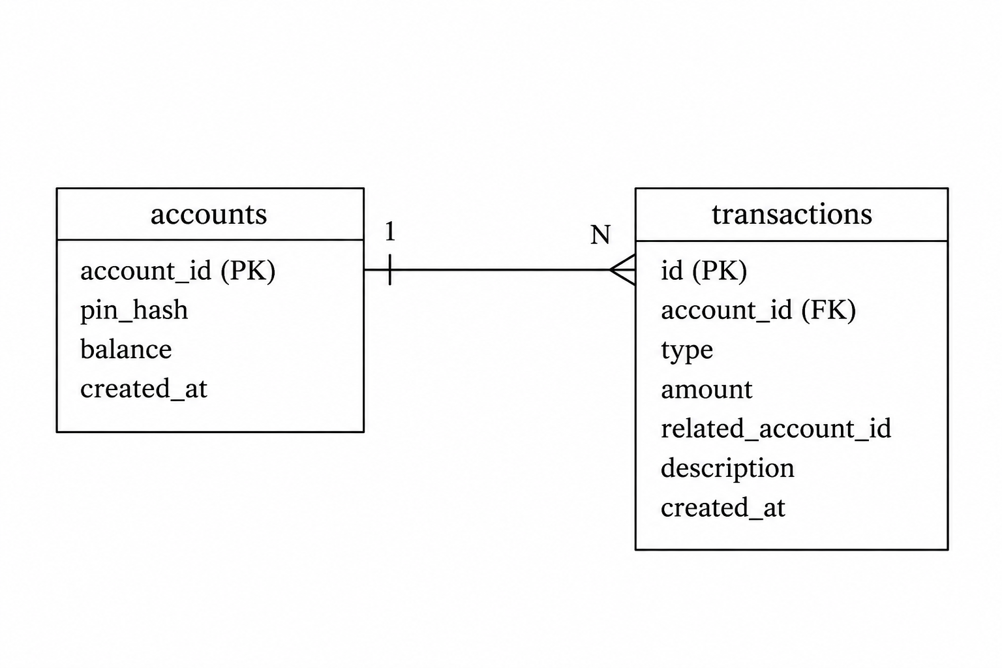
Database Schema
The database has two main tables.
  The accounts table stores each user’s account information
    Unique Account ID
    Hashed PIN
    Current balance
    Creation date.
  The transactions table records
    Deposit
    Withdrawal
    Transfer
    Amount
    Transaction Type
    Related account when applicable
    Timestamp.
One account can have many transaction records, which creates a one-to-many relationship between the two tables.

Slide 7
Testing And Logging
Logging
Logs stored in logs/bank-of-cli.log
INFO logs successful application activity
ERROR logs failed operations, security issues, and technical problems
Used to:
  Monitor user actions
  Troubleshoot failures
  Track authentication problems
  Record database errors
  Keep technical stack traces hidden from the user
Testing - JUnit 5
28 Total Automated Tests
14 Service Layer tests
12 Account Repository tests
2 Transaction Repository tests
Includes both positive and negative scenarios
Validates:
  Registration and login
  Balance retrieval
  Deposits and withdrawals
  Overdraft prevention
  Transfers between accounts
  Transaction history
  Transfer rollback / atomic behavior
Example positive test: successful deposit updates balance
Example negative test: overdraft attempt is rejected

