Slide 1
nirogcare.in
Hospital Management System
Founders : Aryaman & Harshit Singh Rajput

Slide 2

Problem Statement :
In India, long waiting queues at hospitals are a major challenge that affects both patients and healthcare providers. The current system suffers from several inefficiencies:
Excessive Queuing Time: Patients often have to wait for hours to get registered, consult doctors, or access lab services due to the lack of a structured digital appointment system.
Spread of Communicable Diseases: Crowded hospital waiting areas significantly increase the risk of transmission of communicable diseases such as tuberculosis, influenza, COVID-19, and dengue (via hospital-acquired mosquito exposure). This poses a serious threat, particularly to elderly and immunocompromised patients.
Stress on Medical Staff and Infrastructure: Unmanaged crowds put unnecessary pressure on hospital staff and infrastructure, reducing the quality and speed of care delivery.
Manual and Fragmented Processes: Most hospitals still rely on paper-based or semi-digital systems that lead to mismanagement of patient flow, appointment overlaps, and confusion at the help desks.

Slide 3
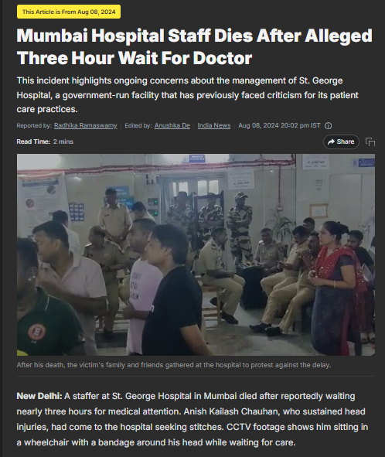
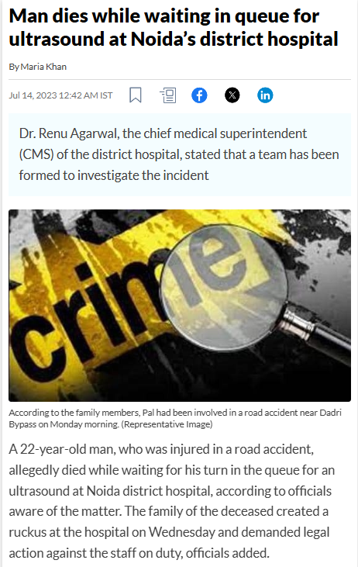
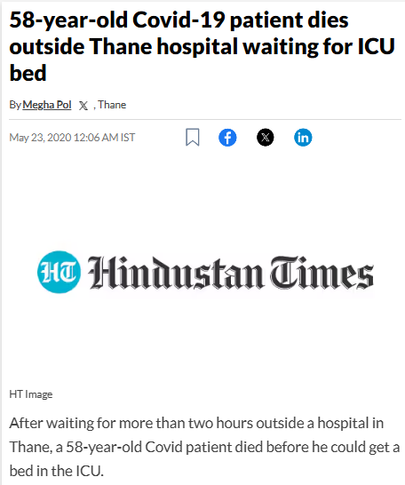
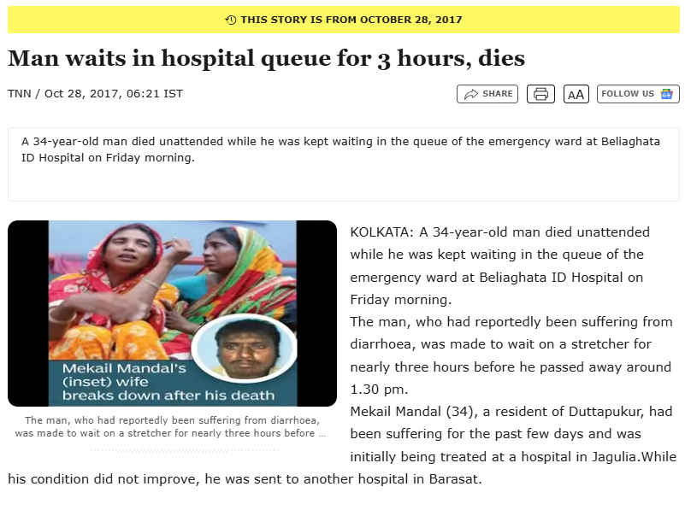
Facts and Figures showing Urgent need of Digital Management System in Government Hospitals:
A broader study published in The Lancet found that 1.6 million Indians died in 2016 due to poor quality of care and Management .
At AIIMS Delhi, a medical store supervisor estimated that 75% of cancer deaths at the hospital are due to long waits, as many patients are turned away or given long dates for treatment, leading to fatal delays. With over 10,000 OPD patients, many die waiting at crowded AIIMS | Latest News Delhi - Hindustan Times
Mumbai Hospital Staff Dies After Alleged Three Hour Wait For Doctor
Man dies while waiting in queue for ultrasound at Noida’s district hospital - Hindustan Times
58-year-old Covid-19 patient dies outside Thane hospital waiting for ICU bed - Hindustan Times
Man waits in hospital queue for 3 hours, dies | Kolkata News - Times of India

Slide 4

Solution :
Doctor Side
View and manage daily appointment schedules in real time.
Send alerts of doctor’s arrivals and timing of patient’s meet.
A compounder or assistant manages patient flow with just a few clicks.
Easily send real-time notifications such as:
✅ “Doctor has arrived at the clinic.”
🕒 “Estimated time for your appointment: X minutes.”
Our system automatically notifies all booked patients with updated estimated timings, helping them plan their arrival.

Slide 5

Solution :
Patient Side
Book doctor and lab appointments in advance through the web portal.
Receive SMS notifications with estimated appointment time to avoid long waits.
Track nearby hospitals and lab centers, and view real-time waiting times, similar to ride-sharing apps like Ola/Uber.
Arrive just-in-time based on updates, ensuring convenience and reduced exposure in crowded spaces.

Slide 6






Solution
Technology Used ⚙️
DataBase
FrontEnd
1. FireBase (Real Time Database)
1. React JS
Real-time queue updates
(patients joining, status changes)
2.Tailwind CSS
Push notifications ("You're next in line!" 🔔)
Push notifications alert patients via FCM when their turn arrives, using stored device tokens and real-time triggers.
BackEnd
2. MongoDB
1. Node Js
Storing detailed patient records, history prescriptions, appointments
2. Express js
Complex queries
(e.g., filter patients by condition, sort by date)

Slide 7
Conclusion :
Our hospital management web application directly addresses the long-standing issue of excessive queuing in Indian hospitals by providing:
Streamlined Online Appointments: Minimizing patient wait times through efficient scheduling.
Digital Workflow Management: Reducing paperwork and easing staff workload with a centralized system.
Safer Hospital Environments: Lowering the risk of communicable disease spread through better crowd management and reduced physical contact.
This is not just a solution—it's a step toward a smarter, healthier future.

