Slide 1




Patient Deterioration Prediction System
12-hour early warning from hourly vital-sign and lab time-series data with final submission PR-AUC 0.734
PROBLEM STATEMENT
PS 2 - Patient Deterioration Prediction
ROUND 1 SUBMISSION
Aalam dhudh soda
TEAM NAME
TEAM ID
anc-052
INSTITUTION
PES UNIVERSITY, BLR
DATE
27 March 2026
AesCode Nexus · Hackathon Round 1
Notes:
1

Slide 2
Problem Context & Motivation
Describe the clinical or real-world problem your solution addresses
5.4%
293,248+
positive hourly records in the official training CSV
hourly clinical records used for model development
PROBLEM STATEMENT
The task is to predict whether a hospitalised patient will physiologically deteriorate within the next 12 hours.
Early warning matters because deterioration signals can emerge gradually across vitals, labs, oxygen support, and nursing context.
A reliable risk score can help staff prioritise monitoring and intervention before the patient reaches a critical state.
Our approach focuses on high-risk detection while controlling false alarms in an imbalanced clinical dataset.
CURRENT LIMITATIONS
Low event prevalence makes plain accuracy misleading.
The dataset has no native patient ID, so admissions must be reconstructed from hour resets.
Simple threshold rules miss nonlinear temporal trends across labs and vitals.
AesCode Nexus · Hackathon Round 1
Team: Aalam dhudh soda | ID: anc-052
Notes:
2

Slide 3
Proposed Approach & Methodology
How are you solving the problem?
METHODOLOGY
INNOVATION & RATIONALE
Model type: Binary classification
Input: Hourly CSV records with vitals, labs, demographics, and care context
Output: 12-hour deterioration risk score + watch/alert band
Frameworks: CatBoost, PyTorch, scikit-learn, pandas, Streamlit
Training: Group-aware 80/20 holdout by reconstructed episode; saved finalist retrained on dev split and revalidated on GPU
Final config: depth 8, 1300 trees, lr 0.050
Episode-aware preprocessing reconstructs admissions when hour_from_admission resets.
Leakage-safe feature engineering adds clinical signals, lags, deltas, and rolling windows to reach 212 model features.
We benchmarked CatBoost against TCN, GRU+Attention, and Transformer encoders, then kept the strongest tabular, deep, and hybrid finalists.
Primary model selection uses PR-AUC because the positive class is only about 5.4% of training rows.
AesCode Nexus · Hackathon Round 1
Team: Aalam dhudh soda | ID: anc-052
Notes:
3

Slide 4
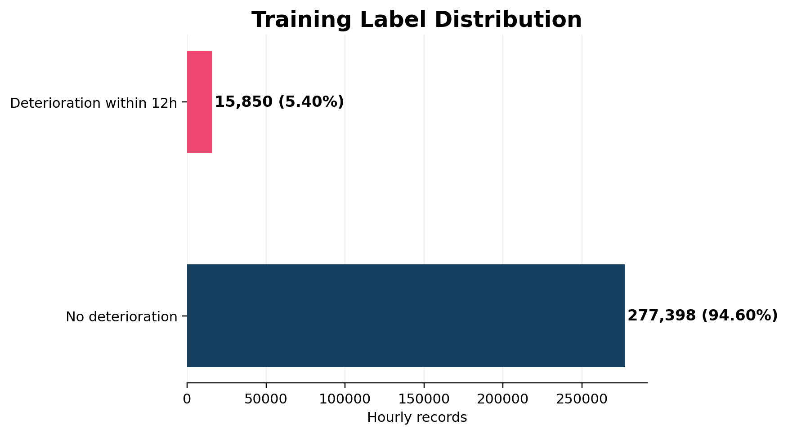
Dataset Overview
Describe the dataset provided and how you are using it
DATASET DIMENSIONS — Official provided CSV files only
Training CSV
Blind Validation CSV
Total Dataset Size
Reconstructed Episodes
Per-file Sizes
293,248 rows x 22 columns
62,487 rows x 21 columns
35,811,452 bytes (35.81 MB)
7,000 training admissions
train.csv: 29,630,460 bytes (29.63 MB)
val_no_labels.csv: 6,180,992 bytes (6.18 MB)
DATASET DETAILS
DATA DISTRIBUTION — Training label distribution
Dataset Name
Official AesCode patient deterioration time-series CSV dataset
Classes / Labels
Binary label: deterioration_next_12h = 0 or 1
Train / Val / Test
Provided: train.csv + blind val_no_labels.csv; internal model eval: 80% dev / 20% episode holdout
Input Format
CSV with hourly vitals, labs, oxygen support, demographics, and admission context
Class Balance
Imbalanced: 15,850 positive vs 277,398 negative rows
Positive rate = 5.40%
AesCode Nexus · Hackathon Round 1
Team: Aalam dhudh soda | ID: anc-052
Notes:
4

Slide 5
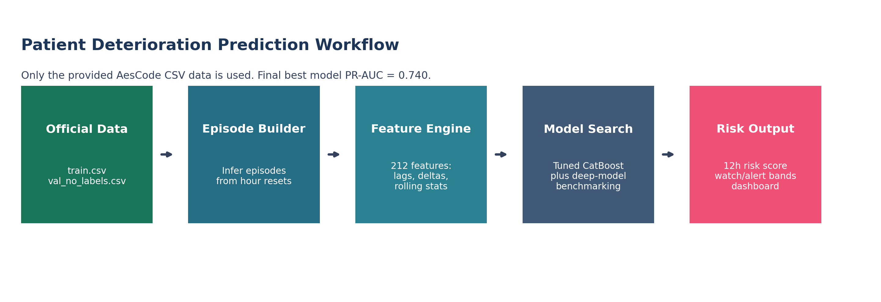
Model Architecture & Workflow
System design and component overview
ARCHITECTURE DIAGRAM
Input Layer
Feature Extractor
Classification Head
Output
Hourly vital signs, labs, demographics, oxygen support
Episode reconstruction + 212 engineered tabular/time-series features
CatBoostClassifier depth 8 with 1300 trees
Probability of deterioration in next 12h + watch/alert band
AesCode Nexus · Hackathon Round 1
Team: Aalam dhudh soda | ID: anc-052
Notes:
5

Slide 6
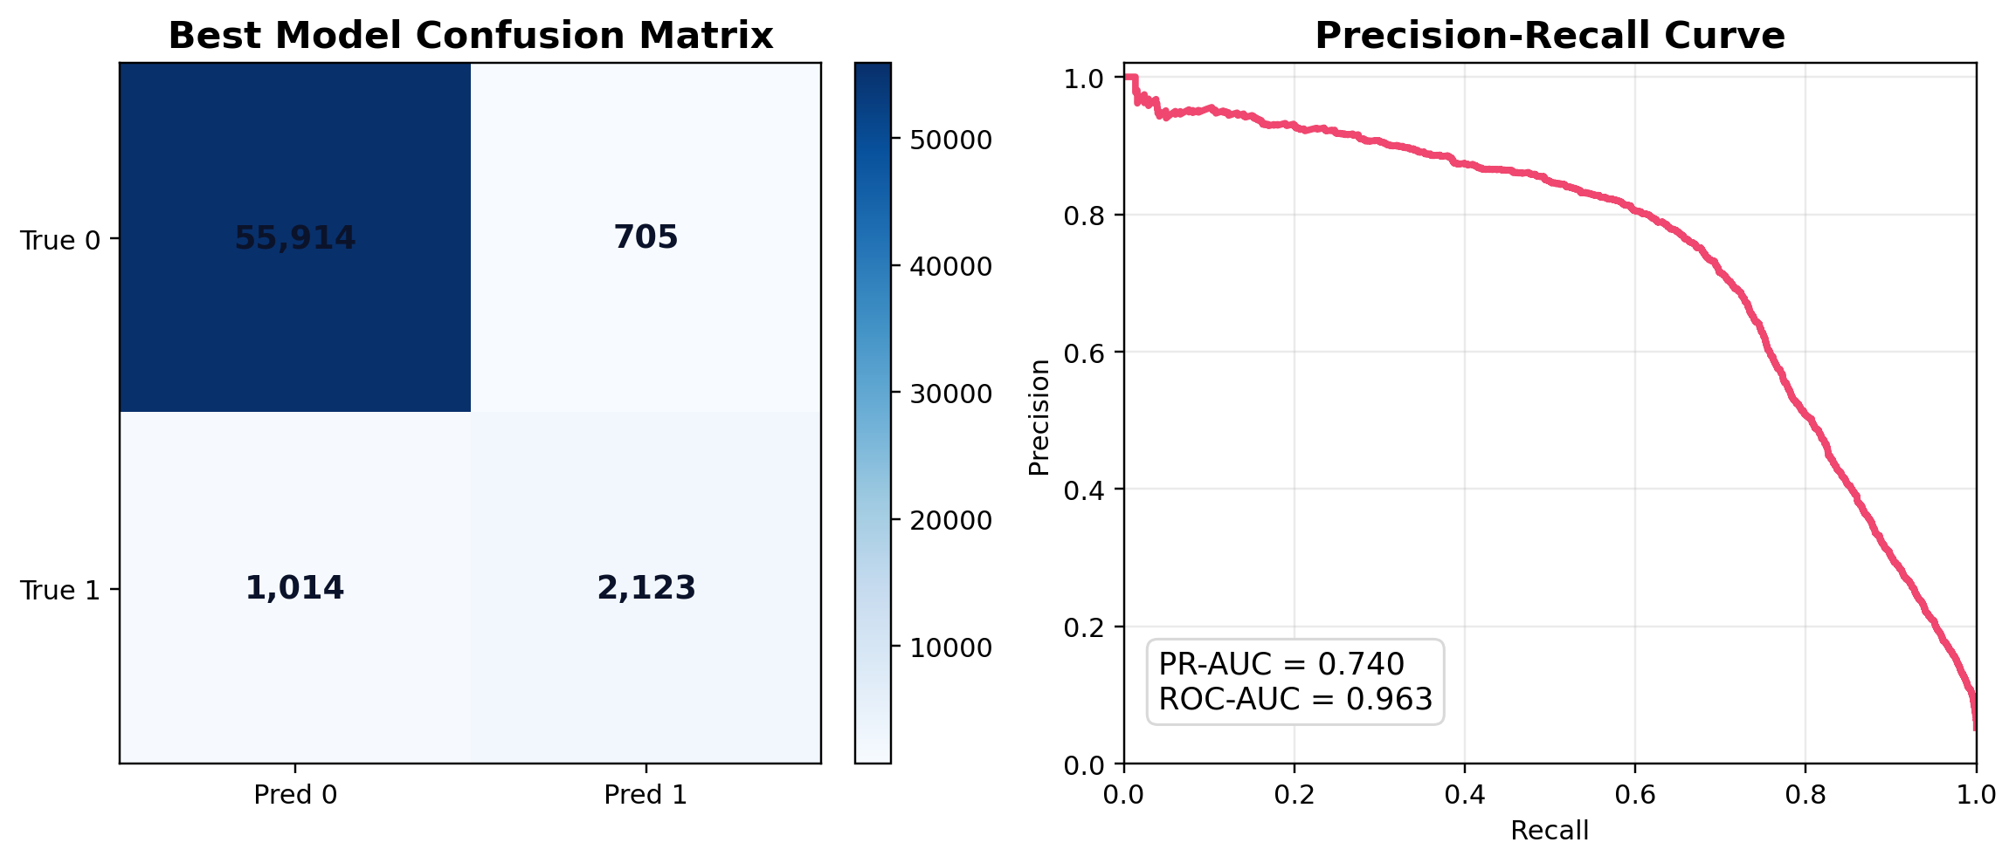
Experiments & Results
Preliminary findings and evaluation metrics
97.14%
75.77%
66.88%
0.710
0.962
Accuracy
Precision
Recall
F1-Score
AUC-ROC
EXPERIMENT LOG
CONFUSION MATRIX + PR CURVE
Experiment | Model | PR-AUC | ROC-AUC | Notes
Exp 1 | Baseline CatBoost | 0.711 | 0.965 | Repo baseline from train_model.py
Exp 2 | Saved Submission CatBoost | 0.734 | 0.962 | Kept repo artifact and strongest overall model
Exp 3 | Best Revalidated Single | 0.704 | 0.964 | GPU rerun winner: repo_catboost_subsample
Exp 4 | Best Revalidated Ensemble | 0.705 | 0.964 | Weighted CatBoost blend from the GPU rerun
AesCode Nexus · Hackathon Round 1
Team: Aalam dhudh soda | ID: anc-052
Notes:
6

Slide 7
Challenges Faced
Obstacles encountered and how you addressed them
📦 Data Quality
⚙️ Model Performance
💻 Compute Constraints
The dataset is highly imbalanced and lacks a native patient/admission ID.
We reconstructed episodes from hour resets and optimized PR-AUC instead of raw accuracy.
We compared CatBoost, TCN, GRU+Attention, and Transformer variants rather than overcommitting to one family.
The saved submission CatBoost reached PR-AUC 0.734, while the stricter GPU rerun topped out at 0.704 on an untouched outer holdout.
The repo keeps only essential artifacts under version control and regenerates bulky outputs locally.
The final revalidation in this environment used the NVIDIA GPU, which let us screen 19 CatBoost candidates quickly and reproducibly.
🔬 Domain Knowledge Gap
🔗 Integration
📏 Evaluation
We added interpretable clinical features such as shock index, pulse pressure, mean arterial pressure, and SpO2 deficit.
This improved both model signal quality and clinical interpretability.
Predictions, thresholds, and metadata are exported to artifacts so the Streamlit dashboard can reuse them directly.
This keeps training and interface layers synchronized.
The blind validation CSV has no labels, so true model comparison depends on an internal group-aware holdout.
We report PR-AUC, ROC-AUC, Brier score, and alert-threshold metrics.
AesCode Nexus · Hackathon Round 1
Team: Aalam dhudh soda | ID: anc-052
Notes:
7

Slide 8
Team Introduction
Who are we?
Team Name: Aalam dhudh soda
Team ID: anc-052 | Problem Statement: PS 2 - Patient Deterioration Prediction
1
Aryaman Singh
2
Pranav Sharma
Team Lead / ML Engineer
Data Scientist
Skills: Deep Learning, PyTorch
Skills: Data preprocessing, EDA
3
Abhay Rajpal
4
Abhishrut Kaushik
Backend / Interface Developer
Domain Expert / Researcher
Skills: Flask, FastAPI, Deployment
Skills: Medical knowledge, Literature review
AesCode Nexus · Hackathon Round 1
Team: Aalam dhudh soda | ID: anc-052
Notes:
8

Slide 9
Additional Information
Any further details about your solution, process, or findings
✅ REPRODUCIBILITY
🛠️ TOOLS & ENVIRONMENT
📋 ETHICAL & CLINICAL NOTES
Training is scripted in train_model.py, optimize_best_model.py, and revalidate_model_search.py.
Random state is fixed at 42, requirements are pinned in requirements.txt, and dataset paths point only to the provided CSV files.
Platform: local Python environment
Compute: GPU-based CatBoost revalidation on RTX 4060; saved deep-learning repo artifacts used for comparison
Stack: pandas, scikit-learn, CatBoost, PyTorch, Streamlit
External data/APIs: none
The target is imbalanced and episode IDs are inferred rather than provided.
A literal zero-overfit claim is not supported; best revalidated single model had train PR-AUC 0.825 vs calibration PR-AUC 0.745.
The dataset is tabular and de-identified, and no external patient data was added.
ANYTHING ELSE?
Submission note: only the official provided CSV dataset was used for training and evaluation.
Final kept model: catboost_gpu_subsample_train80 with PR-AUC 0.734, ROC-AUC 0.962, and alert F1 0.710.
AesCode Nexus · Hackathon Round 1
Team: Aalam dhudh soda | ID: anc-052
Notes:
9

