Slide 1
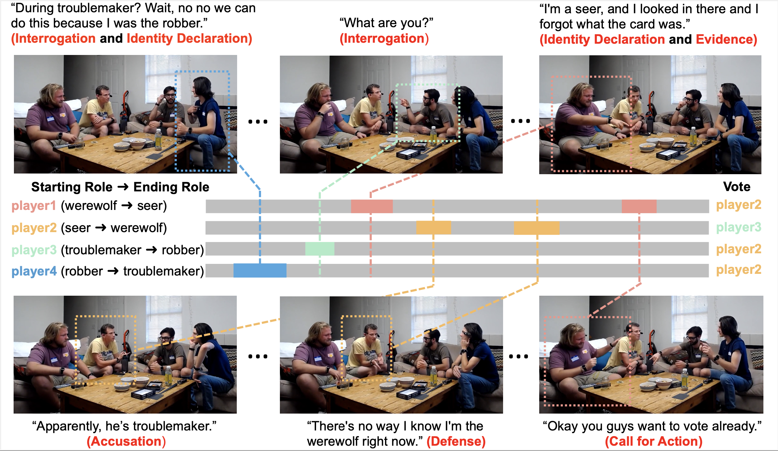
Persuasion Strategies in Multiplayer
Social Deduction Game

