Slide 1
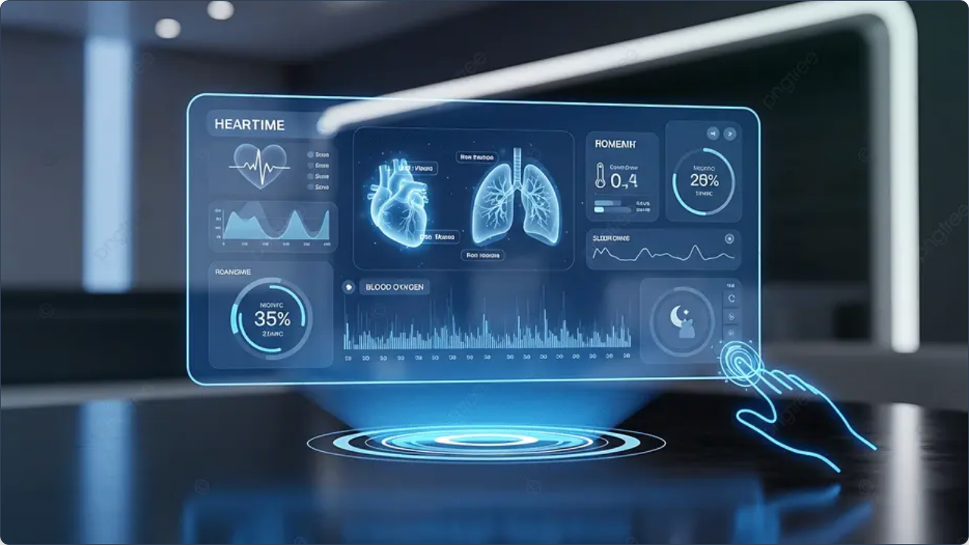

MONSOON SEMESTER 2026
Computing for Medicine
Lecture 2 · Big Picture: Health systems, Data, and AI
Notes:
[Sources]
- User-provided Computing for Medicine source deck.
- User-provided Foundations in Biomedical Informatics template deck.

Slide 2

Today's Menu
Data | What are the kinds of Data in Healthcare?
Big Picture | What Will it Take to Go From “Computing for Medicine” to “Knowing Medicine”?
Notes:
[Sources]
- User-provided Computing for Medicine source deck.
- User-provided Foundations in Biomedical Informatics template deck.

Slide 3
Computing for Medicine Starts with Data
Open discussion
5 Minutes
What are the Types of Health Data?
Notes:
[Sources]
- User-provided Computing for Medicine source deck.
- User-provided Foundations in Biomedical Informatics template deck.

Slide 4
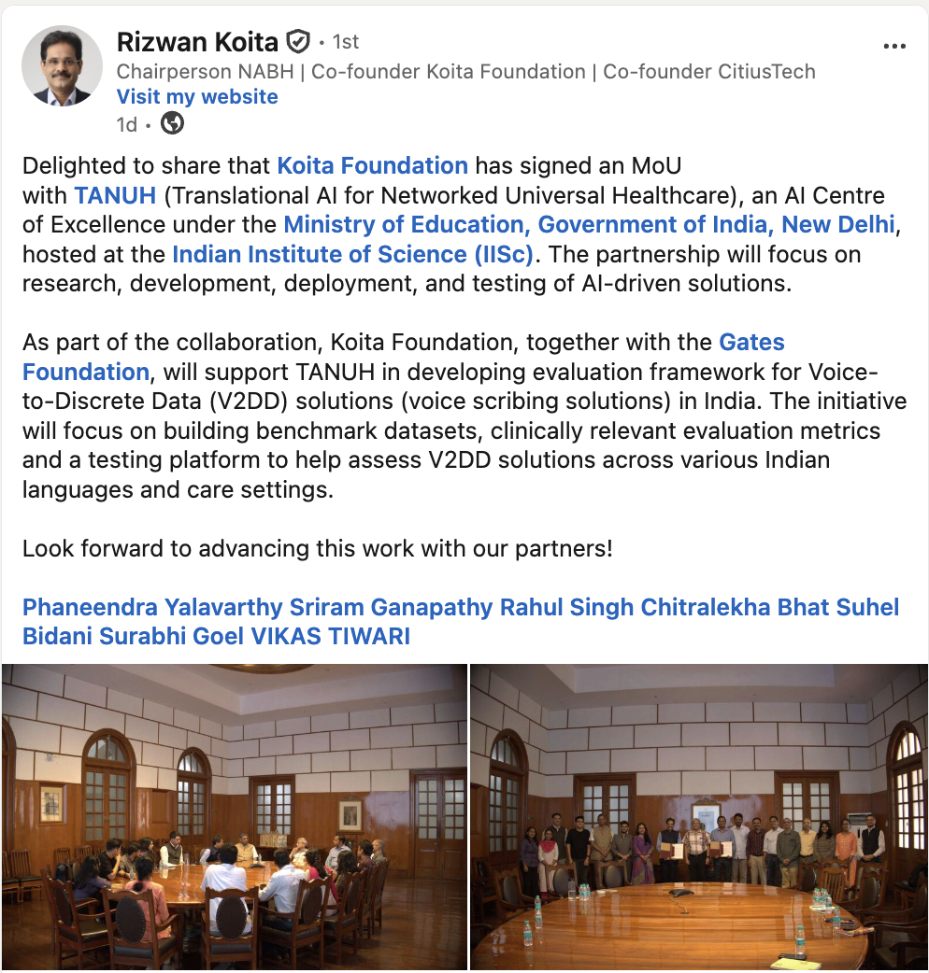
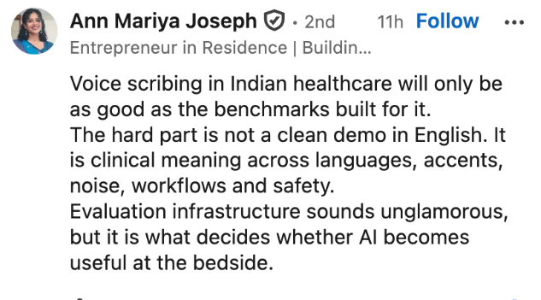

Slide 5
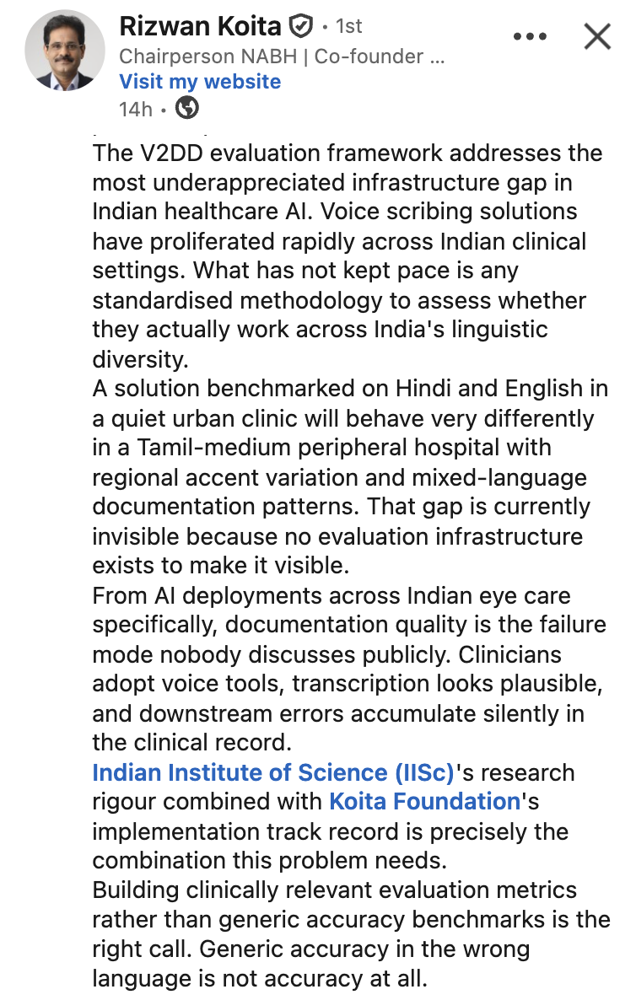

Slide 6
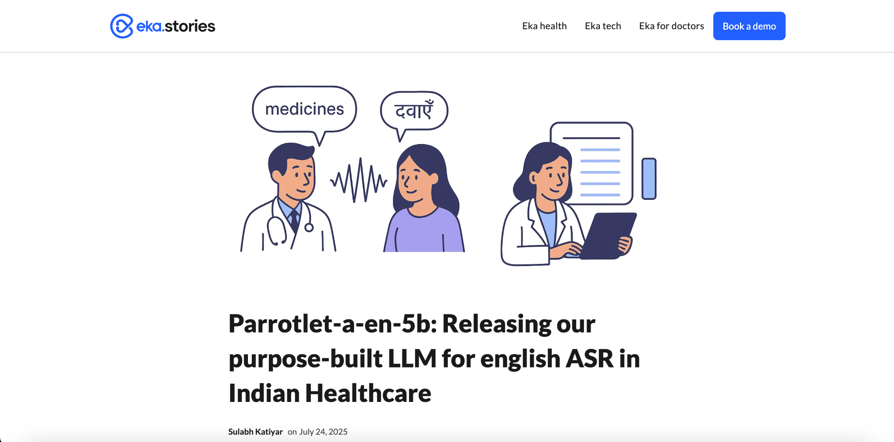

Slide 7
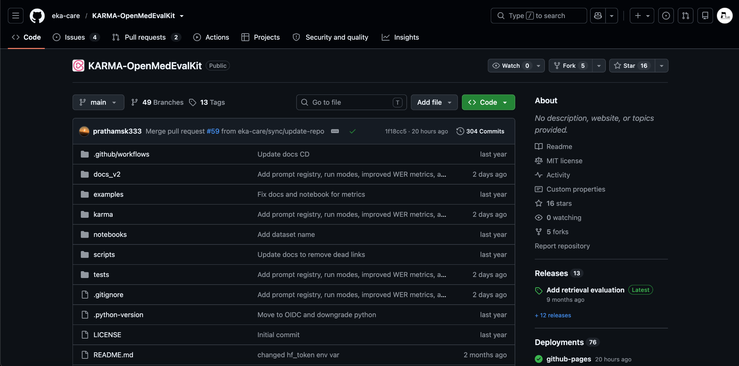

Slide 8
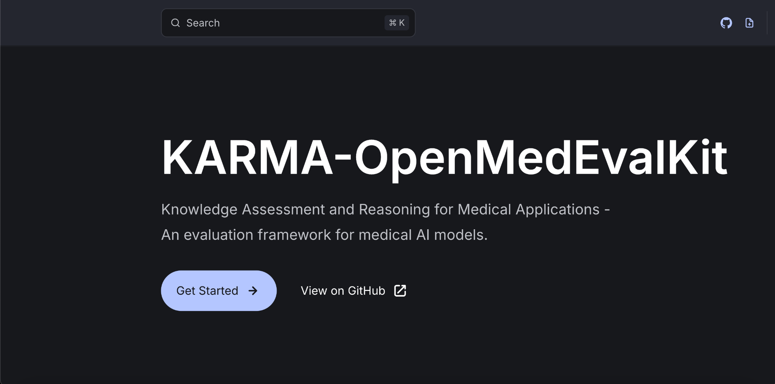

Slide 9
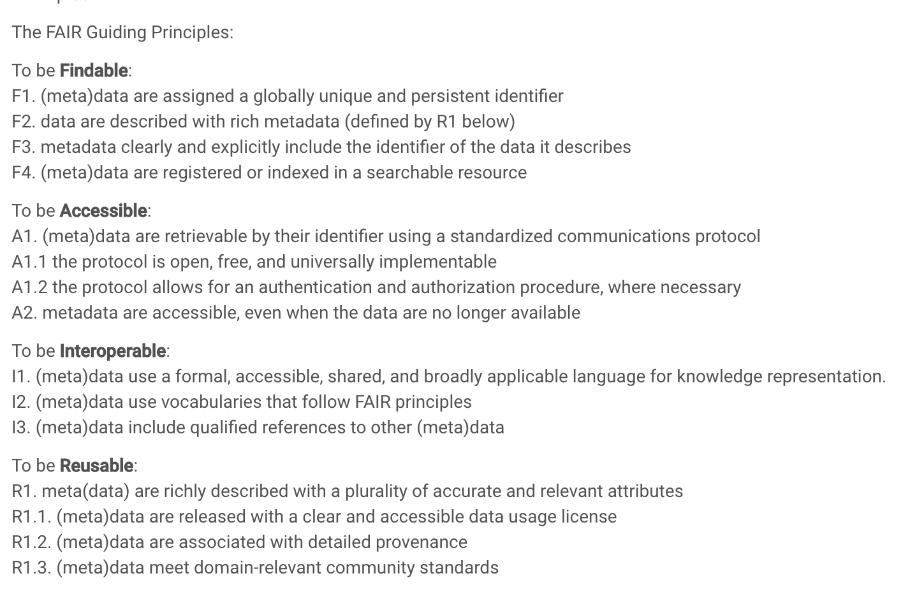
Making Healthcare Data Science Reproducible and FAIR

Slide 10
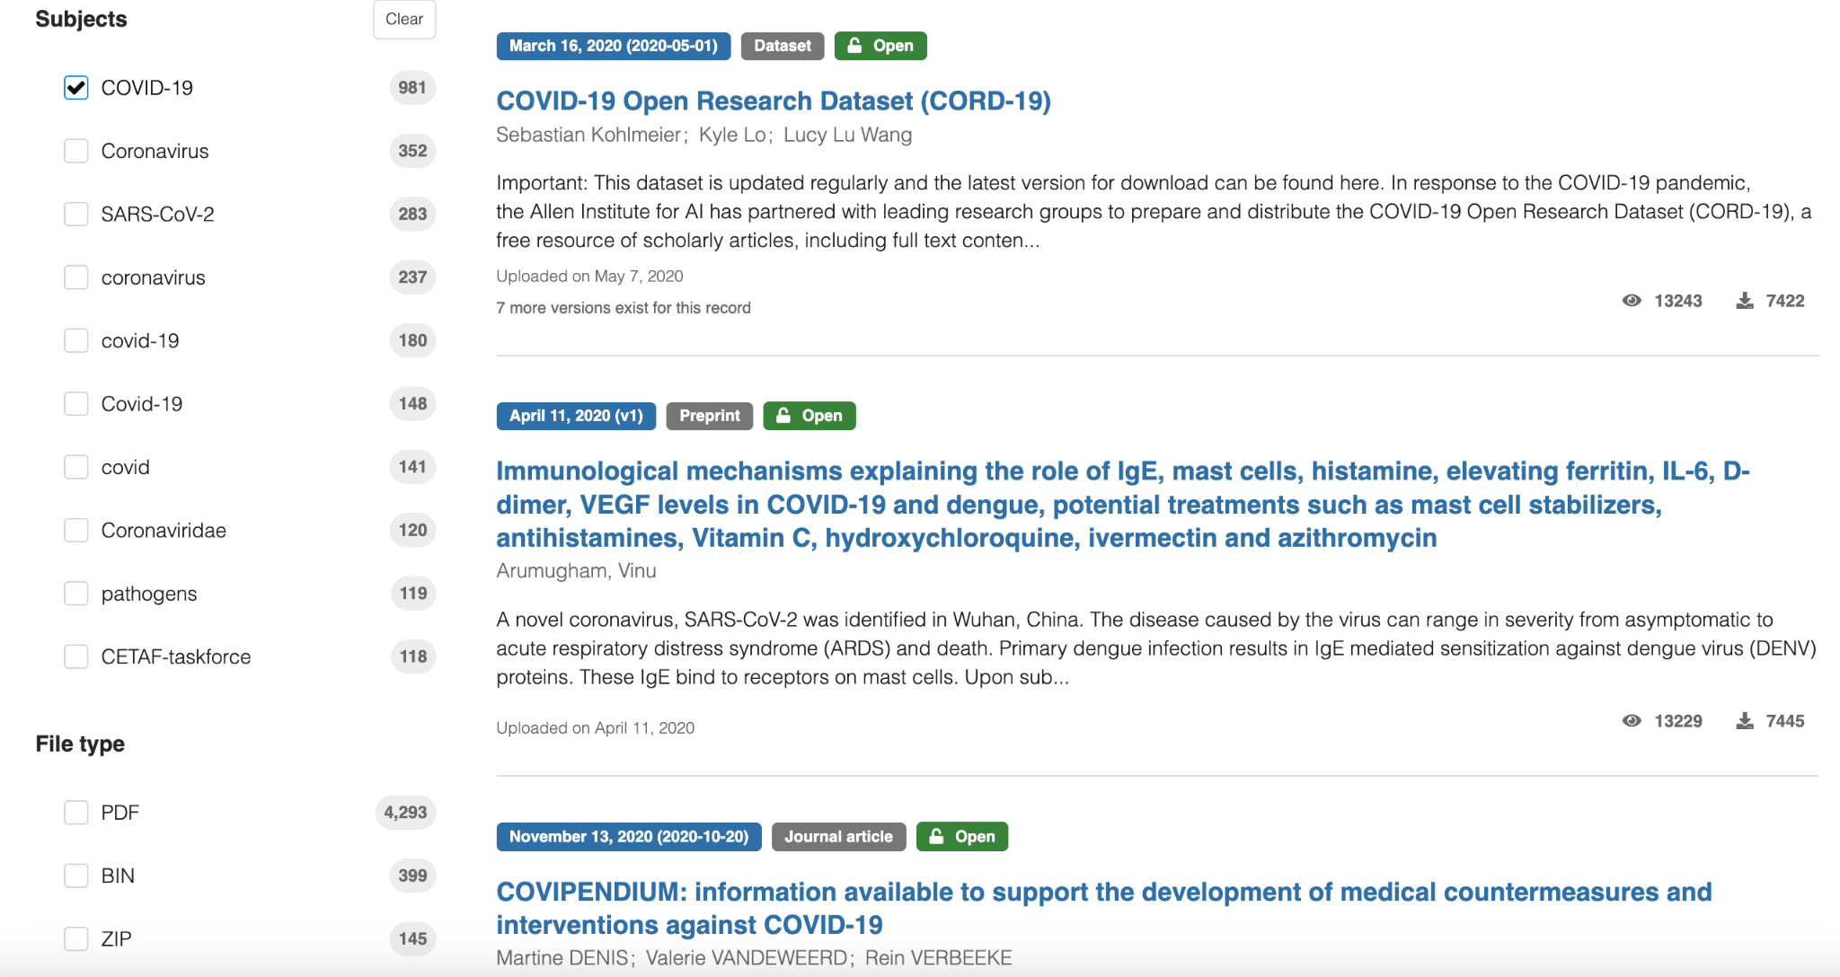
https://zenodo.org/search?q=coronavirus&f=subject%3ACOVID-19&l=list&p=1&s=10&sort=mostviewed

Slide 11
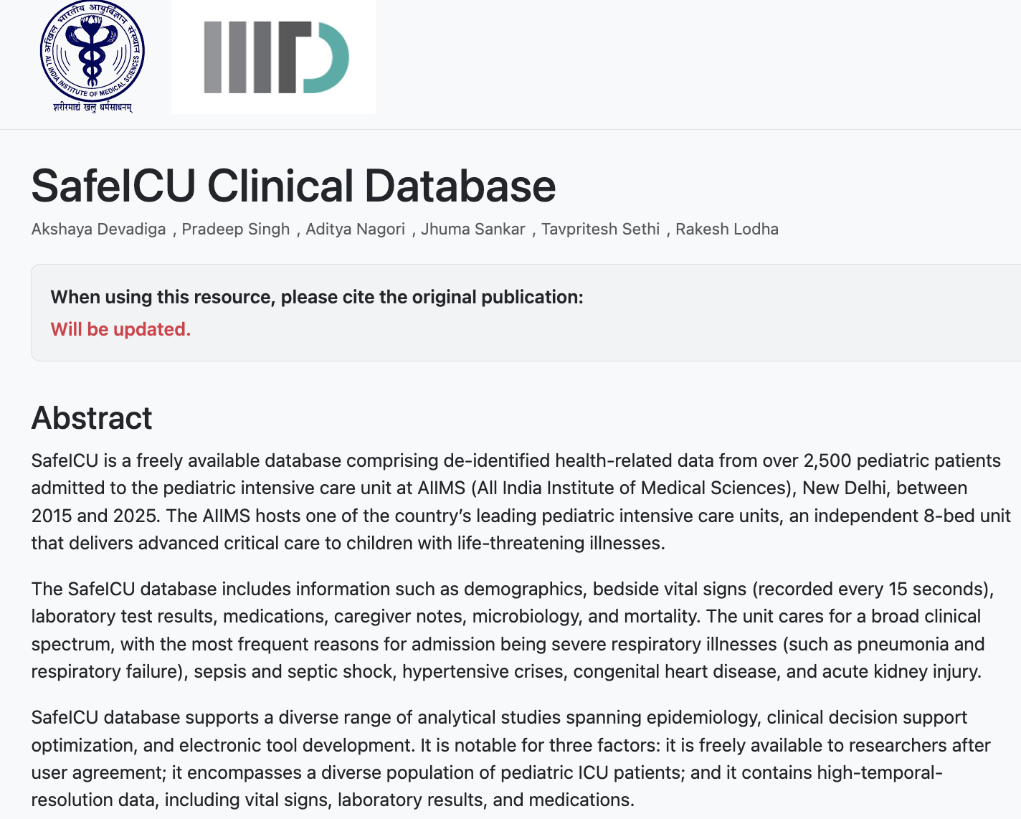
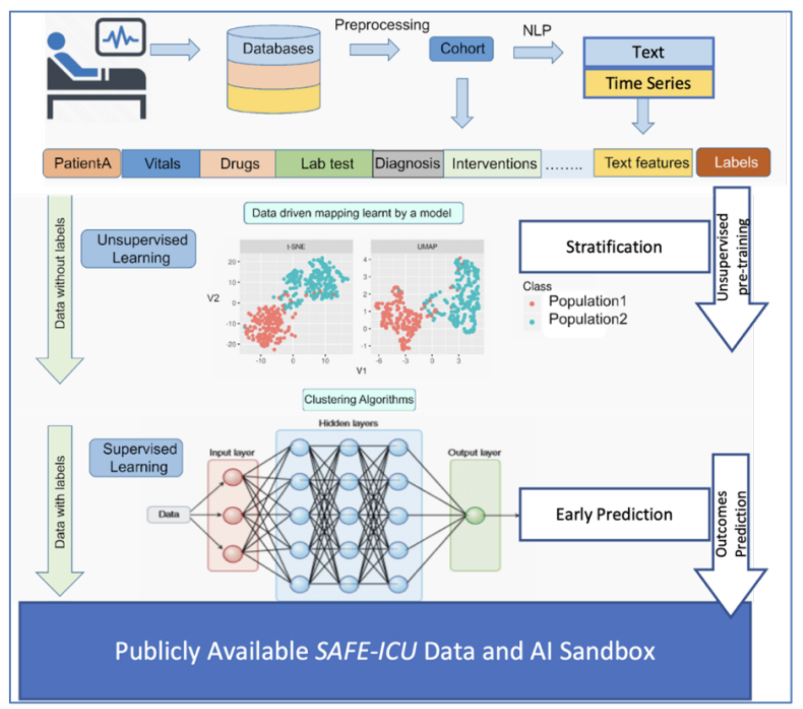
SAFE-ICU a TavLab-AIIMS Initiative
https://safeicu.aiims.edu.in/project/safeicu/

Slide 12
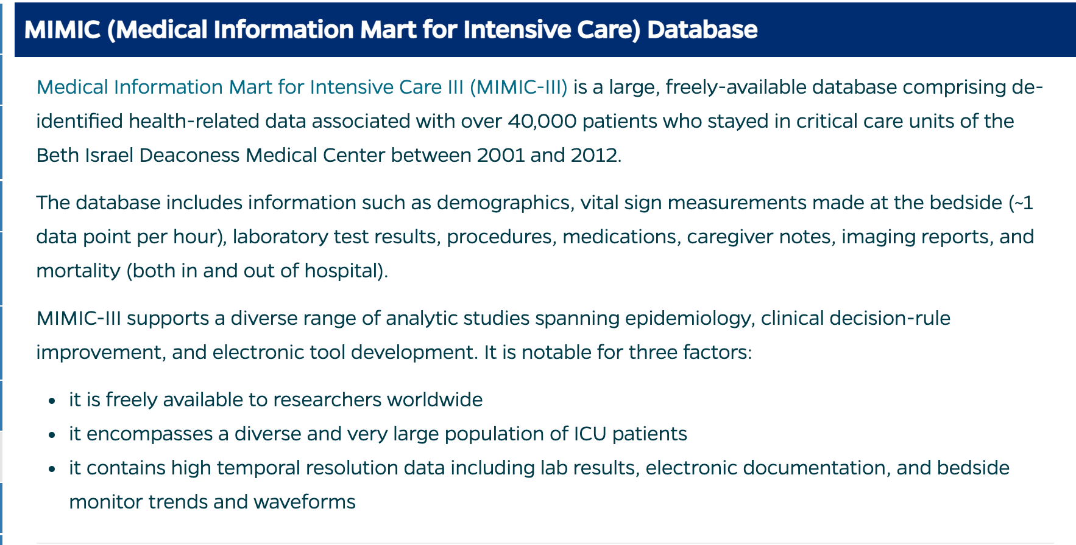
https://browse.welch.jhmi.edu/datasets/ehr-databases

Slide 13
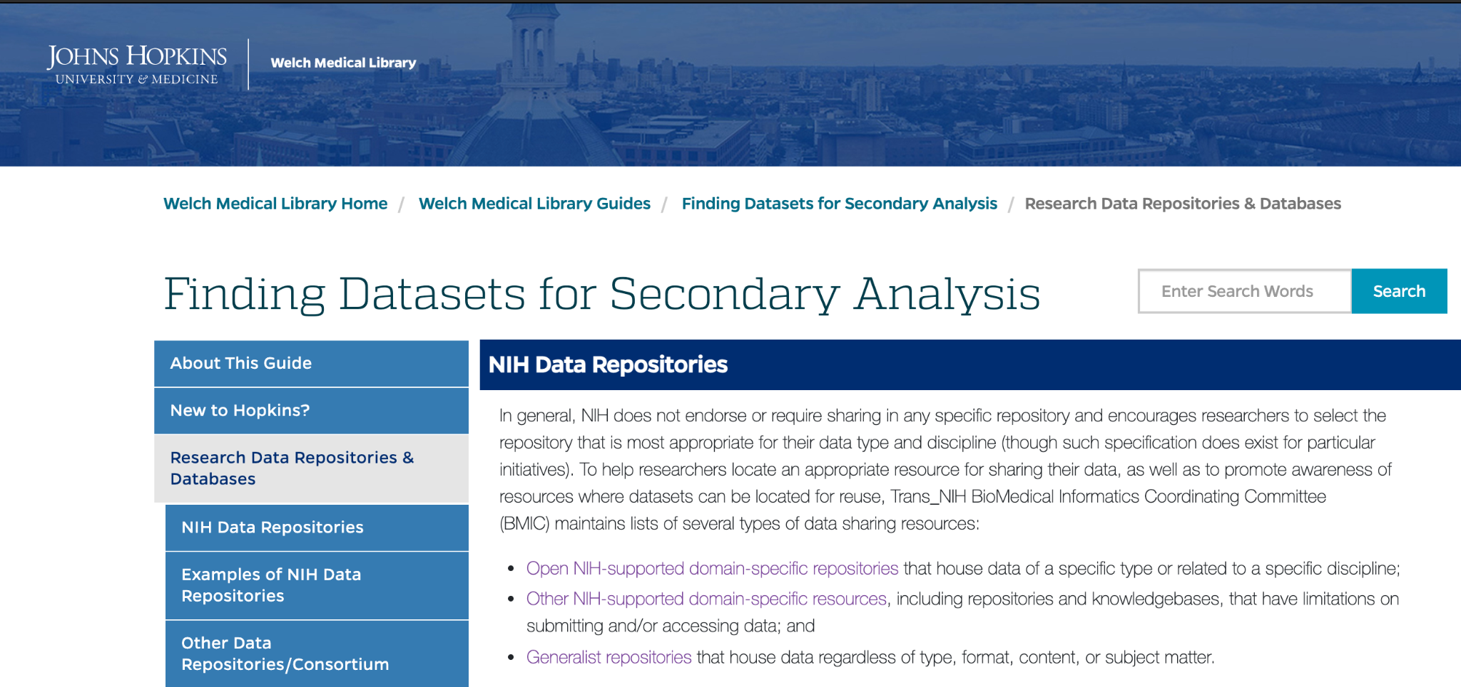
https://browse.welch.jhmi.edu/datasets/nih-data-repositories

Slide 14
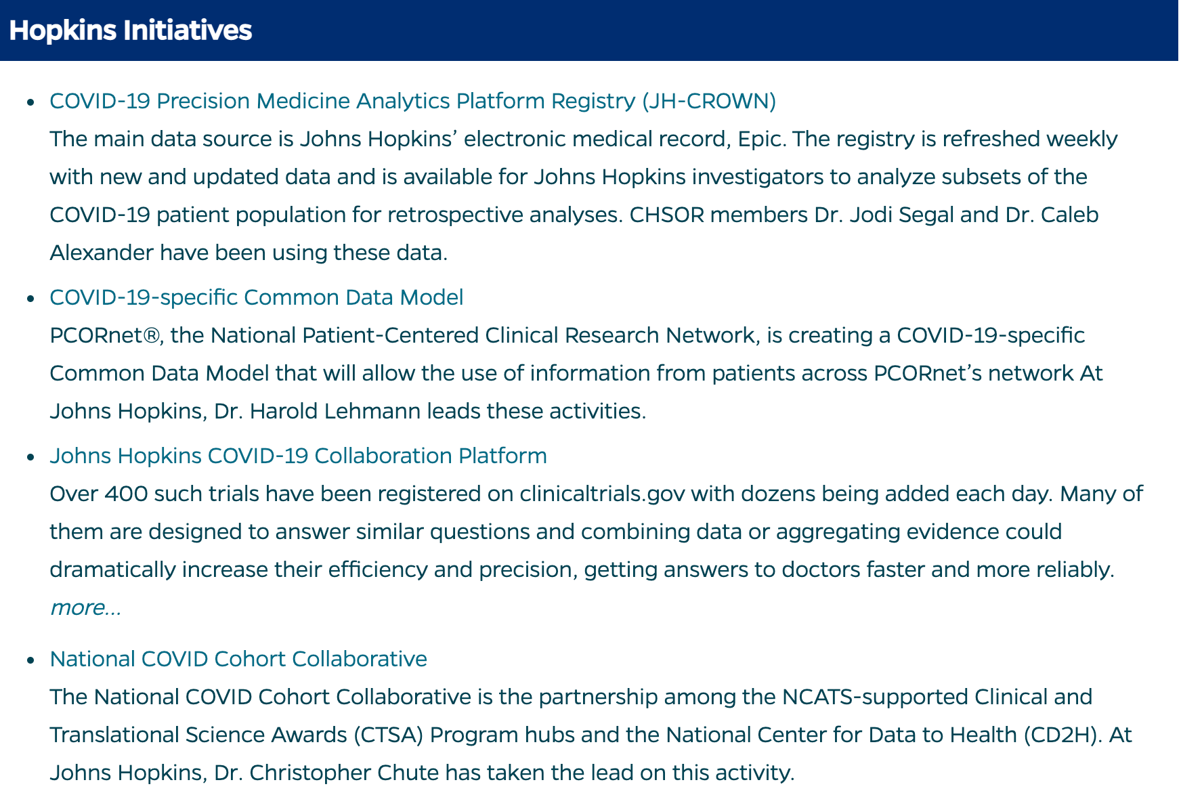

Slide 15
The Healthcare Data Revolution -> Transformation
4CE: Consortium for Clinical Characterization of COVID-19 by EHR
Figshare: COVID-19 open data
GitHub: COVID-19 Open Repo Data
Harvard Dataverse: COVID-19 Data
ICPSR: COVID-19 Data Repoasitory
ImmPort: COVID 19
Mendeley Data: Elsevier COVID-19 Research Environment
National COVID Cohort Collaborative (N3C) OHDSI: Characterizing Health Associated Risks, and Your Baseline Disease In SARS-COV-2 (CHARYBDIS)
Open-Access Data and Computational Resources to Address COVID-19.
OpenSAFELY Tableau: COVID-19 Data Hub
Vivli: Covid data Zenodo: Coronavirus Disease Research Community - COVID-19
COVID-19 Research Database

Slide 16

Sources of Health Data

Slide 17
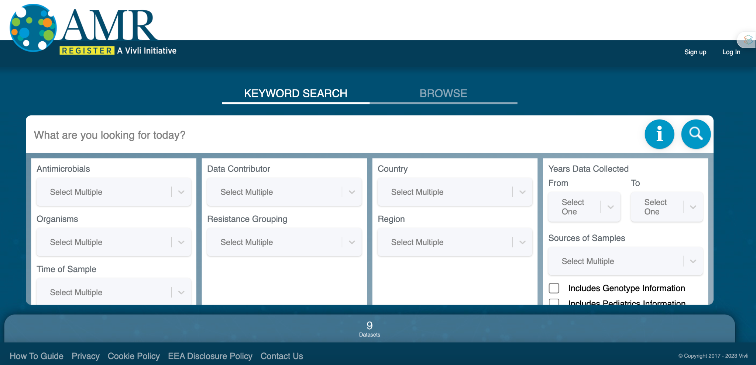
Sources of Health Data

Slide 18
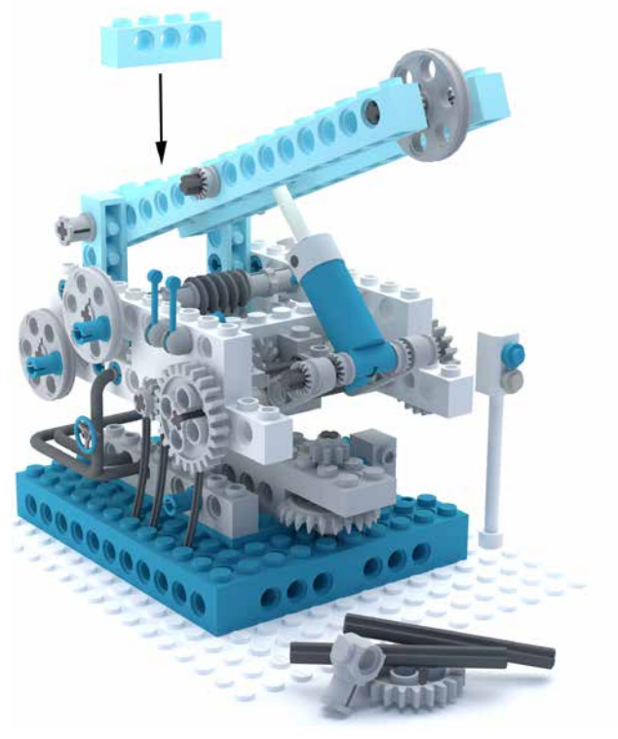
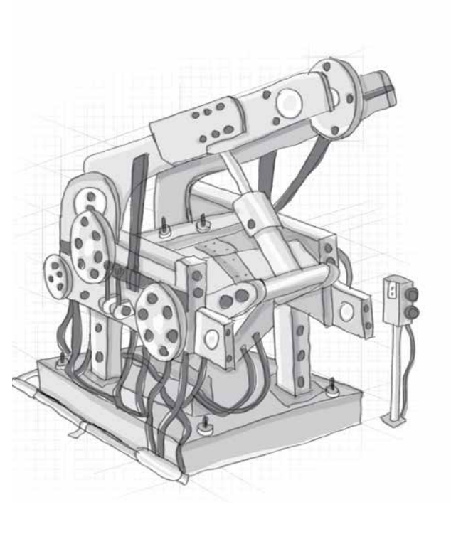
“Biology is the study of the complex things in the Universe. Physics is the study of the simple ones.”
Richard Dawkins
How is Healthcare Different?

Slide 19
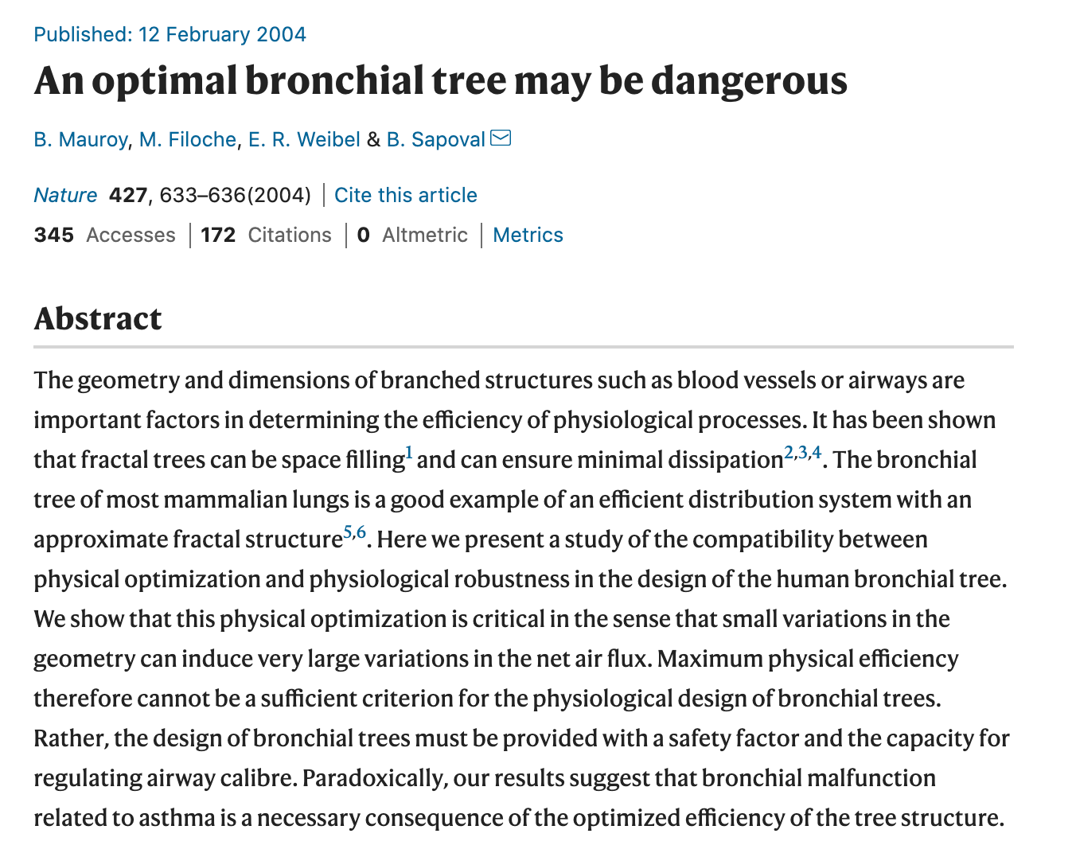
Complexity of Health Systems
Health Systems are:-
Are not always optimized
Exhibit Self Organizing behavior
Are dynamically changing
Are homeokinetic
Operate far from equilibrium
Unpredictably sensitive

Slide 20

Notes:
[Sources]
- User-provided Computing for Medicine source deck.
- User-provided Foundations in Biomedical Informatics template deck.

Slide 21

Notes:
[Sources]
- User-provided Computing for Medicine source deck.
- User-provided Foundations in Biomedical Informatics template deck.

Slide 22
Notes:
[Sources]
- User-provided Computing for Medicine source deck.
- User-provided Foundations in Biomedical Informatics template deck.

Slide 23
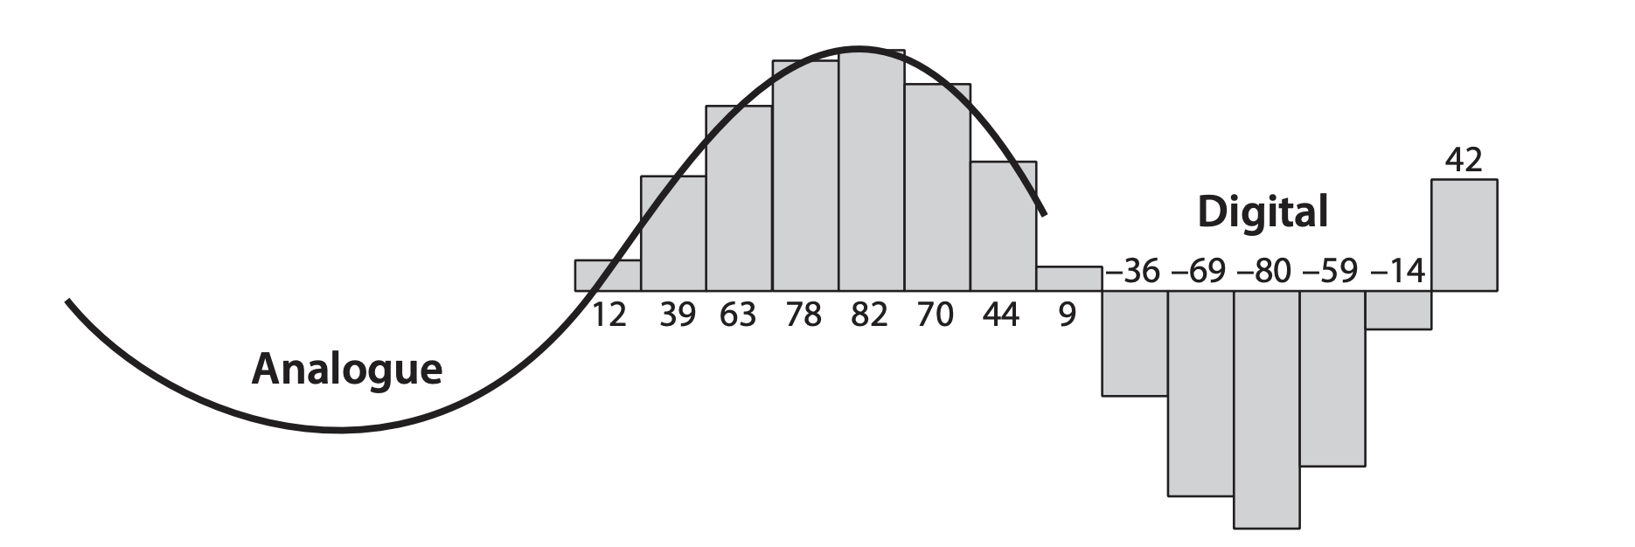
Is Computation Ready for Capturing Human Health?

Slide 24
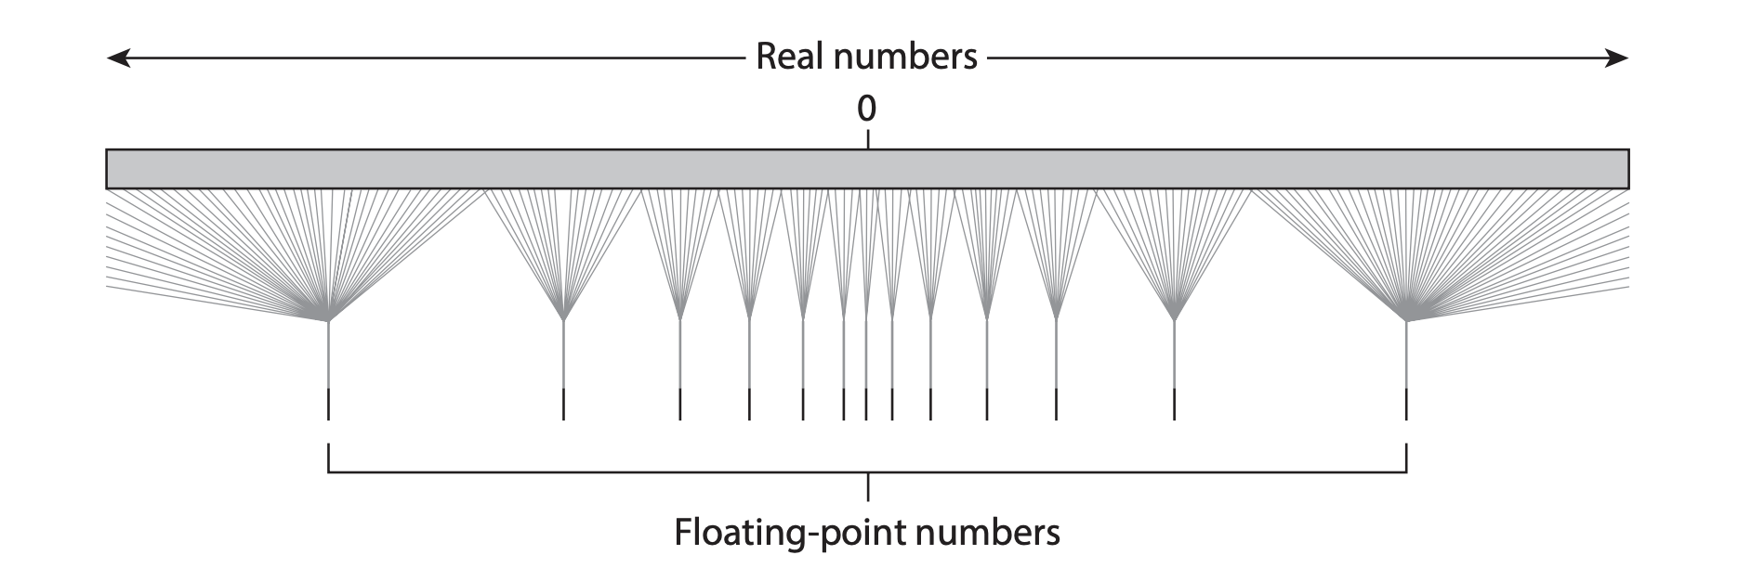
Is Computation Ready for Capturing Human Health?

Slide 25
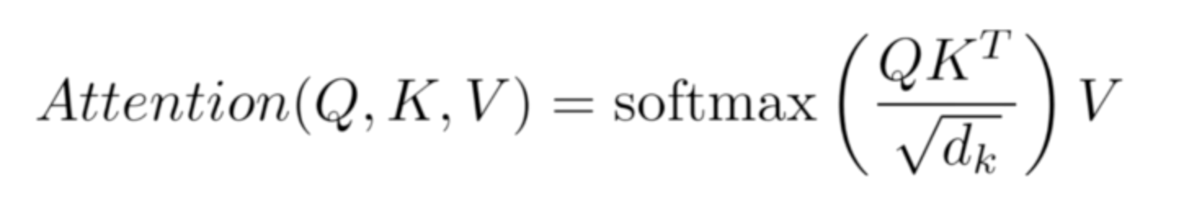
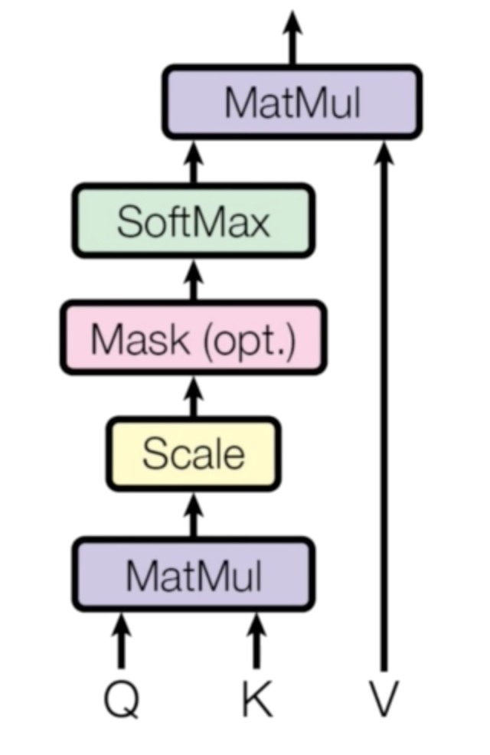
Scaled Dot Product (Similarity with Context)
What is at the Heart of Computing for Medicine Today?
Notes:
[Sources]
- User-provided Computing for Medicine source deck.
- User-provided Foundations in Biomedical Informatics template deck.

Slide 26
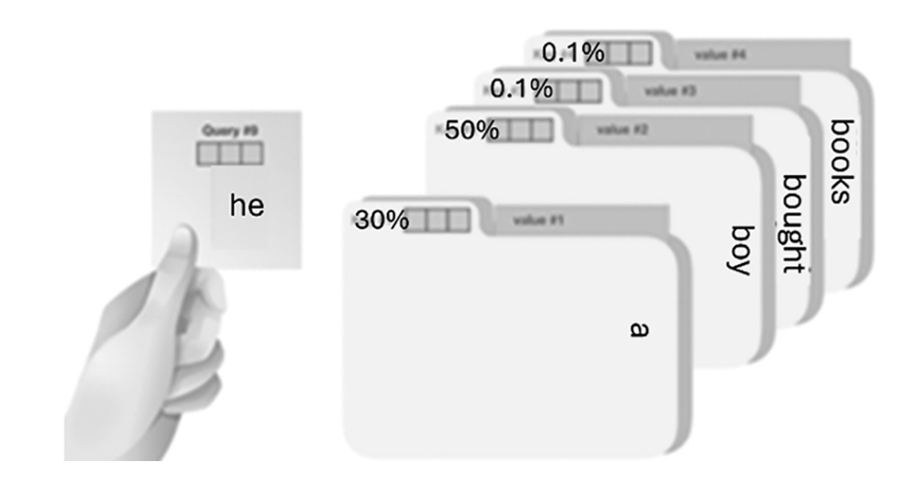
Library Analogy: Query, Key, Value

Slide 27
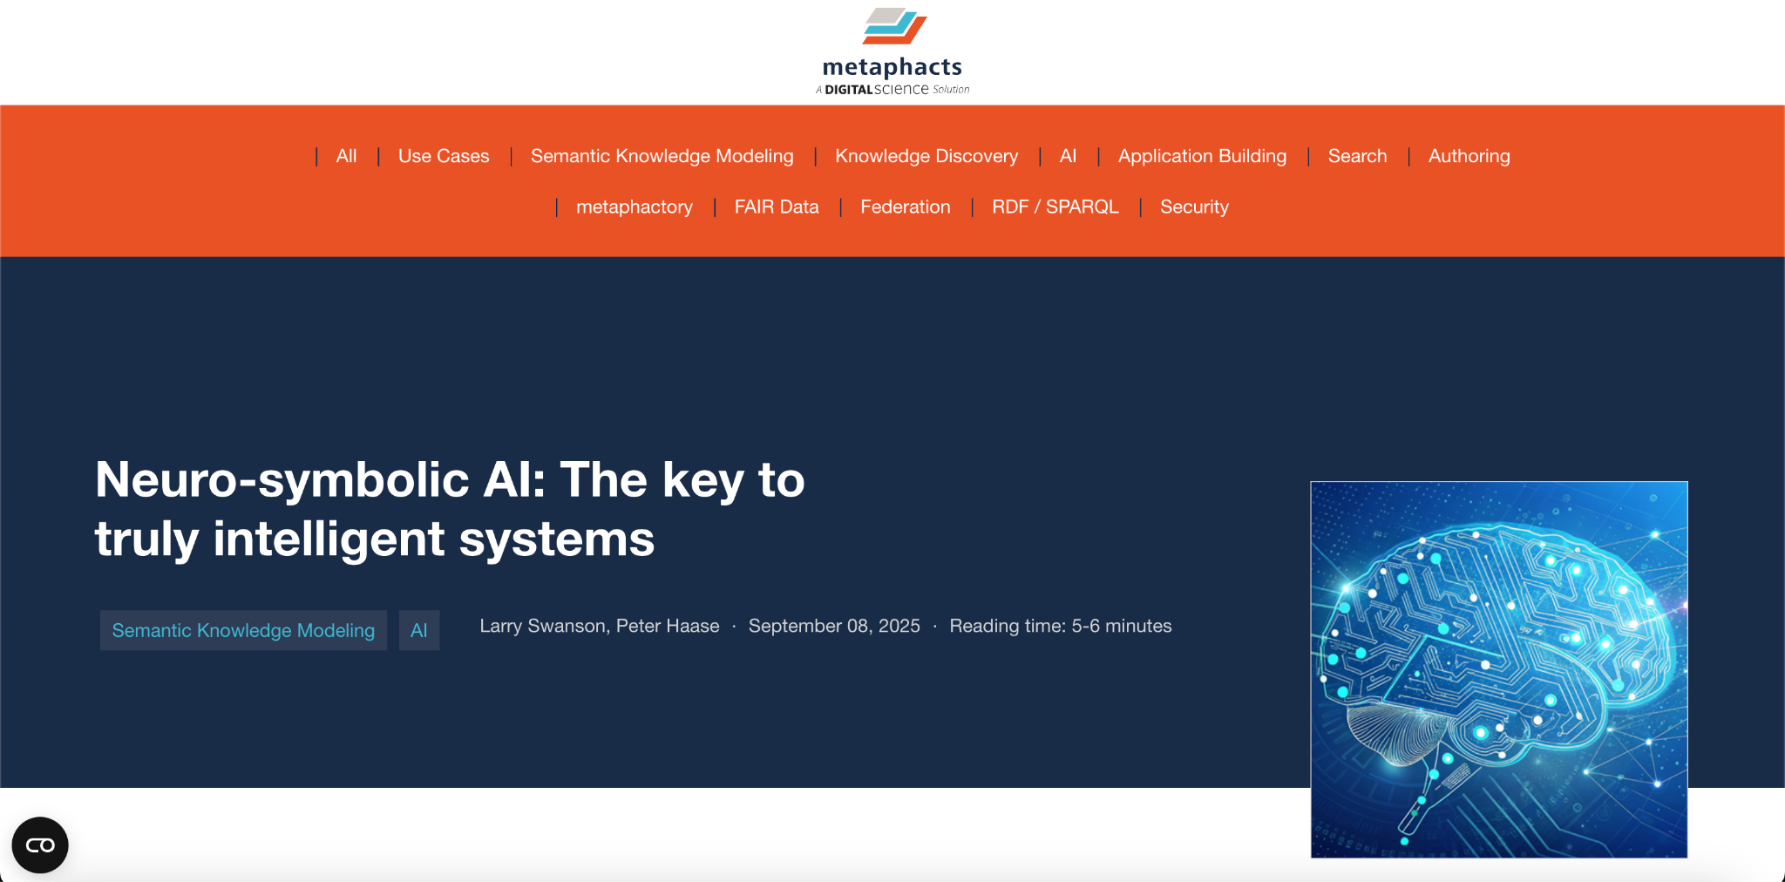
https://blog.metaphacts.com/neuro-symbolic-ai-the-key-to-truly-intelligent-systems
Notes:
[Sources]
- User-provided Computing for Medicine source deck.
- User-provided Foundations in Biomedical Informatics template deck.

Slide 28
Thank you
Notes:
[Sources]
- User-provided Computing for Medicine source deck.
- User-provided Foundations in Biomedical Informatics template deck.

