Slide 1
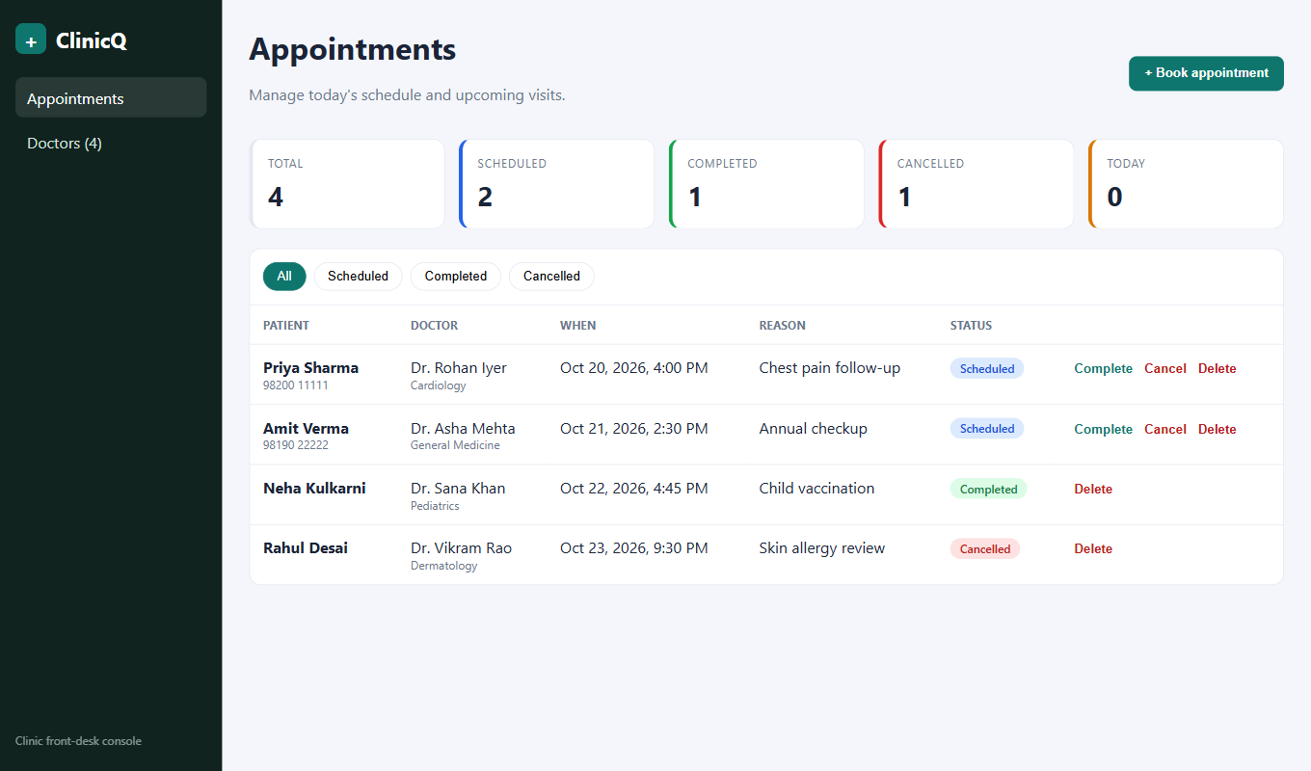
ClinicQ
Clinic appointment booking, taken from a laptop to a monitored Kubernetes cluster on AWS
DevOps Final Capstone
Aryan Bhendarkar
github.com/Aryan-Bhendarkar/ClinicQ
Notes:
Introduce ClinicQ: a clinic front-desk booking console. The app is deliberately small; the point is the path from a git commit to a monitored Kubernetes cluster on AWS. Everything on the next slides is real and in the repository.

Slide 2
What I built
The problem: front desks double-book doctors when schedules live on paper or in chat.
The app: a booking console with stats, filters, status updates, and a 409 conflict guard per doctor and slot.
The stack: React + Vite, FastAPI, PostgreSQL, SQLAlchemy and Alembic.
The platform: Docker, GitHub Actions, Trivy, GHCR, Terraform, EKS, Helm, ArgoCD, Prometheus and Grafana.
12
15
REST endpoints
automated tests
2
20+
Alembic migrations
descriptive commits
Notes:
One slide of context. Twelve endpoints, fifteen tests, two migrations, twenty commits. The rest of the deck follows the course modules in order.

Slide 3
Architecture
Developer
GitHub
GitHub Actions
GHCR
ArgoCD
git push
main branch
test, build, scan, tag
SHA-tagged images
syncs from Git
AWS ap-south-1 · EKS cluster in a VPC (2 public + 2 private subnets, NAT)
provisioned by Terraform
scrapes /metrics
Backend x2 to 6
Prometheus
Grafana
Ingress nginx
Frontend x2
PostgreSQL + EBS
Notes:
Top row is delivery: a push to main runs Actions, which pushes SHA-tagged images to GHCR and commits the new tag to Git; ArgoCD watches the repo and syncs the cluster. Terraform builds the network and cluster underneath. Inside the cluster the Ingress routes slash-api to the backend and everything else to the frontend; the backend talks to PostgreSQL on an EBS volume; Prometheus scrapes the backend and Grafana reads from Prometheus.

Slide 4
The application
M1 · App · 10 pts
React + Vite UI: KPI cards, status filters, booking modal, responsive layout.
FastAPI: 12 endpoints; Swagger at /docs; /health, /ready, /metrics.
Alembic: schema migration plus a seed migration for doctors.
Conflict guard: double-booking a doctor's slot returns 409.
Docker Compose stack at localhost:3000
Notes:
Show the running app. Booking the same doctor and slot twice returns 409, so a doctor cannot be double-booked. The backend has liveness, readiness and metrics endpoints, which the later Kubernetes and monitoring slides depend on.

Slide 5
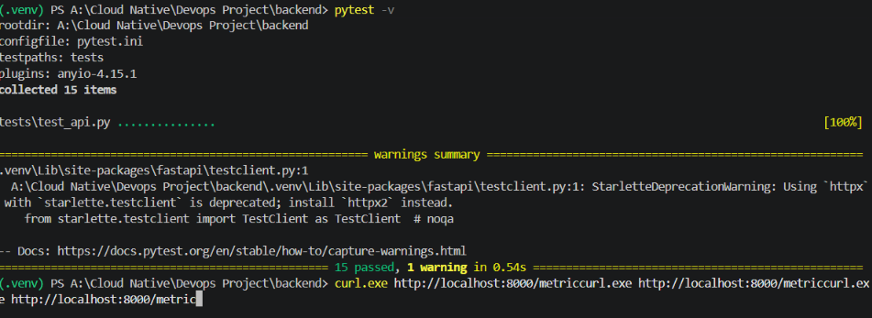
Automated tests
M2 · Testing · 10 pts
15 tests covering health, readiness, metrics, doctors and every appointment endpoint.
Isolated: in-memory SQLite through a FastAPI dependency override, never the real database.
Configured: pytest.ini and conftest.py.
pytest -v: 15 passed
First quality gate: failing tests stop the pipeline, so no broken image is ever built or pushed.
Notes:
Fifteen tests, all on an in-memory database through a dependency override. They run before any Docker image is built, so a failing test stops the pipeline.

Slide 6
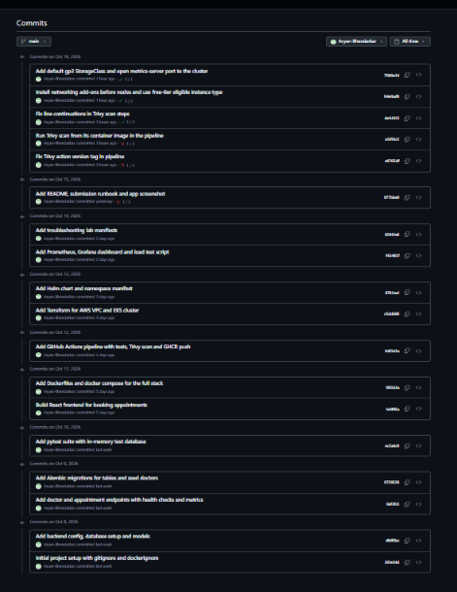
Git and GitHub
M3 · Git · 5 pts
20+
0
commits, Oct 8 to Oct 16
secrets in the history
Messages: short and descriptive, one per feature or fix.
.gitignore covers .env, __pycache__, node_modules, .venv, Terraform state and plans.
Public repo: github.com/Aryan-Bhendarkar/ClinicQ
Notes:
Commit history is incremental: backend, migrations, tests, frontend, Docker, CI, Terraform, Helm, monitoring, docs, then the deployment fixes. No credentials are committed; the gitignore covers env files, caches, virtual environments and Terraform state.

Slide 7
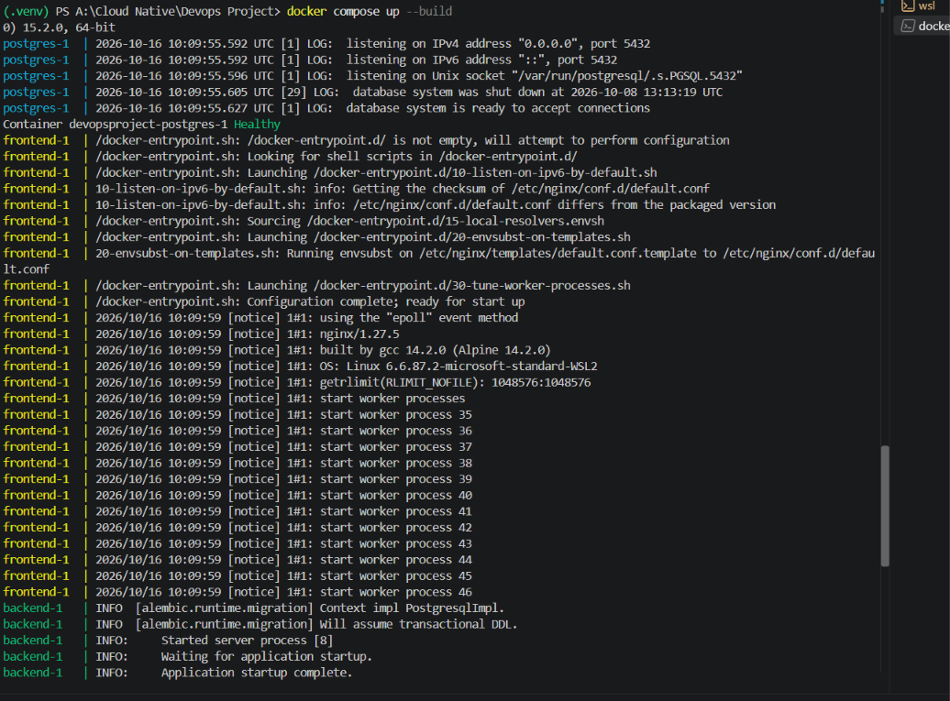
Docker and Compose
M4 · Docker · 10 pts
Multi-stage frontend: Node builds, unprivileged Nginx serves.
Non-root: backend runs as uid 10001, frontend as uid 101.
One command: postgres, backend and frontend; the backend waits for a healthy database.
Health checks on Postgres and the backend.
10001
101
backend uid
frontend uid
docker compose up --build
Notes:
The frontend Dockerfile is multi-stage so build tooling stays out of the runtime image. Both containers run as non-root users. Compose starts all three services with one command, and the backend waits for a healthy database.

Slide 8
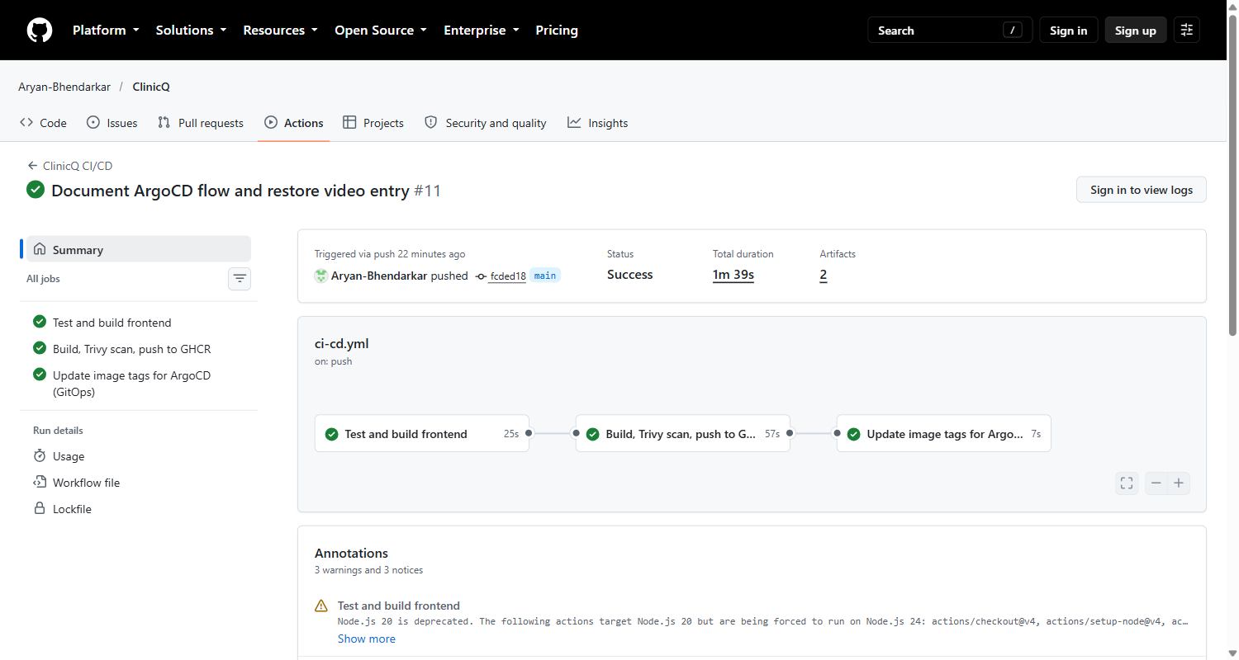
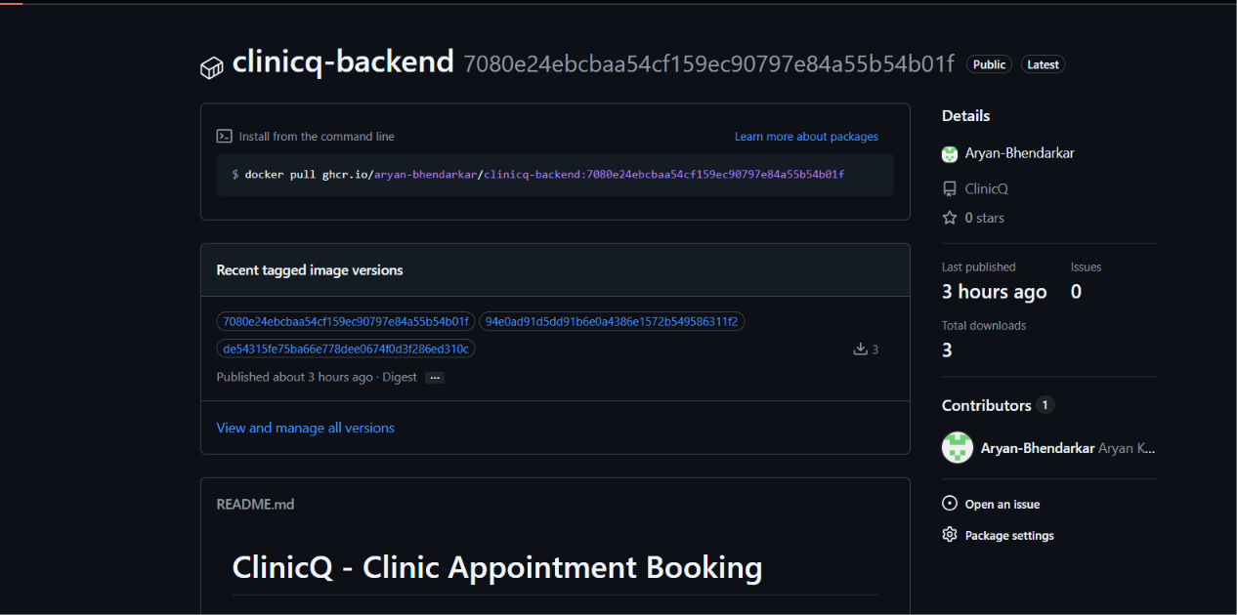
CI/CD pipeline
M5 · CI/CD · 15 pts
pytest
Frontend build
Docker build x2
Trivy scan x2
Push to GHCR
Commit tag to Git
GHCR images tagged with the commit SHA
Green run: all three jobs
Runs on every push to main. Nothing is pushed unless tests and both scans pass; tags are commit SHAs, and the last step commits the new tag to Git for ArgoCD.
Notes:
The pipeline runs on every push to main. Tests gate the build, both images are scanned before they are pushed, and each image is tagged with the commit SHA so a running pod traces back to a commit. The last job commits the new tag to the Helm values file in Git, and ArgoCD deploys from there, so the pipeline needs no cluster credentials.

Slide 9
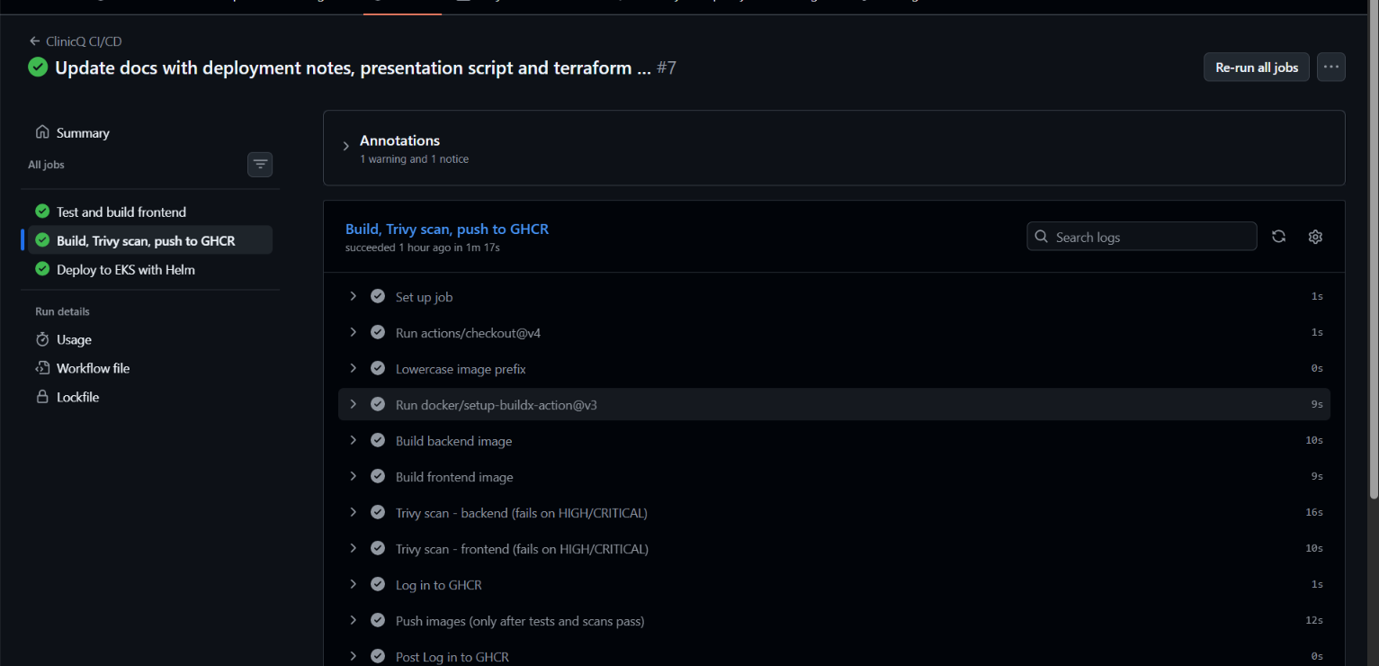
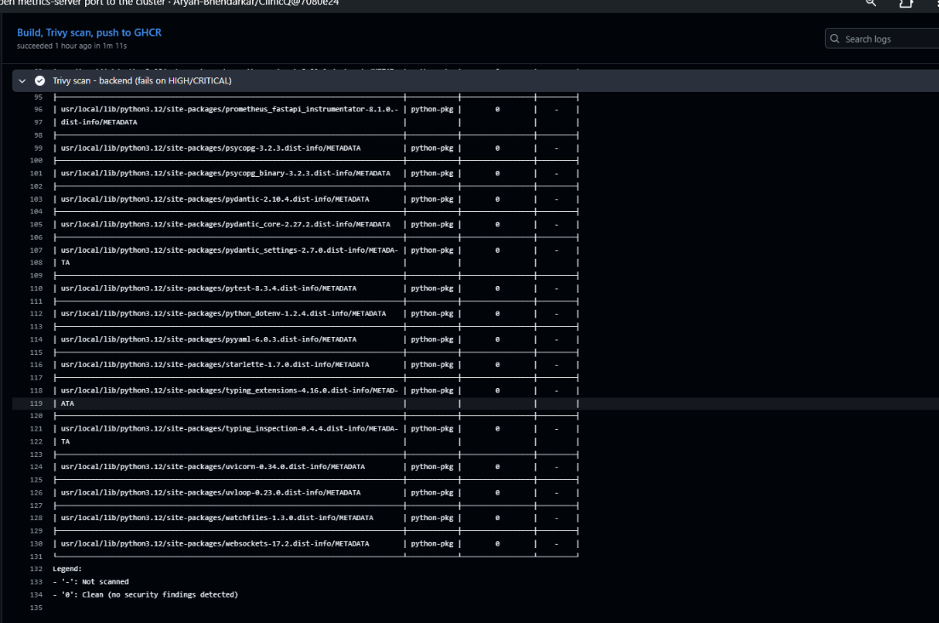
Security scanning with Trivy
M6 · Security · 5 pts
3 → 0
2 / 2
HIGH CVEs, before and after
images scanned in CI
Found: 3 HIGH CVEs in Starlette (via an old FastAPI pin); zlib and nghttp2 in the Alpine image.
Fixed: upgraded FastAPI, Starlette and the instrumentator; apk upgrade in the runtime image.
Gate: --exit-code 1 fails the build on any HIGH or CRITICAL finding.
Both scans run before the push step
Backend: zero findings
Notes:
My first local scan found three high severity issues in Starlette and two in Alpine libraries. I upgraded the dependencies and ran an Alpine upgrade in the runtime image; the rescan is clean. The pipeline scans both images and fails the build on any high or critical finding with a fix available, before anything is pushed.

Slide 10
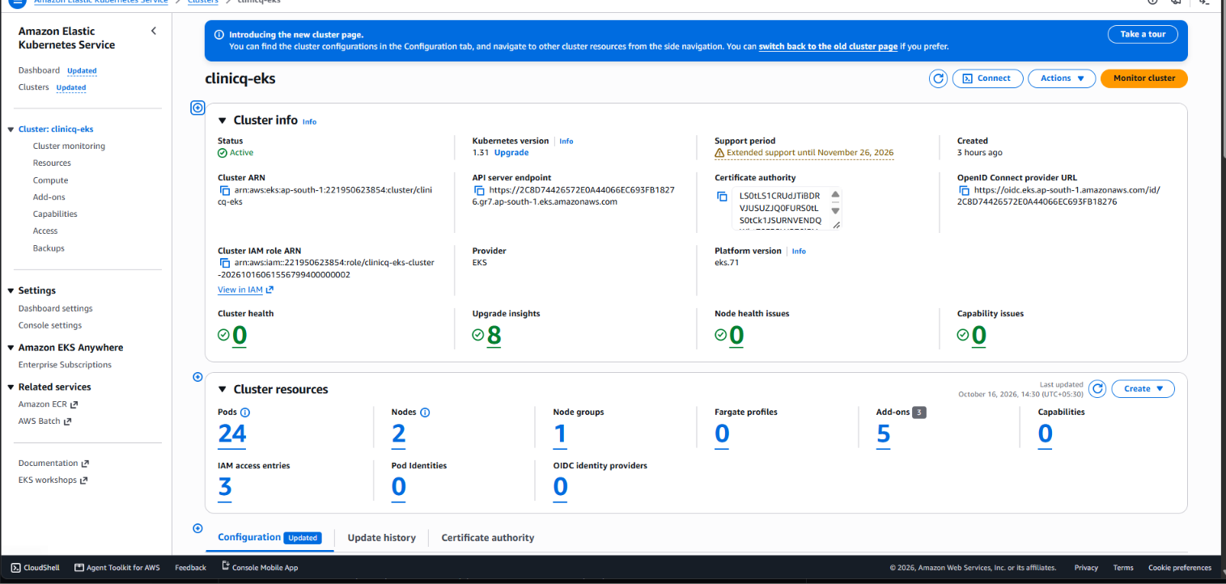
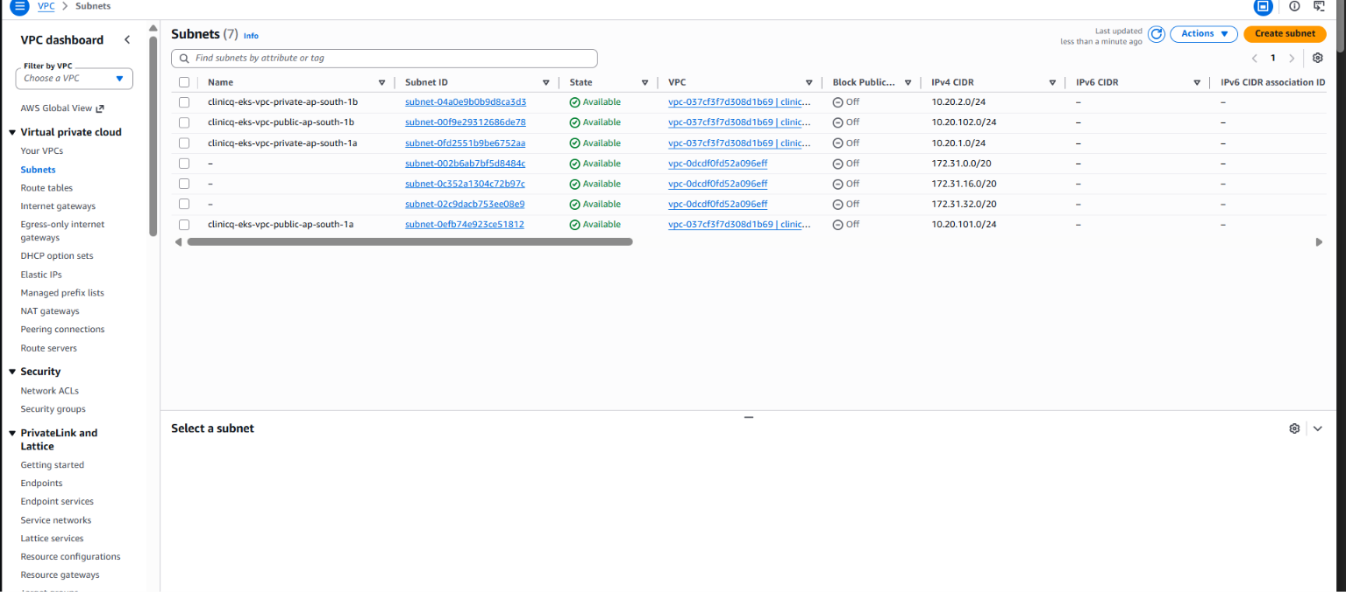
Terraform on AWS
M7 · Terraform · 15 pts
VPC: 2 public + 2 private subnets, internet gateway, NAT.
EKS 1.31: managed node group, 2 x m7i-flex.large.
Add-ons: vpc-cni, kube-proxy, CoreDNS, EBS CSI, metrics-server.
Variables: terraform.tfvars.example, no credentials in Git.
EKS cluster clinicq-eks: Active, ap-south-1
VPC subnets: two public, two private
Notes:
Terraform creates the VPC with two public and two private subnets and a NAT gateway, then EKS with a managed node group and the add-ons the workload needs: the EBS CSI driver for the Postgres volume and metrics-server for the autoscaler.

Slide 11
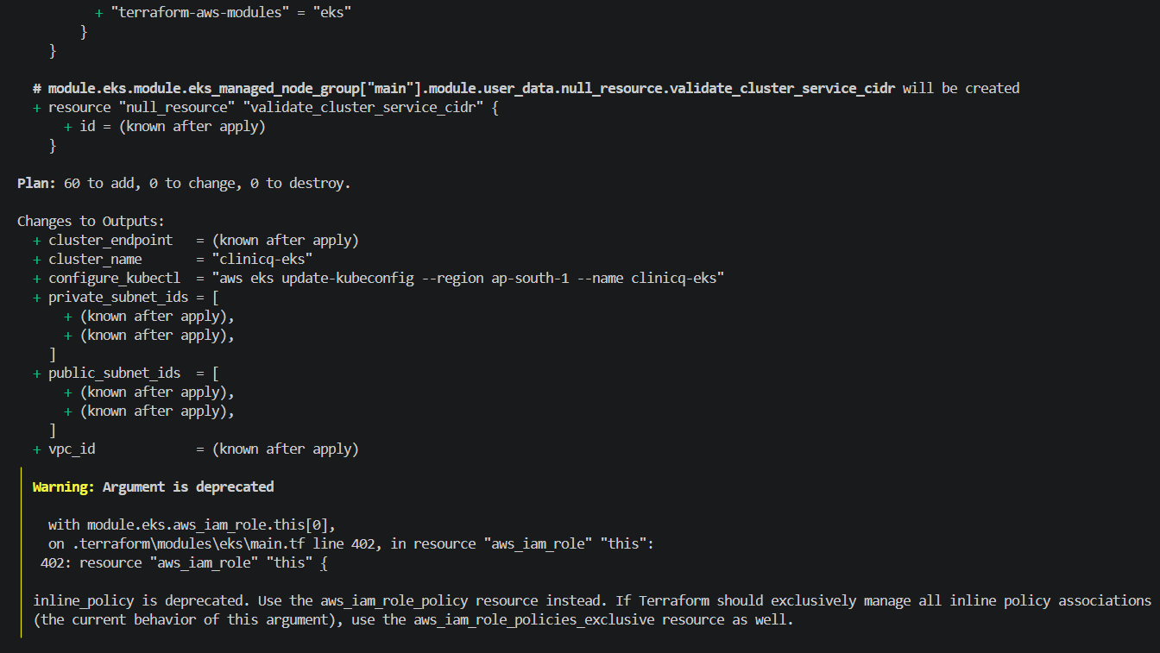
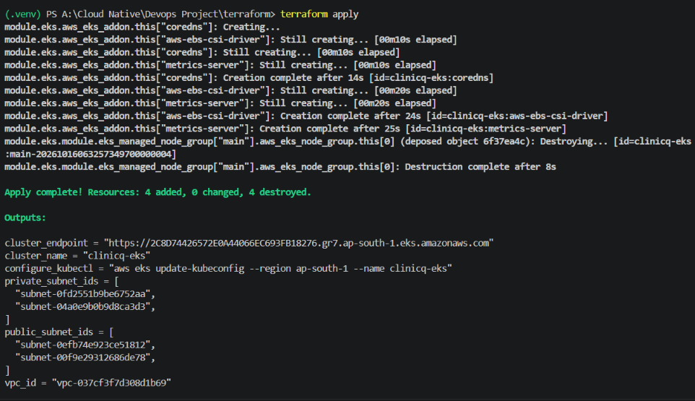
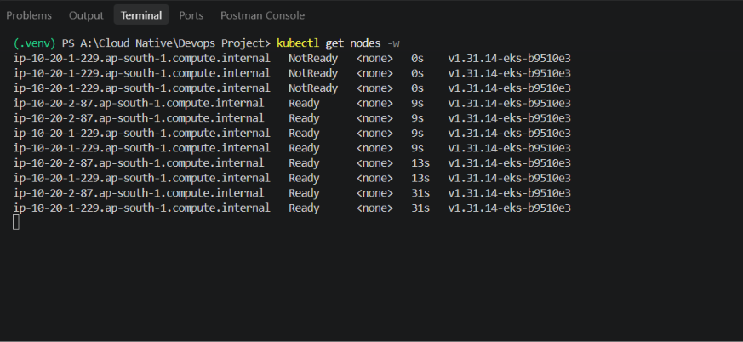
Plan, apply, destroy
M7 · Terraform · 15 pts
terraform plan: 60 to add, 0 errors
terraform apply: complete, with outputs
Plan first, then apply the saved plan.
Destroy removes everything, so there is no runaway AWS cost.
kubectl get nodes: both nodes Ready
Notes:
Plan shows sixty resources to add with no errors. Apply creates the network, cluster and add-ons. Nodes join and become Ready. At the end terraform destroy tears all of it down so no AWS cost is left running.

Slide 12
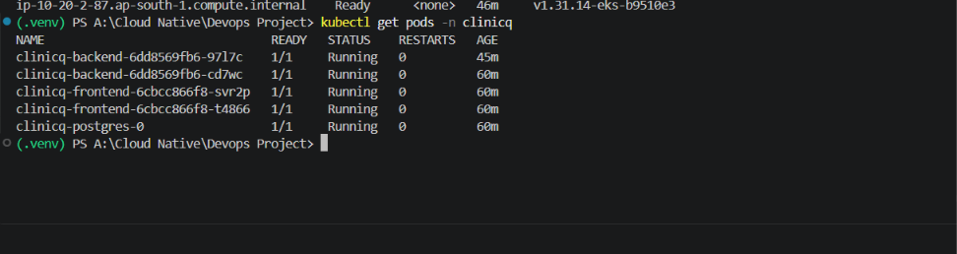
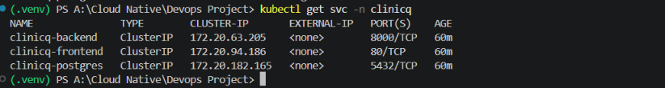
Kubernetes and Helm
M8 · K8s + Helm · 15 pts
Helm chart: Deployments, ClusterIP Services, Ingress, HPA, ServiceMonitor.
PostgreSQL: StatefulSet on an EBS gp3 volume.
Migrations: a Helm hook Job, so replicas never race.
Replicas: 2 backend and 2 frontend.
Namespace and StorageClass manifests in k8s/.
kubectl get pods -n clinicq
kubectl get svc -n clinicq
helm list -n clinicq
Notes:
The Helm chart packages everything. Two replicas each for frontend and backend, ClusterIP services, PostgreSQL as a StatefulSet on an EBS volume, and database migrations as a post-install Helm hook job, so several replicas never race to migrate the same schema. All pods are Running.

Slide 13
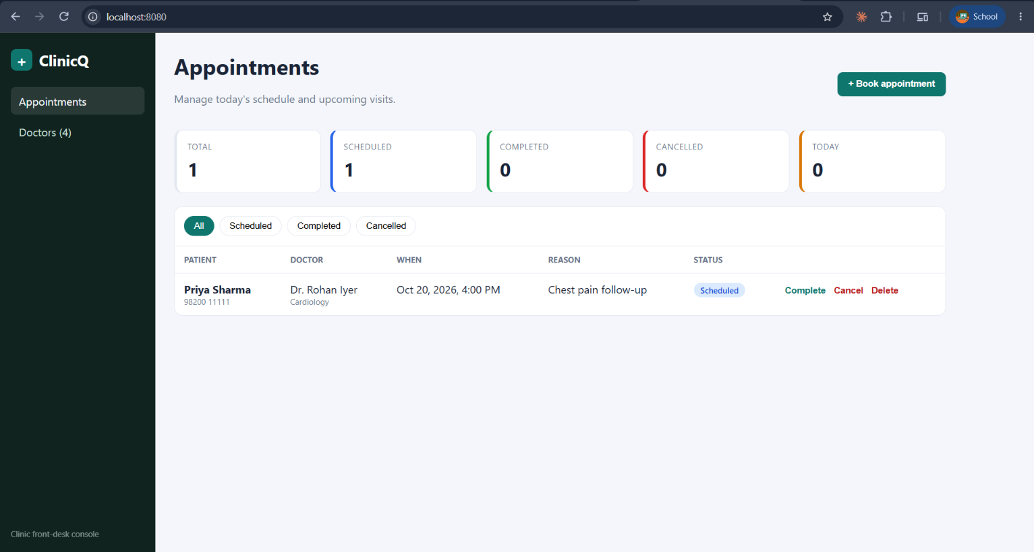
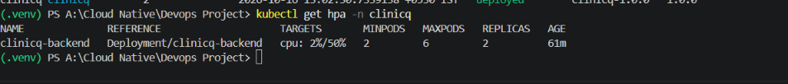
Ingress and autoscaling
M8 · K8s + Helm · 15 pts
kubectl get hpa: min 2, max 6
2 → 6
50%
backend pods under load
CPU target
App served through the Ingress
Ingress: /api goes to the backend, everything else to the frontend.
HPA: scaled the backend from 2 to 6 pods during a load test.
Note: this AWS account cannot create load balancers, so I reach the Ingress with a port-forward.
Notes:
The Ingress sends slash-api to the backend and everything else to the frontend. Under a load test the autoscaler took the backend from two to six pods. One honest limitation: this AWS account refuses to create load balancers, so I reach the Ingress controller with a port-forward; the routing rules are the same.

Slide 14
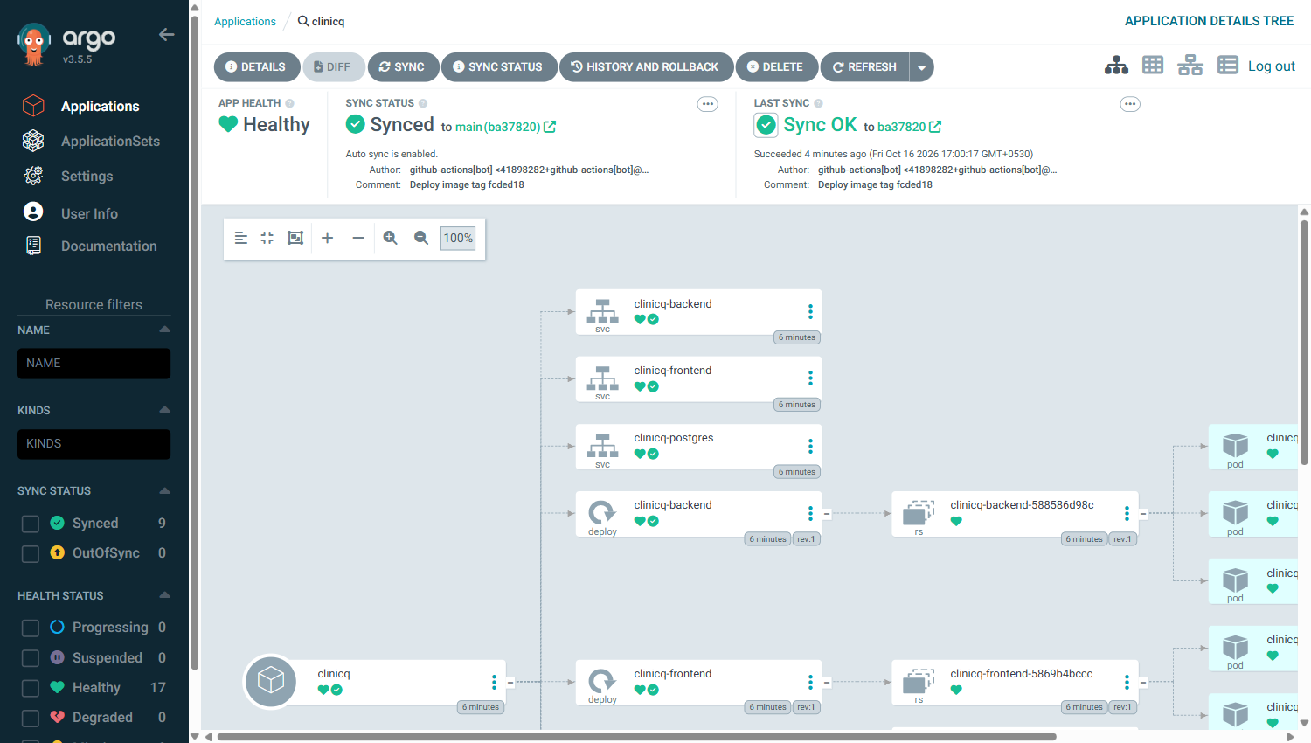
GitOps with ArgoCD
GitOps · ArgoCD
1
Push to main
one commit starts everything
2
Actions
test, build, scan, push SHA-tagged images
3
Commit the tag
pipeline writes the SHA into values-prod.yaml
4
ArgoCD syncs
cluster follows Git: Synced and Healthy
ArgoCD: clinicq Healthy and Synced; last sync is the pipeline's tag commit
Notes:
This is the GitOps flow. A push to main runs the pipeline; its last job commits the new image tag into the Helm values file in Git; ArgoCD sees that commit and rolls the cluster forward. In ArgoCD the clinicq application is Healthy and Synced, and the last sync is the commit made by github-actions with the new tag. The cluster changes only through Git, with prune and self-heal on, so manual drift is reverted.

Slide 15
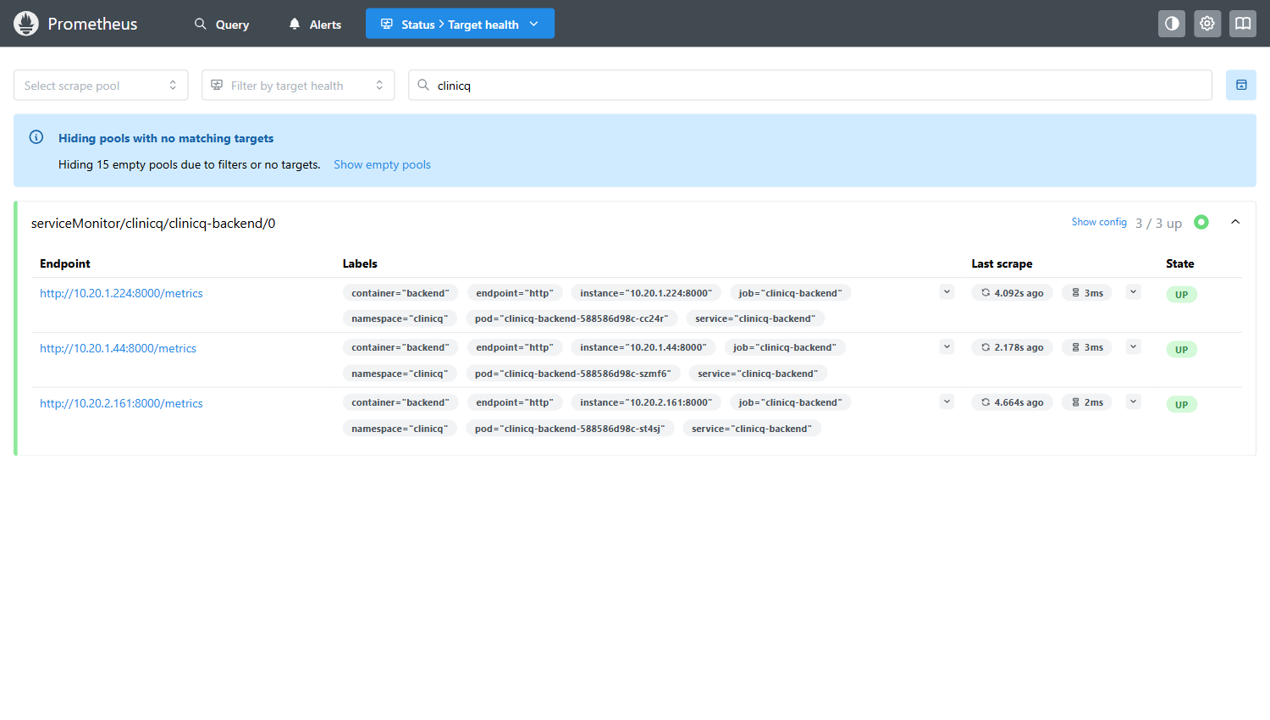
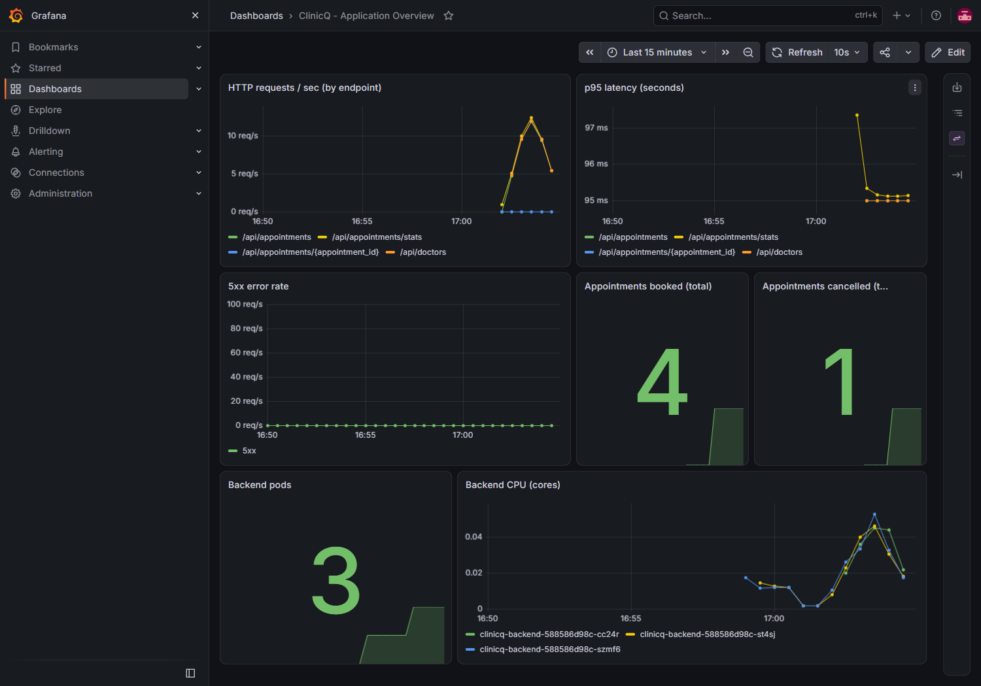
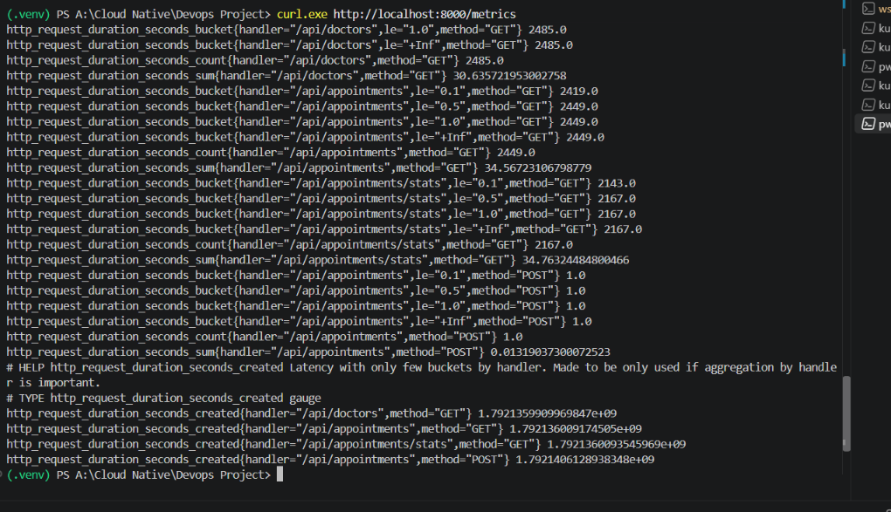
Monitoring
M9 · Observability · 10 pts
Prometheus: clinicq-backend 2/2 UP
Grafana: request rate, p95 latency, 5xx, bookings, pods, CPU
A ServiceMonitor tells Prometheus to scrape both backend pods. A custom counter tracks bookings and cancellations.
/metrics in Prometheus format
Notes:
The backend exposes metrics, a ServiceMonitor tells Prometheus to scrape both pods, and Grafana shows request rate by endpoint, p95 latency, 5xx errors, bookings and cancellations from a custom counter, pod count and CPU.

Slide 16
Problems I solved
Symptom | Root cause | Fix
Node group stuck CREATING | Free Tier plan rejects t3.medium | Use m7i-flex.large
Nodes never Ready | Networking add-ons created after the nodes | before_compute for vpc-cni and kube-proxy
Postgres volume Pending | No default StorageClass for the CSI driver | Default gp3 StorageClass
HPA showed <unknown> | Port 10251 to metrics-server was blocked | Security group rule in Terraform
Ingress had no address | Account cannot create load balancers | Port-forward to the Ingress controller
Trivy and Terraform errors | Bad action tag; expiring credentials | Trivy container; auto-refreshing profile
Notes:
These are the real failures during deployment, each diagnosed from events and describe output. They are documented in the repo so they stay fixed in code: the Terraform and StorageClass changes are committed.

Slide 17
Troubleshooting lab
1
Bad image tag
2
Service has no endpoints
3
Pod never Ready
Symptom
ImagePullBackOff
Diagnose
kubectl describe pod
kubectl get events
Fix
Correct the image tag
Symptom
Label mismatch
Diagnose
kubectl get endpoints
kubectl get pods --show-labels
Fix
Patch the Service selector
Symptom
Wrong readiness path
Diagnose
kubectl describe pod
look at probe events
Fix
Fix the probe path
Notes:
Three deliberately broken manifests live in the troubleshooting folder. The live demo applies one, reads the symptom, follows the diagnosis commands, and fixes it. The key lesson for the Service case: no matching labels means no endpoints means no traffic.

Slide 18
Limits and next steps
Known limits
What I would do next
The AWS account cannot create load balancers, so the Ingress is reached by port-forward.
PostgreSQL runs inside the cluster for a self-contained capstone.
Amazon RDS for backups and Multi-AZ failover.
A real load balancer with DNS and TLS.
Secrets in AWS Secrets Manager.
OIDC-based credentials so the pipeline can deploy without stored secrets.
Alert rules for error rate and latency.
Notes:
Be upfront about the limits. Then the next steps I would take for production.

Slide 19
Demo and questions
Commit, pipeline, image, Helm deploy, Ingress, Grafana, then a live break and fix.
✓ M1 App
✓ M2 Tests
✓ M3 Git
✓ M4 Docker
✓ M5 CI/CD
✓ M6 Trivy
✓ M7 Terraform
✓ M8 K8s + Helm
✓ M9 Monitoring
✓ M10 Docs + demo
github.com/Aryan-Bhendarkar/ClinicQ
Notes:
Run the live demo: small UI change, commit, push, watch the pipeline, deploy the new SHA with Helm, refresh through the Ingress, show Grafana, then break and fix a Service. Close by pointing at the repo.

