Slide 1

Shri Vaishnav Vidyapeeth Vishwavidyalaya
Shri Vaishnav Institute of Information Technology
Department of Computer Science Engineering
AlluminiConnect
Mentor: Dr. Avdesh Kumar Sharma
Submitted by: Aryan Gore
Jayesh Khatke
Course Teacher: prof. Varsha Choudhary

Slide 2



Problem Statement
WHY THIS PROJECT
Most institutions have no reliable, centralized system for alumni data.
Contact details, academic records, and career updates scatter across spreadsheets, emails, and personal devices — or are lost outright.
Alumni communication is often limited to informal WhatsApp groups and outdated mailing lists.
The result: long-term engagement between the institution, its alumni, and its current students stays difficult to sustain.
Spreadsheets on personal laptops
Informal WhatsApp groups
Outdated mailing lists
One centralized, structured alumni record

Slide 3
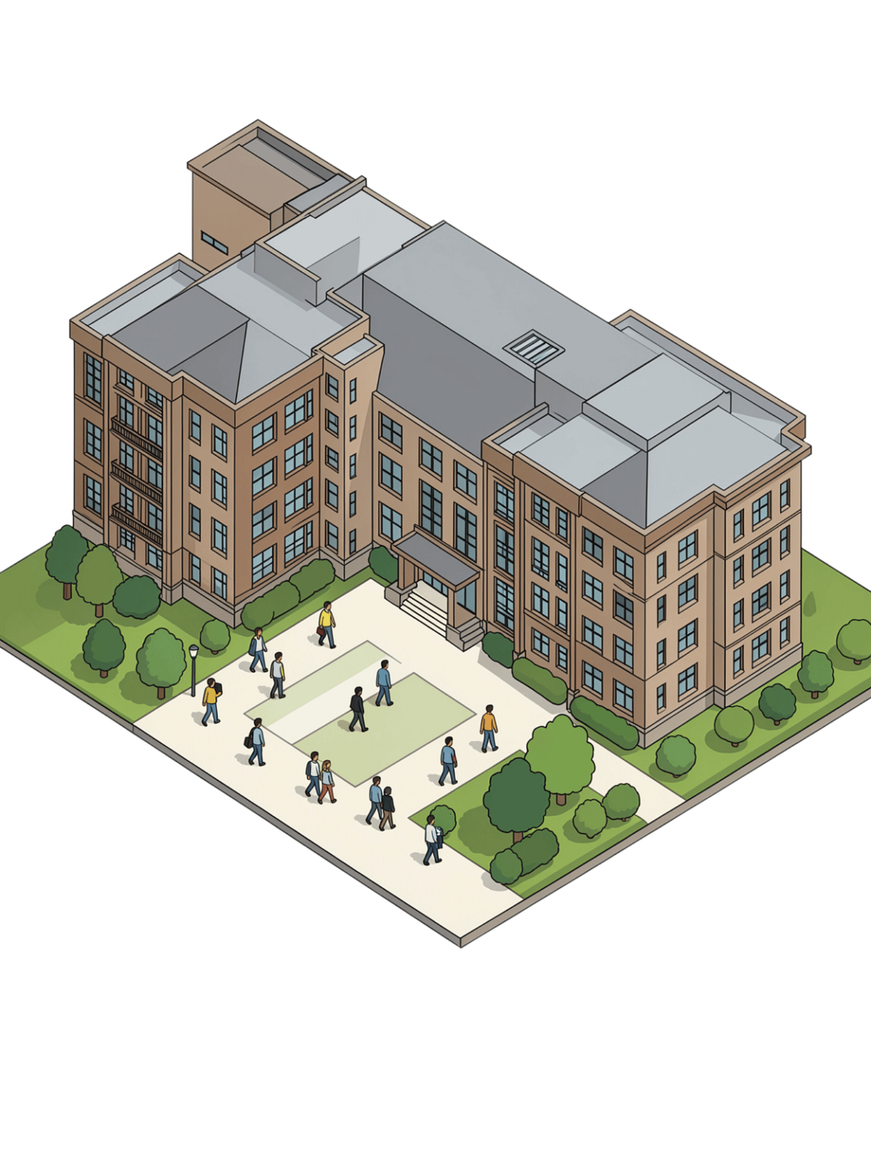
AlumniConnect
Digital Platform for Centralized Alumni Data Management and Engagement
Connecting Students, Alumni & Institution Through One Digital Platform

Slide 4

The Alumni Data & Engagement Gap
No Centralized System
Alumni data scattered across spreadsheets, emails, and personal devices with no single source of truth.
Poor Communication
Institutions rely on WhatsApp groups and outdated mailing lists to reach alumni communities.
Lost Connections
Difficult to locate alumni or maintain updated contact information as careers evolve.
Missed Opportunities
Student-alumni networking, mentorship, and engagement remain fragmented and unstructured.

Slide 5

Literature Survey
ACADEMIC RESEARCH REVIEWED
Study | Focus | Gap identified
Mukherjee, Roy et al. — "Centralized Alumni Management System (CAMS)" (IEEE) | Institution-independent centralized alumni network; mentorship as the core incentive. | No verified link to a cross institution's own historical records — nothing prevents duplicate profiles
IEEE — "Design and Implementation of an Alumni Management System," Aleksander Moisiu University | Single-institution alumni info system focused on career opportunities | No described process for bulk-migrating pre-existing historical alumni data
IEEE — "CAs Based Student–Alumni Management System" | Predicts career paths by matching student CGPA/credentials against alumni outcomes | Adds ML complexity this project's SRS deliberately avoids unless genuinely needed
IRJMETS (2025) — "Reconnecting with Alumni" | Centralized DB + role-based access replacing manual, siloed record-keeping | Doesn't address migrating an institution's existing scattered records at onboarding
Systematic Literature Review, 34 studies via Scopus/Web of Science (2026) | Synthesizes alumni-engagement research across career development and relationship management | Flags AI-personalized engagement as immature research — supports a traditional, non-ML approach now
0

Slide 6

Review of Existing Systems
COMMERCIAL ALUMNI PLATFORMS
Platform | Primary focus | Pricing model | Limitation here
Graduway (Gravyty) | Branded alumni communities, mentorship | Enterprise SaaS, ₹4.7 L – ₹14.2 L+ | Built for 1,000+ multi-tenant institutions, not a single college's own DB
Almabase | Engagement + fundraising, CRM sync | Custom, ₹2.8 L – ₹9.5 L | Fundraising-first; no native mobile app; template-only branding
PeopleGrove | Career networking & mentorship | ₹4.7 L – ₹23.6 L+ | Reviewers note limited admin customization and navigation
Hivebrite | General-purpose community platform | ₹7.5 L – ₹23.6 L+ | Not alumni-specific by design
LinkedIn Alumni Tool | Free directory filter by school | Free | No institutional data ownership or verified record-linking
Common thread: opaque enterprise pricing, fundraising-first scope, and no equivalent of this project's import-then-claim workflow for an institution's own pre-existing records.
05

Slide 7
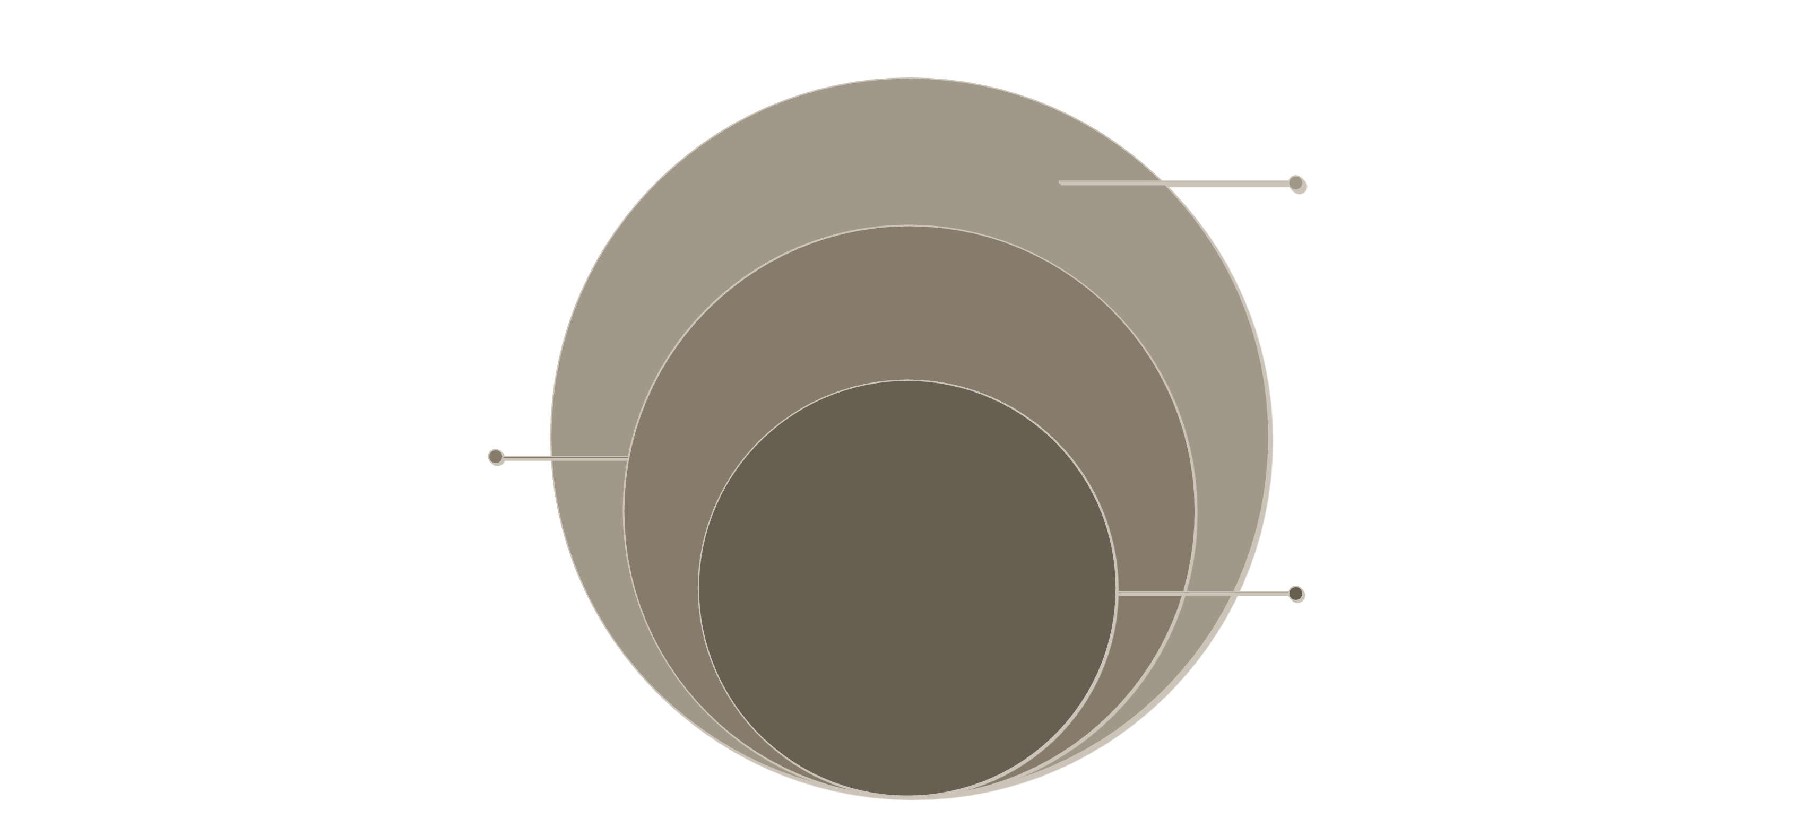
Introducing AlumniConnect
A single ecosystem connecting all stakeholders through verified, updated alumni data.
Outer Layer
Networking, mentorship, events, jobs, continuous engagement
Inner Layer
Students and alumni profiles
Core: Alumni Database
Verified, centralized alumni records

Slide 8
Platform Ecosystem
Students
Alumni
Professional profiles, discover alumni, request mentorship, browse jobs & events.
Update career information, mentor students, post opportunities, attend events.
Institution / Admin
Central Database
Manage records, import historical data, verify profiles, manage events, view analytics.
Academic, contact, career, and engagement data — the single source of truth.

Slide 9



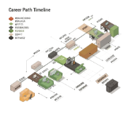
Alumni Profile & Professional Networking
Verified
Profiles
Alumni
Discovery
Direct Engagement
Career Transparency
Name, education, experience, skills, career history, and professional links — all in one place.
Browse alumni by department, company, industry, or location to find the right connection.
Connect with alumni or request mentorship with one click — no friction, no gatekeeping.
Alumni share current roles, achievements, and career paths to inspire and guide students.

Slide 10

Engagement Features
Mentorship
Students discover and request guidance from alumni mentors in structured sessions.
Events
Centralized discovery and registration for alumni and institutional events.
Jobs
Alumni post opportunities; students and alumni apply and connect directly.
Networking
Professional profiles enabling meaningful student-alumni connections at scale.
These features drive alumni engagement; the core purpose remains centralized data management and institutional connectivity.

Slide 11
References
SOURCES REVIEWED FOR THIS SYNOPSIS
Mukherjee, S., Roy, D. et al. “Centralized Alumni Management System (CAMS) — A Prototype Proposal.” IEEE Conference Publication.
“Design and Implementation of an Alumni Management System,” Aleksander Moisiu University (UAMD). IEEE Conference Publication, 2023.
“CAs Based Student-Alumni Management System.” IEEE Conference Publication.
“Reconnecting with Alumni.” International Research Journal of Modernization in Engineering, Technology and Science (IRJMETS), 2025.
“Alumni Engagement in Higher Education Institutions: A Comprehensive Systematic Literature Review (SLR).” ResearchGate, 2026.
“Digital Platform for Centralized Alumni Data Management and Engagement.” ResearchGate, 2026.
Almabase. “Alumni Management Software: Best Platforms Compared” and “Choosing the Right Alumni Management Software (2026 Guide).” almabase.com/blog.
Gravyty. “Graduway vs. Almabase vs. Hivebrite: Choosing the Right Alumni Engagement Software.” gravyty.com/blog.
09

Slide 12
THANK YOU
09

