Slide 1

NASHIK
Virtual Tour
By
Aryan Jade

Slide 2
Title
1. PandavlenI caves
8. Gangapur Dam
2. Saptashrungi
9. Dugarwadi Waterfall
3. Anjneri Hills
10. Kalaram Temple
4. Ramkund
11. Harihar Fort
5. Dudhsagar Falls
12. Vihigaon Waterfall
6. Trimbakeshwar Temple
13. Sundarnarayan Temple
7. Sita Gumpha
14. Brahmagiri Hill

Slide 3
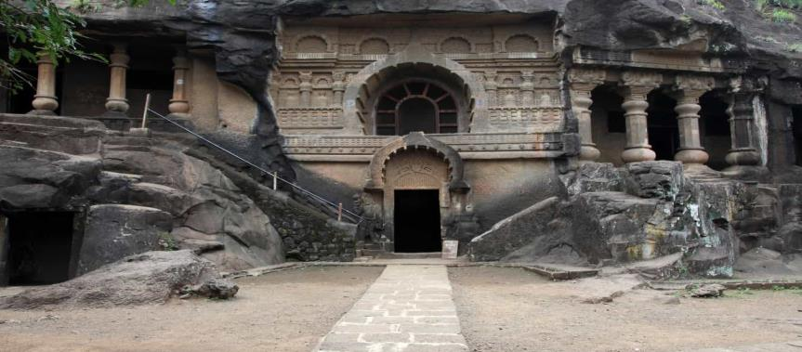
1. PandavlenI caves
All you adventurous and thrill-seeking people, an enthralling experience awaits at the Pandavleni caves in Nashik. If you like mountaineering and trekking then you have to tread the trail towards these caves, as they are situated on a hammock. Located at a height of approximately 300 ft, amidst a thick green forest, these caves also make a perfect destination for peace lovers and nature

Slide 4
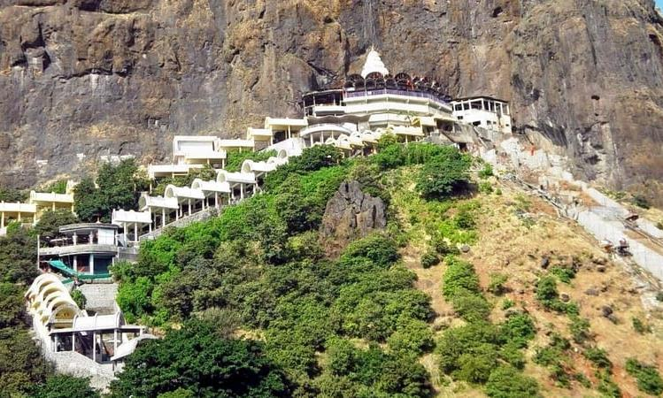
2. Saptashrungi
The Saptshrungi Garh is a holy place situated approximately at a distance of 60 KM from Nashik. According to the mythology, it is an abode of Goddess Bhagawati. Innumerable travelers and pilgrims visit Saptshrungi every year. The name Saptshrungi means seven mountain pinnacles. There are around 108 water reservoirs on this Mountain, which are known as Kundas and it is one of the popular places to visit in Nashik.

Slide 5
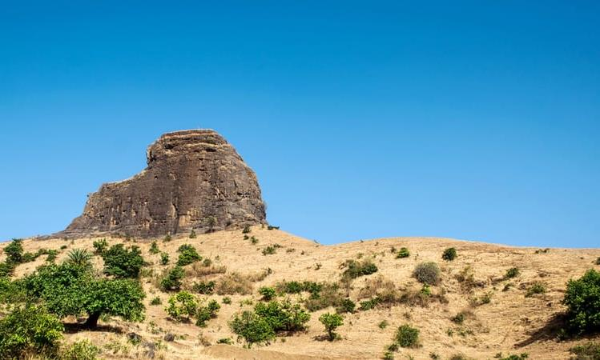
3. Anjneri Hills
The Anjaneri hills derive their name from Goddess Anjana, as the locals say that the Goddess Anjana gave birth to Lord Hanuman in the cave atop the hill and it is one of the holy places to visit in Nashik.Among the Nashik tourist places, reaching Anjaneri hills is comparatively harder.

Slide 6
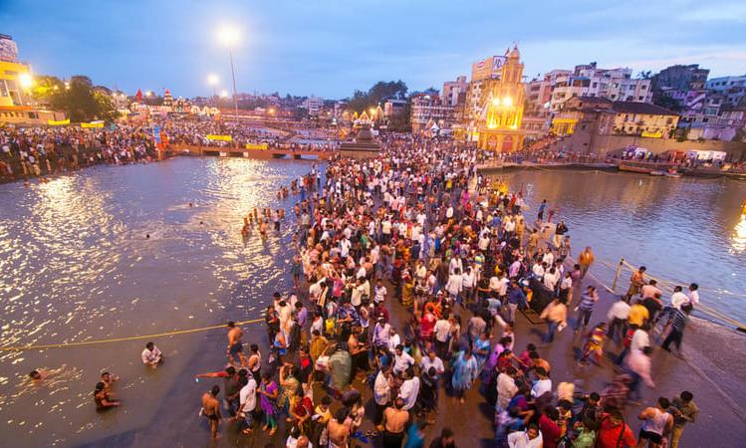
4. Ramkund
A sacred bathing ghat in Nashik, Ramkund is situated at the bank of the Godavari River. The place is considered to be the holiest place in Nashik and is surrounded with folklores and various mythological stories.Every year, thousands of Hindus visit the Kund to pray and take.

Slide 7
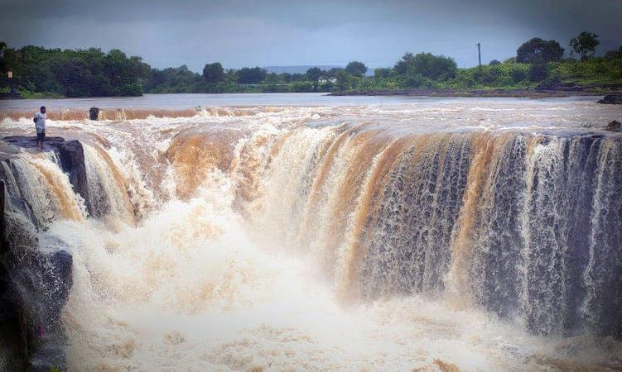
5. Dudhsagar Falls
Dudhsagar Falls, also known as Someshwar Falls, is one of the most captivating Nashik tourist places that you can visit.Just 9 km away from Nashik Central Bus Station, the waterfall has a height of 10 meters.Best time to visit the Dudhsagar Falls is during monsoon, when everything around the place becomes more beautiful and attractive.

Slide 8
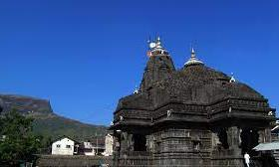
6. Trimbakeshwar Temple
One of the most popular places of worship, Trimbakeshwar is located in Nashik. People all across India visit Trimbakeshwar to express their faith and devotion. It is one amongst the twelve Jyotirlingas of Lord Shiva. The temple is located at the base of the Bramhagiri Mountain and it is one of the best Nashik tourist places. It is considered holy as the sacred Godavari River originates from here.

Slide 9
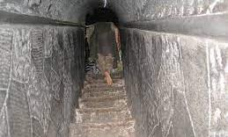
7. Sita Gumpha
If you are an explorer intrigued by the Indian ancient legends, then the Sita Gumpha is one of the places to visit in Nashik. It is situated near the Kalaram Temple, where Sita expressed her devotion for Lord Shiva. The Sita Gumpha that is also known as Sita Gupha attracts innumerable devotees every year.

Slide 10
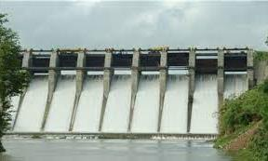
8. Gangapur Dam
Amongst all the places to visit in Nashik, the Gangapur Dam is a must. Approximately 10 KM away from the main city of Nashik is the Gangapur Dam, a highly fascinating tourist spot. It is situated on the banks of the sacred Godavari River. Being constructed in the year 1954, it is built in conventional style using stones, clay, mud, and sand.

Slide 11
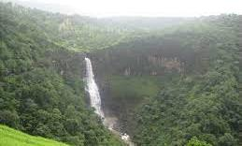
9. Dugarwadi Waterfall
Dugarwadi waterfall is one of the most enchanting places to visit in Nashik. It is a majestic waterfall located just 30 km away from Nashik. The cascading falls and the surrounding beauty is sure to soothe the eyes of every visitor.It is one of the best tourist places in the city for a one-day outing with friends and family.

Slide 12
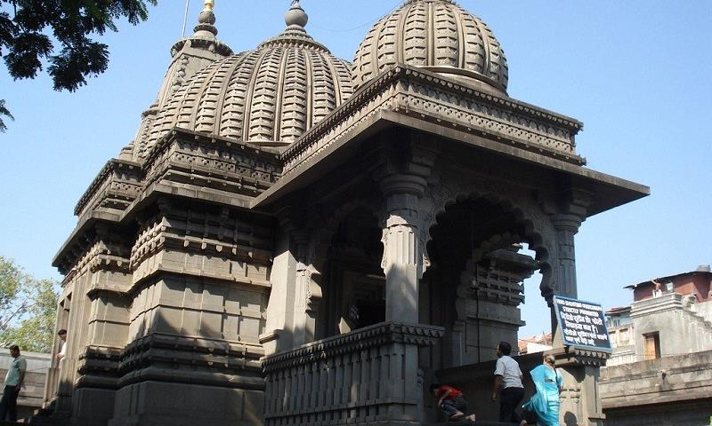
10. Kalaram Temple
The Kalaram temple in Nashik is one of the most religious Nashik tourist places. The Kalaram temple is a very old Hindu place of worship which is dedicated to Lord Rama and it was built around 1788 by Sardar Rangarao Odhekar. The temple is named as such because the statue of Lord Rama present in the temple is black.

Slide 13
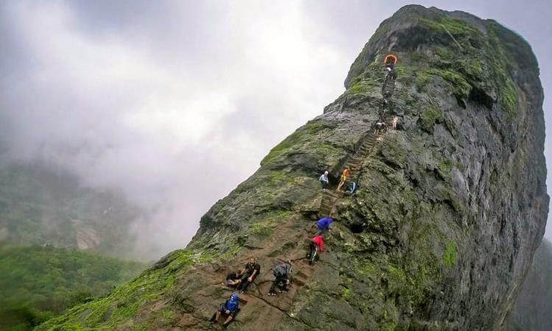
11. Harihar Fort
Located 48 km from Igatpuri, Harihar fort is an important fort of Nashik district. The fort captures the attention of the visitors because of its peculiar rock-cut steps and its one of the famous Nashik tourist places.The fort is very old and it mostly is in ruins at present except for a storage house and a few rock-cut cisterns.

Slide 14
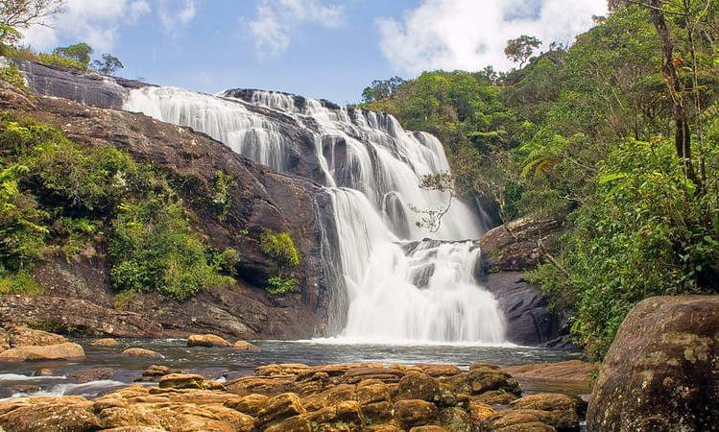
12. Vihigaon Waterfall
The Vihigaon Waterfall is one of the most alluring places to visit in Nashik. It is based in the in the heart of the forest, in the Western Ghats. It is so popular for its natural beauty that it has been utilised as a prominent location in several films, short as well as feature.The best time to visit this place is during monsoon, as heavy rainfall bejewels the panorama.

Slide 15
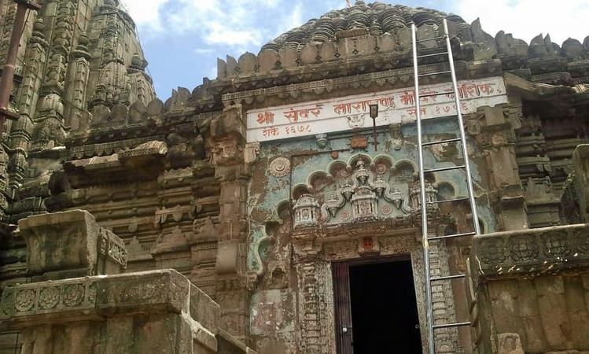
13. Sundarnarayan Temple
Sundarnarayan temple in Nashik is a must visit place for the devotees of Lord Vishnu. The Temple was constructed in 1756 by Gangadhar Yashwant Chandrachud.Temple is very beautiful and it is adorned by intricate carvings and paintings and its imposing architecture inspired by Mughal sculpture is bound to please the art lover in you.

Slide 16
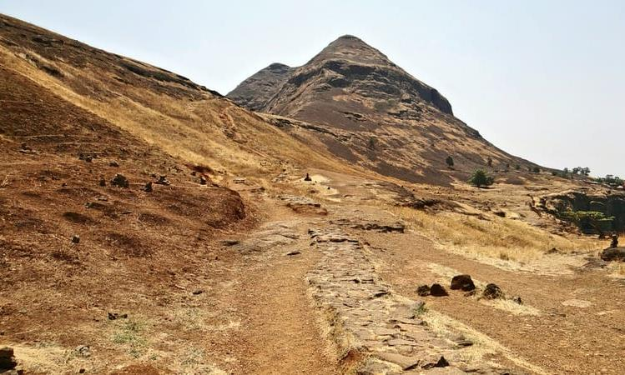
14. Brahmagiri Hill
The word Brahmagiri translates to Hill of Lord Brahma. With mythological stories intricately woven into the history of this place, the Brahmagiri hill is one of the famous Nashik tourist places.The ascent to Brahmagiri hill can be started from Trimbakeshwar. It takes about 2 hours for one to reach the top of Brahmagiri hill from Trimbakeshwar.

Slide 17
Thank you

