Slide 1
FINAL REVIEW / AUTONOMOUS DRONES / FALL 2026-27
Drone-Based Crowd Monitoring,
Without a Single Camera
Locating people from the WiFi their phones already broadcast.
TEAM
Aryan Kochhar
Hari Samhita
23BAI1533
23BAI1473
01
Notes:
[~15 s] Names, then the one-line idea: we find where people are from the WiFi signals their phones already send, with no cameras anywhere. Move on.

Slide 2
WHY
Why not just use cameras?
CAMERA
PASSIVE WIFI — THIS PROJECT
Counts precisely
Records every face
Needs light and a clear view
Counts approximately
Records no image
Works in darkness and smoke
Both tell you how many, and where. Only the camera also tells you who.
02
Notes:
[~40 s] Crowd density is a safety number, and the usual way to measure it is cameras, which record everyone's face. An operator only needs how many people, and roughly where. Read the bottom line out loud: WiFi answers 'how many and where' without ever answering 'who'.

Slide 3
HOW IT WORKS
Five stages, from phone to map.
01
02
03
04
05
PHONES
ESP32 NODES
BACKEND
SOLVER
LIVE MAP
Send WiFi probes on their own
→
Log MAC and signal strength
→
Groups the readings by phone
→
Turns three distances into one (x, y)
→
Shows density, every second
LIVE DEMO
Stage 02 is running on the ESP32 in front of you.
In deployment, each of three UAVs carries one node.
03
Notes:
[~45 s, plus the live demo] Walk the five stages once, left to right. Then show the hardware: the highlighted stage 02 is the ESP32 on the table, running now (point at its serial output or the dashboard). The drone is the carrier. If asked why the simulation shows three drones: a 2-D fix needs three nodes, so a deployment flies three; the demo is one.

Slide 4
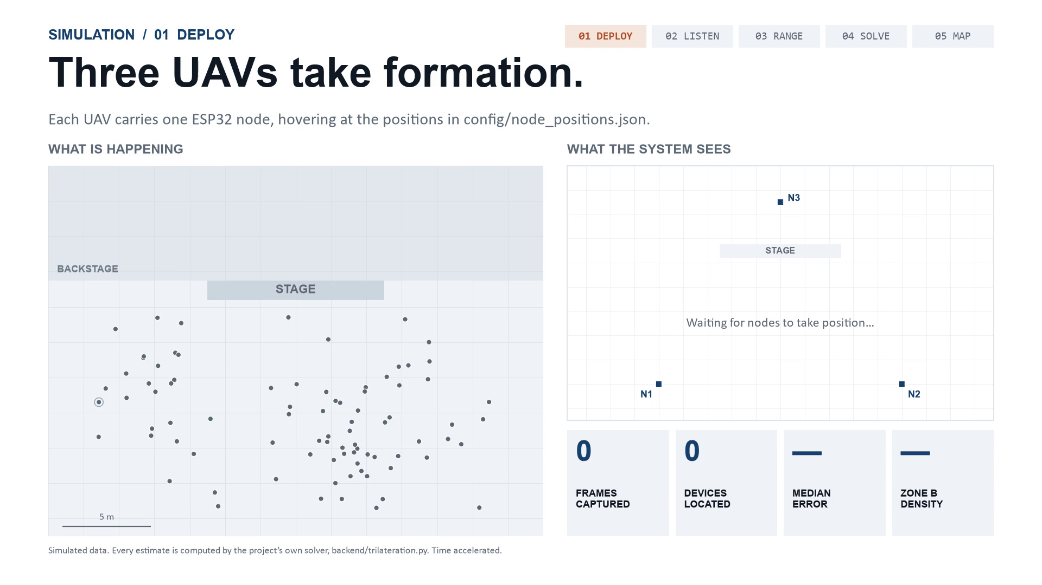
04
Notes:
[~60 s] Let it play: 42 seconds, and it loops, so talk over it. The five chips top-right light up in order. Say two things. First: every position on the right is computed by our backend's own trilateration code from simulated signal strengths, so this is the real algorithm running, not an animation of it. Second: left is what is really happening, right is what the system believes, and the gap between them is the error. If asked why the map lags the moving crowd: the backend averages five frames per phone, so it trails by a few probe intervals.

Slide 5
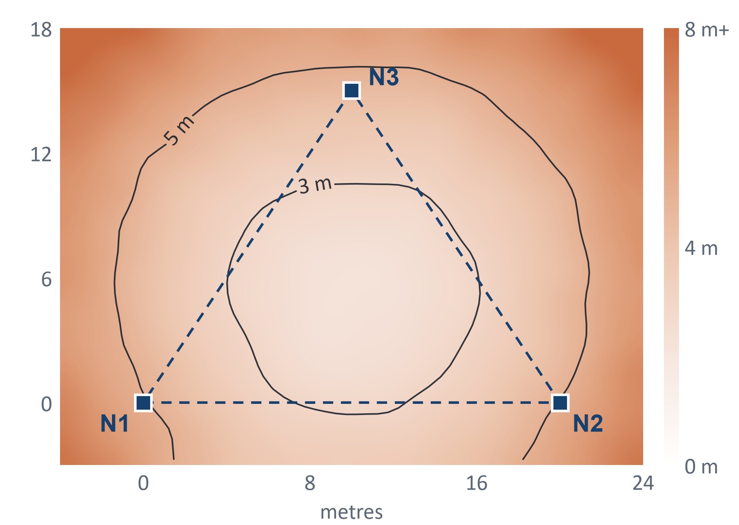
SIMULATION RESULTS
The solver lands within 2.8 m.
2.8 m
inside the node triangle
4.8 m
outside it — so fly over the crowd
~35 m
if n is wrong — so calibrate on site
282,240 simulated solves · 4 dB signal noise · backend defaults (−40 dBm, n = 2.0)
05
Notes:
[~45 s] Simulated, so say that first: 282,240 runs of our own solver over the whole area, with 4 dB of signal noise per frame. Median error is 2.8 m inside the node triangle and 4.8 m outside it. Land the rust number: if the room really decays at n = 2.7 while the backend assumes 2.0, error jumps to about 35 m. That one constant decides whether the system works, so calibrating it is the first job of a real deployment.

Slide 6
WHERE IT STANDS
Built, and what comes next.
BUILT
NEXT
— ESP32 nodes capturing live
— Least-squares backend
— Live map and full simulation
— Calibrate n on site
— Field accuracy test
— Fly three nodes on UAVs
Aryan Kochhar 23BAI1533 Hari Samhita 23BAI1473
Thank you.
06
Notes:
[~30 s] Close on what is real: the nodes capture, the backend solves, the map draws, and the simulation shows the whole deployment with our own solver. Then be direct about what is not done: no field accuracy number yet, because n has not been calibrated on site.

