Slide 1
FINAL REVIEW / AUTONOMOUS DRONES / FALL 2026-27
Drone-Based Crowd Monitoring,
Without a Single Camera
Locating people by the WiFi their phones already broadcast — ESP32 packet sniffing, RSSI trilateration, and a live density map.
MEASUREMENT CHAIN — THREE STAGES BUILT FOR THIS REVIEW
CAPTURE
promiscuous
MAC + RSSI
no handshake
3 nodes, 1 solver
RANGE
log-distance
path loss n
→ metres
< 1 s capture to map
RESOLVE
three circles
least squares
→ (x, y)
0 cameras anywhere in the loop
TEAM
Aryan Kochhar 23BAI1533
Hari Samhita 23BAI1473
01
Notes:
Open with the framing, not the title. One sentence: this measures how crowded a space is without ever forming an image of it. Introduce both names, then move on — do not read the chip grid aloud, it is there so the panel can see the whole pipeline at once.

Slide 2
SCOPE
Three radios, one solver, and no camera in the loop.
Everything below is fixed for the final build. The numbers are the design in miniature.
3
2K
<1s
0
ESP32 NODES
RUPEES OF HARDWARE
CAPTURE TO MAP
IMAGES RETAINED
The minimum for a unique two-dimensional fix. Each node captures independently and never talks to the others.
Complete three-node cluster, power included — roughly two orders of magnitude under a camera install.
Frame seen, distance solved, marker moved. Fast enough to follow a crowd that is actually moving.
No picture is ever formed. The system reads only what every device already announces in the clear.
The contribution is integration, not invention. Promiscuous-mode sniffing, the log-distance path-loss model and least-squares trilateration are all established individually. What this project builds is the working path from a raw 802.11 frame to a plotted coordinate on commodity hardware.
02
Notes:
The four numbers are the design in miniature. Pause on the zero — it is a design constraint we chose, not a capability we lack. Say the warm box out loud; it pre-empts the novelty question before anyone asks it.

Slide 3
MOTIVATION
Counting a crowd usually means watching it.
Crowd density is a safety variable. At concerts, transit hubs and religious gatherings, the distance between a manageable crowd and a crush is measured in people per square metre.
The standard instrument for measuring it is the camera. Cameras work — and they also produce a permanent, identifiable record of everyone who walked through the space.
The quantity an operator actually acts on is far smaller than what a camera collects: how many people, and roughly where they are standing.
TWO INSTRUMENTS FOR THE SAME QUANTITY
CAMERA + COMPUTER VISION
Counts precisely. Needs light and line of sight, and creates a retention liability the moment it records.
PASSIVE RADIO
Counts approximately. Works in darkness and smoke, and carries no image — only a rotating hardware address.
Both answer how many, and where. Only one of them also answers who — a question crowd safety never needed to ask.
03
Notes:
This is the motivation slide, so do not rush it. Concrete framing: in a crush, the operator needs to know where pressure is building, not who is standing there. Be honest that cameras are more accurate — the argument is about what you give up to get that accuracy.

Slide 4
PROBLEM
A phone announces itself long before it joins any network.
Every WiFi-enabled device periodically broadcasts probe requests — unencrypted management frames that carry a source address and are readable by any radio within range.
That signal is already in the air. No association, no authentication and no cooperation from the device is required in order to hear it.
What does not exist yet is the path from that raw frame to a coordinate stable enough to plot.
WHAT THE RADIO HANDS YOU, AND WHAT IT DOES NOT
PER FRAME MAC · RSSI · CHANNEL · TIME
Directly measured. Costs nothing to collect.
RSSI IS NOT DISTANCE → needs a propagation model
ONE NODE IS NOT A FIX → needs three, and a solver
Inferred. This is the part that has to be built.
The engineering problem is not detection — that is a library call. It is turning a noisy scalar, signal strength, into a coordinate that holds still enough to be useful.
04
Notes:
The key technical fact is that probe requests are unencrypted and already in the air. Detection is a library call. The rust line is the actual project: turning a noisy scalar into a stable coordinate. If you only land one sentence on this slide, land that one.

Slide 5
OBJECTIVES
Four objectives, fixed before implementation began.
Each one has to work before the next is meaningful — the chain is strictly sequential.
01
Passive capture
02
Calibrated ranging
Drive three ESP32 nodes in promiscuous mode and extract (MAC, RSSI) from 802.11 management frames without associating to any device.
Fit the log-distance path-loss model to the deployment environment and convert each RSSI reading into a distance in metres.
03
Position solving
04
Live visualisation
Combine three simultaneous range estimates into one (x, y) fix through linearised least squares, and degrade sensibly when a reading is bad.
Stream solved positions to a browser canvas that repaints at sub-second cadence and renders density rather than bare points.
05
Notes:
Read objectives 1 and 3; summarise 2 and 4. If asked why four rather than one: they are strictly sequential, each a precondition for the next. Objective 2 is the one most likely to disappoint in practice, and saying so first is better than being caught by it.

Slide 6
METHOD / ARCHITECTURE
Five stages from broadcast frame to plotted dot.
The nodes are deliberately dumb. Every decision that needs more than one radio happens server-side.
01
02
03
04
05
DEVICES
→
ESP32 NODES
→
BACKEND
→
TRILATERATION
→
LIVE MAP
Phones and laptops emit probe requests across channels 1–13, unprompted.
Three radios in promiscuous mode read each frame's source MAC and RSSI.
A Flask server groups readings by MAC inside a bounded time window.
Least squares turns three range estimates into one (x, y) fix.
A browser canvas repaints positions and density once per second.
WHY THE NODES STAY DUMB
The three nodes never communicate with each other, and none of them knows where it is. All fusion happens on the server, which keeps the firmware small enough to fit alongside the sniffer and makes adding a fourth node a change to one JSON file rather than a redesign.
06
Notes:
Walk the five stages left to right, once. The thing to land is the warm box — the nodes are stateless and none of them knows where it is, which is why adding a fourth node is a config change rather than a redesign.

Slide 7
METHOD / CAPTURE
Promiscuous mode: read every frame, join no network.
The ESP32 radio can be placed in a mode where it passes every received 802.11 frame to a callback, regardless of who the frame was addressed to.
Management frames are unencrypted, so both the source address and the receiver's own RSSI reading are available without any key material at all.
The node discards broadcast and multicast addresses, applies a signal floor, and forwards what is left.
PACKET CALLBACK — ESP-IDF
void sniffer_cb(void *buf,
wifi_promiscuous_pkt_type_t type) {
auto *pkt = (wifi_promiscuous_pkt_t *) buf;
int8_t rssi = pkt->rx_ctrl.rssi;
uint8_t *mac = pkt->payload + 10;
if (rssi < RSSI_FLOOR) return;
publish(mac, rssi, NODE_ID, millis());
}
RSSI FLOOR
−85 dBm
MAC OFFSET
payload + 10 (addr2)
One radio cannot sniff and transmit at once. Capture is suspended for the few milliseconds each POST takes, so uploads are batched — otherwise the node spends most of its life deaf.
UPLINK
HTTP POST, JSON body
07
Notes:
Do not read the code. Point at two lines only: the RSSI read, and the payload+10 offset that gets you addr2. The warm box is the honest limitation — one radio cannot listen and transmit at the same time, so every upload costs you capture.

Slide 8
METHOD / RANGING
Signal strength becomes distance through one calibrated model.
RSSI(d) = RSSI₀ − 10 · n · log₁₀(d / d₀)
d = d₀ · 10^((RSSI₀ − RSSI) / (10 · n))
SYMBOL
WHAT IT IS
VALUE USED
WHY IT MATTERS
RSSI₀
Reference signal strength measured at exactly one metre
−40 dBm
Backend default today; an on-site calibration value replaces it
n
Path-loss exponent describing how fast signal decays here
2.0 (default)
Dominates total error; free space is 2.0, a reflective corridor exceeds 3.5
d₀
Reference distance the model is anchored to
1 m
Fixed by convention so RSSI₀ stays comparable across sites
RSSI
Strength of the frame just captured, per node
−30 … −85 dBm
The only live input; everything else is fixed before the run
n is where the accuracy lives. The backend ships with the free-space value, and slide 14 shows what a wrong n costs — which is why on-site calibration comes first.
08
Notes:
Slowest slide in the deck. Do not rush the model. Be upfront that the backend currently uses the default values, −40 dBm and n = 2.0, not calibrated ones — slide 14 puts a number on why that matters. If the panel asks about accuracy, point forward to slide 14.

Slide 9
METHOD / GEOMETRY
Three distances, three circles, one intersection.
CIRCLE EQUATIONS
GEOMETRIC INTERSECTION
NODE 1 (x − x₁)² + (y − y₁)² = r₁²
NODE 2 (x − x₂)² + (y − y₂)² = r₂²
NODE 3 (x − x₃)² + (y − y₃)² = r₃²
Subtracting the third equation from the first two cancels every quadratic term, leaving two linear equations in x and y — which is what makes a closed-form solution possible.
N₃
(x, y)
N₁
N₂
Three circles almost never meet at a point. RSSI noise makes them overlap in a small region, and the solver returns the least-squares centre of that region rather than a true intersection.
Node coordinates are surveyed once and read from config; only the radii change per frame.
09
Notes:
Use the figure, not the equations. The line that matters: three circles essentially never meet at a point, and that is exactly why the solver is least squares rather than algebra. The equations are there for the record.

Slide 10
METHOD / SOLVER
The linearised system and its closed-form solution.
Subtracting the last equation from each of the others removes the nonlinear terms and leaves a standard overdetermined linear system.
2(xᵢ − xₙ)·x + 2(yᵢ − yₙ)·y = rₙ² − rᵢ² + xᵢ² − xₙ² + yᵢ² − yₙ²
COEFFICIENT MATRIX
OBSERVATION VECTOR
A = [ 2(x₁−x₃) 2(y₁−y₃) ]
b = [ r₃²−r₁² + x₁²−x₃² + y₁²−y₃² ]
[ 2(x₂−x₃) 2(y₂−y₃) ]
[ r₃²−r₂² + x₂²−x₃² + y₂²−y₃² ]
SOLUTION
RSSI noise is not uniform across nodes. A device three metres from a node yields a far more trustworthy range than one at twenty, so the backend's weighted least squares scales each row by 1/d² and pulls the fix toward the nodes that actually have signal.
x̂ = (AᵀA)⁻¹ Aᵀ b → [x, y]ᵀ
10
Notes:
Move quickly here. Two claims: subtracting one equation linearises the system, and the solution is closed form so it costs nothing to run per frame. The weighted least squares box is your answer to 'how do you handle noise' — have it ready.

Slide 11
METHOD / BACKEND
Four stages, running continuously on the server.
The backend is stateless between devices — each MAC is solved on its own.
01
Packet ingestion
Every node POSTs (device_id, MAC, RSSI, timestamp) as JSON. Readings arrive independently, with no ordering guarantee and no coordination between nodes.
02
MAC grouping
Readings are bucketed by source address. A fix is attempted only once all three nodes have reported for that MAC inside the time window.
03
Distance estimation
Each RSSI is pushed through the calibrated path-loss model, producing r₁, r₂ and r₃ in metres for that one device.
04
Least-squares solve
A and b are assembled and solved. The resulting (x, y) replaces that device's previous entry in the live position table served to the browser.
Stale readings are the failure case that actually bites. Without the window, a device that left the area an hour ago would still be trilaterated against one fresh reading and dropped somewhere plausible but entirely wrong.
11
Notes:
Four stages. Spend your time on stage 2. The time window is the thing that stops a device which left the building an hour ago from being confidently plotted somewhere plausible and wrong.

Slide 12
METHOD / OUTPUT
A live floor plan, repainted every second.
The browser polls the current position table on a fixed interval and repaints a canvas in floor-plan coordinates — metres, not pixels.
FLOOR-PLAN CANVAS
Y
N3
DEVICE MARKERS
One dot per resolved MAC, with its (x, y) printed alongside it.
NODE ANCHORS
The three surveyed positions, drawn from the same config the solver reads.
(11.0, 9.5)
(5.4, 8.1)
REFRESH
Full repaint at 1 Hz. No incremental diffing — the table is small.
(8.2, 5.6)
(13.1, 4.2)
TRANSPORT
Plain REST polling, chosen over WebSocket because it is trivial to debug.
N1
N2
X
Mock render — axes in metres, anchors from config/node_positions.json
12
Notes:
Short slide, keep it short. The canvas drawn here is a mock — the next slide shows the real solver running on a simulated crowd. The one substantive point: the node anchors are read from the same config file the solver uses, so there is a single source of truth for geometry.

Slide 13
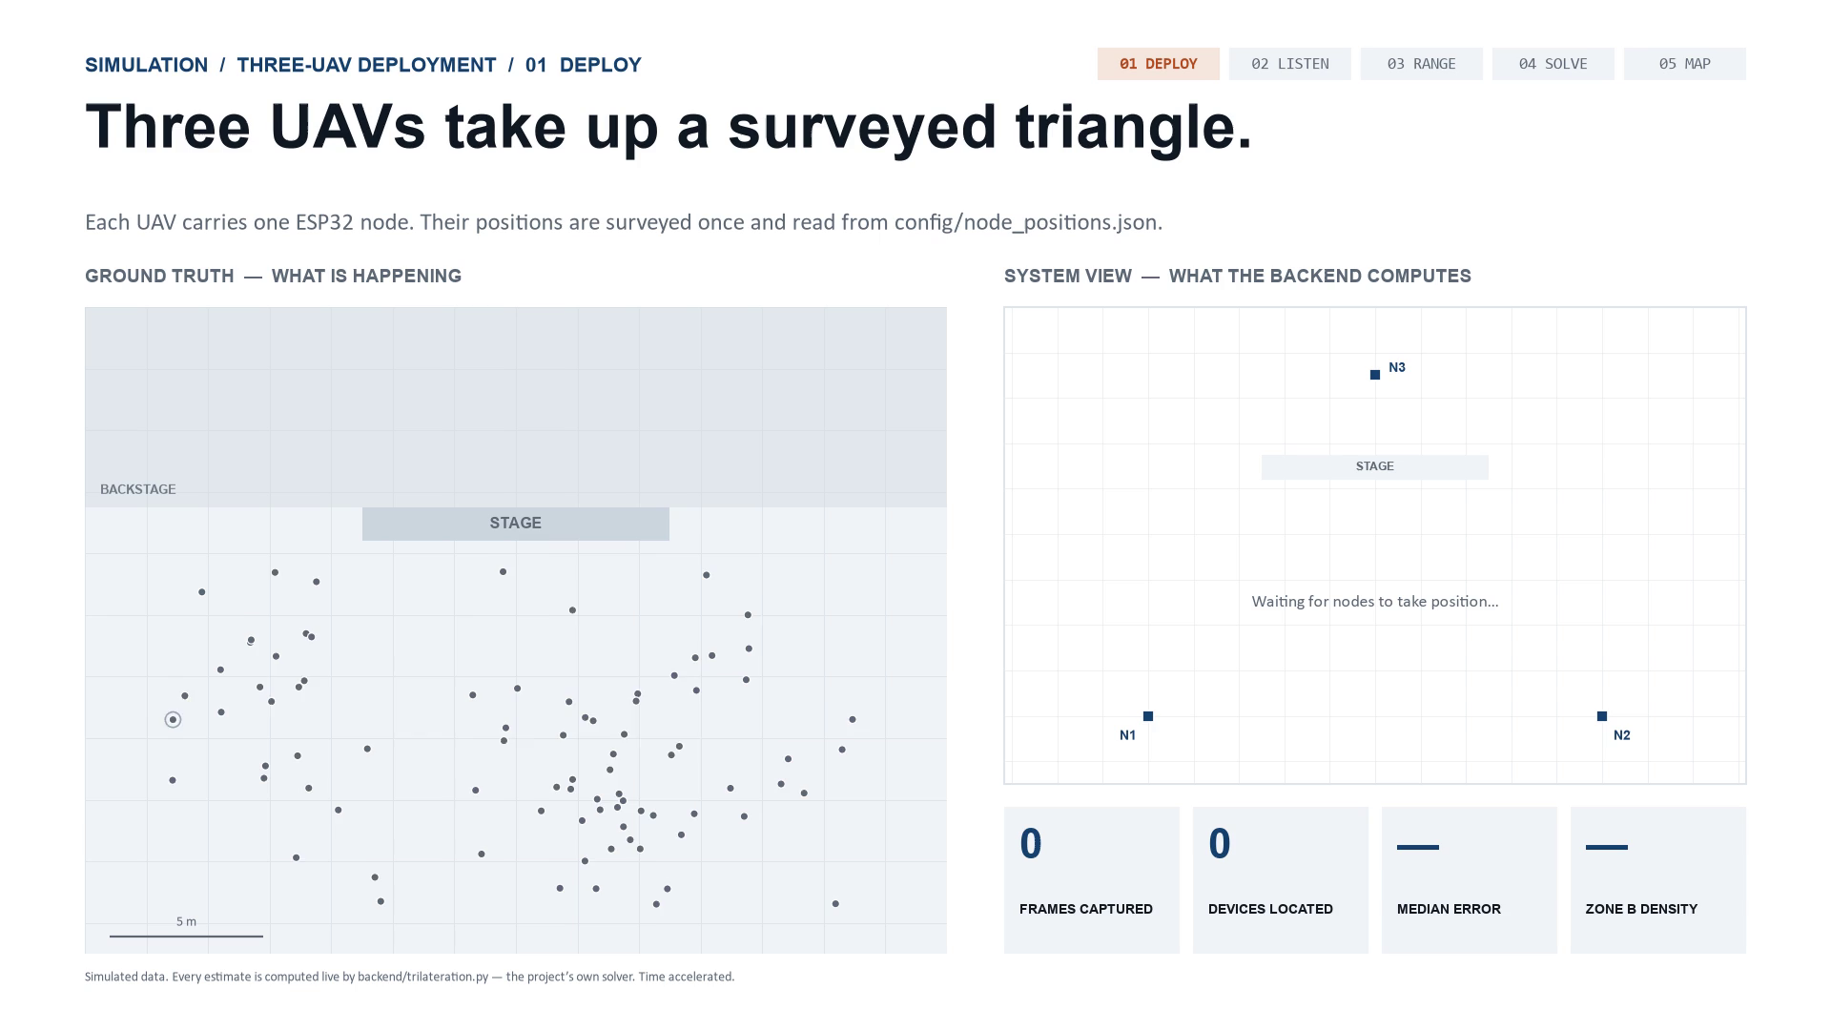
13
Notes:
Let it play — 42 seconds, and it loops, so talk over it. The five chips top-right light up in order: deploy, listen, range, solve, map. Say two things out loud. First: every estimate in the right-hand panel is computed by our backend's own trilateration code from simulated signal strengths — this is the real algorithm running, not an animation of it. Second: left is ground truth, right is what the system believes, and the gap between them is the error. If asked why the map lags a moving crowd: the backend averages five frames per node, so it trails by a few probe intervals. Real phones probe far less often than in this time-accelerated run, so in the field that lag would be much longer — an honest limitation worth naming.

Slide 14
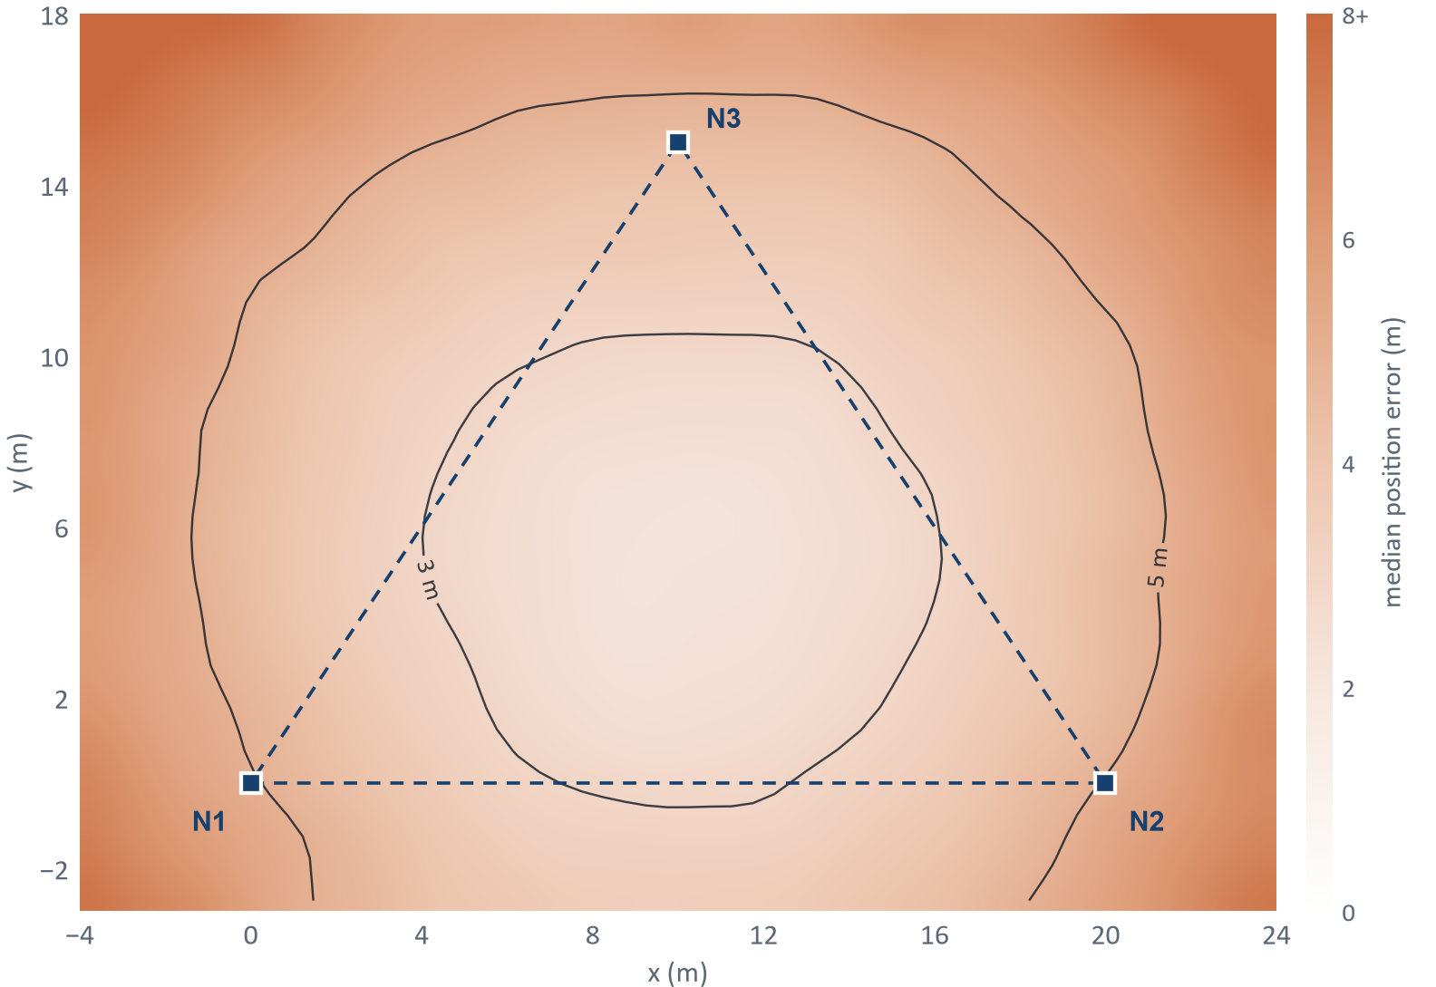
SIMULATION / ACCURACY
Inside the node triangle, the solver lands within about 2.8 m.
WHAT 282,240 SOLVES OF THE BACKEND SOLVER SHOW
2.8 m
MEDIAN ERROR, INSIDE THE TRIANGLE
31% of fixes land within 2 m of the device.
4.8 m
MEDIAN ERROR, OUTSIDE IT
Same signal noise, weaker geometry — so fly the triangle over the crowd.
~35 m
IF THE PATH-LOSS EXPONENT IS WRONG
Room decays at n = 2.7, backend assumes 2.0. Calibration is not optional.
Accuracy is decided before take-off: by where the triangle is flown, and by whether n was measured on site. Signal strength alone does not set it.
Median position error over 120 trials per 0.5 m cell. σ = 4 dB shadowing, 5-frame average, −40 dBm, n = 2.0. Lightly smoothed for display.
14
Notes:
This is the deck's quantitative result, and it is simulated — say that first. 282,240 runs of our own solver over the whole area, with 4 dB of signal noise per frame. Median error is 2.8 m inside the node triangle and 4.8 m outside it — same noise, worse geometry. The number to land is the rust one: if the room actually decays at n = 2.7 while the backend assumes 2.0, median error jumps to about 35 m. That one constant decides whether the system works, which is why calibrating it on site is the first step of a real deployment. The map also says how to fly: put the triangle over the area you care about.

Slide 15
RISKS
Three failure modes, named before deployment rather than after.
Each one degrades the fix in a different way, so each needs a different correction.
CHALLENGE
WHY IT HAPPENS
EFFECT ON THE FIX
MITIGATION
RSSI noise and multipath
Walls, bodies and furniture reflect and absorb 2.4 GHz. The same device in the same spot varies by ±10 dBm.
Distance error grows non-linearly with range; the circles stop overlapping cleanly.
Five-frame moving average per MAC and node, plus weighted least squares — both live. Kalman filter next.
MAC randomisation
iOS and Android rotate the source address between probe bursts to defeat exactly this kind of tracking.
One person appears as several short-lived devices, so raw headcount inflates.
Cluster bursts inside a 100 ms window and use sequence-number continuity as a soft identity.
Single-radio contention
The ESP32 cannot sniff and transmit at the same time; the uplink blanks capture for a few milliseconds.
Frames are missed during every POST, biasing the sample toward quiet periods.
Batch the uploads and split the work across cores — core 0 captures, core 1 sends.
Randomisation is the one that bounds the whole approach. It corrupts absolute headcount while leaving relative density — which is the quantity a crowd-safety operator actually watches — largely intact.
15
Notes:
Deliver all three unprompted and at pace — a panel trusts a proposal that names its own weaknesses first. Volunteer MAC randomisation especially, because it is the sharpest attack available and the warm box is your answer to it.

Slide 16
APPLICATIONS
Where an approximate, camera-free count beats an exact one.
CROWD SAFETY
DISASTER RESPONSE
URBAN ANALYTICS
VENUE OPERATIONS
Density at concerts, stations and processions, where the operational question is where pressure is building — not who is standing there.
Sweeping a collapsed structure from a UAV for devices still transmitting, in conditions where optical search returns nothing.
Pedestrian flow measured over weeks, so infrastructure is sized against observed demand instead of survey estimates.
Queue length and bottleneck detection inside a controlled space whose floor plan is already known.
WHY THIS STACK, AND NOT A CAMERA
~₹2,000 total
< 200 g airborne
works in darkness
emits nothing
no image retained
The trade is deliberate. This system will never tell you that forty-one people are present — it tells you that the north-east corner is three times denser than it was ten minutes ago, which is the number that actually triggers a decision.
16
Notes:
Do not read all four applications. Pick crowd safety and disaster response and let the other two sit on the slide. The warm box is the framing to land: this system trades an exact count for a relative density that is available in the dark.

Slide 17
FINAL REVIEW — CLOSING
What is built, and what a deployment needs next.
BUILT AND RUNNING
NEXT, FOR A FIELD DEPLOYMENT
—
Three-node ESP32 firmware streaming each frame's source MAC and RSSI
—
On-site calibration of RSSI₀ and n, with measured error bars
—
Backend with 5-frame RSSI smoothing and a 60 s staleness window
—
Kalman filtering, and clustering to survive MAC randomisation
—
Weighted least-squares trilateration returning (x, y) in metres
—
Field accuracy benchmark against surveyed ground-truth positions
—
Live dashboard, plus a full simulation of the three-UAV deployment
—
Airborne trial with all three nodes mounted on UAVs
The chain runs end to end, and in simulation it places a device within about 2.8 m inside the node triangle. The same simulation shows the field number hangs on one constant, n — so calibrating it on site is the first job of any real deployment.
Aryan Kochhar 23BAI1533 · Hari Samhita 23BAI1473
Autonomous Drones · Final Review
17
Notes:
Close on what is real: the hardware streams, the backend solves, the dashboard draws, and the simulation shows the whole deployment end to end with our own solver. Then be direct about what is not done: no field accuracy number yet, because n has not been calibrated on site. Naming that yourself is a stronger close than being asked for it.

