Slide 1
Access List

Slide 2
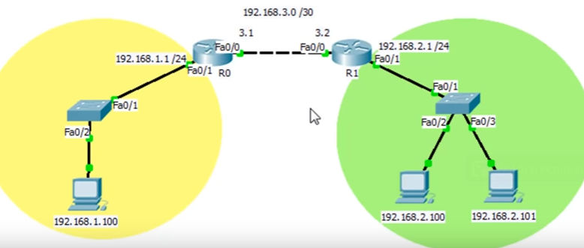

Slide 3


Slide 4
Commands
static
ip access-list ?
ip access-list standard ?
permit 10.0.1.1 0.0.0.0
deny 10.0.1.2 0.0.0.0 - exit
int Fa0/0
ip access-group ?
<1-199> IP access list (standard or extended)
WORD Access-list name

Slide 5
Router(config-if)#ip access-group 10 out
Router(config-if)#exit
Router(config)#exit
Router#
%SYS-5-CONFIG_I: Configured from console by console
Router#
Router#
Router#show ip access-list 10
Standard IP access list 10
permit host 10.0.1.1
deny host 10.0.1.2

Slide 6


Slide 7


Slide 8
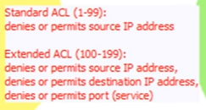

Slide 9
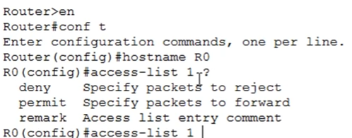

Slide 10
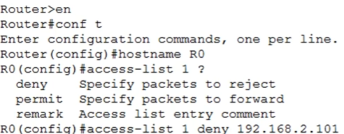

Slide 11
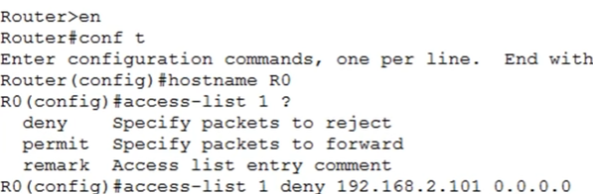

Slide 12
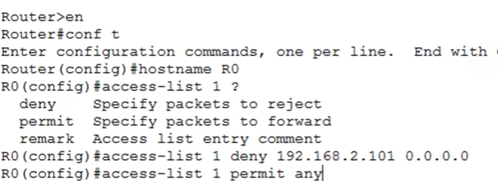

Slide 13


Slide 14
