Slide 1
Dynamic Programming for Power Systems
Aryan Ritwajeet Jha
Notes:
Remember to hit the reset button to make sure all the page elements react properly.
There are 20 different layouts that you can choose from.

Slide 2
Contents
Anamika Dubey and Surya Santoso (2015) Electric Vehicle Charging on Residential Distribution Systems: Impacts and Mitigation.
Problem Statements where Dynamic Programming is utilized.

Slide 3
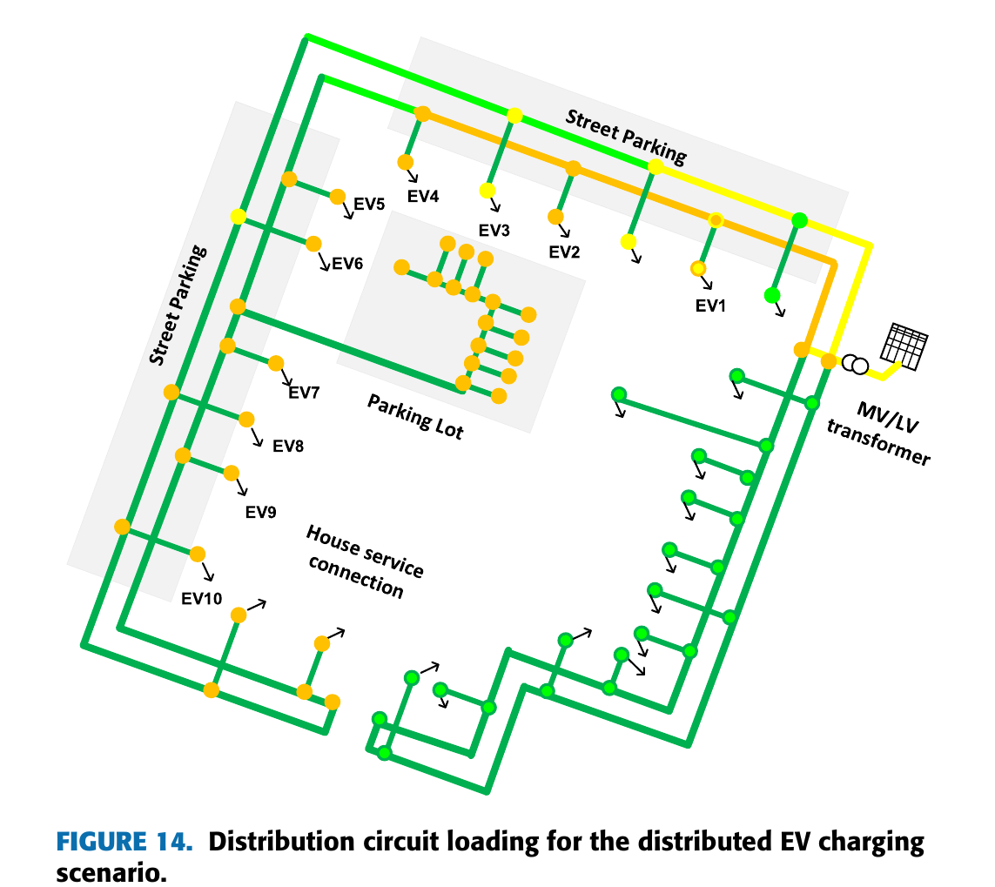
Electric Vehicle Charging on Residential Distribution Systems: Impacts and Mitigation Anamika Dubey and Surya Santoso (2015)
EVs are plugged in during the night for charging.
Charging at multiple locations of the residential grid (a distribution network) at the same time causes voltage drops.
Such uncoordinated power consumption at the local scale can lead to grid problems.

Slide 4
Electric Vehicle Charging on Residential Distribution Systems: Impacts and Mitigation Anamika Dubey and Surya Santoso (2015)
Context:
Charge M vehicles (loads) during night-time from M charging stations (nodes).
Night-time = 6PM to 6AM.
Charge them fully before the next morning.
They aren’t leaving before 6AM, so no hard constraints on the available charging timings themselves.

Slide 5
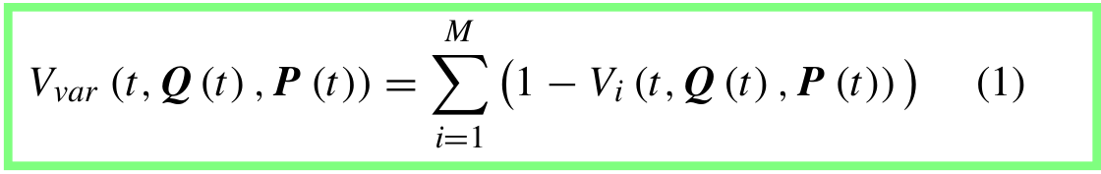
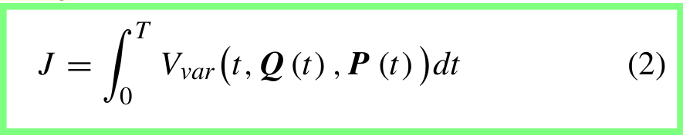
Electric Vehicle Charging on Residential Distribution Systems: Impacts and Mitigation Anamika Dubey and Surya Santoso
Objective:
minimize impact on residential grid voltage, for the whole night.
Design objective (constraint): Charge every EV fully by time T.

Slide 6
Electric Vehicle Charging on Residential Distribution Systems: Impacts and Mitigation Anamika Dubey and Surya Santoso
NOT an Objective:
No optimization of time intended; every EV plugged in for the full time period from zero to T anyway.

Slide 7
Electric Vehicle Charging on Residential Distribution Systems: Impacts and Mitigation Anamika Dubey and Surya Santoso
Design Formulation:
Battery-charger power levels P(t) variable only in discrete-steps.
Power-flow-analysis also done in discrete time-steps.
We’re solving a discretized Optimal Control Problem.

Slide 8
Do we even need a dynamic programming formulation in Power Systems?
Instead of using dynamic programming and optimization on
N state variables (including memory elements like Battery SOC)
C constraints
- All for T time steps
Why not just form:
N*T state variables (including Battery SOC)
C*T constraints plus T additional constraints to maintain continuity for those memory elements. (Let’s assume just one battery in our whole grid)
All into one big ‘steady-state-like’ Optimization problem and plug it into a solver?

Slide 9
Do we even need a dynamic programming formulation in Power Systems?
Instead of using dynamic programming and optimization, why not just incorporate more state variables, more constraints (both by a factor of the number of time-steps: T) into one big ‘steady-state-like’ Optimization problem and plug it into a solver?
I do not have an answer for this now, I’d imagine that the time complexity will increase exponentially, but that’s just my speculation.

Slide 10
References (not in order)
CTU Prague Optimal and Robust Control - L5.1 - Introduction to dynamic programming and its application to discrete-time optimal control
The Julia Programming Language - Dynamic Programming and Seam Carving | MIT Computational Thinking Spring 2021 | Lecture 6
Hu et al. (2016) - A Dynamic Programming based method for optimizing power system restoration with high wind power penetration
Guerrero, Heydt et al (2008) - Optimal Restoration of Distribution Systems Using Dynamic Programming
Anamika Dubey, Surya Santoso (2015) - Electric Vehicle Charging on Residential Distribution Systems: Impacts and Mitigations
freeCodeCamp.org - Dynamic Programming - Learn to Solve Algorithmic Problems & Coding Challenges
Johan Driesen et al (KU Leuven, 2009) - The Impact of Charging Plug-In Hybrid Electric Vehicles on a Residential Distribution Grid

