Slide 1
Distributed Optimization in Distribution Systems
Aryan Ritwajeet Jha

Slide 2
Distributed Optimization in Distribution Systems
Current problem statement:
Perform Distributed Optimal Power Flow on a Single-phase power distribution network.
Desired objective(s):
Incorporate battery storage into the algorithm.
Convert the code (currently in MATLAB) into Python/Julia.
Later: Incorporate battery storage into a three-phase network.
This is based on the previous work by:
Rabayet Sadnan and Anamika Dubey (2022) Distributed Computing for Scalable Optimal Power Flow in Large Radial Electric Power Distribution Systems with Distributed Energy Resources
Rabayet Sadnan and Anamika Dubey (2021) Distributed Optimization Using Reduced Network Equivalents for Radial Power Distribution Systems

Slide 3
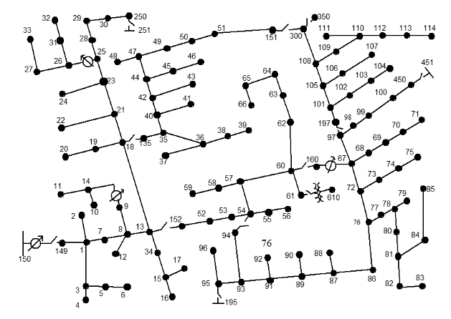
Distributed Optimization in Distribution Systems
Current problem statement:
Single-phase power distribution network (Here, the IEEE123 Node Test System)

Slide 4
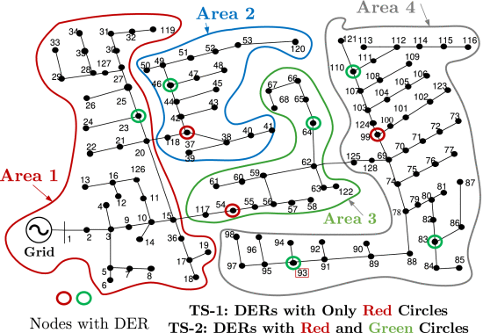
Distributed Optimization in Distribution Systems
Current problem statement:
Divide the network into several areas in order to solve for their Optimal Power Flow solutions separately, with exchange of boundary variables after every ‘macro-iteration’.

Slide 5
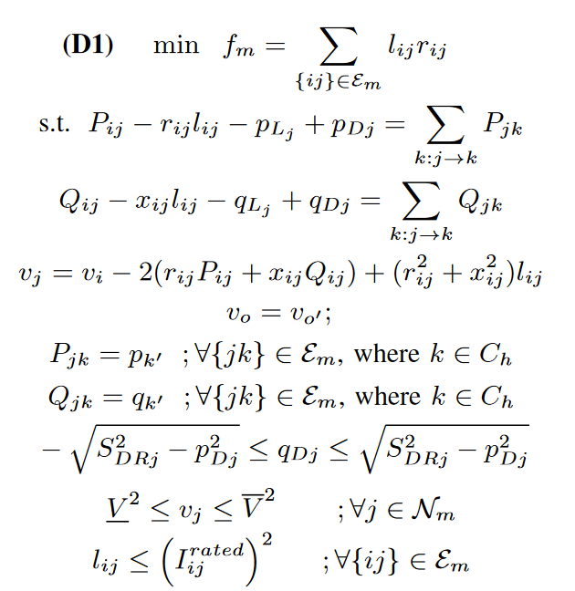
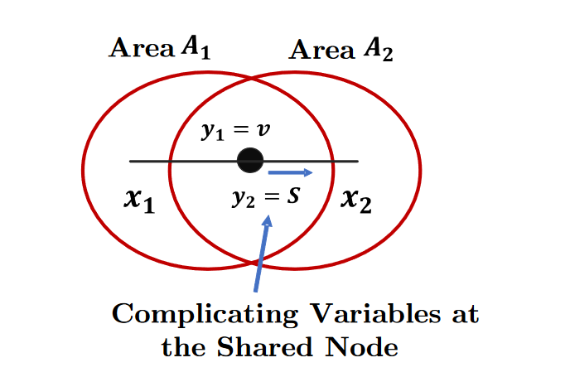
Distributed Optimization in Distribution Systems
Current problem statement:
Perform a ‘Distributed OPF’ for minimizing line losses for each area. After every macro-iteration, exchange border variables between connected areas.

Slide 6
Some test runs over different area divisions
The Distributed Optimization Algorithm was run on the IEEE 123 Node Test Feeder, which was divided into three, four and five Areas in separate runs.
This was to check if the results of the algorithm are consistent irrespective of the number of areas the system was divided into.

Slide 7
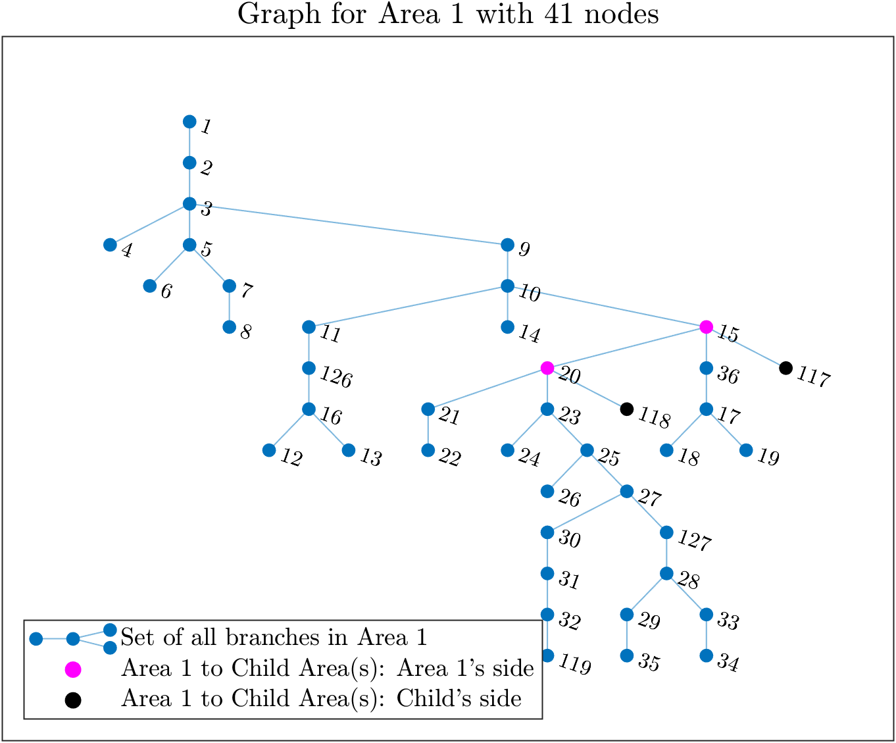
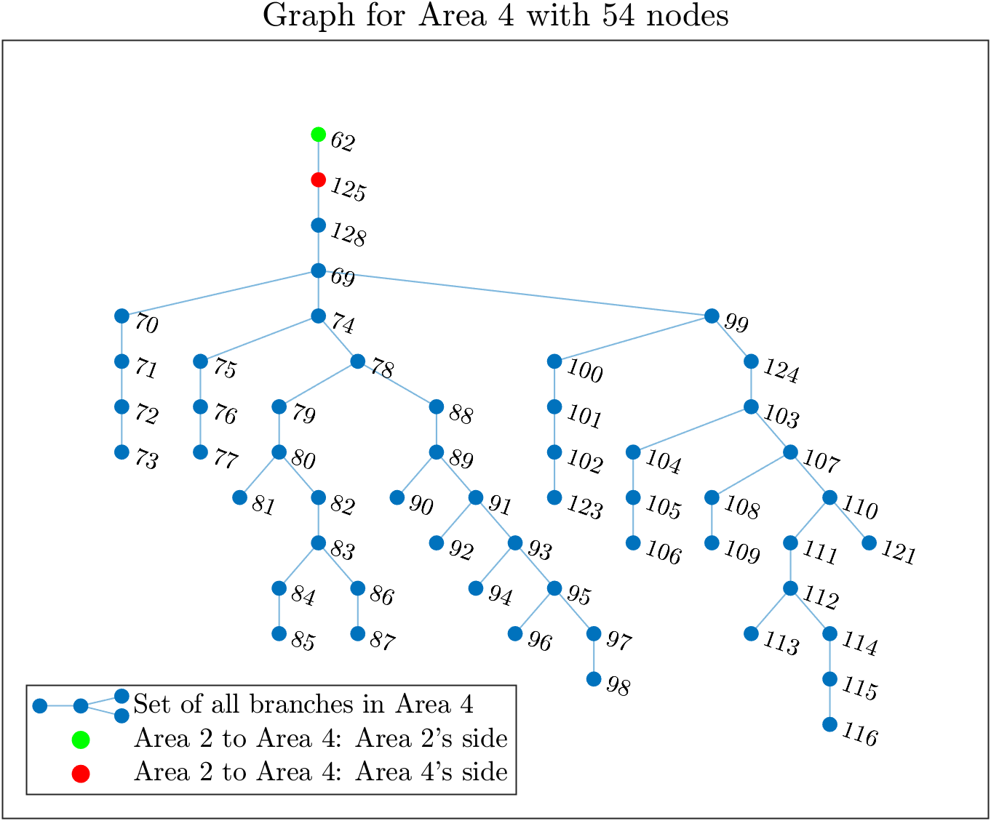
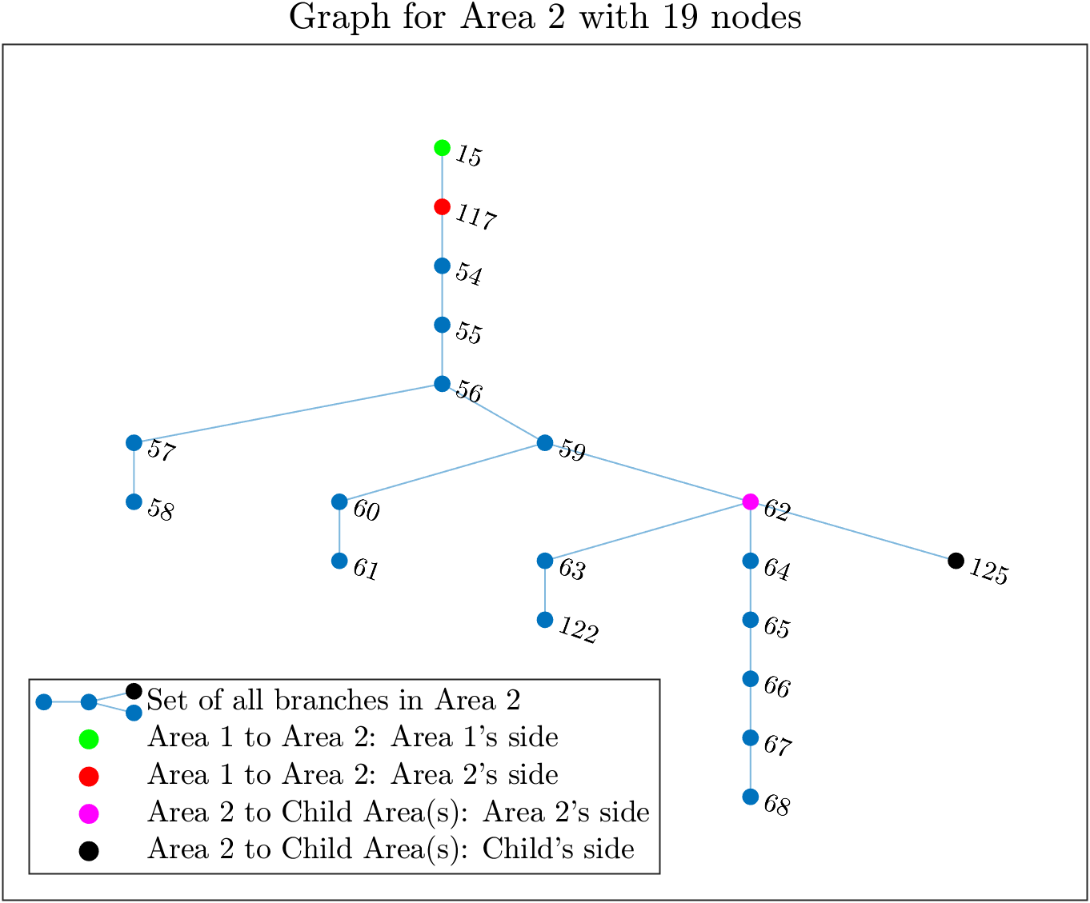
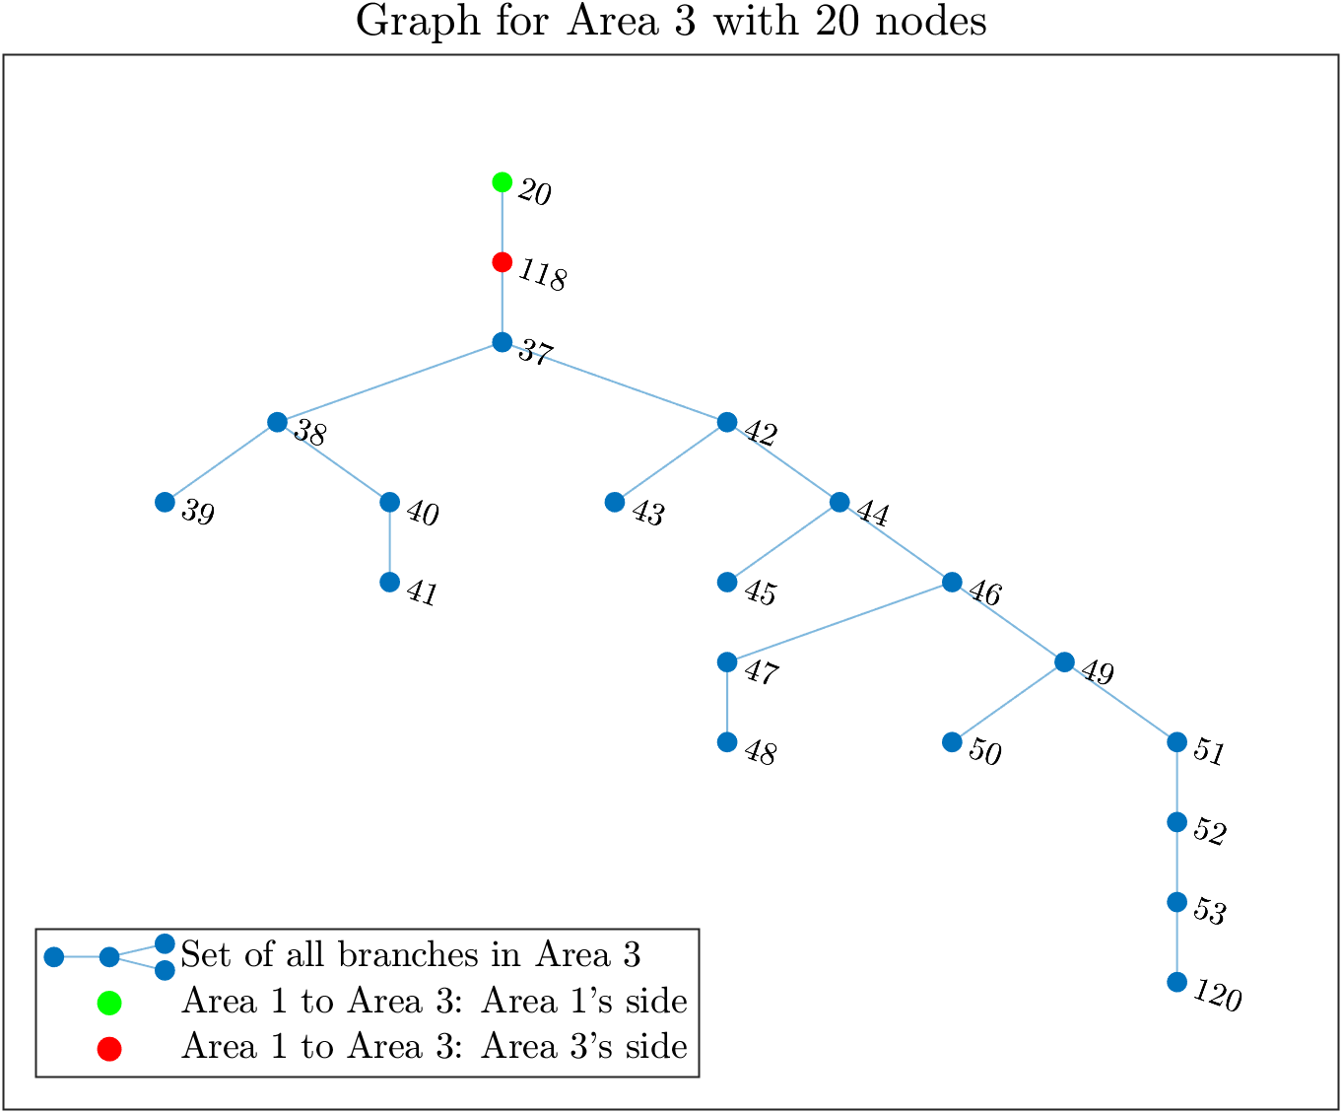
4 Area System

Slide 8
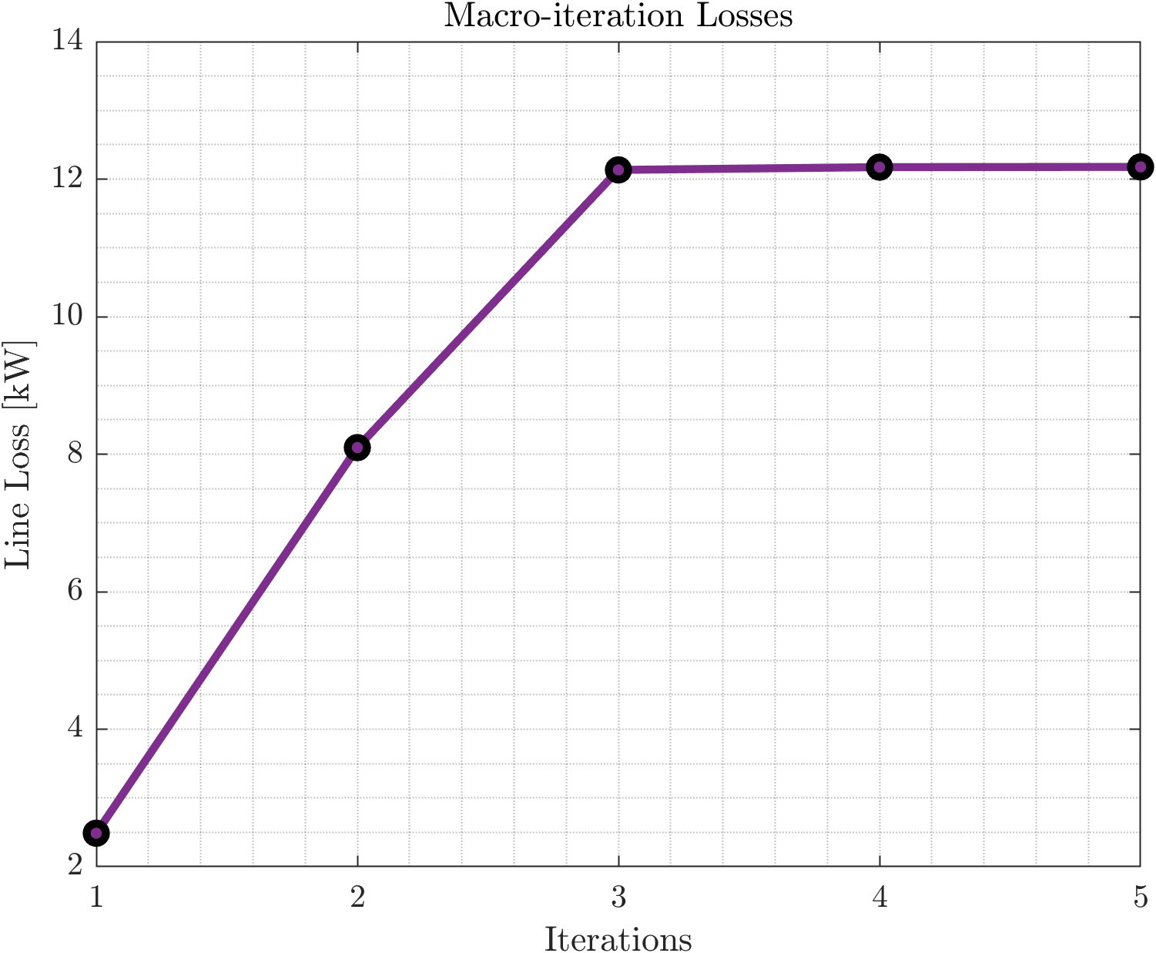
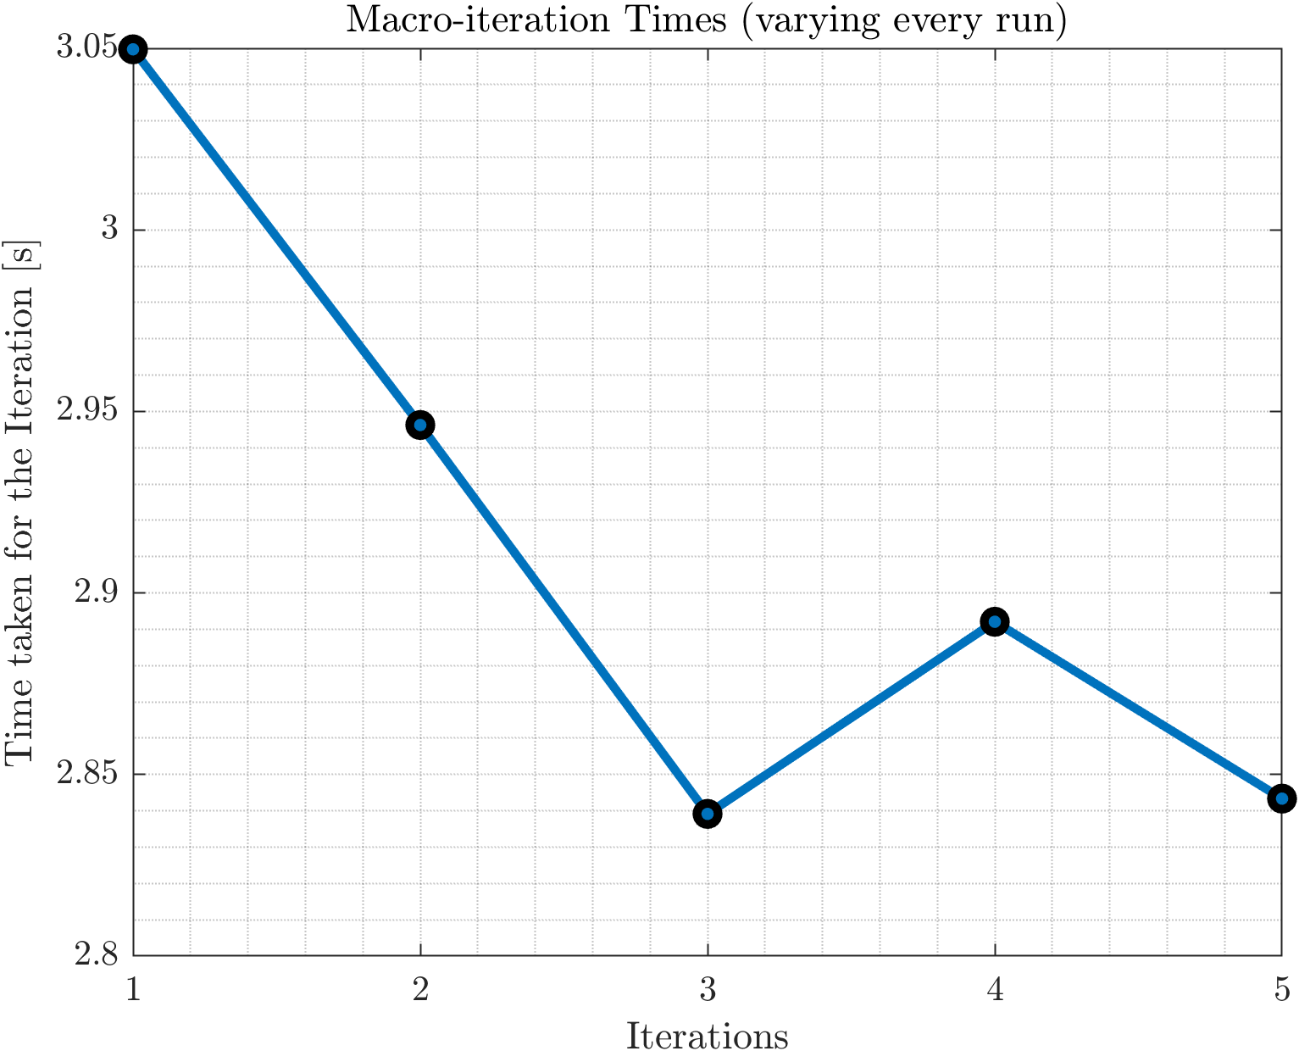
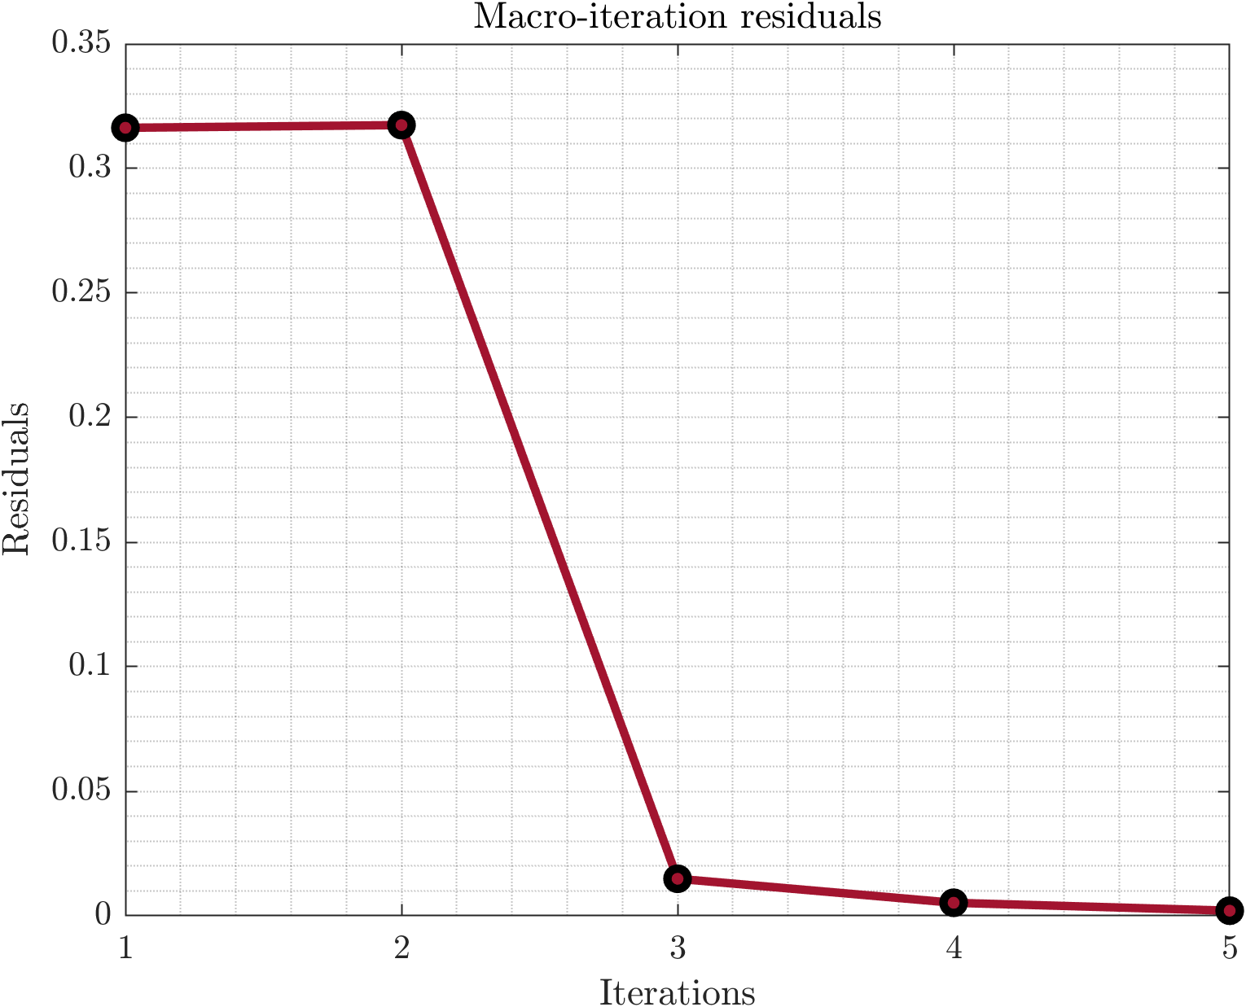
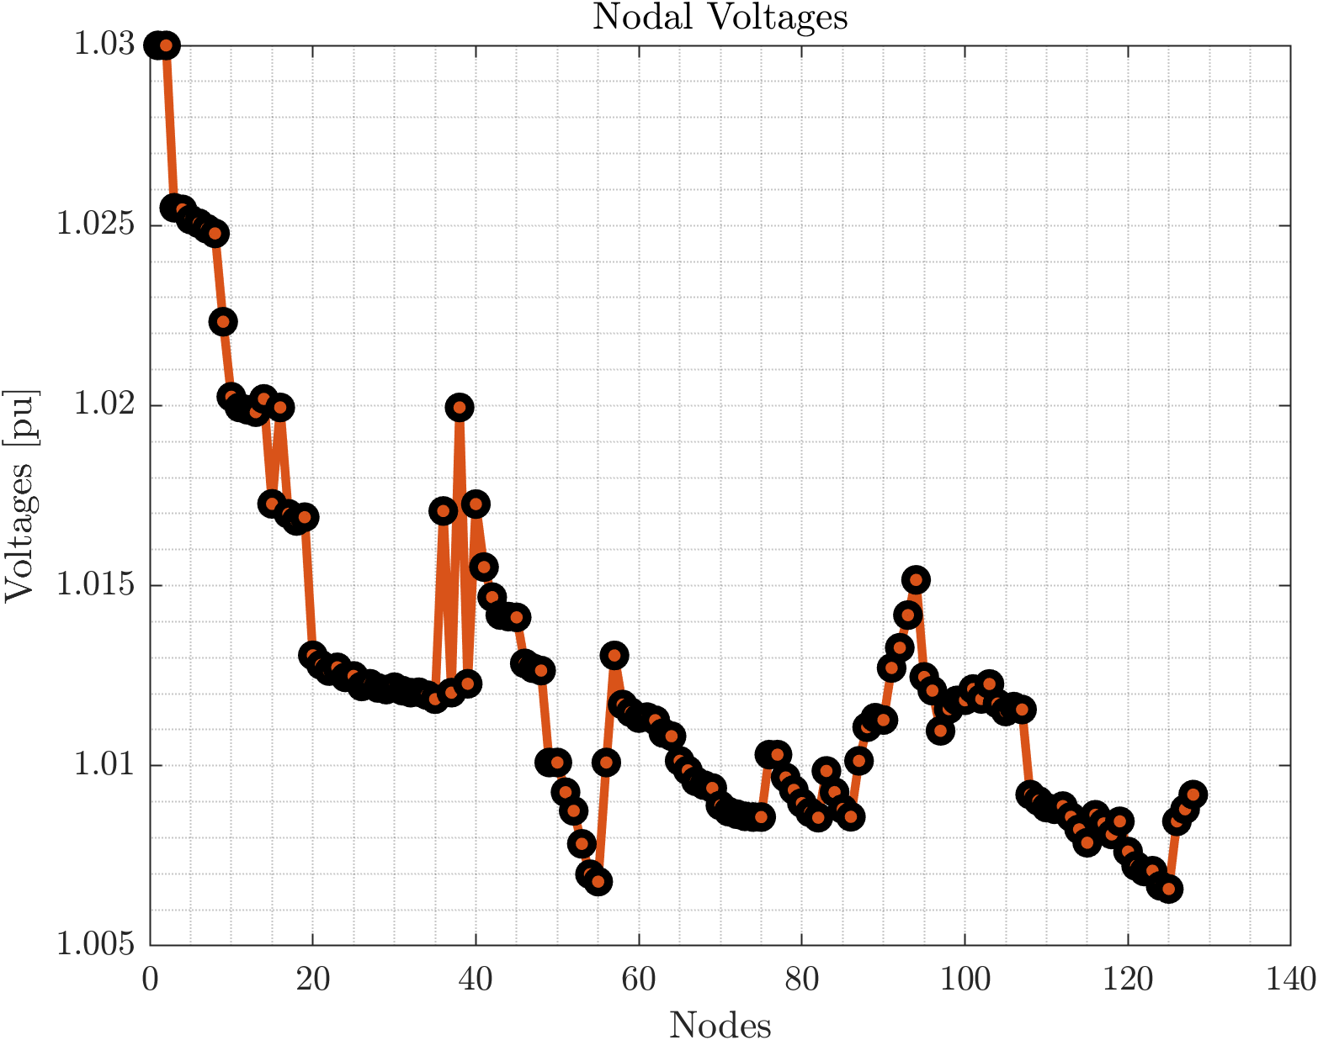
4 Area System

Slide 9


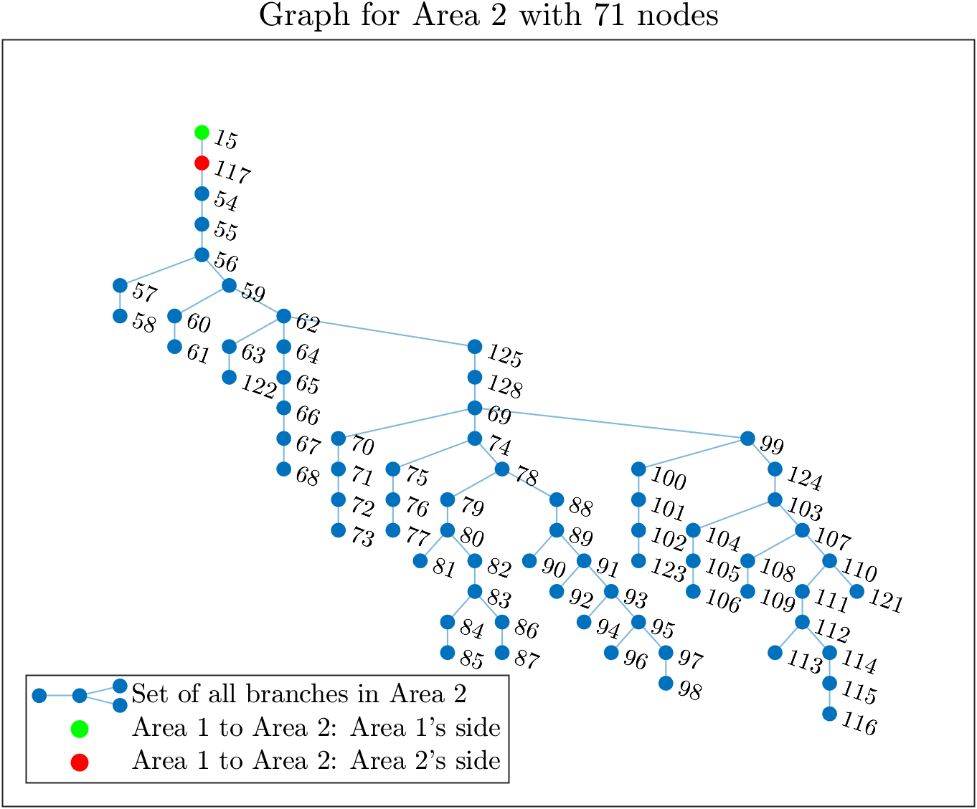
3 Area System

Slide 10
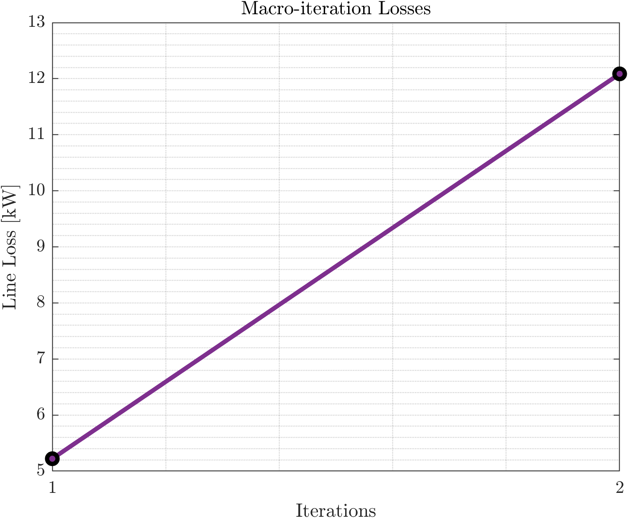
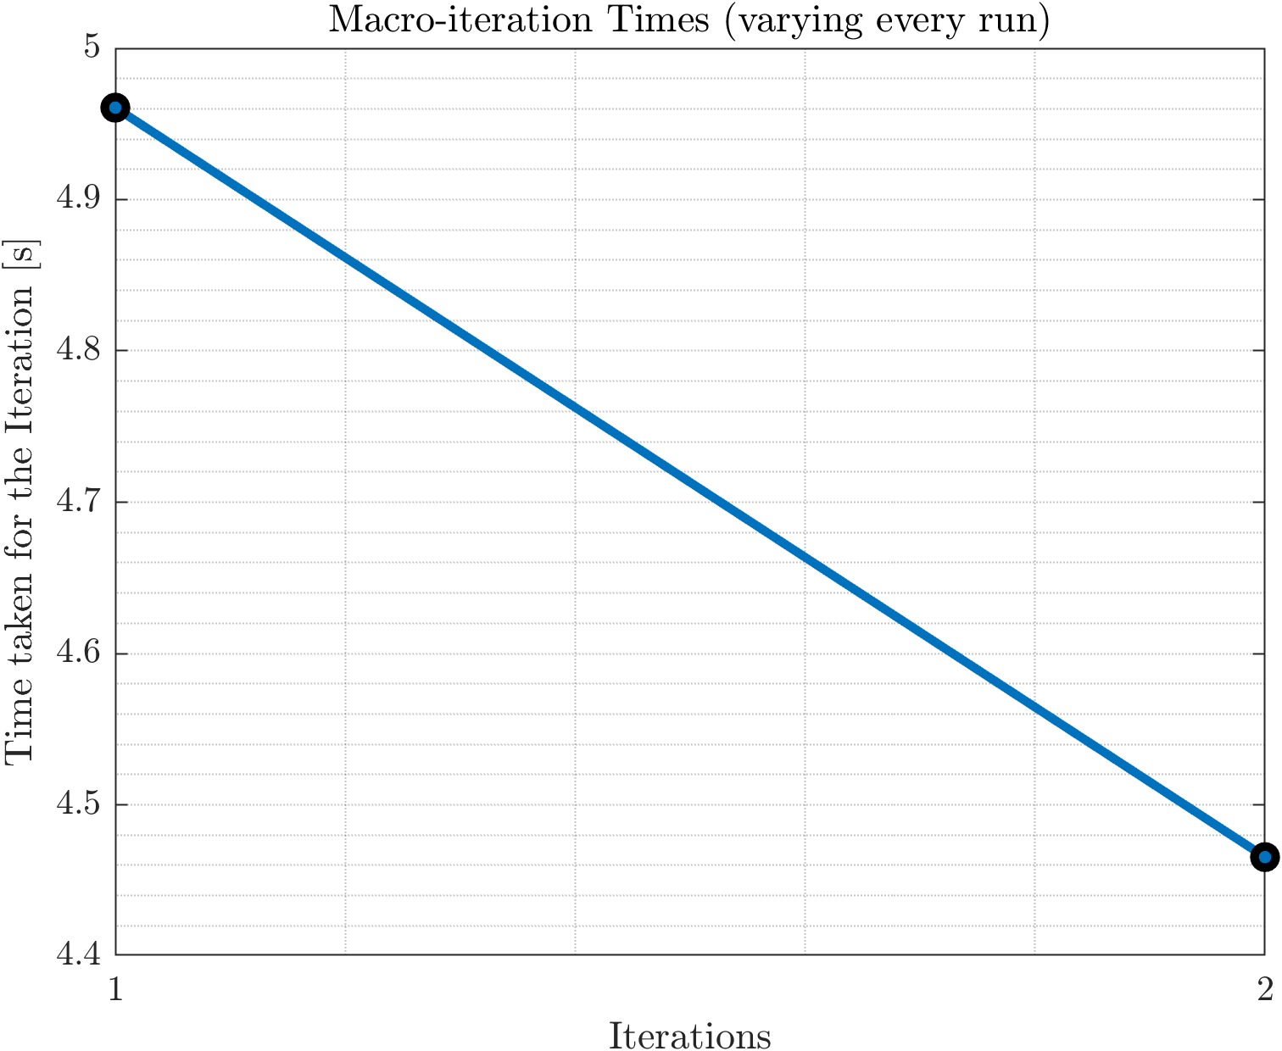
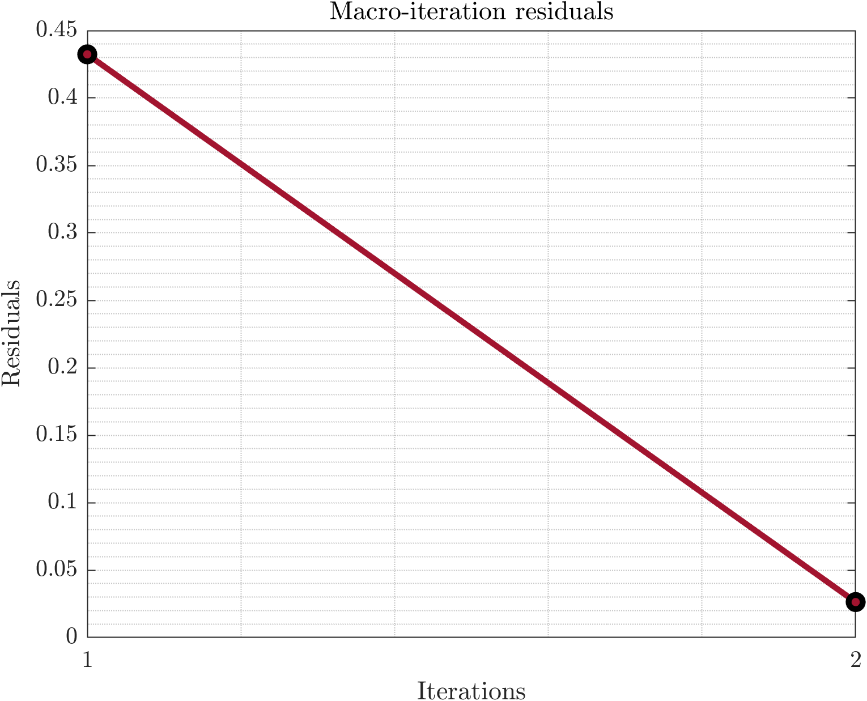
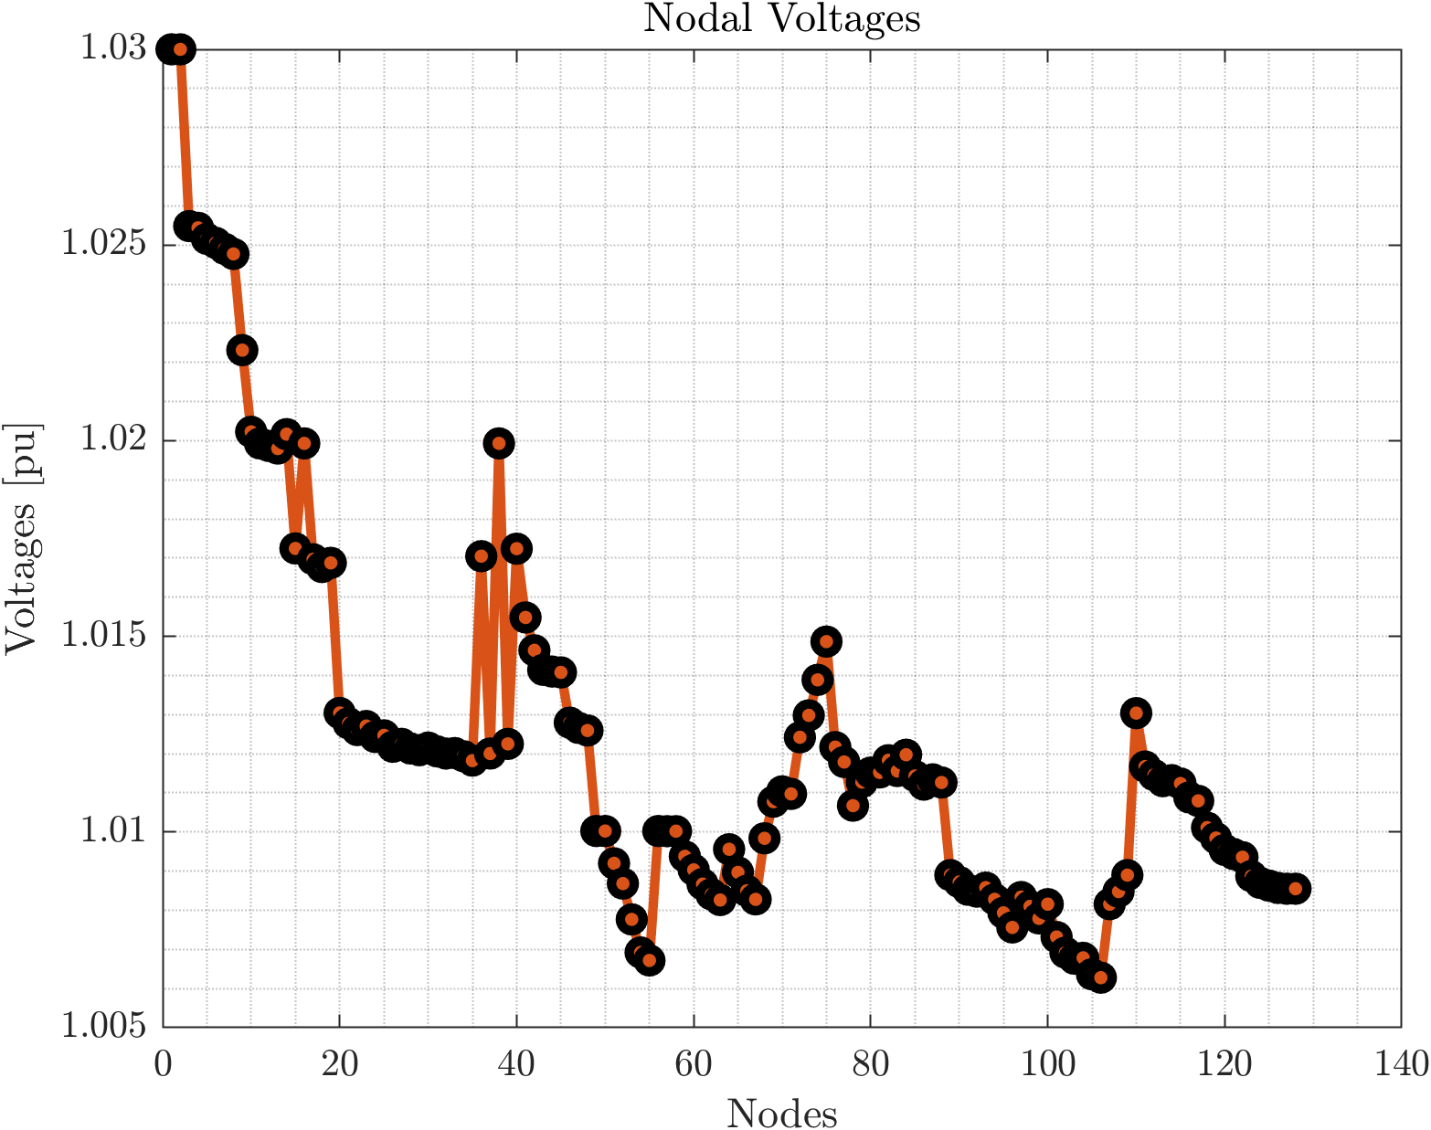
3 Area System

Slide 11
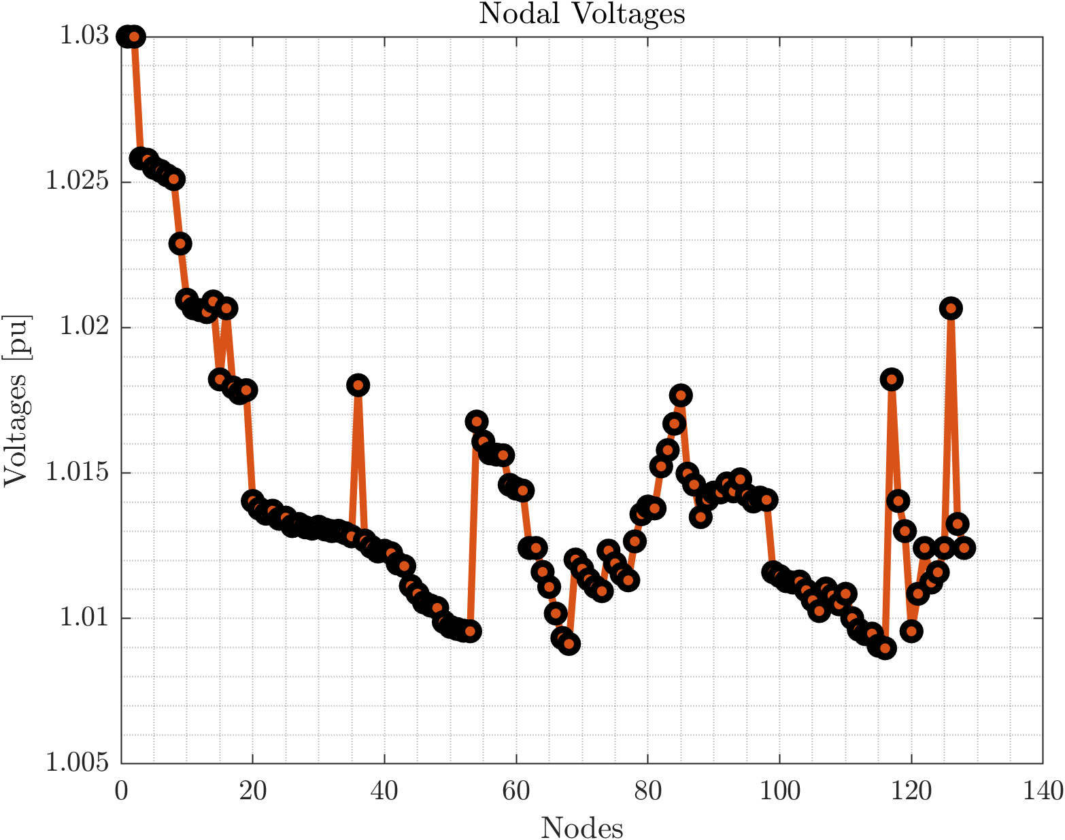
Central OPF

Slide 12
Some Test Runs over Different Area Divisions
Optimal line losses match for all sets of areas.
Number of Areas | Substation Power | Line Losses | Macro-Iterations | Time
1 (COPF) | 768.1715 kW | 12.0934 kW | - | 10.5403s
4 (DOPF) | 768.24kW | 12.18 kW | 5 | 10.067s
3 (DOPF) | 768.16kW | 12.09 kW | 2 | 7.903s

Slide 13
Next Objectives
Desired objective(s):
Incorporate battery storage into the algorithm using Multi-Period Optimization.
Convert the code (currently in MATLAB) into Python/Julia.
Later: Incorporate battery storage into a three-phase network.

